Slide 1

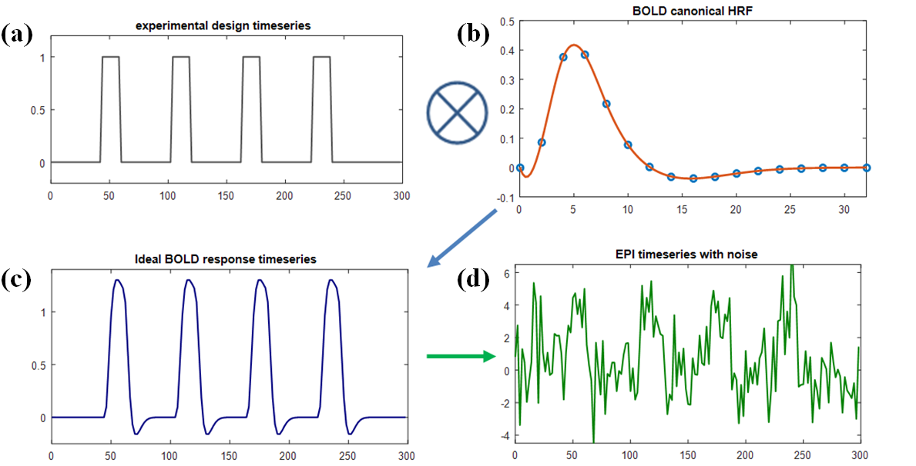
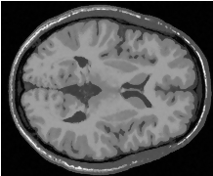
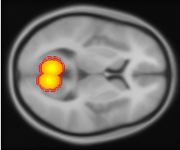
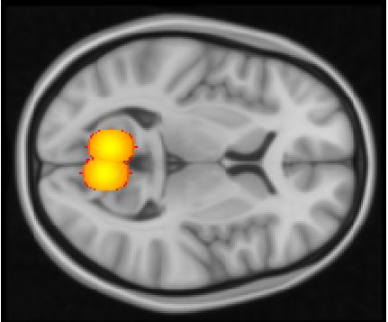
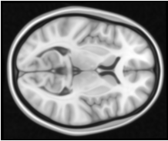
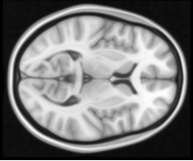
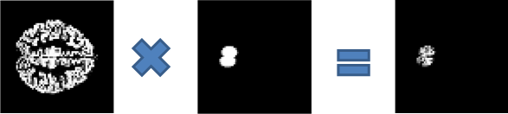
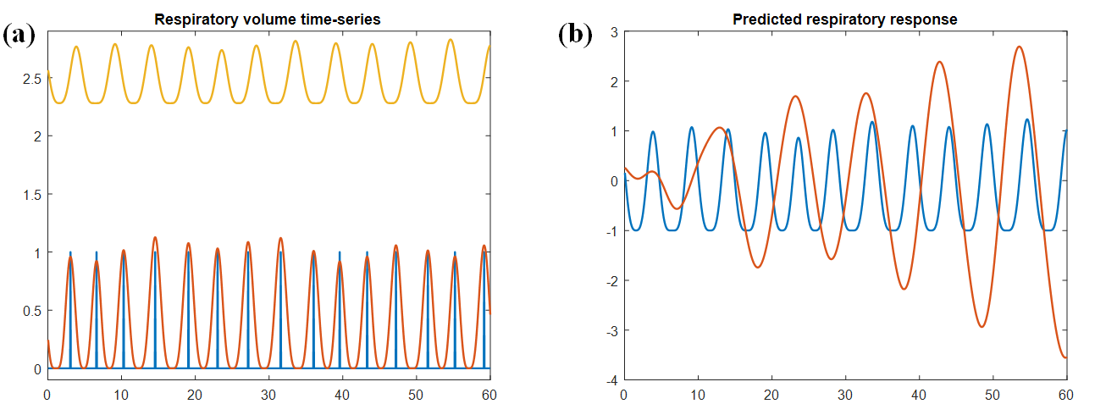
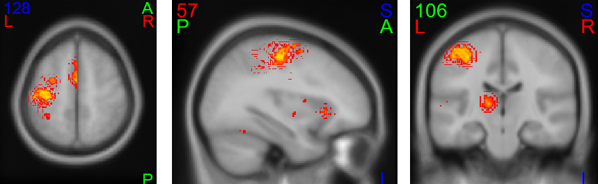
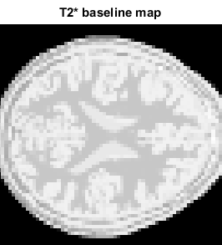
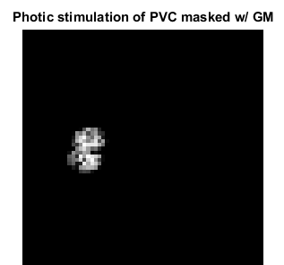

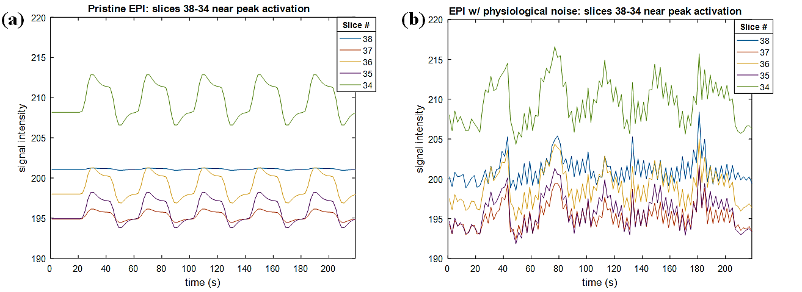
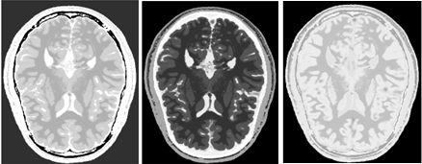
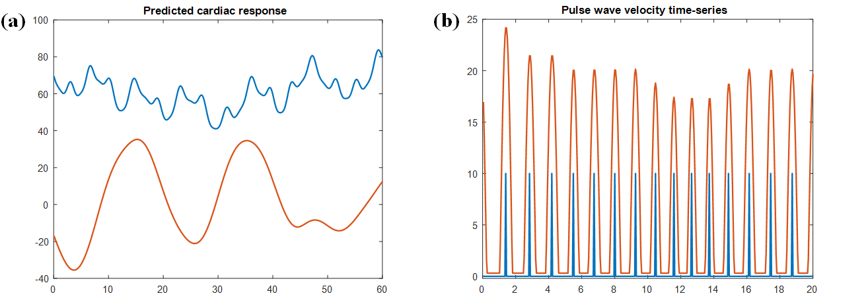
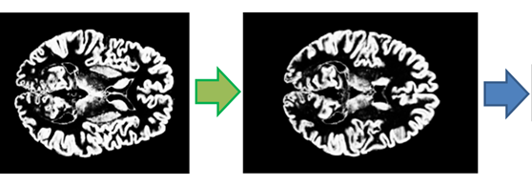
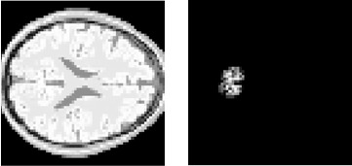


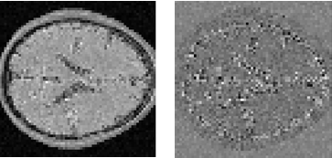

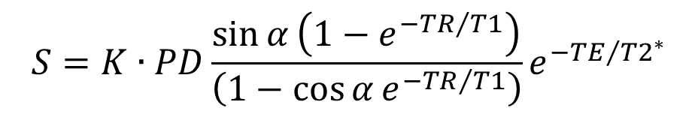

A Task-related & Resting State Realistic fMRI Simulator for fMRI Data Validation Jason E. Hillª, Xiangyu Liu, Brian Nutter, Sunanda Mitra* ªDepartment of Electrical and Computer Engineering, Texas Tech University, Lubbock, Texas 79409, U.S.A. *e-mail: sunanda.mitra@ttu.edu
providing a diagnostic aid to uterine cervical cancer.
Abstract
The complex nature of fMRI data generation and acquisition results in certain uncertainties in the true estimation of task-related activation maps or resting state functional connectivity networks despite the use of various statistical data analysis methodologies. The goal of developing the proposed STANCE (Spontaneous & Task-related Activation of Neuronally Correlated Events) simulator is to generate realistic resting-state and/or task-related 4D BOLD signals given certain experimental paradigms by using digital phantoms of 20 normal brains (available from http://brainweb.bic.mni.mcgill.ca/brainweb/). The proposed simulator will include estimated system and physiological noise to serve as reference to measured brain activities. In its current form, STANCE is a MATLAB toolbox with command line functions serving as an open-source add-on to SPM8 (obtainable at www.fil.ion.ucl.ac.uk/spm/software/spm8/). The STANCE simulator has been designed in a modular framework so that the hemodynamic response functions (HRFs) and various noise models can be iteratively upgraded to include the evolving knowledge about such models.
Introduction
Despite the development of several fMRI simulators [1-6] for generating data under various models, no common data generating process is available, not only because of the lack of a common platform, but more importantly due to the challenges involved in modeling the HRF [7] and various sources of noise [8-13]. Historically, fMRI studies investigated simple activation maps that represent the average level of engagement in response to a specific task [14]. Moreover, fMRI data analysis has progressed to a greater depth to reveal the neuronal organization of the human brain under the condition of exposure to a specific stimulus or even without stimulus, i.e. under the so called resting state fMRI (rs-fMRI) [15-17]. We propose to develop STANCE at multiple levels to serve as a validation tool for current research studies in fMRI focusing on the possibility of estimating and removing motion and physiological noise [18-21]. Future developments will be used to investigate the effect of noise and possible dynamics on resting-state/task-related time series and the corresponding estimation of the characteristic functional connectivity networks.
Figure 1. The flowchart for STANCE generating a 3D fMRI volume.
Figure 2. Ideal BOLD response time-series: convolution of HRF with design.
Register MNI152 brain to native space
Define neuronal activation template in MNI space & transform to native space
Subject’s native space has a voxel size of 1mm³ with dimensions 181x217x181
Register
Transform & reslice activations to functional space and mask with gray matter
Figure 3. Respiratory physiological noise.
Figure 5. Finger tapping task.
Affine transform of MNI152 to subject’s native space
MNI152 brain
fMRI scan parameters
Construct T₂* volume with activation
Figure 6. Synthetic 4D EPI signal.
Construct PD, T₁ & T₂* volumes
Figure 4. Cardiac physiological noise.
Generate functional space
Solve EPI signal equation
$$S=K∙PD\frac{\sin{α}\left(1−e^{−{TR}/{T1}}\right)}{\left(1−\cos{α}e^{−{TR}/{T1}}\right)}e^{−{TE}/{{T2}^{∗}}}$$
Rotated by pitch tilt angle.
$$σ=\sqrt{σ_{0}^{2}+σ_{P}^{2}}$$
Resize voxels and reslice volume with slice gap & new dimensions.
Left: Pristine EPI signal; Right: difference between EPI signal and that with no activation.
Noise equation:
T1-w data &12 fuzzy tissue membership volumes from one of 20 brain phantoms; average PD, T₁ & T₂* values for various tissues
Add noise, etc.
This research was supported by the NIH-NLM [HHSN276201 500690P].
Gray matter priors in functional space
Left: 4% of peak system noise; Right: difference between noisy & pristine signals.
Methodology
See Fig. 1 about 3D fMRI volume generation. Simulation steps: (1) select subject brain from 20 normal brain phantoms provided by BrainWEB [22-23]; (2) Create baseline volumes for PD, T1, and T2*; (3) define activation by: (a) data, (b) shape, (c) atlas, (d) coordinates, (e) combos; (4) generate the ideal BOLD response from the HRF convolved with the experimental design, see Fig 2; (5) solve the EPI signal equation, in Fig.1, with slice timing to simulate the fMRI signal; (6) add various tissue-type dependent noise, motion and attenuation.
The system noise has a Rician distribution [24]. Physiological noise (Figs. 3-4) comes from 6 sources [11-13]: (1) the respiratory pulse (RP) that follows the respiratory volume time-series (RVT); (2) the cardiac pulse which follows the pulse wave velocity (PWV); (3) the interaction between CP and RP (InterCRP); (4) the result of the respiratory response function (RRF) convolved with the RVT [18]; (5) the result of the cardiac response function (CRF) convolved with heart rate variability (HRV) [19]; (6) Mayer waves that describe variations in arterial blood pressure.
Fig. 3(a) shows the simulated regular respiratory impulse response (blue), the chest displacement in cm (red) and the RVT in L (yellow) of a 75 kg subject. Fig. 3(b) shows the quasi-sinusoidal RVT (blue) and the RRF response (red). Fig. 4(a) shows the HRV in beats/min (blue) and the CRF response (red). Fig. 4(b) shows the cardiac impulse as governed by the HRV (blue) and the PWV (red). Overall noise is modeled as following the noise equation, under Fig. 4, and the tSNR model [8].
Results
Fig. 1 shows a model of photic stimulated activation of the visual cortex as defined by two ellipsoids with centers [7, -68, 8] and [-8, -65, 8] (MNI coordinates); both with the estimated volume 5,000 mm³, aspect ratio 4:3:4, and rotations from the X-axis of -30º and +30º respectively [25].
Fig. 5 shows the activation template of a right-handed finger tapping task, which was derived from data available on Neurosynth [26], masked to the left hemisphere and with t > 5.0. Fig. 6 shows synthetic fMRI data for this task, both ideal and with physiological noise added, using an experimental design with blocks (20-s rest & 20-s task) repeated.
Conclusion
An fMRI simulator called STANCE has been initiated, with the goal to generate not only task-related time-series with noise, but also resting state time-series that are driven by a possibly dynamic correlation matrix [17].
Acknowledgements
Thanks to Oliver Xie, Rodney Long, and Sameer Antani for the many discussions and feed-back in regards to this effort.
References
[1] Welvaert, M. & Rosseel, Y., "A review of fMRI simulation studies," PLoS ONE 9(7), e101953 (2014).
[2] Drobnjak, I., "FMRI simulator: Development and Applications," Ph.D. Thesis, Computing Laboratory and FMRIB Centre, Department of Clinical Neurology, University of Oxford (2007).
[3] Ning, X., Fitzpatrick, J. M., Yong, L., Dawant, B. M., Pickens, D. R., & Morgan, V. L., "Computer-generated fMRI phantoms with motion–distortion interaction," Magn. Reson. Imag., 25, 1376-1384, (2007).
[4] Welvaert, M., Durnez, J., Moerkerke, B., Verdoolaege, G., & Rosseel, Y., "neuRosim: An R package for generating fMRI data," Journal of Statistical Software 044(i10), online (2011).
[5] Friston, K., Moran, R. & Seth, A. K. "Analysing connectivity with Granger causality and dynamic causal modelling," Current Opinions in Neurobiology 23(2), 172-178 (2013).
[6] Allen, E., Erhardt, E., Wei, Y., Etchele, T., & Calhoun, V., "A simulation toolbox for fMRI data: SimTB," online user manual, available at http://mialab.mrn.org.
[7] Handwerker, D. A., Gonzalez-Castillo, J., D’Esposito, M., and Bandettini, P. A., "The continuing challenge of understanding and modeling hemodynamic variation in fMRI" NeuroImage 62(2), 1017-1023 (2012).
[8] Krüger, G. & Glover, G. H., "Physiological Noise in Oxygenation-Sensitive Magnetic Resonance Imaging," Magn. Reson. Med. 46, 631–637 (2001).
[9] Bright, M. G. & Murphy, K. "Removing motion and physiological artifacts from intrinsic BOLD fluctuations using short echo data," NeuroImage 64, 526-537 (2013).
[10] Bright, M. G., & Murphy, K. "Is fMRI ‘noise’ really noise? Resting state nuisance regressors remove variance with network structure," NeuroImage 114, 158-169 (2015).
[11] Nunes, S., Characterization of physiological noise in resting-state fMRI data at 7T, Thesis, Técnico Lisboa (2014).
[12] Wu, G-R., and Marinazzo, D., "Hemodynamic response function in resting brain: disambiguating neural events and autonomic effects" bioRχiv (beta): the preprint server for biology, doi: https://doi.org/10.1101/028514 (2015).
[13] Wu, G-R., and Marinazzo, D., “Sensitivity of the resting state hemodynamic response function estimation to autonomic nervous system fluctuations” Phil. Trans. R. Soc. A., in press (2017).
[14] Rogers, B. P., Morgan, V. L., Newton, A. T., & Gore, J. C. "Assessing functional connectivity in the human brain by fMRI," Magn. Reson. Imag. 25, 1347–1357 (2007).
[15] Biswal, B., DeYoe, E. A., and Hyde, J.S. "Reduction of Physiological Fluctuations in fMRI Using Digital Filters," Magn. Reson. Med. 35(1), 107-113, (1996).
[16] Bandettini, P. A., "Functional MRI Limitations and Aspirations," chap. in Neural Correlates of Thinking, Vol. 1 of the series On Thinking, 15-38, (2009).
[17] Hutchison, R. M., Womelsdorf , T., Allen, E.A., and Bandettini, P.A., Calhoun, V.D., Corbetta, M., Della Penna, S., Duyn, J. H., Glover, G. H., Gonzalez-Castillo, J., Handwerker, D. A., Keilholz, S., Kiviniemi, V., Leopold, D.A., de Pasquale, F., Sporns, O., Walter, M., Chang, C., "Dynamic functional connectivity: Promise, issues, and interpretations," NeuroImage 80, 360-378, (2013).
[18] Birn, M. B., Smith, M. A., Jones, T. B., and Bendettini, P. A. "The respiration response function: The temporal dynamics of fMRI signal fluctuations related to changes in respiration," NeuroImage 40(2), 644–654 (2008).
[19] Chang, C., Cunningham, J. P., and Glover, G. H., "Influence of heart rate on the BOLD signal: The cardiac response function", NeuroImage 44, 857–869 (2009).
[20] Kundu, P., Inati, S.J., Evans, J.W., Luh, W.M., and Bandettini, P.A., "Differentiating BOLD and non-BOLD signals in fMRI time series using multi-echo EPI," NeuroImage 60(3), 1759-1770 (2012).
[21] Lombardo, M. V., Auyeung, B., Holt, R. J., Waldman, J., Ruigrok, A. N. V., Mooney, N., Bullmore, E. T. Baron-Cohen, S., and Kundu, P., "Improving effect size estimation and statistical power with multi-echo fMRI and its impact on understanding the neural systems supporting mentalizing," NeuroImage, 142, 55-66 (2016).
[22] Aubert-Broche, B., Evans A.C. and Collins, L., "A new improved version of realistic brain phantoms, " NeuroImage 32, 138–145 (2006).
[23] Aubert-Broche, B., Griffin, M., Pike, G. B., Evans, A. C. and Collins, D. L. "Twenty New Digital Brain Phantoms for Creation of Validation Image Data Bases," IEEE Transactions on Medical Imaging 25(11), 1410–1416 (2006).
[24] Gudbjartsson, H. and Patz, S., "The Rician Distribution of Noisy MRI Data," Magn. Reson. Med. 34(6), 910–914 (1995).
[25] Belliveau, J. W., Kennedy, D. N., McKinstry, R. C., Buchbinder, B. R., Weisskeopf, R. M., Cohen, M. S., Vevea, J. M., Brady, T. J. & Rosen, B. R. "Functional Mapping of the Human Visual Cortex by Magnetic Resonance Imaging," Science 254(5032), 716-9 (1991).
[26] Yarkoni, T., www.neurosynth.org. See also www.neurovault.org for shared SPMs.

