Slide 1
CUSTOMER SHOPPING BEHAVIOR
Customer shopping behavior,
translated into growth moves

Slide 2
01 — CUSTOMER BASE
3,900 purchases reveal a broad but highly repeat-driven customer base
3,900
$59.76
37
PURCHASES
AVERAGE SPEND
MISSING RATINGS
Across 25 products, 4 categories, 50 locations, and 18 columns
Typical purchase, with a 3.75 average review rating
Review ratings imputed by product-category median
Customer shopping behavior, translated into growth moves
2

Slide 3
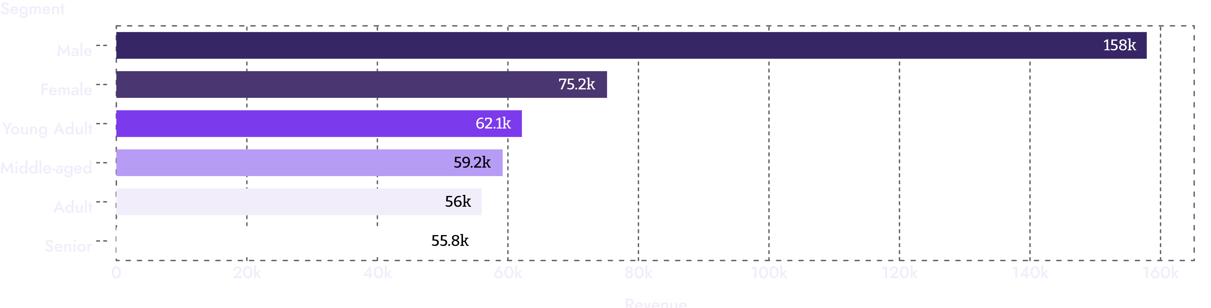
02 — REVENUE MIX
Revenue is concentrated in male customers, with young adults leading age groups
Revenue by gender and age group points to two practical targeting anchors.
Customer shopping behavior, translated into growth moves
3

Slide 4
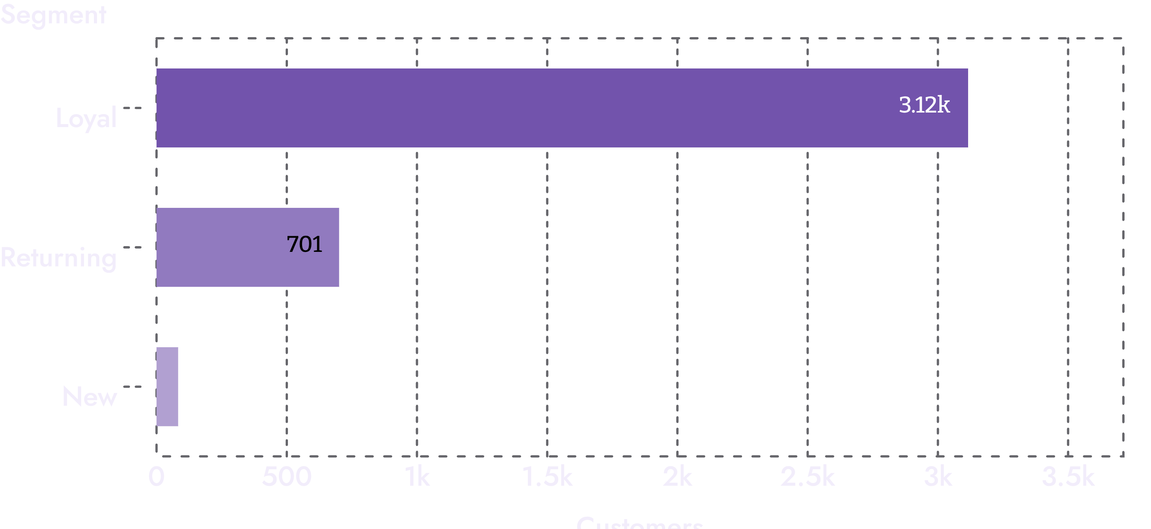
03 — CUSTOMER SEGMENTS
Loyal customers are the engine, but the newest buyers remain underdeveloped
GROWTH PRIORITY
Prioritize retention economics
Build a stronger first-to-second-purchase journey.
Customer shopping behavior, translated into growth moves
4

Slide 5
04 — SUBSCRIPTIONS
Subscriptions are not yet creating measurable spend lift
Status | Customers | Average spend | Revenue
Yes | 1,053 | $59.49 | $62,645
No | 2,847 | $59.87 | $170,436
$0.38
The near-identical average spend suggests the subscription value proposition needs sharper benefits.
Difference in average spend
Customer shopping behavior, translated into growth moves
5

Slide 6
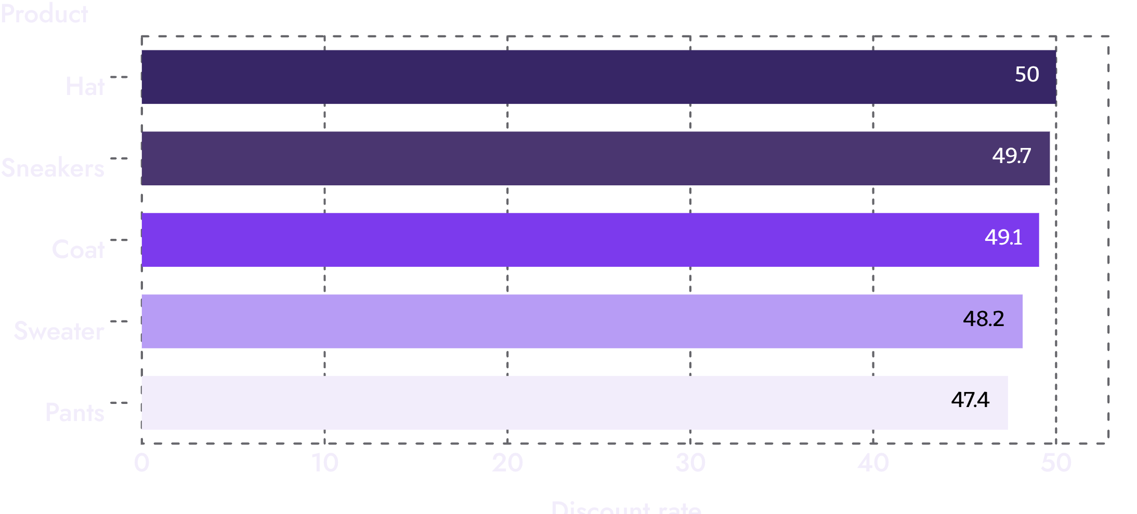
05 — DISCOUNT ECONOMICS
Discounts can drive high-value baskets, but some products may be over-dependent
839
CUSTOMERS USED DISCOUNTS AND STILL SPENT ABOVE THE AVERAGE PURCHASE AMOUNT
Use targeted offers where discounts unlock incremental demand, not blanket markdowns.
Customer shopping behavior, translated into growth moves
6

Slide 7
06 — MERCHANDISING SIGNALS
Product signals point to a clear merchandising shortlist
TOP-RATED
TOP-SELLING BY CATEGORY
Gloves · 3.86
Jewelry · Blouse
Sandals 3.84 · Boots 3.82 · Hat 3.80 · Skirt 3.78
Jewelry leads Accessories; Blouse leads Clothing.
FOOTWEAR + OUTERWEAR
Sandals · Jacket
Sandals lead Footwear; Jacket leads Outerwear.
Pair product visibility with the right job: ratings build confidence, while volume supports conversion.
Customer shopping behavior, translated into growth moves
7

Slide 8
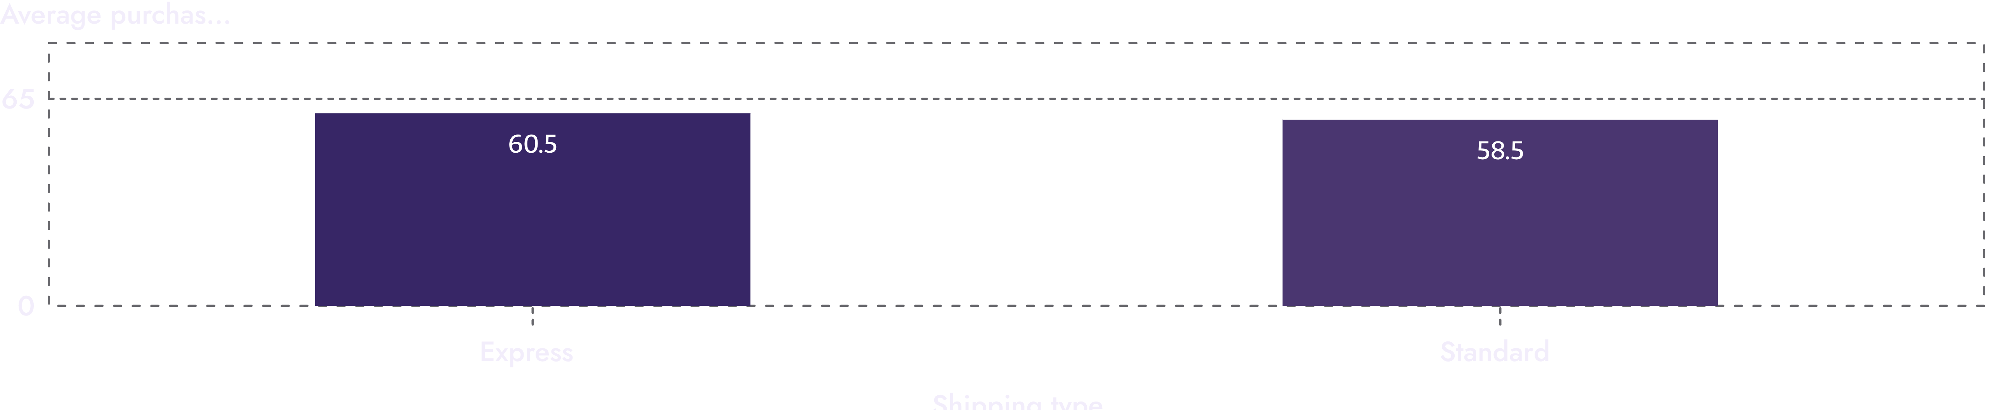
07 — SHIPPING SIGNAL
Shipping speed is a modest but useful value signal
$2.02
The gap is directional, not proof of causality. Test express-shipping messaging with higher-intent segments and larger baskets.
EXPRESS GAP
Customer shopping behavior, translated into growth moves
8

Slide 9


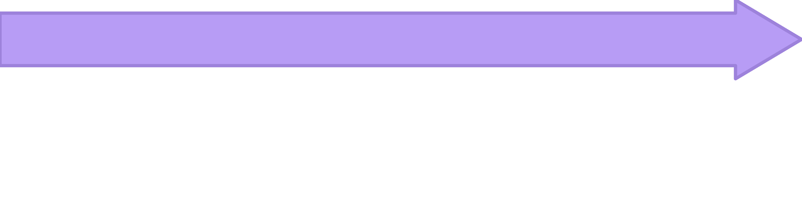

08 — ANALYSIS WORKFLOW
The analysis workflow is repeatable, not just descriptive
Engineer features
Clean and standardize
Age groups and purchase-frequency features
Transaction data in Python
Translate outputs
Load for queries
Interactive Power BI dashboard
Cleaned data into PostgreSQL
That pipeline creates a practical loop from raw purchases to commercial action.
Customer shopping behavior, translated into growth moves
9

Slide 10
09 — GROWTH MOVES
Four moves to improve growth efficiency
1
2
01
02
Make subscriptions earn attention
Build the second purchase
Test exclusive benefits, not just a badge.
Use loyalty rewards to move returning buyers into the loyal tier.
3
4
03
04
Protect margin
Sharpen targeting
Review discount dependence by product and customer value.
Prioritize high-revenue age groups, proven products, and express-shipping intent.
Customer shopping behavior, translated into growth moves
10

