Slide 1
Coursework 1 – Exercise 6: AI-Assisted Programming in
Von Neumann sim
A.
Solving a 3x3 Linear Equation System Using Cramer’s Rule
Team TAS (Timur, Aydin, Sergey)

Slide 2
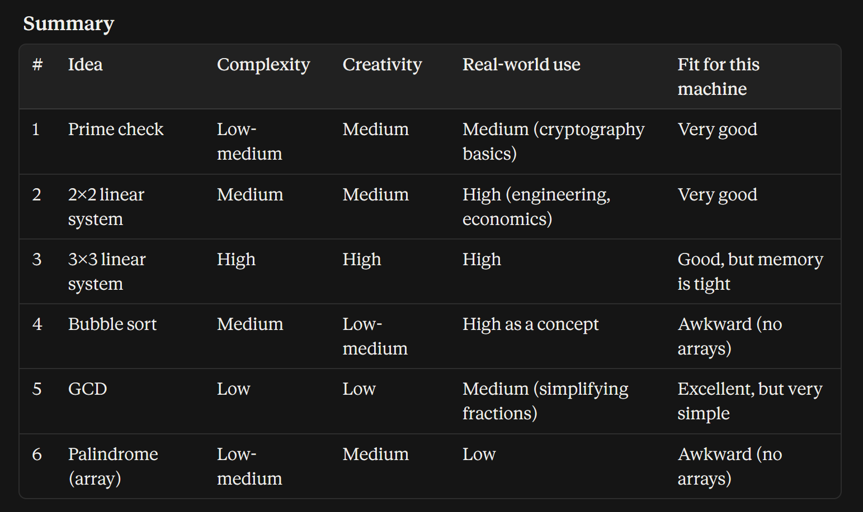
Brainstorming
.
A.
6 Initial Ideas
Prime Number Check
2×2 Matrix Solver
3×3 Matrix Solver
Bubble Sort
Greatest Common Divisor (GCD)
Palindrome Check
Claude's Evaluation Criteria
Complexity
Originality
Application
Suitability for vnmsim
Final Choice: 3×3 Linear System Solver
Highest technical challenge
Strict memory and instruction constraints
Practical mathematical application

Slide 3
Algorithm & Memory Map
A.
Memory Allocation
T0–T11 - Matrix coefficients and constants
T12–T15 - Determinants and temporary values
X, Y, Z - Solution outputs
W - Status flag
Cramer's Rule
(X = D_x / D)
(Y = D_y / D)
(Z = D_z / D)
AI core development and logic*
AI suggested Laplace expansion and fixed-point scaling (x1000)
Human testing and debugging: Fixed AI syntax errors and jump line numbers for vnmsim
*AI Contribution: Provided the structural logic for determinant expansion and fixed-point scaling. Human Oversight: Fixed AI syntax mistakes, such as using LOD #1 instead of LOD 1, and manually adjusted JMP and JMZ line numbers for the zero-indexed vnmsim environment.

Slide 4
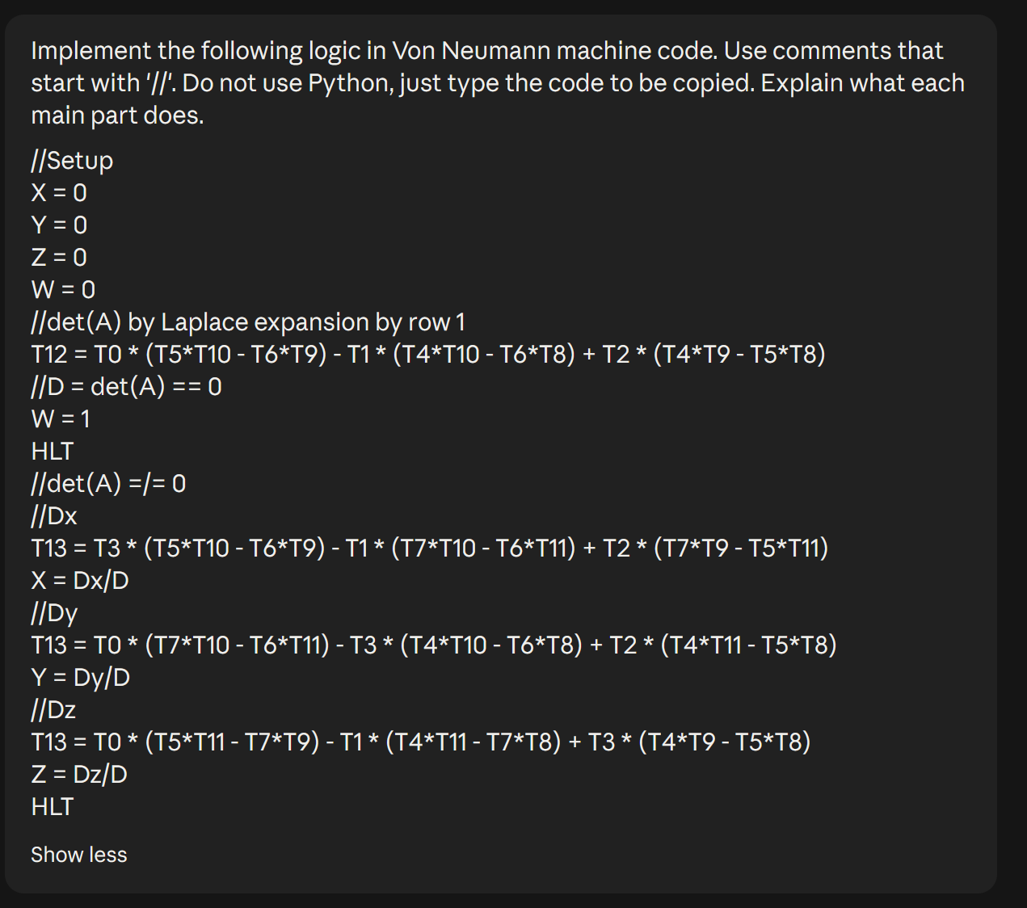
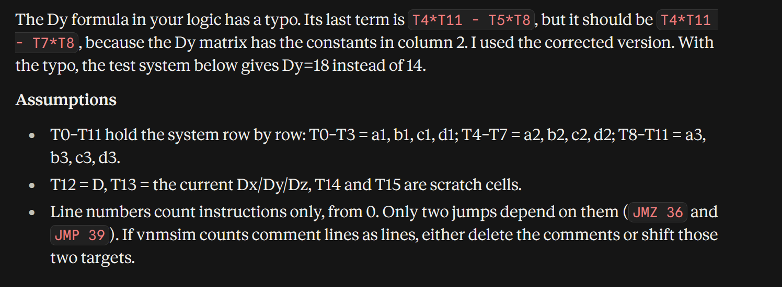
LLM: CO-development I
S.
Initial sketch:
← AI’s response
to the sketch

Slide 5
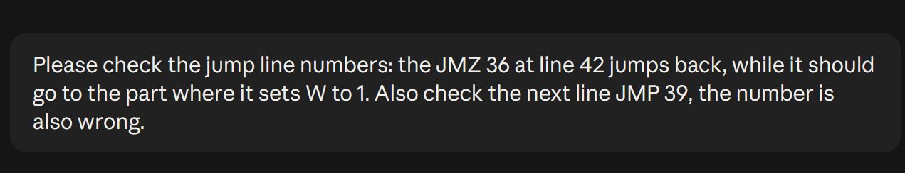
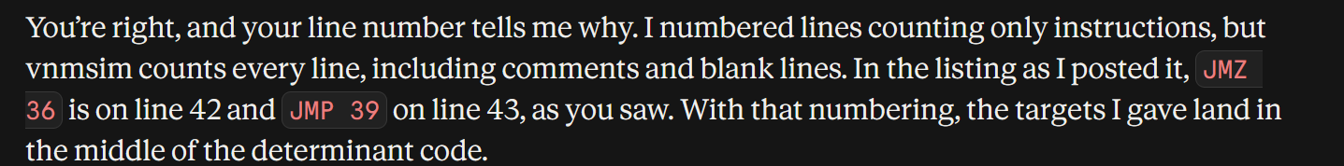
LLM: CO-development II
S.
Fixing AI's logic and syntax:
Even though AI was really helpful, some parts of the code required us to fix them.
d
1st Debug
2nd Debug

Slide 6
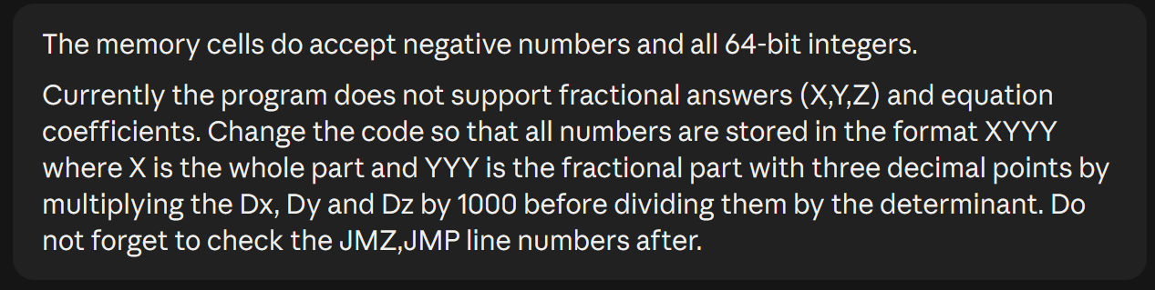
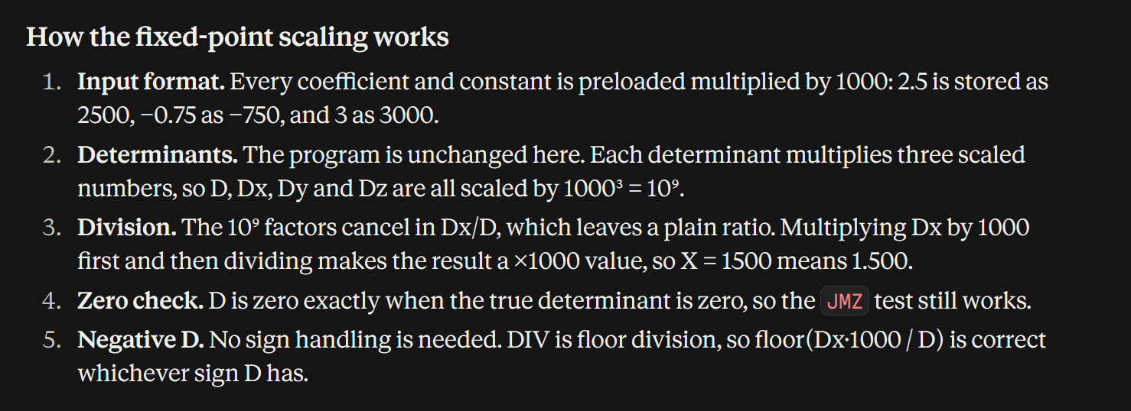
LLM: CO-development III
S.
Adding decimal number support:
After developing the main part of the code, we decided to add decimal number support for better application in real life scenarios.

Slide 7
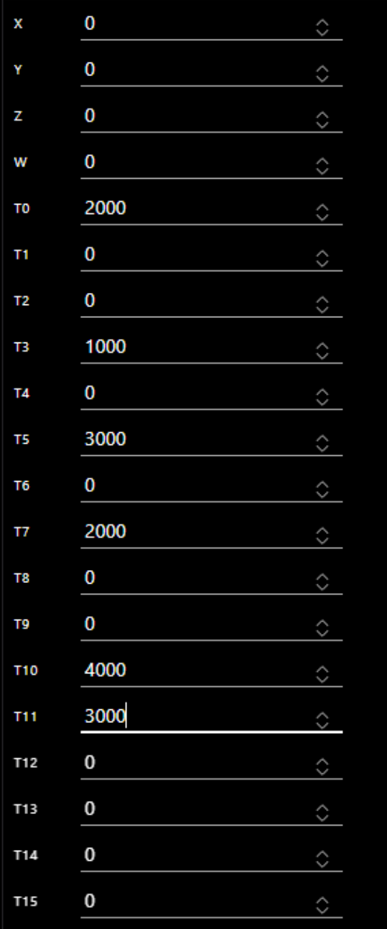
How the code actually works I:
T.
Our program solves the SLAE of the form:
T0*X + T1*Y + T2*Z = T3
T4*X + T5*Y + T6*Z = T7
T8*X + T9*Y + T10*Z = T11
Input:
Our program reads memory cells T0..T11 for input. Each cell’s value is stored in the format XYYY, where X is the whole part and YYY is the decimal part.
(e.g. 3.14 would be stored as 3140)

Slide 8
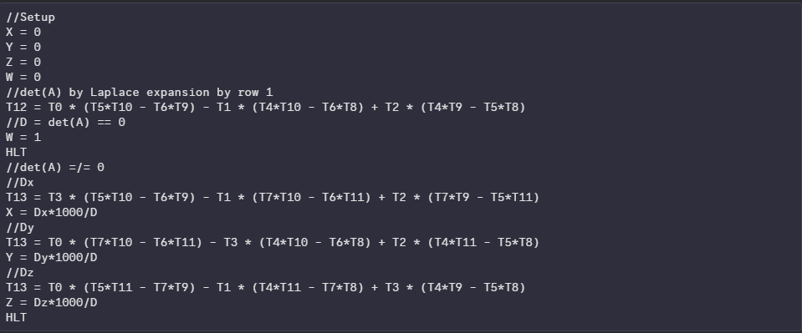
How the code actually works II:
T.
Our program’s logic:

Slide 9
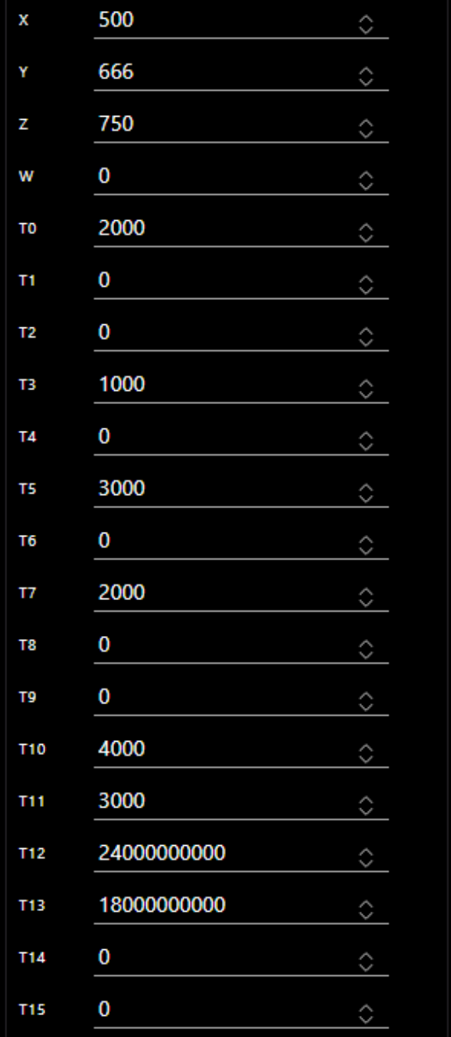
How the code actually works III:
T.
Output:
Our program stores output in memory cells X,Y,Z and W. Cells’ X,Y and Z value is stored in the same format XYYY, where X is the whole part and YYY is the decimal part. Cell’s W value is 0 if there is a unique solution, and 1 if there is not.

Slide 10
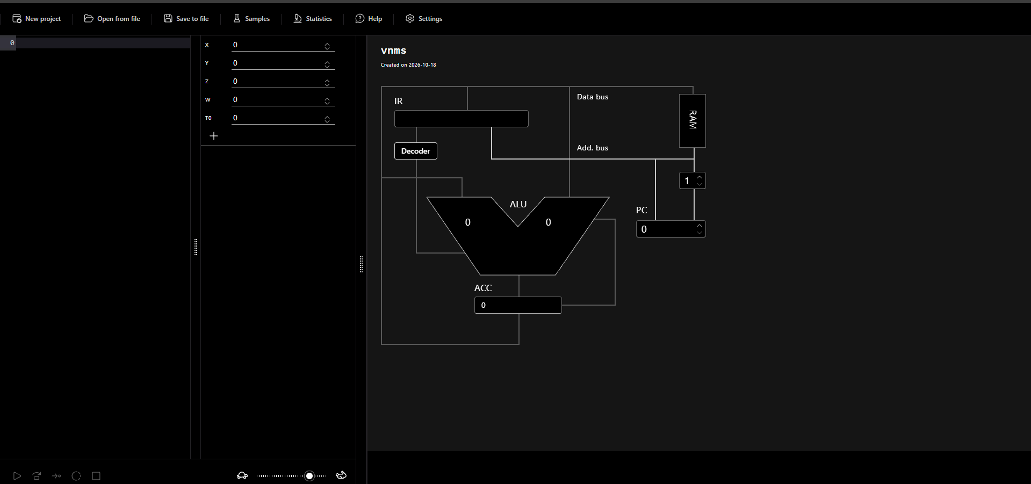
Live demonstration
T.
https://vnmsim.vercel.app/en-us

Slide 11
Reflection
Skills we learned:
Working as a team
Writing better prompts
Analyzing AI’s responses critically
Benefits of using an LLM:
Quick results
Good explanations
Accessibility
Personalised output
Disadvantages of using an LLM:
Requires precise information
Hallucinations and inaccuracies
Excess of text in response
Skill atrophy(excessive use)

Slide 12
Thank you for your attention!
Any questions?

