Slide 1
Project 2
To The Moon
Jack Lovrinic

Slide 2
Making the spacetato move
I just used the input section in the project settings to set up some keybinds, and that seemed to work pretty well for the movement. I also got a really nice floaty effect so that was great for matching the theme.

Slide 3
2 Elements
The first element I worked on were the Moon Holes that take you farther into the moon (the next level). That worked pretty well
There was also the teleporter, It didn’t work all the time and was fairly buggy and I was never really able to get it fixed.
The moon dust floating around in the second level acts as points for the player to collect while being chased by the Moon monster.

Slide 4
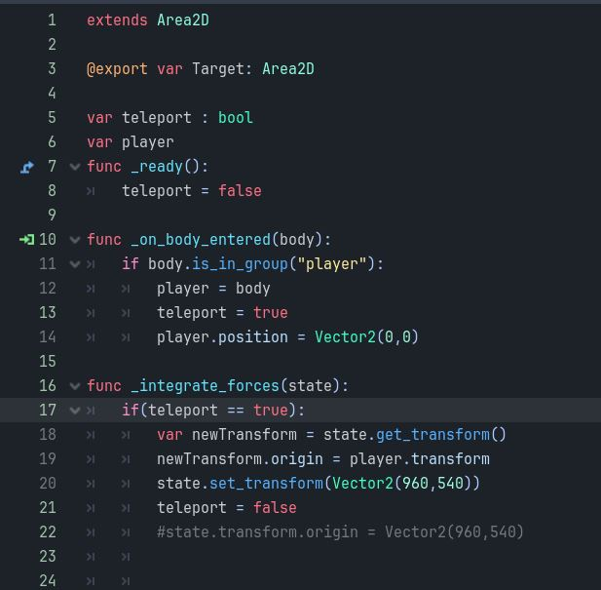
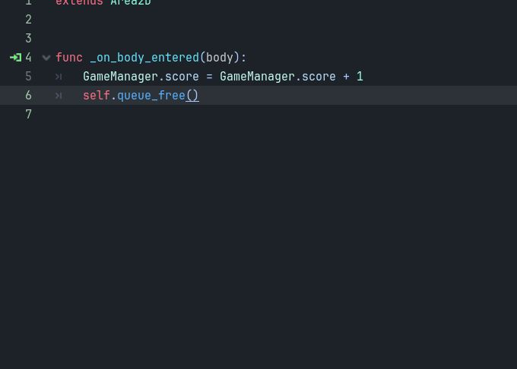
The teleporter was pretty buggy
Point system worked really well with the game manager.

Slide 5
2 Elements
The first element I worked on were the Moon Holes that take you farther into the moon (the next level). That worked pretty well
There was also the teleporter, It didn’t work all the time and was fairly buggy and I was never really able to get it fixed.
The moon dust floating around in the second level acts as points for the player to collect while being chased by the Moon monster.

Slide 6
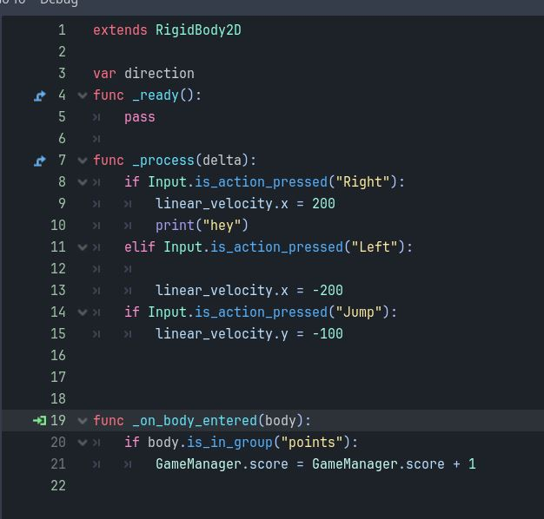
Movement was pretty simple

Slide 7
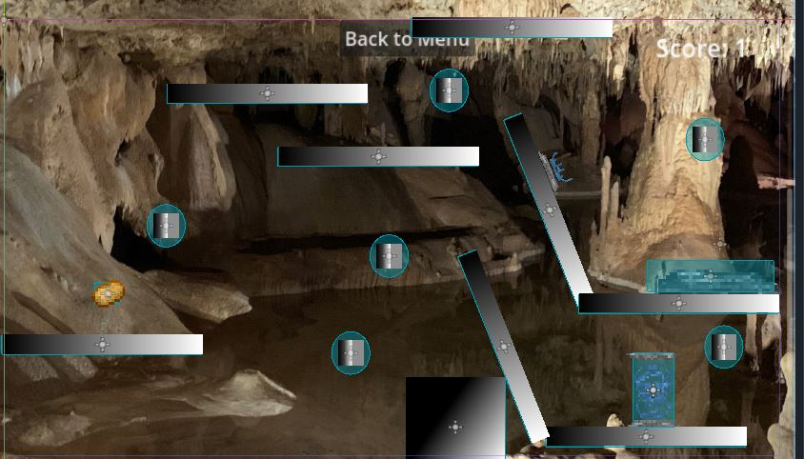
The level design worked fairly well I think, especially on the second level

Slide 8
Goal
The goal for this game is to make it from the surface of mars deeper into the crust and eventually to the core, but I only had 2 levels. During the second level the player will be chased by a moon monster, and also given the opportunity to collect moon dust.

