Slide 1
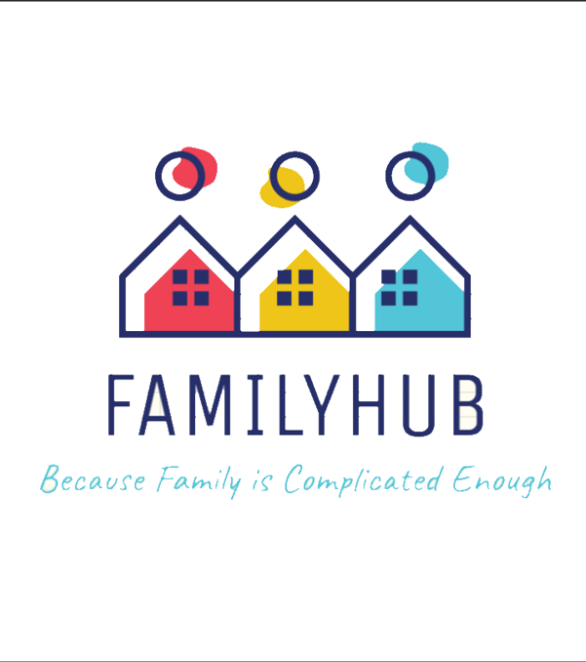
FamilyHub Team: We Tried
Notes:
@Tanisha
Have you ever missed an important family event or struggled to keep track of your family's schedule?
Imagine having a tool that could help you stay organized and connected with your loved ones
That's exactly what our web-based application, FamilyHub, is designed to do.
We are team : We Tried and Today, we're excited to share with you how FamilyHub can help you reduce friction and conflict within your family,
while strengthening your bonds and creating lasting memories together.
FamilyHub: Because Family is Complicated Enough

Slide 2
Core Features
Shared Calendar
Individual Profiles
Family Groups
Notes:
@Tanisha
FamilyHub has a number of featured to help you keep up to date with all of the important events in your families lives
These features include
The shared calendar, where you can view all past and upcoming family events
Your individual profile, where you can display your contact info so everyone in your family will be able to reach you
And finally, the family groups, which can be made by any user to help them stay close with the people that matter the most
And now here is a demonstration of our application

Slide 3
DEMO
Notes:
@Jasmine
Pre-Demo
Create account #2
juan@demo.com
FamilyHub Demo
Create account #1
jasmine@demo.com
Navigate/view calendar
Prev, next, today
Weekly, monthly, daily
Calendar date selector
Family groups
Create group
We Tried
Create events
Single - presentation
All day - vacation
Recurring - birthday
View/edit events
Single
Recurring
Delete events
Single
Recurring – single
Recurring – series
Shared Calendar
Add member
Juan@demo.com
Logout
Log in as juan@demo.com
See events
Can’t edit or delete
Filter group
View group member profiles
Leave group
Return to calendar
Relog in as jasmine@demo.com
See that Juan is no longer a member
Profile
Edit details
Delete account
Attempt to login again
--End of Demo--

Slide 4








Two-Tier Architecture
MERN Stack: MongoDB, Express.js, React, and Node.js
Client
React
Vite
Toast UI
Next UI
Server
Node JS
Express JS
MongoDB
Mongoose
Notes:
@Juan
As you might have noticed, we use a two-tier architecture, the most common among web applications. We also use the MERN stack, composed of MongoDB, Express.js, React, and Node.js.
On the client side, we use tools such as:
React: for creating user interfaces with reusable components.
Vite: for building and bundling JavaScript code.
Next UI and Toast UI are a collection of open-source javascript UI components. The calendar specifically is a component of Toast UI.
On the server side, we use Node.js with the framework Express.js for building the server and setting up routes and controllers. And Mongoose to interact with our database, which is Mongo DB.

Slide 5

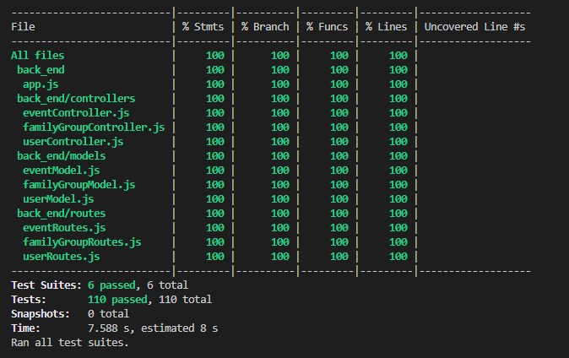
Testing Tools
Unit and Integration Testing
Jest
Notes:
@Juan
Moving on to the Testing tools, we used Jest for unit and integration testing. It was helpful in automatic mocking, snapshot testing, and, most importantly, code coverage analysis. That's how we got this nice screenshot.

Slide 6

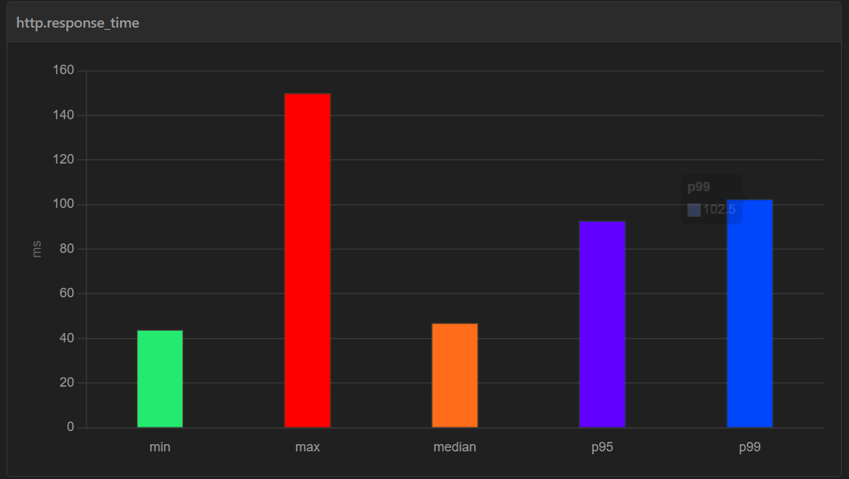
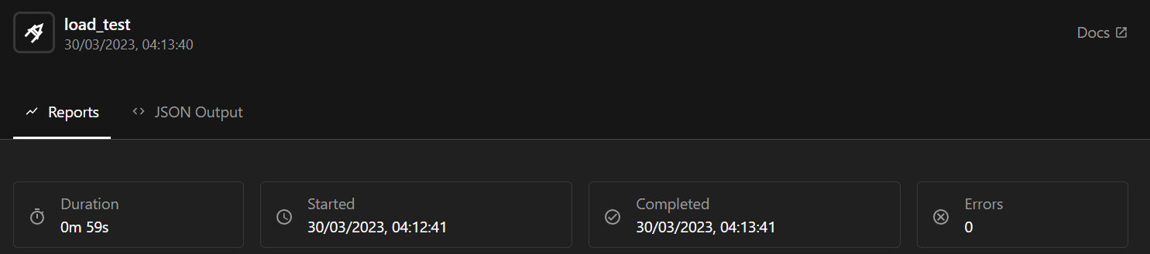
Testing Tools
Load Testing
Artillery
Notes:
@Juan
For Load Testing, we used Artillery because it was easy to implement, had good documentation, and could generate HTML reports on how the application performed during the test.

Slide 7

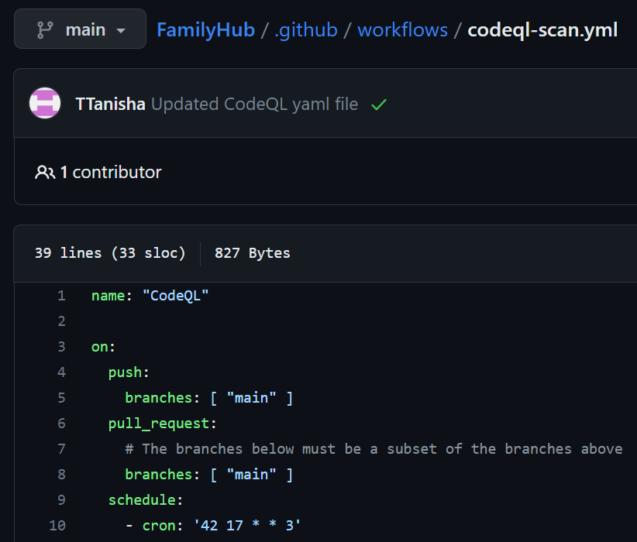
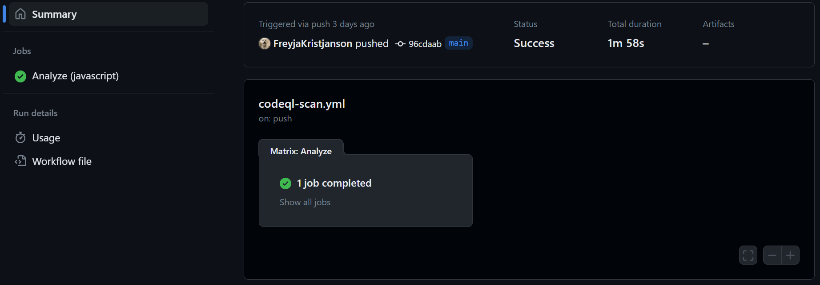
Testing Tools
Security Analysis
CodeQL
Notes:
@Juan
And for Security Analysis, we integrated CodeQL in GitHub Actions. It only took an extra workflow script. It also had very straightforward documentation. And it showed us all our potential security breaches.

Slide 8

Development Testing
Server:
Postman
Sending HTTP requests to our API.
MongoDB Management Console
Check state of data
Client:
Manual Testing
Trying to break the application with edge cases
Notes:
@Juan
Next, these are the tools we used to test our application during the development process:
We used Postman to manually send HTTP requests to our API endpoints and see the values returned. It was before we had a working front end.
MongoDB Management Console was also helpful, mainly in solving data inconsistencies or leaks in our application. We could see the data without having to write queries.
And for testing the user interface, we tested every edge case, and when reviewing a Pull Request, we often tried to break each other code to ensure everything was working correctly.

Slide 9


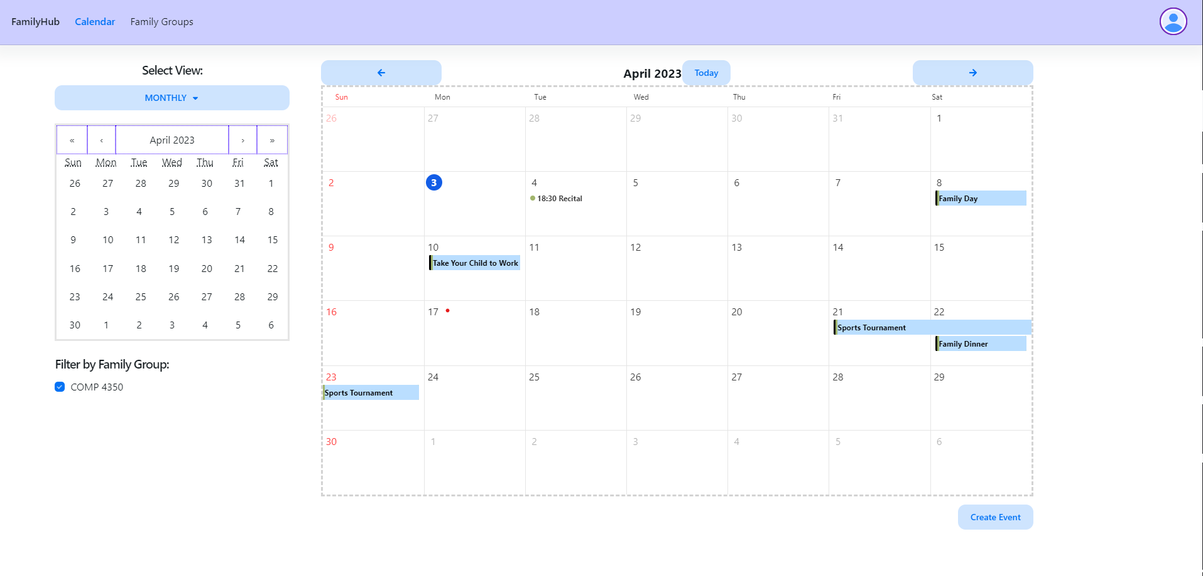
Biggest Core Feature
Notes:
Our biggest core feature, which took the most time, and the most lines of code is our shared calendar.
While we used ToastUI to create our calendar there were unfortunately, some problems that resulted from that choice, which we will go into more detail on later.
In addition to the calendar itself, we also implemented
One time events, which required us to create a custom create event form from scratch, as the default one was unable to support our needs
Recurring events, which we had to implement entirely ourselves as they were not supported at all by ToastUI
And family group filters, which are calendar event filters that allow users to choose which family groups events appear on the calendar at any given time, which also required quite a bit of time to implement.
Speaking of time, not all of the ideas we had made it into our application.
Next I will talk about some of the things that did not make it into FamilyHub.

Slide 10
What We Left Out
Message Board
Customization
Automatic Birthday Events
Family Group Invitations
Notes:
@Tanisha
As I mentioned there were some features that we had originally planned for our project that we wound up leaving out of our final product.
These features were left out due to time constraints that we had to work with.
These features include the
Message board: which was a place where families could post images and messages viewable by other members of their family groups
Customization – customizable colours for different events on the calendar. This would allow any individual to choose the color that certain events appeared as on their view of the calendar
Automatic Birthday Events – which would automatically add users birthdays to the shared calendars of family groups that they were a part of
Family Group Invitations – so users can email invitations to family their groups
Next I will pass to Freyja to talk about our development process

Slide 11
Development Process
Right
GitHub
Discord
Meetings
No merge conflicts
Core features
Frontend and backend connection
Wrong
Time got in the way of quality and quantity
Library error messages
ToastUI
Recurring events
Notes:
@Freyja
Next, we want to talk about what went right and what went wrong in our development process.
Our coding and documentation process was organized and easy to maintain, we set up our GitHub early on, and used discord to keep each other informed on our individual progress and alert the rest of the team when we made a pull request. We were also able to have consistent meetings, which, depending on where in a sprint we were, mostly occurred weekly, and everyone was always able to attend.
Due to how we divided up the work, we were each working on a fairly isolated portion of the project, which meant that while we always did code reviews and made sure the changes didn’t break any tests (both automatic and manual), there wasn’t much code overlap, meaning there were hardly ever any merge conflicts. This made the process smooth and efficient. We each became more knowledgeable about the area we worked on, but still felt confident in what the rest of the team was doing.
Two other technical things that went right were: one, we were able to complete all of our core features we originally planned, and two, connecting the front and back end was easier than expected.
In terms of what went wrong, there was not anything major, but there were several annoyances and inconveniences. We dealt with some time constraint issues, we were busy with other courses and life sometimes got in the way, of both the quality and quantity of work we were hoping to achieve.
We also encountered library error messages generated by dependencies used in our application. We couldn't solve a few console errors because they were part of the library's code, not ours. These are well-known issues that have yet to be fixed by the providers. To address this, we created a frequently asked questions page to specify and document them. It is important to note that these do not affect the operation of our application.
Another issue we had was with ToastUI, the calendar API we used. The documentation was both incomplete and out of date, which made the API very difficult to navigate.
There were also issues with the API itself, which caused some functionality problems with our application that we had to work around, like multi-day events showing up as all day events in the daily view of the calendar.
The thing we struggled with the most, was being able to add and edit recurring events. Dealing with recurring dates is a challenging task. You have to consider time zones, leap years, the different lengths of months, etc. On the frontend you have to get the information from the user in a way that makes sense to them and is able to be converted into a format that the backend understands. We had issues with all three of these stages.
The frontend calendar API we chose did not have built-in recurring event capabilities, so we had to implement that ourselves. And because of this, we spent a lot of time on what was supposed to be a minor but important feature of our website.
Unfortunately, the solution that we ended up using is not a particularly good one. On the frontend it is not very versatile, and on the backend, it is clunky and not scalable. But, we felt that for our purposes, it was suitable.

Slide 12
What We Would Do Differently
Set coding standards earlier
Research the calendar API more, look at alternatives
Focus on creating a secure system
Notes:
@Freyja
Next, we want to talk about what we would do differently. Due to the nature of group projects and the difficulties surrounding them, there is not a whole lot that we feel we could have done differently, but there are two things we should have done and one that would have been nice to have.
First, we did not formally discuss or document any coding standards or styling that we would follow before we began, and while it wasn’t too much of a challenge to update at the end, we did waste time that could have been avoided.
Secondly, we should have done a bit more research on the calendar API we used before we began. An API that had recurring events integrated would have made our lives so much easier.
Lastly, if we could start over, we would have considered making our features less complex and opting for building a more secure system instead.
And now Tanisha will talk about what we learned.

Slide 13
What We Learned
Web Development
Security Scanning
CI/CD Pipeline
Notes:
Throughout the creation of our product, our team learned a great deal. The parts that we feel we learned the most about, both individually and as a group are
Web development: including libraries and tools that can assist with the process
Security scanning: which was easier to implement than we had originally thought and provided valuable feedback on our application
CICD pipeline: which helped us keep our project up to date and tested throughout the development process

Slide 14
Family is not an important thing.
It's everything.
Michael J. Fox
Notes:
@Tanisha
In conclusion, FamilyHub is a powerful tool that has the potential to revolutionize the way families stay organized and connected.
By streamlining communication and providing a shared platform for important events, FamilyHub simplifies the process of staying in touch with loved ones.
But what truly sets FamilyHub apart is its ease of use and accessibility.
Our user-friendly interface and comprehensive features make it easy for anyone to get started, regardless of technical ability.
So whether you're a busy parent juggling work and family responsibilities or a grandparent wanting to stay connected with your loved ones, FamilyHub has something for everyone.
We believe that FamilyHub is not just a marketable product, but a game-changer for families looking to build stronger bonds and reduce friction in their daily lives.
So if you're ready to take the first step towards a more organized and connected family life, we invite you to join the FamilyHub community.
Because family is not an important thing, its everything!
Thank you so much for your time, we hope you enjoyed our presentation.

Slide 15
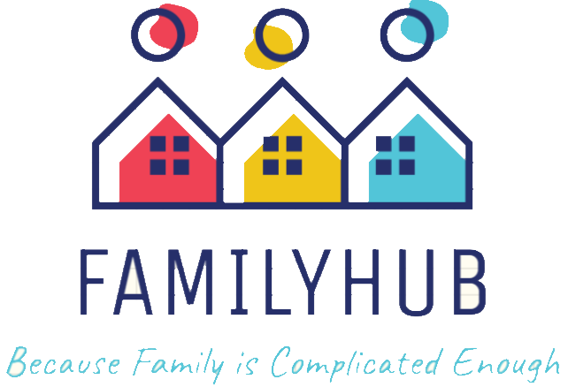
Thank You!

