Slide 1

FamilyHub
We Tried: Juan Armijos Freyja Kristjanson Jasmine Tabuzo Tanisha Turner
Notes:
Image by pch.vector on Freepik
Hi everyone, my name is Jasmine and these are my team members, -group says their names-, and today we’ll be talking about our project, FamilyHub.

Slide 2

Table of Contents
1
The Problem
2
Our Vision
3
Project Summary
What do we aim to solve?
What do we want to achieve?
What is our project about?
4
Core Features
5
Technologies
6
Conclusion
What features will our project have?
What technologies will we use?
Notes:
Going over a quick table of contents, first we’ll discuss the problem we aim to solve, the vision we aim to achieve, a summary of our project, the core features, the technologies we’ll be using, and then we’ll finish off with the conclusion.

Slide 3



The Problem
Traditional methods are…
Disorganized and disconnected
Notes:
Image by rawpixel.com on Freepik
Image by Drazen Zigic on Freepik
First and foremost, the problem. Traditional methods of planning and organizing events are currently
-next (same slide, but for text animation)-
disorganized and disconnected. Physical calendars, agendas, and notes can often be forgotten or misplaced. Additionally, the disconnect between event attendees can result in miscommunication of event details. These problems can cause conflict within families, especially when special events continue to be forgotten or overlooked.

Slide 4
Our Vision
To help families stay on top of important events with their loved ones through the use of a shared calendar.
To reduce friction and conflict within families by enabling them to improve their organization and communication of events.
Notes:
Thus, our vision is to help families stay on top of important events with their loved ones through the use of a shared calendar. We aim to reduce friction and conflict within families by enabling them to improve their organization and communication of events. Overall, FamilyHub hopes to bring families closer together by giving them a hub to stay connected, share memories, plan events, and build stronger bonds.

Slide 5

Project Summary
Designed for families wanting to organize and keep track of shared events
Private, shared calendar for one time and recurring events
Reduce the stress of planning and remembering events
Reduce repetitiveness of traditional event invites
Notes:
Image by upklyak on Freepik
To achieve our vision, we would like to design a web-application for families that are wanting to organize and keep track of their shared events, such as birthdays and anniversaries. Users will be able to access a private, shared calendar with their family members, where they can add one time and recurring events. This project’s value comes from the reduction of stress when planning and remembering events, and also the reduction of the repetitiveness of traditional event invites.
Now we will talk about the core features of our project.

Slide 6







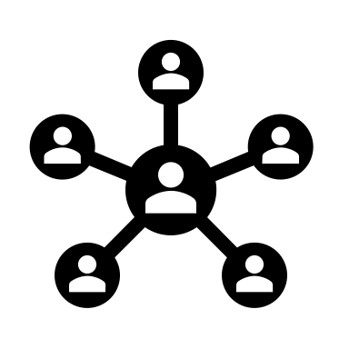

Core Features
Notes:
Our three core features include family member profiles, family groups, and a shared calendar. The individual family member profiles are where users can add personal information that other users in the same family group can see. ​Users can create a family group and then invite other users to join the group. Members of the same group can view the profiles of the other users, and see the events in the shared calendar. ​
The shared calendar has a monthly and daily view, and family members can add recurring or one-time events. ​Our non-functional feature is that the site can respond to 100 users with 1000 requests per minute concurrently. For example, if 100 users in various groups all add an event to their calendar at the same time.

Slide 7
Family Member Profiles (User Stories)
As a signed-in user, I want to be able to add/edit my personal information.
Name
Pronouns
Birthday
Cell number
Home phone number
Address
As a signed-in user in a family group, I want to be able to view other family members' profiles.
Notes:
We have a few user stories for the family member profiles. ​First: As a newly registered user, I want to be able to add personal information to my profile, so that other signed-in users in the same group can see my information. ​Second: As a signed-in user, I want to be able to edit my personal information, so that my information stays current and accurate.​ The information that can be added and edited includes name, pronouns, birthday, cell number, home phone number, and address.​ Lastly, as a signed-in user in a family group, I want to be able to view family members' profiles, so that I can see their personal information.

Slide 8
Family Groups (User Stories)
As a user, I would like to be able to create a family group.
As a family member, I want to be able to invite my family members to the family group.
As a user, I want to be able to leave a family group.
Notes:
In regards to the user stories for the family groups, we have three main goals. ​First, as a user, I would like to be able to create a family group.​ Second: as a family member, I want to be able to invite my family members to the family group.​ And third: as a user, I want to be able to leave a family group.

Slide 9


Shared Calendar (User Stories)
Users of the FamilyHub application will be able to...
Access the shared calendar for their family group
View calendar events in a monthly or daily layout
Add, edit, or remove events
Customize the calendar colour palette they see
Notes:
Each family group has a calendar that is accessible for all group members.
The calendar contains both recurring events, such as birthdays and anniversaries
And one-time events, like recitals or sporting events.
The users can view the shared calendar for family groups they are a part of
And see the events in a monthly or daily view
They can add, edit or remove events from family calendars.
Additionally, they will be able to customize the colour palette on their personal view of the calendar.

Slide 10
Technologies
Front End – Back End – Database – Pipeline – Architecture
Notes:
Next we will cover the technologies that we are planning to use for our application .
We will cover the
front end, back end, and database technologies we will use,
As well as the pipeline and architecture for our project

Slide 11

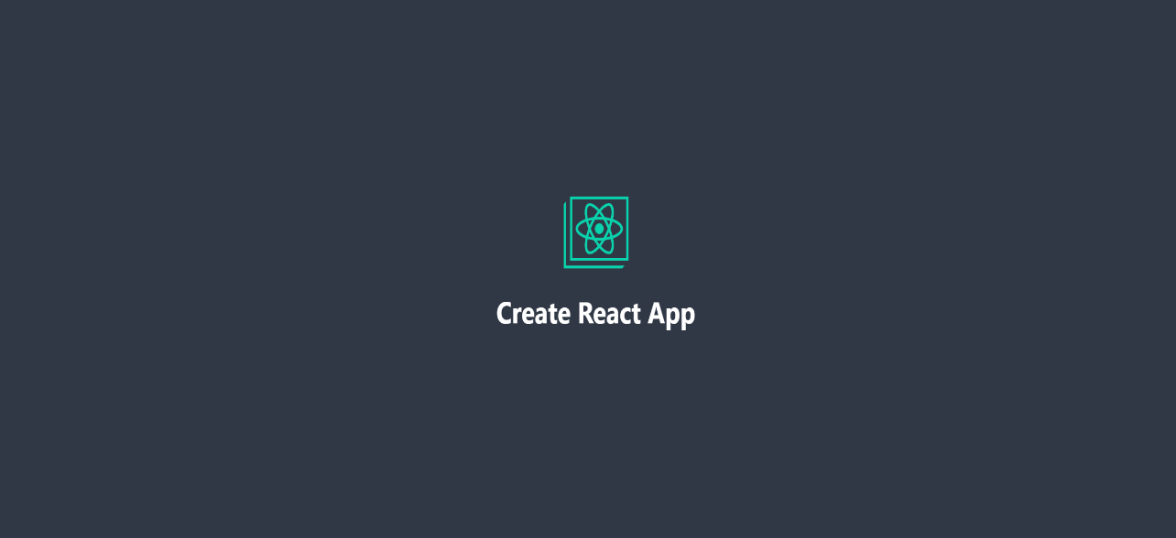

Technologies – Front End
Notes:
For front end technologies, we are going to use either
Create react app or Vite (Veet) as our main front end framework .
These are the two we are considering due to their speed, maintainability, and popularity.
we also plan on using the ToastUI, which is an open source JavaScript UI library, for its detailed calendars that support daily and monthly views.

Slide 12

Technologies – Back End
Notes:
NodeJS and ExpressJS were chosen for the back-end of the web application because they offer fast and efficient server-side JavaScript execution. NodeJS has a large and active community, which means that there is a lot of support available and a vast number of modules and packages to choose from. ExpressJS is a popular framework for building web applications on top of NodeJS and provides a simple and easy to use interface for routing, middleware (important) and more.

Slide 13

Technologies - Database
Notes:
For the database MongoDB was chosen because it is a NoSQL database that is highly scalable, flexible and offers a lot of performance benefits. It is also a popular choice for modern web applications because it allows for storing semi-structured data, making it a good fit for applications with dynamic data models.

Slide 14
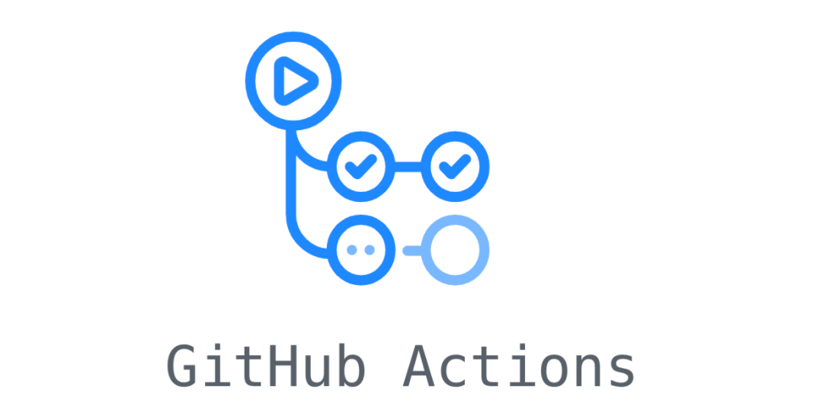


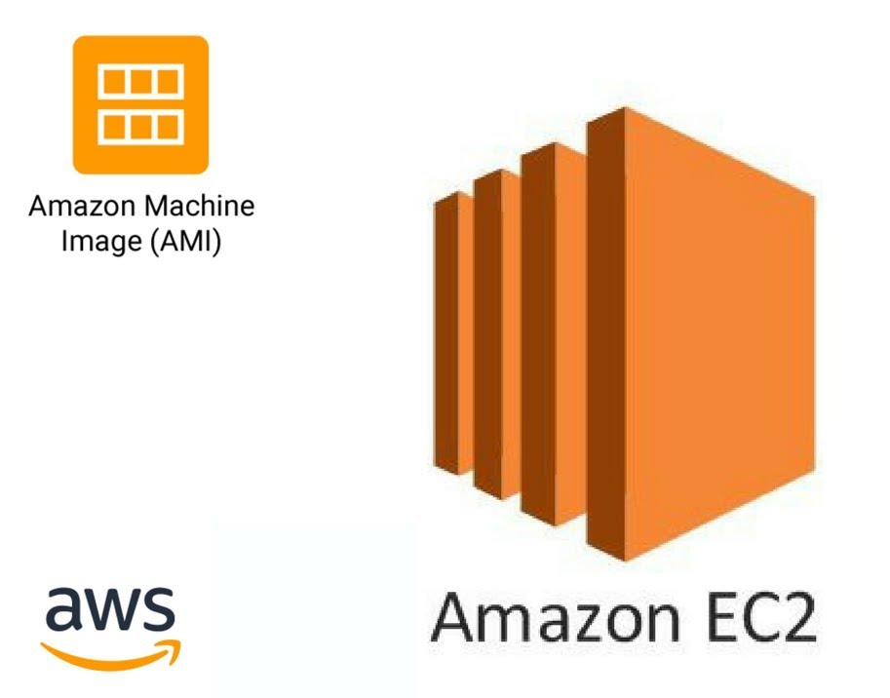
Technologies – CI/CD Pipeline
Notes:
GitHub Actions will handle the CI/CD pipeline because it provides an easy-to-use and powerful platform for automating the software development process, just like Jenkins. The difference is that it is integrated with Github repos; therefore, it will be easier for us to create, manage and run workflows for building, testing and deploying software. Having things in one place will allow us to be more efficient.
We are using the Docker containers to package the applications into images that can be easily deployed in E2 from amazon by GitHub Actions. They are a flexible and scalable cloud computing platform with a wide range of services and features to support the deployment and management of applications at scale.

Slide 15
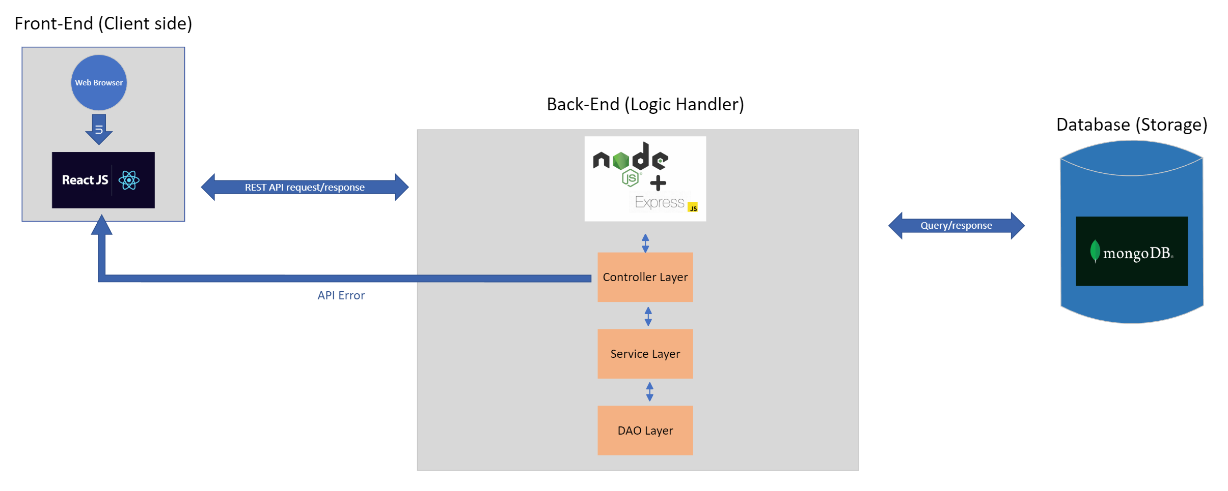
Architecture Diagram
Notes:
Here we can see how it all fits together with the central part of our project being operated by ExpressJS. It will handle the different layers such as controller, service, and DAOs (Data Access layer), while in the front end, we are using a React Based Framework and on the persistence side: MongoDB.

Slide 16

Conclusion
Notes:
Image by rawpixel.com on Freepik
In conclusion, using these technologies, we would like to implement the features we’ve discussed in hopes of improving the communication and organization of events within families so that they are able to build stronger connections.

Slide 17



Thank you
Notes:
Image by storyset on Freepik
And that concludes our presentation, thank you for listening. <3

