Slide 1
Hateful group
short but tough group

Slide 2
“
First of all, I'd like to introduce to you what our group discussed. It's about Django and turbogears framework. In the following content, our group will bring you the history, advantages and disadvantages, framework and code of both. Here we are
Chang Yusheng
Li Yuanyucheng
Huang Yujia
n
Guo Zhekai
Liu Xunhai
Long Lin
Xie Songjiang
Li Zhiling
I hope our works will be liked by you

Slide 3

History
01
What happens to the Django and Turbogears frameworks
over time.
In this section, we will talk about the birth and development of Django and turbo gears, and which versions they have experienced. Their main characteristics are whether they have changed, which we will explain one by one in the following ppt.

Slide 4

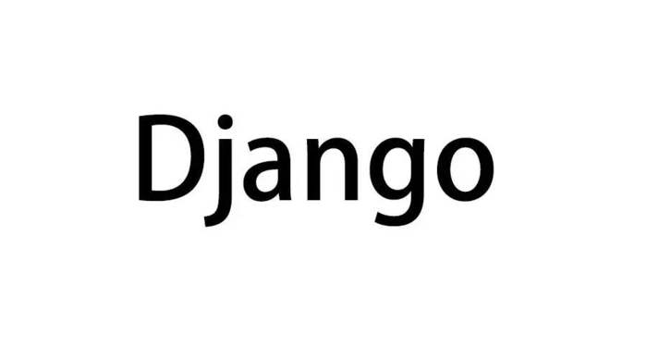

History
History is the human activity related to material things. It is necessary for Web Framework
source
Django, pronounced [` d ʒ æ ŋ ɡ goes ʊ], is written in python open source web development framework, and follow the MVC design
time
The framework was developed for the purpose of developing news-focused websites and was released in July 2005.
purpose
The main purpose of Django is to develop a "database" driven web site easily. It emphasizes code reuse, and multiple components can easily serve the entire framework as "plug-ins."

Slide 5
History
History is the human activity related to material things. It is necessary for Web Framework
source
TurboGears is a python-based Web development framework
turbogears
purpose
It help developers integrate many major components into a Web framework that provides front-end to back-end Web integration. The code is hosted on Github under the MIT open source license

Slide 6
description of Django and turbogears
02
What exactly are Django and turbogears? We'll give you a brief overview of
them in the following sections
Django, Flask, Tornado, etc., are common frameworks for learning python. Compared with other frameworks, Django framework has the advantage of being large and complete. etc..

Slide 7
Django framework
MVC is the well-known pattern of breaking an application into its three components :model,view, and controller. Among them:
M
V
C
manages the state of the application and restricts behavior that changes the state .
access the model according to the actions, and call the "view" to display the data. become the link between the"model" and the "view".
responsible for formatting the data and presenting it to the user.

Slide 8
Django framework
Django focuses more on models, templates, and Views, called the MTV pattern:
M
T
V
stands for Model, the data access layer. This layer handles all transactions related to the data: how to access it, how to validate it, what behaviors are included, and the relationships between the data.
stands for Template, the presentation layer. This layer handles performance-related decisions about how to display in a page or other type of document.
This layer contains the logic to access the model and retrieve the appropriate template. You can think of it as a bridge between the model and the template.

Slide 9
TurboGears framework
Turbogears support through ORM
It is made up of a number of subprojects that help us bring together many important components.
TurboGears is a great Web site development framework for the Python programming language.
SQLite
MySQL
Postgres
Firebird
MS SQL Server
Oracle

Slide 10
TurboGears and django features
03
in order to achieve a very efficient website structure, a clean project
Why Django is so popular, and why turbogears is far less popular than Django, we can see part of the reasons in the following features.

Slide 11

Django
features
• there is a sound ORM relational mapping
• it has powerful routing mapping function
• there is a sound implementation of the view template
• a sound background management system
• strong cache support

Slide 12
turbogears
features
•Best of Breed Modules for Python
• Interactive Programming Experience
• Integration, which can be freely combined with preference
• built in web server, ORM, AJAX capabilities, can generate HTML, json and other formats by default
• you can start developing web applications without installing the Apache web server, which can be deployed separately or with Apache, lighttpd web server
• you can start developing database websites without installing the database MySQL/PostgreSQL
• convenient deployment capability
• multiple Extension support

Slide 13
Advantages and disadvantages
04
Secret of success of Django
framework and turbogears
framework
Why do Django framework and turbo gears framework stand out from so many web frameworks? In the following part, we will answer for you
.

Slide 14
Advantage of Django
Secret of success of Django framework
Good documentation:
Powerful database access components:
Full features, full elements: with a large number of commonly used tools and frameworks (such as paging, authorization, authority management, etc.), suitable for rapid development of enterprise web sites.
Administrator: a complete backend data management and control platform can be implemented with a few simple configurations and lines of code.
it's easy to find code errors.

Slide 15
DisAdvantage of Django
deficiencies
Over-encapsulation: many classes and methods are encapsulated, which makes it harder to change.
Django comes with some lightweight applications that don't need it, and it's not portable like Flask.
compared to C and C ++, Django's performance is low

Slide 16
TurboGears:
A lot of advantages and a fatal disadvantage
1
ROR mode
2
Is there a certain amount of time to accumulate and corresponding development tools and modules
Support for Ajax, I18N
3
4
Drawbacks
Less development effort
SQLObject (ORM tool) is protected by the LGPL(smaller general public license). The license does not require that applications. However, some companies will ban lgpl-protected software.

Slide 17
Django VS turbogears
05
Who is better?
Django and TurboGears are MVC style frameworks that developers can use to quickly develop Web sites in the Python language. To choose the technology that best suits your needs, consider the following differences:

Slide 18
Background:
Django and TurboGears are MVC style frameworks that developers can use to quickly develop Web sites in the Python language
TurboGears has a better community drive than Django because it is built on top of existing open source components.
The TurboGears project is based on a consumer product that focuses on fat-client applications and pluggable architectures.
Elegant and concise, business style general work plan summary template.
Elegant and concise, business style general work plan summary template. The use of halo type light shadow design, creating a clean, simple, fresh, elegant, delicate visual temperament, to convey professional, rigorous

Slide 19
URLs
TurboGears' request distribution mechanism is routed through controller classes and method names.
The TurboGears system is much faster to set up than Django
Django provides maximum control and flexibility. Django urls can simply be remapped to the application.
Django uses a separate regular configuration file , reducing the coupling between the URL path structure and the actual implementation.

Slide 20
Some other comparisons
Elegant and concise, business style general work plan summary template.
code reuse
JavaScript
Elegant and concise, business style general work plan summary template.
The TurboGears team calls their project the big framework, which clearly expresses the idea that TG is a project made up of many existing components
TurboGears starts by providing MochiKit, a JavaScript library while Django not
Both projects have a management interface. Django administration tools are aimed at end users so that you don't need to customize the tool every time you add new functionality.
management tools:
Elegant and concise, business style general work plan summary template.
popular
Elegant and concise, business style general work plan summary template.
Django

Slide 21
practical examples
06
turbogears

Slide 22
2
3
1
/dev$ tg-admin
TurboGears 0.9a5 command line interface
Usage: /usr/bin/tg-admin [command] [options]
Available commands:
i18n Manage i18n data
info Show version info
quickstart Create a new TurboGears project
shell Start a Python prompt with your database available
sql Run the SQLObject manager
toolbox Launch the TurboGears Toolbox
update Update an existing turbogears project
/dev$ tg-admin quickstart
Enter project name: TG Commerce
Enter package name [tgcommerce]:
Selected and implied templates:
turbogears#turbogears web framework
Variables:
package: tgcommerce
project: TG-Commerce
Creating template turbogears
Creating ./TG-Commerce/
... (output snipped) ...
~/dev/TG-Commerce$ python start-tgcommerce.py
... (output snipped) ...
05/Mar/2006:11:31:54 HTTP INFO Serving HTTP on http://localhost:8080/
4
sqlobject.dburi="notrans_sqlite:///path/to/devdir/TG-Commerce/tgcommerce.database"
server.environment="development"
autoreload.package="tgcommerce"
6
7
5
~/dev/TG-Commerce$ tg-admin sql sql
Using database URI sqlite:///home/ubuntu/dev/TG-Commerce/tgcommerce.db
CREATE TABLE category (
id INTEGER PRIMARY KEY,
name VARCHAR(64),
parent_id INT
);
CREATE TABLE product (
id INTEGER PRIMARY KEY,
name VARCHAR(64),
sku VARCHAR(64),
price DECIMAL(10, 2) NOT NULL,
category_id INT
class Category(SQLObject):
name = StringCol(length=64)
parent = ForeignKey('Category', default=None)
subcategories = MultipleJoin('Category', joinColumn='parent_id')
products = MultipleJoin('Product')
class Product(SQLObject):
name = StringCol(length=64)
sku = StringCol(length=64)
price = CurrencyCol(notNone=True, default=0.0)
category = ForeignKey('Category')
from sqlobject import *
from turbogears.database import PackageHub
hub = PackageHub("tgcommerce")
__connection__ = hub

Slide 23
practical examples
06
Django

Slide 24
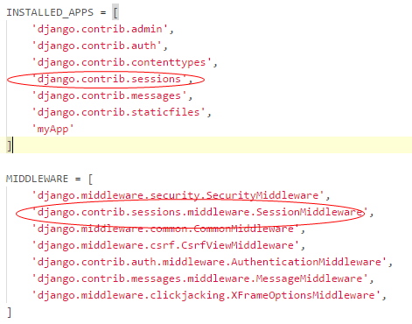
2
3
1
from django.conf.urls import url
from django.contrib import admin
from myApp import views
urlpatterns = [
url(r'^admin/', admin.site.urls),
url(r'^login/$', views.login),
url(r'^index/$', views.index),
]
# -*- coding: utf-8 -*-
from django.shortcuts import render, redirect, HttpResponse
# Create your views here.
# from django.contrib import auth
# from django.contrib.auth.decorators import login_required
from myApp.models import Students,Grades,User
from functools import wraps
6
<body>
<h1>欢迎登录！</h1>
<form action="/login/" method="post">
{% csrf_token %}
<p>
用户名：
<input type="text" name="username">
</p>
<p>
密码：
<input type="text" name="password">
</p>
<p>
<input type="submit" value="登录">
</p>
<hr>
</form>
</body>
4
5
def check_login(f):
@wraps(f)
def inner(request,*arg,**kwargs):
if request.session.get('is_login')=='1':
return f(request,*arg,**kwargs)
else:
return redirect('/login/')
return inner
from django.db import models
class User(models.Model):
username=models.CharField(max_length=16)
password=models.CharField(max_length=32)

Slide 25


第三部分：
Django的特点：
https://www.jianshu.com/p/e37318135a8a
TurboGears的特点：
https://www.leiue.com/what-is-turbogears
第四部分：
Django的优缺点：
https://www.jianshu.com/p/e37318135a8a
TurboGears的优缺点：
https://www.leiue.com/what-is-turbogears
第五部分：
Django和TurboGears的比较：
https://blog.csdn.net/iteye_16821/article/details/81616137
第一部分：
Django的历史背景：
http://www.nowamagic.net/academy/detail/1318216
TurboGears的历史背景：
https://blog.csdn.net/iteye_16821/article/details/81616137
第二部分：
Django的简介：
https://blog.csdn.net/yangsen99/article/details/82505636
TurboGears的简介：
https://www.leiue.com/what-is-turbogears

