Slide 1
Optimizing Machine Learning Workloads with Experiment Databases
Behrouz Derakhshan
behrouz.derakhshan@dfki.de

Slide 2


Motivation
Online data science platforms allow
Write solutions (typically via Jupyter Notebooks)
Share solutions
Learn from existing solutions
Examples
Google Collaboratory
Kaggle
Coursera
Notes:
There are many online platforms that provide users with tools to perform data science. They allow users to write scripts (Jupiter notebooks), execute them on the platform, share them and learn from other peoples solutions.
Some examples are
Collaboratory is an online platform that allows users to write data analysis scripts, it is specifically tailored for tensorflow as it offers GPUs and TPU units for data processing
Kaggle, online data science challenge platform that allows data science competitions to be published the goal of which are typically a machine learning pipeline that should maximize a given evaluation metric. But it also allows users to share their scripts with each other
Lastly, Coursera has assignment submission systems that are also based on Jupyter notebooks where students write the assignments and submit them online

Slide 3
Motivation
Users incorporate existing solutions
Repetition of (similar) operations
Mixed Classifier
(25)
Exploring Survival
(5060)
Best Working Classifier
(1154)
Intro to Ensembling
(6254)
Step-by-step Intro
(202)
Stacking Starter
(112)
Figure 1: Kaggle’s notebook relation¹
1. https://www.kaggle.com/c/titanic
Notes:
The core idea of all of these platforms is to ease the share of knowledge
As a result of this knowledge sharing and working toward solving a common problem, there is going to be a lot of data processing repetition
Example the Kaggle figure

Slide 4
Goal
Efficient design and execution of machine learning (and data science) workloads in collaborative environments
Notes:
My goal is to make the process of design and execution of machine learning and data science workloads in general, in these collaborative environments efficient.

Slide 5
Problem with Existing Solutions
Ignore existing knowledge
Learn by reading
Through Experiment Databases
(e.g., OpenML)
Time Consuming
Experiment
Database
Ignores
intermediate
parts
Time Consuming
workload
workload
workload
workload
Existing
workloads
design
Workload
query
study
knowledge
knowledge
extract meta and publish
publish
design
and optimize
Workload
design
and optimize
Workload
Notes:
Currently there are three ways of approaching this:
Ignore everything
Learn by reading
Time consuming
Experiment databases
Slightly time consuming
Ignores intermediate artifacts

Slide 6
Solution
Workload
Experiment Database
Optimized
workload
design
submit
optimize
Graph
Optimizations:
Reuse
Warmstarting
Improved Hyperparameter tuning
submit
Directed graph
Vertices = artifacts
Edges = operations
Notes:
Our solution:
Use the experiment database to automatically optimize the workload
How we do it:
We represent the information in the experiment database as a graph, which we call an experiment graph, where each node is an artifact, and each edge is an operation and its parameters
When workloads are designed, we first transform them to a graph, nodes are vertices and edges are operations
Then apply these three optimizations, which I will explain next

Slide 7
Reuse Optimization
Edges are uniquely identified
For new workloads, traverse the Experiment Graph
Workload
Experiment Graph
Optimized workload
dataset
dataset
e₁
e₁
e₂
…
…
e₉
e₃
e₄
e₃
e₄
…
…
e₁₁
e₁₀
e₅
e₉
e₅
e₆
…
…
e₁₁
e₁₀
e₇
Improves total execution time
…
Notes:
In reuse, for a given workload we check if any of the operations in the workload has exist in the experiment graph and we use the result of them instead of executing the workload.

Slide 8
Model Warmstarting
Warmstart a training operations with the best model from the same model group
Model group: set of all models (of same type) trained on one artifact
Workload
Experiment Graph
Optimized workload
dataset
dataset
e₁
e₁
e₂
…
…
e₉
e₃
e₄
e₃
e₄
…
…
merge
e₇
e₁₀
e₅
e₉
e₅
e₆
…
e₁₁
merge
…
e₁₁
e₁₀
e₇
Improves total execution time and model quality
…
e₇ and e₁₁ are both model training operations
Notes:
Model warmstarting means to initialize the weight parameters
One Pattern that I saw in many of the workloads in Kaggle and OpenML is that they reuse the same preprocessed data to train models with different hyperparameters.
We call this a model group, which essentially refers to all the models that are the result of different training operations on a node.
However, I’m currently studying in what situation warmstarting is not suitable, since it may lead to local minimas
Another very common pattern is to first analyze the data on a sample and train a model and then move to the original data and do the same analysis. Here we can also do model warmstarting, though the solution is slightly different.
If we have time I can talk about that as well.

Slide 9
Improved Hyperparameter Tuning
Challenges in Hyperparameter tuning
Search space definition (grid, random, and Bayesian tuning)
Requires several initial runs until promising models are trained (Bayesian tuning)
Experiment Graph
…
…
…
Model
group
{
…
…
Extract
Hyperparameters
Improves total execution time and model quality
Hyperparameters
Propose search space
Propose new/existing hyperparameters
Initialize Bayesian tuning
Bayesian Model
Notes:
In hyperparameter tuning, several models with different hyperparameters are trained and the best performing model is returned as the final solution.
There are two challenges in hyperparameter tuning:
The search space of the hyperaprameters have to be specified beforehand, however, there is no golden rule for defining the appropriate space and typically they proper values are defined through trial and error or experience
The second issue, which is specific to the Bayesian hyperparameter tuning, is that it requires many initial steps until it starts to provide promising hyperparameter values. Which increase the execution time of an already long process.
We utilize the experiment graph to address these two challenges.
With enough time passed, we have access to hundred or thousands of models with hyperparameter values and how each one has performed.
For each model group, we extract all the hyperparameters and the performance of the model using those hyperparameters. Moreover, for every model group we start a Bayesian tuning process in the background and update it whenever a new model is trained.
The users can interact with these components using three different methods.
Propose search space
Propose a new hyperparameter or the best existing one
If user is doing Bayesian tuning, we can initialize the process so it starts providing promising results faster

Slide 10
Progress
Mar18–Aug18: Initial experiments and first draft of Experiment Databases paper
Aug18-Oct18: Submission of Continuous Deployment Paper to EBDT 2019
Dec19: Acceptance of Continuous Deployment paper at EDBT 2019
Nov19-Feb19: Prototype including Pandas and Scikit-learn

Slide 11
Next Steps
Feb19-May19: Finalize the paper
When to reuse
When to warmstart
Feb19-May19: Finalize the experiments
2 Kaggle Challenges
Entire OpenML (scikit-learn pipelines)
May19 or Jul19: Submit to VLDB 2020
Aug19-Oct19: On leave
Oct19-Jun20: Distributed Experiment Graph and Automatic Machine Learning
Jul20: Submit the next work to VLDB/SIGMOD 2021

Slide 12
Summary
design
Workload
submit
Experiment Database
optimize
Optimized
workload
Optimizing machine learning workloads in collaborative environments by
Reuse
Model warmstarting
Improved Hyperparameter tuning
By using a graph representation of the database
Graph Construction
Materialization Strategy
Graph
Optimizations:
Reuse
Warmstarting
Improved Hyperparameter tuning
submit
Experiment Graph
Workload
dataset
dataset
e₁
e₂
Optimized workload
e₁
…
…
e₃
e₄
e₃
e₄
…
…
e₅
e₆
e₉
e₅
e₉
…
…
e₇
e₇
merge
e₁₀
e₁₁
e₁₀
…
e₁₁
merge
Hyperparameters
Bayesian Models

Slide 13
References
https://data.world
https://colab.research.google.com
https://www.kaggle.com/
https://www.coursera.org/
Vanschoren, Joaquin, et al. "OpenML: networked science in machine learning." ACM SIGKDD Explorations Newsletter15.2 (2014): 49-60.
Vartak, Manasi, et al. "Model DB: a system for machine learning model management." Proceedings of the Workshop on Human-In-the-Loop Data Analytics. ACM, 2016.
Hutter, Frank, Holger H. Hoos, and Kevin Leyton-Brown. "Sequential model-based optimization for general algorithm configuration." International Conference on Learning and Intelligent Optimization. Springer, Berlin, Heidelberg, 2011.
Jasper Snoek, Hugo Larochelle, and Ryan P Adams. Practical bayesian optimization of machine learning algorithms In Advances in neural information processing systems, pages 2951–2959, 2012.
Bergstra, James, and Yoshua Bengio. "Random search for hyper-parameter optimization." Journal of Machine Learning Research 13.Feb (2012): 281-305.
Vartak, Manasi, et al. "MISTIQUE: A System to Store and Query Model Intermediates for Model Diagnosis." Proceedings of the 2018 International Conference on Management of Data. ACM, 2018.
Souvik Bhattacherjee, Amit Chavan, Silu Huang, Amol Deshpande, and Aditya Parameswaran. Principles of dataset versioning: Exploring the recreation/storage tradeo. Proceedings of the VLDB Endowment, 8(12):1346–1357, 2015.

Slide 14
Scope of the optimizations
Optimizations are limited to a task
A task defines the goal of the machine learning or data science work
Examples of tasks and workloads:
A competition on the Kaggle,
An assignment in Coursera
Each task is associated with one connected component in the experiment graph
Notes:
Task specifies the collective goal of all the parties involved in the collaborative environment
So in the rest of this talk, when I mention experiment graph, I essentially mean the connected component that is associated for the specific task and workloads we are trying to optimize

Slide 15
Initial Experiments
OpenML Pipelines
Reuse Optimization
id | operations | #exec
5981 | Impute→ Scale → logistic regression | 11
7707 | Impute → Onehot encode → Scale → Variance Threshold → SVM | 594
8315 | Impute → Onehot encode → Variance Threshold → Random Forest | 1084
8353 | Impute → Onehot encode → Variance Threshold → SVM Forest | 1000
8568 | Impute → Onehot encode → Variance Threshold → Random Forest | 555
Notes:
Effect of the reuse optimization on the total number of executed transformations (top) and the total execution time (bottom) for every OpenML pipeline

Slide 16
Model warm-starting Optimizations
(a) Total training time (#5981)
(a) Total iteration count (#5981)
(a) Total training time (#8568)
Effect of the warm-starting optimization on the total training time and iteration count. In (a) and (b) we train 11 logistic regression models and in (c) we train 555 random forest model from the configurations that exist in the experiment data.

Slide 17
Bayesian hyperparameter search
Initialize Bayesian search with values from the experiment database
The figure shows the loss value gained for a Bayesian tuning process with budget of 100 (with/without initialization)
Initialization

Slide 18
Progress
Implementation
Questions
Promising initial experiment results
Prototype of Experiment Graph with Pandas dataframes and scikit-learn
Experiments on Kaggle use case
Home Credit Default Risk (In progress)
Another competition
Single node with a large memory or a cluster
Are these experiments adequate
OpenML
2 Kaggle competitions
Notes:
The way I see the the worklflow in platforms like Kaggle, is users are given a docker container or a virtual machine with a limited memory and computation power and they can run their scripts. And my current assumption is individual workloads are not big enough that require a cluster of nodes you have max 2-3 gb of data and would like to train a machine learning model on it
Two ways to do the experiments are,
Either use one single node with a large memory and where the experiment graph resizes on the node memory
Or use a cluster of nodes for storing the graph, but each individual script is still executed on one node
Method 1 is much easier since I don’t need to use a distributed graph database, and I can simply use the existing python code that I have.

Slide 19




Modes of Operation
Remote Experiment Graph
Single Node
Experiment Graph
Experiment Graph
workloads
containers
workloads
Compute nodes or containers

Slide 20
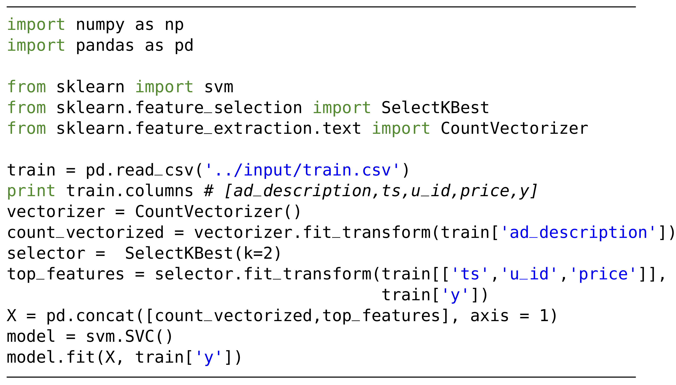
Graph Representation
Example script
Graph Representation
train
project
project
project
count_vectorizer
select_k_best(2)
merge
merge
merge
concat
merge
fit_SVM
merge operation:
Logical operation with a run time of 0 that combines two nodes

Slide 21
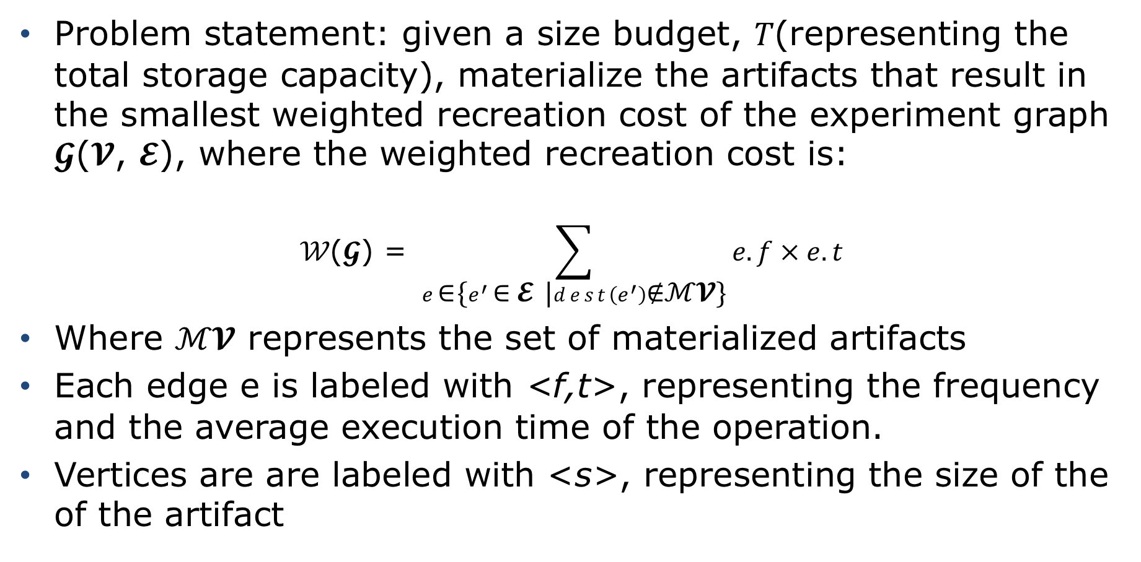
Materialization of Artifacts
Problem statement: given a size budget, 𝑇(representing the total storage capacity), materialize the artifacts that result in the smallest weighted recreation cost of the experiment graph 𝓖(𝓥, 𝓔), where the weighted recreation cost is:
$$\text{𝒲}\text{(}\text{𝓖}\text{) = }\sum_{e \text{∈} \text{\{}e^{′} \text{∈} \text{𝓔} \text{|}dest\left(e^{′}\right)\text{∉}\text{ℳ}\text{𝓥}\text{\}}}{e.f × e.t}$$
Where $\text{ℳ}\text{𝓥}$ represents the set of materialized artifacts
Each edge e is labeled with <f,t>, representing the frequency and the average execution time of the operation.
Vertices are are labeled with <s>, representing the size of the of the artifact

Slide 22
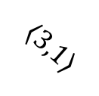
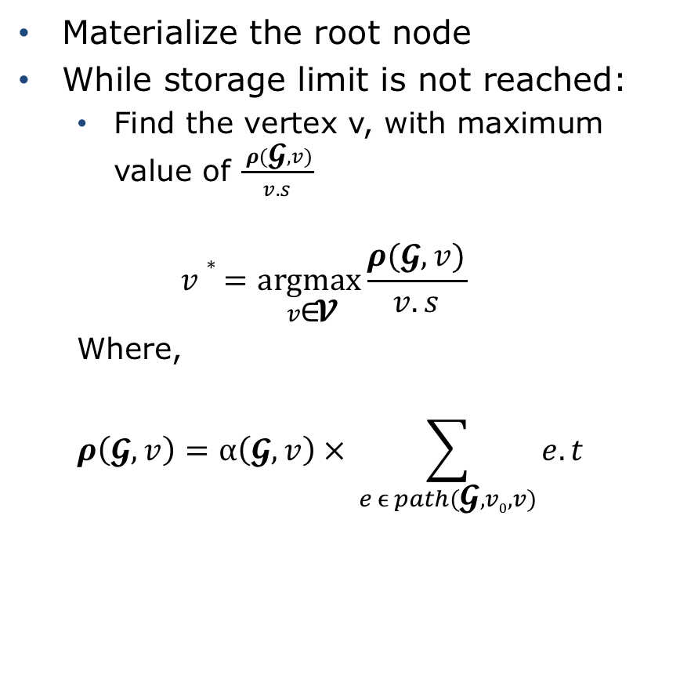

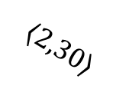

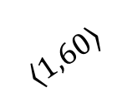
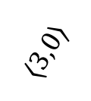

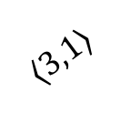
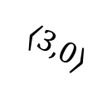
Materialization of Artifacts
Materialize the root node
While storage limit is not reached:
Find the vertex v, with maximum value of $\frac{ ρ(\text{𝓖}, v)}{v.s}$
$$v∗=\underset{v\text{∈}\text{𝓥}}{argmax}{\frac{ρ(\text{𝓖}, v)}{v.s}}$$
Where,
$$ρ\left(\text{𝓖}, v\right)=⍺\left(\text{𝓖}, v\right) × \sum_{e ϵ path(\text{𝓖}, v0,v)}{e.t}$$
10
$$〈3,1⟩$$
$$〈3,1⟩$$
8
2
$$〈3,25⟩$$
$$〈2,25⟩$$
$$〈3,0⟩$$
40
1
$$〈3,0⟩$$
42
$$〈3,20⟩$$
30
$$〈1,60⟩$$
$$〈2,30⟩$$
2
3
Notes:
For each vertex, we assume the vertex is not materialized and how much time do we save by materializing, which how many time has it been accessed multiplied by how long does it take to recreate it all the way from the root node.

Slide 23


Materialization of Artifacts
$$T=10$$
$$max size=55$$
10
$$〈3,1⟩$$
$$〈3,1⟩$$
8
2
$$〈3,25⟩$$
$$〈2,25⟩$$
$$〈3,0⟩$$
40
1
$$〈3,0⟩$$
42
$$〈3,20⟩$$
30
$$〈1,60⟩$$
$$〈2,30⟩$$
2
3
Notes:
For each vertex, we assume the vertex is not materialized and how much time do we save by materializing, which how many time has it been accessed multiplied by how long does it take to recreate it all the way from the root node.

Slide 24



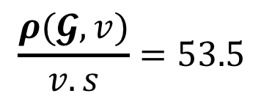
Materialization of Artifacts
$$T=10$$
$$max size=55$$
10
$$v.s=2$$
$$〈3,1⟩$$
$$〈3,1⟩$$
$$T+v.s<max size$$
8
2
$$〈3,25⟩$$
$$〈2,25⟩$$
$$ρ\left(\text{𝓖}, v\right)=1×\left(1+1+25+0+0+20+60\right)=107$$
$$〈3,0⟩$$
$$\frac{ρ(\text{𝓖}, v)}{v.s}=53.5$$
40
1
$$〈3,0⟩$$
42
$$〈3,20⟩$$
$$⍺\left(\text{𝓖}, v\right)$$
30
$$〈1,60⟩$$
$$〈2,30⟩$$
2
3
Notes:
For each vertex, we assume the vertex is not materialized and how much time do we save by materializing, which how many time has it been accessed multiplied by how long does it take to recreate it all the way from the root node.

Slide 25




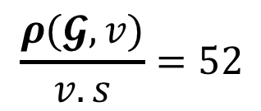
Materialization of Artifacts
$$T=12$$
$$max size=55$$
10
$$v.s=1$$
$$〈3,1⟩$$
$$〈3,1⟩$$
$$T+v.s<max size$$
8
2
$$〈3,25⟩$$
$$⍺\left(\text{𝓖}, v\right)$$
$$ρ\left(\text{𝓖}, v\right)=2×\left(1+25\right)=52$$
$$〈2,25⟩$$
$$〈3,0⟩$$
$$\frac{ρ(\text{𝓖}, v)}{v.s}=52$$
40
1
$$〈3,0⟩$$
42
$$〈3,20⟩$$
30
$$〈1,60⟩$$
$$〈2,30⟩$$
2
3
Notes:
For each vertex, we assume the vertex is not materialized and how much time do we save by materializing, which how many time has it been accessed multiplied by how long does it take to recreate it all the way from the root node.

Slide 26



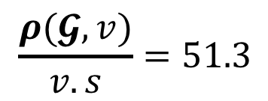
Materialization of Artifacts
$$T=13$$
$$max size=55$$
10
$$v.s=3$$
$$〈3,1⟩$$
$$〈3,1⟩$$
$$T+v.s<max size$$
8
2
$$〈3,25⟩$$
$$〈2,25⟩$$
$$ρ\left(\text{𝓖}, v\right)=2×\left(1+1+25+0+20+30\right)=154$$
$$〈3,0⟩$$
$$\frac{ρ(\text{𝓖}, v)}{v.s}=51.3$$
40
1
$$〈3,0⟩$$
42
$$〈3,20⟩$$
$$⍺\left(\text{𝓖}, v\right)$$
30
$$〈1,60⟩$$
$$〈2,30⟩$$
2
3
Notes:
For each vertex, we assume the vertex is not materialized and how much time do we save by materializing, which how many time has it been accessed multiplied by how long does it take to recreate it all the way from the root node.

Slide 27



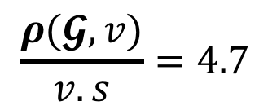
Materialization of Artifacts
$$T=16$$
$$max size=55$$
10
$$v.s=30$$
$$〈3,1⟩$$
$$〈3,1⟩$$
$$T+v.s<max size$$
8
2
$$〈3,25⟩$$
$$〈2,25⟩$$
$$ρ\left(\text{𝓖}, v\right)=3×(1+1+25+0+0+20)=141$$
$$〈3,0⟩$$
$$\frac{ρ(\text{𝓖}, v)}{v.s}=4.7$$
40
1
$$〈3,0⟩$$
42
$$⍺\left(\text{𝓖}, v\right)$$
$$〈3,20⟩$$
30
$$〈1,60⟩$$
$$〈2,30⟩$$
2
3
Notes:
For each vertex, we assume the vertex is not materialized and how much time do we save by materializing, which how many time has it been accessed multiplied by how long does it take to recreate it all the way from the root node.

Slide 28




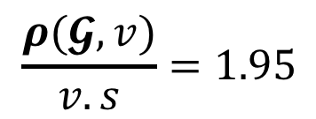
Materialization of Artifacts
$$T=46$$
$$max size=55$$
10
$$v.s=40$$
$$〈3,1⟩$$
$$〈3,1⟩$$
$$T+v.s<max size$$
$$⍺\left(\text{𝓖}, v\right)$$
8
2
$$〈3,25⟩$$
$$〈2,25⟩$$
$$ρ\left(\text{𝓖}, v\right)=3×(1+25)=78$$
$$〈3,0⟩$$
$$\frac{ρ(\text{𝓖}, v)}{v.s}=1.95$$
40
1
$$〈3,0⟩$$
42
$$〈3,20⟩$$
30
$$〈1,60⟩$$
$$〈2,30⟩$$
2
3
Notes:
For each vertex, we assume the vertex is not materialized and how much time do we save by materializing, which how many time has it been accessed multiplied by how long does it take to recreate it all the way from the root node.

Slide 29



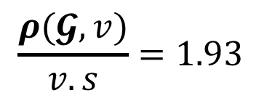
Materialization of Artifacts
$$T=46$$
$$max size=55$$
10
$$v.s=42$$
$$〈3,1⟩$$
$$〈3,1⟩$$
$$T+v.s<max size$$
8
2
$$〈3,25⟩$$
$$⍺\left(\text{𝓖}, v\right)$$
$$〈2,25⟩$$
$$ρ\left(\text{𝓖}, v\right)=3×(1+1+25+0+0)=81$$
$$〈3,0⟩$$
$$\frac{ρ(\text{𝓖}, v)}{v.s}=1.93$$
40
1
$$〈3,0⟩$$
42
$$〈3,20⟩$$
30
$$〈1,60⟩$$
$$〈2,30⟩$$
2
3
Notes:
For each vertex, we assume the vertex is not materialized and how much time do we save by materializing, which how many time has it been accessed multiplied by how long does it take to recreate it all the way from the root node.

Slide 30


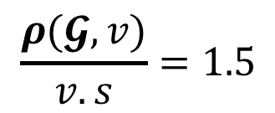
Materialization of Artifacts
$$T=46$$
$$max size=55$$
$$⍺\left(\text{𝓖}, v\right)$$
10
$$v.s=2$$
$$〈3,1⟩$$
$$〈3,1⟩$$
$$T+v.s<max size$$
8
2
$$〈3,25⟩$$
$$〈2,25⟩$$
$$ρ\left(\text{𝓖}, v\right)=3×(1)=3$$
$$〈3,0⟩$$
$$\frac{ρ(\text{𝓖}, v)}{v.s}=1.5$$
40
1
$$〈3,0⟩$$
42
$$〈3,20⟩$$
30
$$〈1,60⟩$$
$$〈2,30⟩$$
2
3
Notes:
For each vertex, we assume the vertex is not materialized and how much time do we save by materializing, which how many time has it been accessed multiplied by how long does it take to recreate it all the way from the root node.

Slide 31



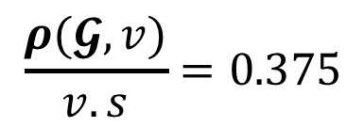
Materialization of Artifacts
$$T=48$$
$$max size=55$$
$$⍺\left(\text{𝓖}, v\right)$$
10
$$v.s=8$$
$$〈3,1⟩$$
$$〈3,1⟩$$
$$T+v.s<max size$$
8
2
$$〈3,25⟩$$
$$〈2,25⟩$$
$$ρ\left(\text{𝓖}, v\right)=3×(1)=3$$
$$〈3,0⟩$$
$$\frac{ρ(\text{𝓖}, v)}{v.s}=0.375$$
40
1
$$〈3,0⟩$$
42
$$〈3,20⟩$$
30
$$〈1,60⟩$$
$$〈2,30⟩$$
2
3
Notes:
For each vertex, we assume the vertex is not materialized and how much time do we save by materializing, which how many time has it been accessed multiplied by how long does it take to recreate it all the way from the root node.

