Slide 1
Optimization of Machine Learning Workloads with Experiment Databases
Behrouz Derakhshan
Behrouz.derakhshan@dfki.de

Slide 2
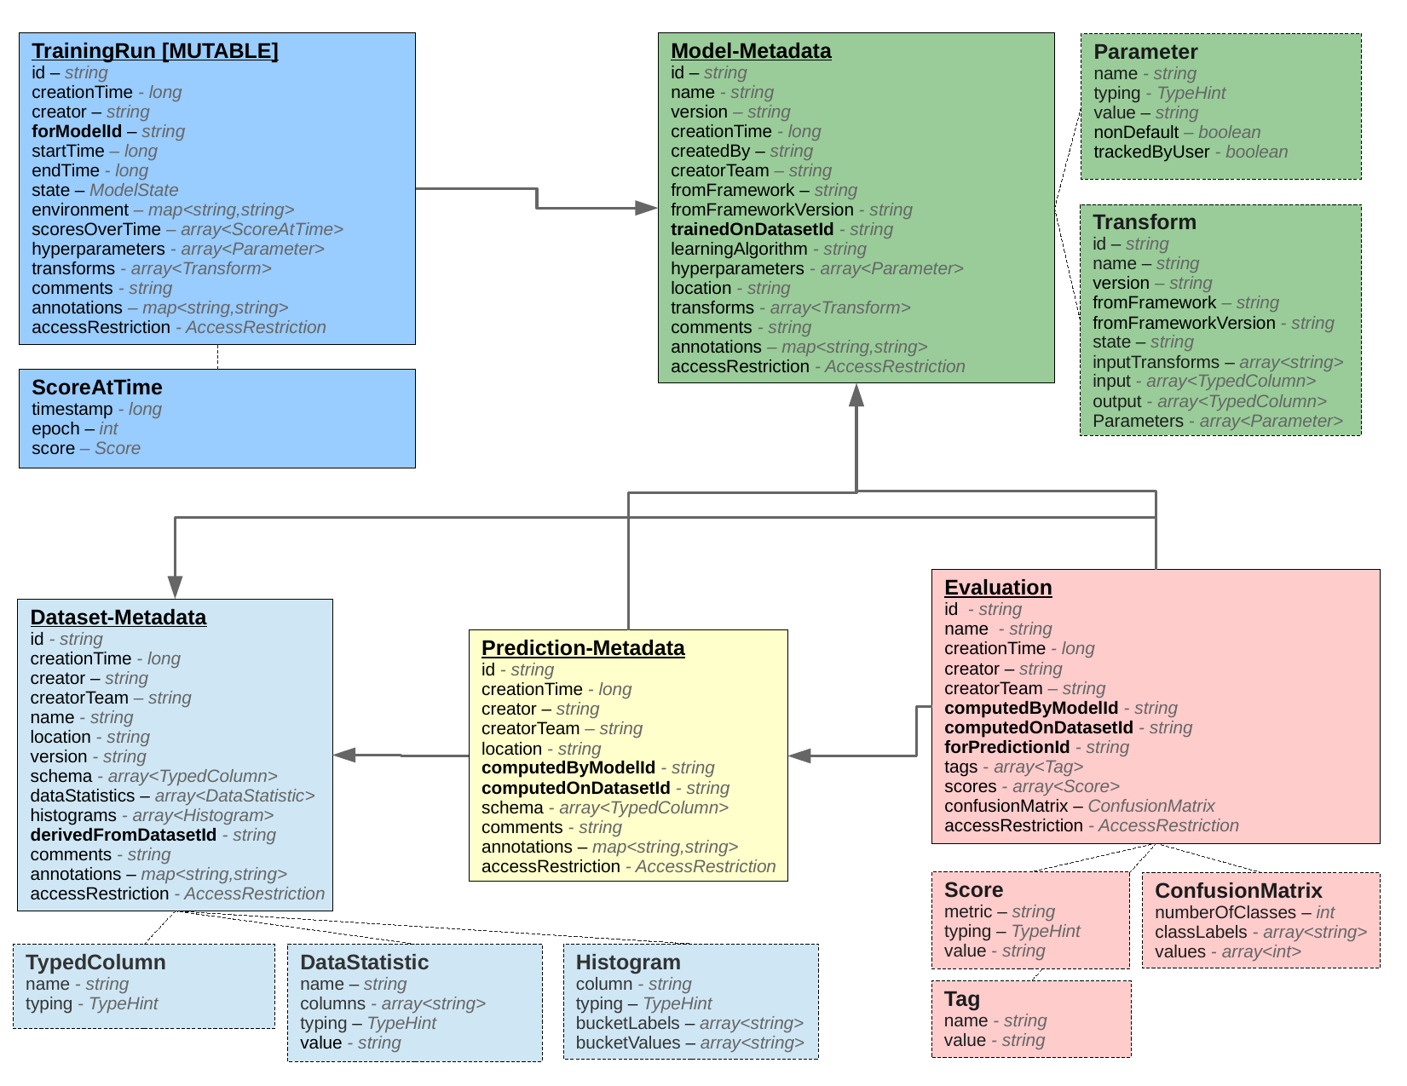
Experiment Database (ED)
Contains meta-data of machine learning experiments about the datasets, models, transformations, and evaluations
Based on [1]
Workload Optimizations using ED:
Reuse of existing models
Materialization of transformed datasets
Multi-query optimization
Warm-starting
Efficient data transformation
Efficient hyper-parameter tuning
Efficient multi-model training
Database schema for storing declarative description of machine learning experiments [1]

Slide 3
Categories of Machine Learning Workloads
Next paper
Future Work
1. Interactive batch workload
2. Incremental Training Workload
3. Continuous Training Workload
Description:
Multi-user (from tens to thousands of users)
Primarily consists of repeated data preprocessing and data transformations
Aggressive Hyper-parameter tuning and model evaluation
Optimizations using ED:
Reuse
Materialization
Multi-query optimization
Warm-starting
Decreasing the search space of hyper-parameters
Description:
Multi-user (tens of users)
Incremental improvement of existing data processing pipelines and ML models
Retrain models and pipelines (typically daily)
Optimizations using ED:
Speed up in data transformation
Decreasing the search space of hyper-parameters
Multi-model training
Warm-starting
Description:
Real-time (or near real-time) data processing
Online ML models
Optimizations using ED:
Speed up in data preprocessing
Multi-model training
Fast detection of model quality degradation

Slide 4
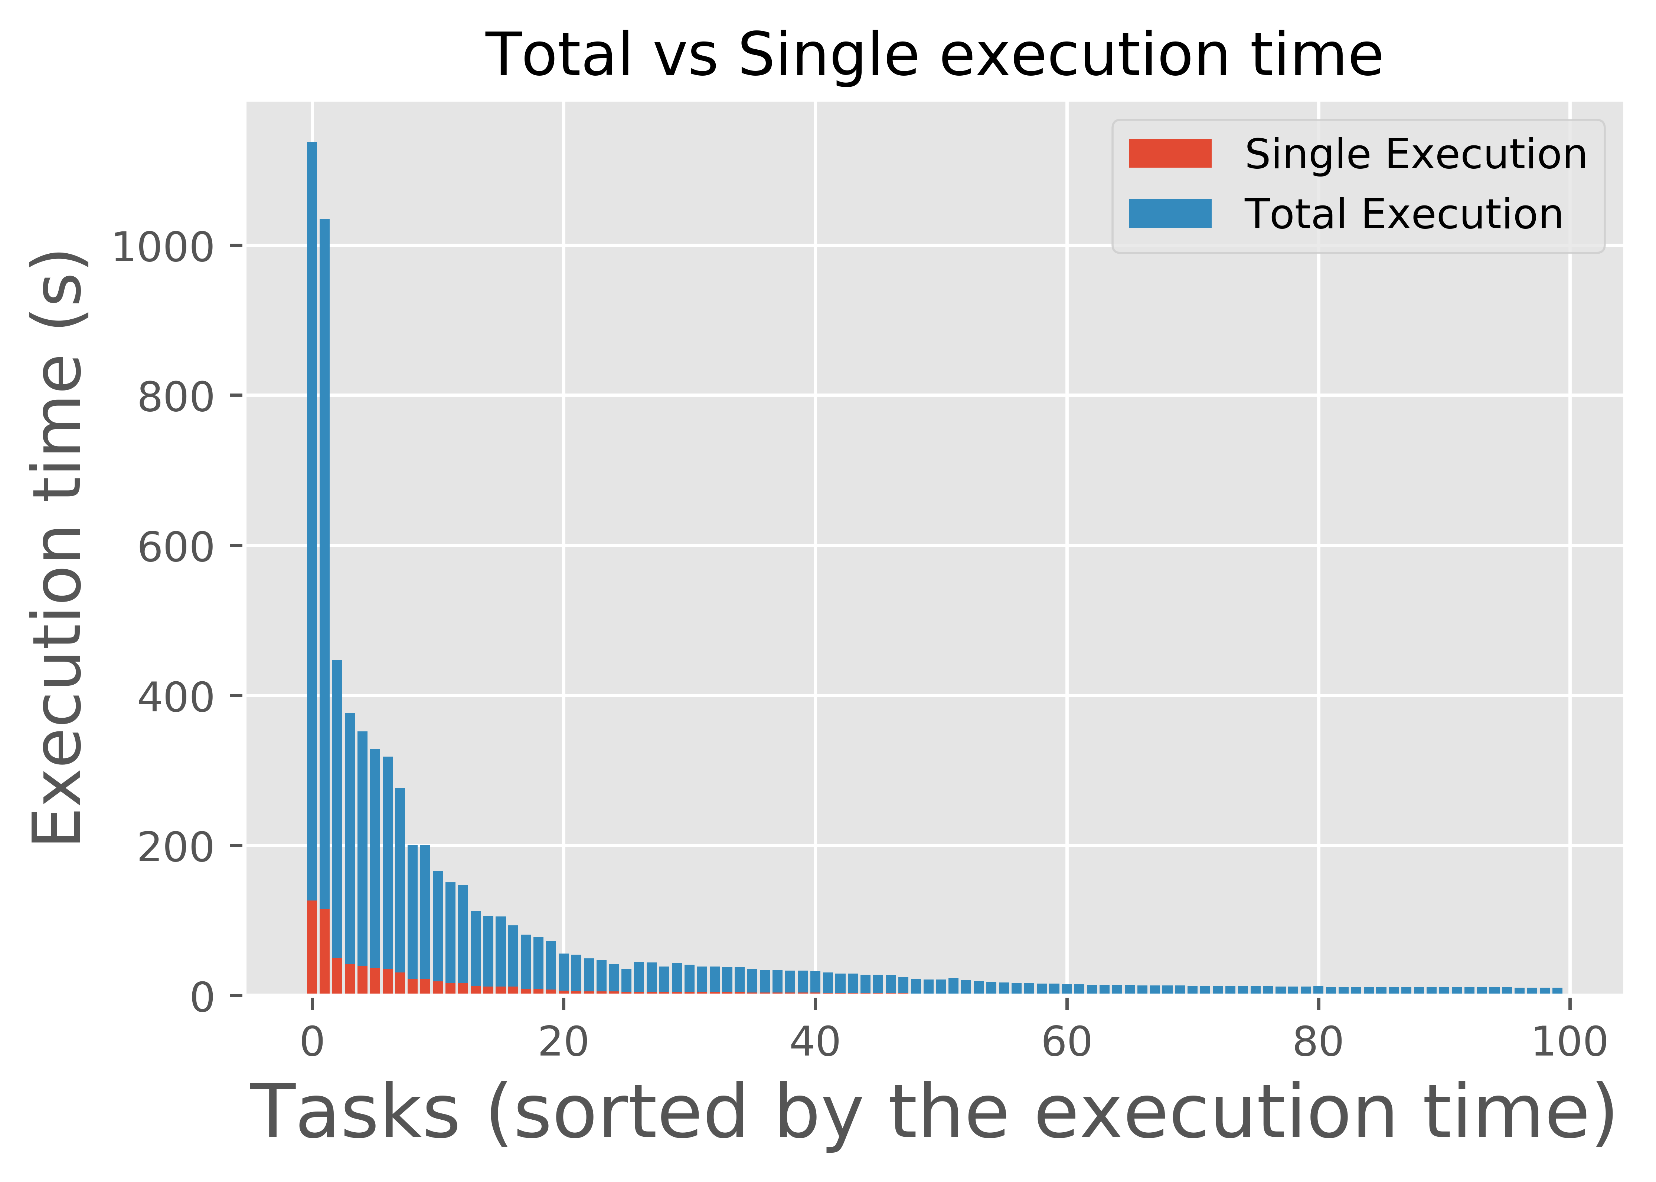
Plan for next Paper
VLDB 2018 (Deadline: 1st of March)
Focus on Workload 1 (Interactive batch)
Plan:
Develop a simple database based on [1]
Experiments:
Focus only on a few frameworks (scikit-learn, R mlr package)
Popular Kaggle competitions [3], OpenML datasets and tasks [2]
I expect a reduction in the processing time and the development time
I currently have a paper under review for SIGMOD2018. Depending on the result of the review, this work may have to be pushed back to SIGMOD2019/VLDB2019
Early Results:
The Most popular pipeline in OpenML (scikit-learn) consists of:
Missing Value Imputer
Dimensionality reduction using PCA
Random Forest Classifier
It is repeatedly executed on 100 different tasks (average of 9 times on each task)
Figure below shows that a simple reuse can save about 2 hours of processing time
This figure may include executions performed by bots, therefore, we cannot reach a conclusion about the reduction on the development time

Slide 5
References
[1] Sebastian Schelter, Joos-Hendrik Böse, Johannes Kirschnick, Thoralf Klein, Stephan Seufert, Automatically Tracking Metadata and Provenance of Machine Learning Experiments, Machine Learning Systems workshop at the conference on Neural Information Processing Systems (NIPS) 2017
[2] https://www.openml.org/
[3] https://www.kaggle.com/

