Slide 1
Optimizing Machine Learning Workloads in Collaborative Environments
Behrouz Derakhshan, Alireza Rezaei Mahdiraji, Ziawasch Abedjan, Tilmann Rabl, and Volker Markl

Slide 2
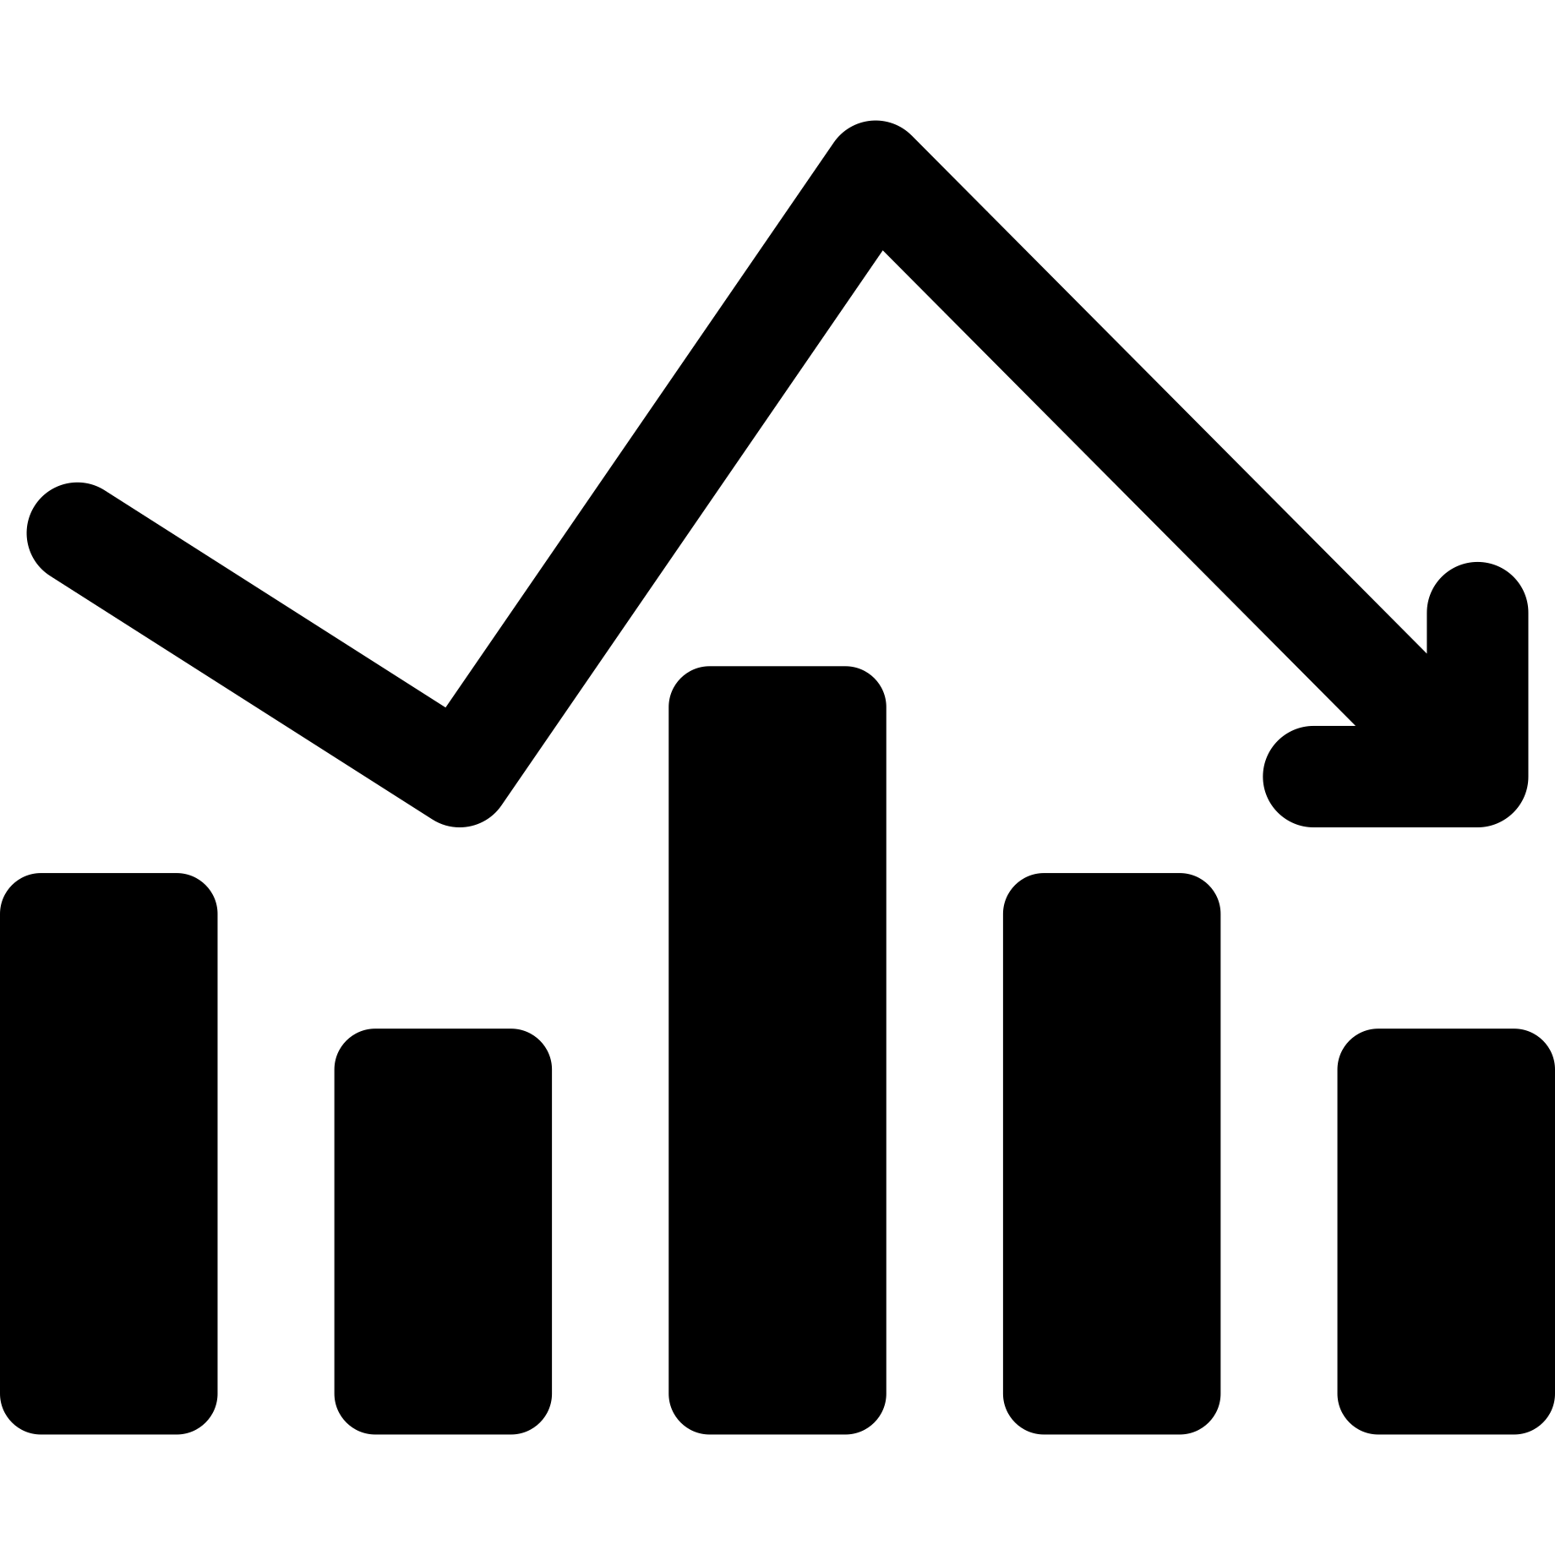











Introduction
Math and Statistics
Computer Science
Domain Knowledge
Data Science and Machine Learning
Data Science and ML Toolkit
High-quality DS and ML applications require effective collaboration
Notes:
THE BEGINNING FEW SLIDES (UNTIL SLIDE 4) IS A BIT RUSHED. WE SHOULD ADJUST THE TIME AND SPENT AN EXTRA MINUTE HERE
DS and ML are interdisciplinary
There are 10s of tools and softwares
Becoming an expert in all of them is difficulty and even impossible
High quality DS and ML application require effective collaboration

Slide 3





Collaborative DS and ML
Jupyter Notebooks enable sharing code and results
Containerized environments enable execution and deployment of the notebooks
[1]
Platforms, such as Google Colab and Kaggle, enable effective collaboration among data scientists
[2]
[3]
https://www.docker.com/
https://colab.research.google.com/
https://www.kaggle.com/

Slide 4
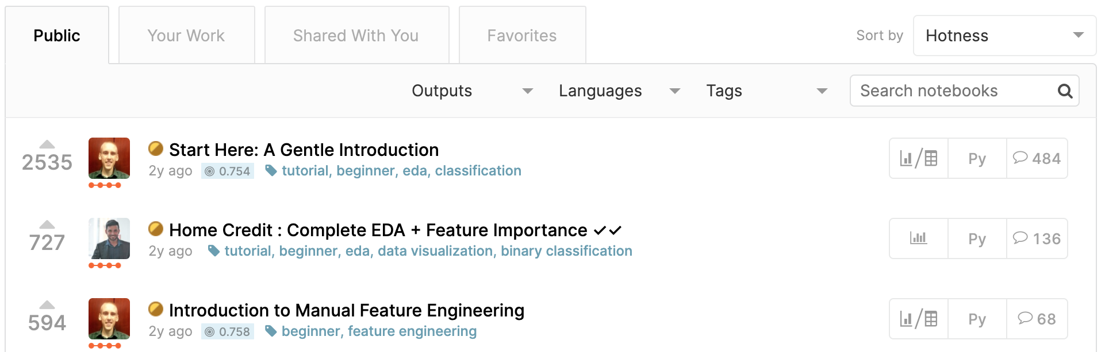
Problems
Lack of generated data artifacts management
Re-execution of existing notebooks
Top 3 notebooks of Home Credit Default Risk Kaggle Competition¹ generate
100s GBs of intermediate data artifact and are copied 10,000 times
Lack of data management in existing collaborative environment leads to 1000s of hours of redundant data processing and model training
https://www.kaggle.com/c/home-credit-default-risk
Notes:
A problem is lack of management of the generated data artifacts
The scripts contains hundreds of intermediate data artifacts
If users want to use one of these artifacts, they have to re-execute the entire notebook
Top 3 notebooks of a Kaggle competition generates more than 100 GB artifacts of intermediate artifacts and are copied 10000 times
Message
55 seconds

Slide 5

Collaborative ML Workload Optimizer
ML Workload
Client
Experiment Graph
Union of all the Workload DAGs
Vertices: data artifacts
Edges: operations
Materializer
Store data artifacts with high-likelihood of future reuse
Optimizer
Linear-time reuse algorithm
Finds optimal execution DAG
A
Parser
Workload DAG
Executor
Annotated DAG
B
1
2
5
1
Optimized DAG
Server
C
Optimizer
Materializer
C
B
Experiment Graph
A
Notes:
2:30
Collaborative ML Optimizer that can be integrated into existing collaborative platforms
On the client side (which can be inside the containers) we parse the workload script into a DAG
On the server side we optimize the workload via materialization and reuse
Specifically, 3 contributions
EG = union of all the workload dags
A materializer component to decide what artifacts to store, this is important as stated earlier the size of the artifacts are large and materializing everything is not possible
An optimizer that offers a reuse algorithm for finding the optimal execution DAG
1 minute

Slide 6
Collaborative ML Workload Optimizer
ML Workload
Client
Experiment Graph
Union of all the Workload DAGs
Vertices: data artifacts
Edges: operations
Materializer
Store data artifacts with high-likelihood of future reuse
Optimizer
Linear-time reuse algorithm
Finds optimal execution DAG
Parser
Extensible APIs
Integration with other Python packages
A
Parser
D
B
Workload DAG
Executor
Annotated DAG
1
2
5
C
1
Optimized DAG
Server
Optimizer
Materializer
D
C
B
Experiment Graph
A

Slide 7
DAG Construction
Source vertex
train
train = pd.read_csv('train.csv') # [ad_desc,ts,u_id,price,y]
ad_desc = train['ad_desc']
vectorizer = CountVectorizer()
count_vectorized = vectorizer.fit_transform(ad_desc)
print count_vectorized.head()
selector = SelectKBest(k=2)
t_subset = train[['ts','u_id','price']]
y = train['y']
top_features = selector.fit_transform(t_subset, y)
model_1 = svm.SVC().fit(top_features, y)
print model_1 # terminal vertex
X = pd.concat([count_vectorized,top_features], axis = 1)
model_2 = svm.SVC().fit(X, y)
print model_2 # terminal vertex
ad_desc
t_subset
y
Operation
cnt_vect
top_feats
model_1
cnt_head
X
Terminal
vertex
model_2
Terminal
vertex
Notes:
3:30
Source vertex
Terminal Vertex
Operations are edges
50 seconds

Slide 8
DAG Annotation
50 MB
Edge run-time
0.91
train
40 MB
0.1 s
0.1 s
Vertex size
0.05 s
5 MB
0.9
0.91
ad_desc
t_subset
y
Vertex potential
Quality of the best reachable model
5 MB
5 s
2 s
0.91
3 MB
0.91
3 s
Model
Quality
10 MB
cnt_vect
top_feats
0.9
3 s
Accuracy=0.91
0.05 s
Model
Quality
model_1
0.1 s
0.1 s
4 s
1.5 MB
0.5 MB
cnt_head
X
0.91
0.0
Model
Quality
4 s
23 MB
0.9
Model
Quality
model_2
Accuracy=0.9
2 MB
0.9
Notes:
4:20
After a DAG is executed we annotate it
Operator run time on edge
Size of the artifact on vertex
Potential on vertex
50 seconds

Slide 9
Materialization Problem
Given a storage budget, materialize a subset of the artifacts in order to minimize the recreation cost
Challenges:
Future workloads are unknown
Even if future workloads are known a priori, the problem is NP-Hard (Bhattacherjee, 2015)
Accommodating large graphs and fast number of incoming workloads
Notes:
5:10
Artifacts could be very large, we stated earlier 100s
Given a budget, select a subset
Challenges:
Unknown future workloads
NP hard
Large and fast incoming workloads typical in colab env
40 seconds

Slide 10
Materialization Algorithm
Server
run-time
For every artifact compute a utility value: size frequency
potential
Client
50,91
0.1
0.1
0.1
40,0.9
5,0.91
5,0.91
5
2
3
Materializer
Experiment Graph
10,0.9
3,0.91
3
0.05
0.1
0.1
1.5,0.91
0.5,0.0
23,0.9
4
4
2,0.9
Materialized artifact
Un-materialized artifact
Notes:
5:50
Mat algorithm assigns utility which has inverse relationship with size
penalize size
But large run-time means costly to execute therefore materializing it is beneficial
High frequency in the past indicates future reuse
High potential means could lead to high-quality models and can be reused by other users

Slide 11
Materialization Algorithm
Server
run-time
For every artifact compute a utility value: size frequency
potential
Client
50,91
0.1
0.1
0.1
40,0.9
5,0.91
5,0.91
5
2
3
Materializer
Experiment Graph
10,0.9
3,0.91
3
0.05
0.1
0.1
1.5,0.91
Meta-data is always stored in EG
① Artifact size ③ Frequency
② Operator run-time ④ Potential
0.5,0.0
23,0.9
4
4
2,0.9
Materialized artifact
Un-materialized artifact
Notes:
Mat algorithm assigns utility
For every generated artifact yes/no
Meta data is always stored

Slide 12
Storage-aware Materialization
Many duplicated columns in intermediate data artifacts
Apply column deduplication strategy
train = pd.read_csv('train.csv') # [ad_desc,ts,u_id,price,y]
ad_desc = train['ad_desc‘]
t_subset = train[['ts','u_id','price‘]]
y = train['y']
train
ad_desc
t_subset
y
Storage-aware Materialization
while budget is not exhausted:
1. run materialization algorithm
2. deduplicate the materialized artifacts
3. update the size of unmaterialized artifact
Improves Storage utilization and Run-time
Notes:
6:50
ML data artifacts tend to have many duplicated columns
Example
We improve our materialization algorithm by adding a deduplication phase to our materialization algorithm
Which is as follows:
Run mat algo
Deduplicate, which reduces the size of the materializied artifacts and allowing us to materialize more
We iteratively perform these steps until the budget is fully exhausted
Improvement
1 minute

Slide 13
Reuse Problem
Given EG and a new workload, find the set of workload artifacts to reuse from EG and the set of artifact to compute
Challenges:
Exponential time complexity of exhaustive search
Accommodating large graphs and fast number of incoming workloads, state-of-the-art has polynomial time complexity 𝓞(|𝒱|.|𝘌|²) (Helix, 2018)
Notes:
7:50
Given the EG and the materialized artifacts
For a new workloads, find the optimal plan
i.e., load from eg, or compute in the client
Challenges:
50 seconds

Slide 14
Reuse Algorithm
A linear-time algorithm to compute optimal execution plan with a forward and backward pass on the workload DAG
train_2
train
t_subset
y
top_feats_2
top_feats
merged_feats
Materialized artifact
Un-materialized or do not exist in EG
model_3
Notes:
8:40
Linear time algorithm to compute in two passes
A new workload that has a new dataset train 2 and the existing data set
Combines them and trains a model
The marked vertices are materialized
40 seconds

Slide 15
Reuse Algorithm (Forward-pass)
Forward-pass
load cost = 0.06
Load < Acc
Load > Acc
Traverse from the source
Accumulate run-times
For every materialized node compare the accumulated run-time with the load-time
train
train_2
train
train_2
Acc = 0.1
Acc = 0.05
t_subset
t_subset
y
y
top_feats_2
top_feats_2
Acc = 2.1
top_feats
top_feats
merged_feats
merged_feats
Materialized artifact
Load < Acc
Un-materialized or do not exist in EG
Artifacts to execute
model_3
load = 1.5
model_3
Artifacts to load
Notes:
9:20
We start traversing and accumulate the run-times as we go along the edges
Any source node that is materialized such as train, we load it from the experiment graph
Any artifact that does not exist in EG (such as the ones from the new workloads), we need to execute them
For remaining workloads, we can decide whether to execute or load
If load time is greater than accumulate run time, then we execute since it is the less costly alternative
If load time is smaller than accumulate run time, then we load them from the experiment graph
At the end we end up with such a dag.
However, some nodes can be pruned
1:20

Slide 16
Reuse Algorithm (Backward-pass)
Backward-pass
Traverse backward from the terminal
For every loaded artifact, stop the traversal of its parents
Prune artifacts that are not visited
train
Stop Traversal
train_2
train
train_2
X
X
t_subset
t_subset
y
y
top_feats_2
top_feats_2
X
top_feats
top_feats
merged_feats
merged_feats
Artifacts to prune
Artifacts to execute
model_3
model_3
Artifacts to load
Notes:
10:40
We traverse backward from the terminals
For every loaded artifacts such these two, we stop the traversal of their parents.
Since the artifacts are loaded we don’t need their parents to compute them and can prune them
The final dag after backward pass looks like this
30 seconds

Slide 17
Evaluation
Workload
Baseline
Kaggle
Kaggle Home Credit Default Risk¹ Competition
9 source datasets
5 real and 3 generated workloads
Total of 130 GB artifact sizes
Helix
State-of-the-art iterative ML framework
Materialization Algorithm:
Only execution-time is considered
Nodes are not prioritized
Reuse Algorithm
Utilizes Edmonds-Karp Max-Flow algorithm, which runs in 𝓞(|𝒱|.|𝘌|²)
Naïve
No Optimization
https://www.kaggle.com/c/home-credit-default-risk
Notes:
11:10
Kaggle workload
Naïve baseline
Helix
State-of-the-art iterative ML Framework
Offers materialization and reuse algorithms
40 seconds

Slide 18
End-to-end Run-time
FIX THIS
Same scale?
Repeated executions of Kaggle workloads (materialization budget = 16 GB)
Execution of Kaggle workloads in sequence (materialization budget = 16 GB)
Optimizing ML Workloads improves run-time up to 1 order of magnitude for repeated executions and 50% for different workloads
Notes:
11:50
Repeated runs of three Kaggle workloads
First run, EG empty → all are the same
Second run our optimizer and Helix outperform naïve
In the last workload we outperform Helix
The budget is much smaller than the size of the generated artifacts in W3 and our optimizer materializes more beneficial artifacts
8 workloads in sequence
Our optimizer outperform both
Helix has high run-time because the budget is small similar to previous
1:10

Slide 19
Materialization Impact
FIX THIS
Sotrage
Total run-time of the Kaggle workloads with different materialization strategies and budgets
Materializing the artifacts based on their utility improves the run-time by 20%. Column Deduplication improves run-time further by 50%.
Notes:
13:00
Total run-time of 8 workloads under different budgets and materialization algorithms
Colab mat (our materialization algorithm) outperforms Helix because it selects artifacts with higher likelihood of reparring in future workloads
Our storage aware algorithm improves the run further incurring a run-time similar to the scenario that all the artifacts are materialized (represented by the red line) even in very small budget of 8 GB
The message:
50 seconds

Slide 20
Reuse Overhead
Overhead of different reuse algorithms for 10,000 synthetically generated workloads
Our linear-time reuse algorithm generates a negligible overhead in real collaborative environments where 1000s of workloads are executed
Notes:
13:50
To examine the overhead of reuse, we synthetically generate 10000 workloads which have similar DAGs to Kaggle workloads.
In the figure we see the cumulative overhead of our reuse algorithm and Helix
We reduce the overhead by a factor of 40 after the execution of all the workloads
The message
40

Slide 21
Summary
ML Workload
Client
Optimization of ML workloads in collaborative environment through Materialization and Reuse
Improving run-time up to 10x
Store data artifacts with high-likelihood of future reuse and deduplicate ML artifacts
A linear-time reuse algorithm that outperforms the state-of-the-art by a factor of 40x
Parser
Workload DAG
Executor
Annotated DAG
1
2
5
1
Optimized DAG
Server
Optimizer
Materializer
Experiment Graph
Notes:
14:30

Slide 22
References
Bhattacherjee, Souvik, et al. "Principles of dataset versioning: Exploring the recreation/storage tradeoff." Proceedings of the VLDB Endowment. International Conference on Very Large Data Bases. Vol. 8. No. 12. NIH Public Access, 2015.
Xin, Doris, et al. "Helix: Holistic optimization for accelerating iterative machine learning." Proceedings of the VLDB Endowment 12.4 (2018): 446-460.
Jack Edmonds and Richard M. Karp. 1972. Theoretical Improvements in Algorithmic Efficiency for Network Flow Problems. J. ACM 19, 2 (April 1972), 248–264. https://doi.org/10.1145/321694.321699
Thomas Kluyver, Benjamin Ragan-Kelley, Fernando Pérez, Brian Granger, Matthias Bussonnier, et al. 2016. Jupyter Notebooks – a publishing format for reproducible computational workflows. In Posi- tioning and Power in Academic Publishing: Players, Agents and Agendas, F. Loizides and B. Schmidt (Eds.). IOS Press, 87 – 90.
Burns, B., Grant, B., Oppenheimer, D., Brewer, E., & Wilkes, J. (2016). Borg, omega, and kubernetes. Queue, 14(1), 70-93.

Slide 23
Workload
Openml
Classification Task 31²
2000 scikit-learn pipelines
1.5 GB of artifact sizes

Slide 24
Impact of Quality on Materialization
Run-time of model benchmarking scenario

