Slide 1
Optimizing Machine Learning Workloads in Collaborative Environments
Behrouz Derakhshan, Alireza Rezaei Mahdiraji, Ziawasch Abedjan, Tilmann Rabl, and Volker Markl
Notes:
Welcome
(15 seconds)

Slide 2
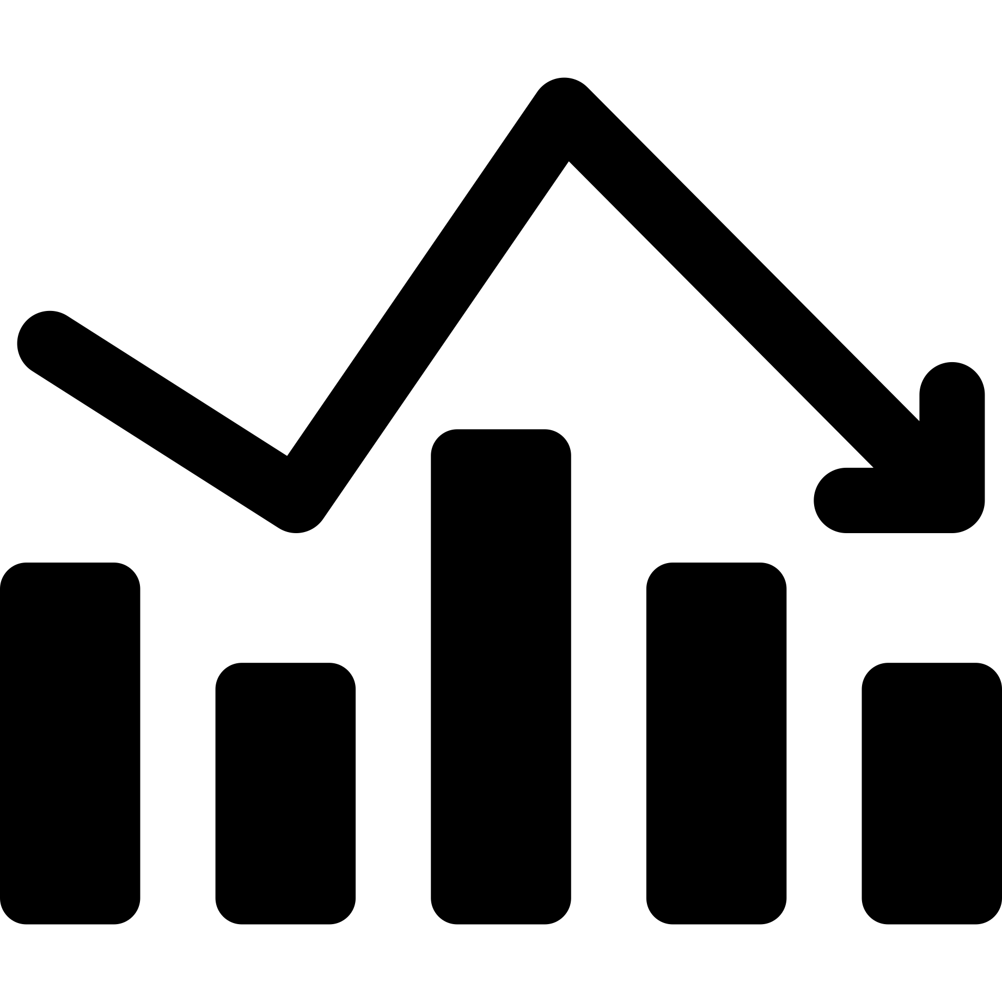











Introduction
Math and Statistics
Computer Science
Domain Knowledge
Data Science and Machine Learning
Data Science and ML Toolkit
High-quality DS and ML applications require effective collaboration
Notes:
00:15
DS and ML are interdisciplinary
There are 10s of tools and software products
Becoming an expert in all of them is difficulty and even impossible
High quality DS and ML application require effective collaboration
40 seconds

Slide 3





Collaborative DS and ML
Jupyter Notebooks enable sharing code and results
Containerized environments enable execution and deployment of the notebooks
[1]
Platforms, such as Google Colab and Kaggle, enable effective collaboration among data scientists
[2]
[3]
https://www.docker.com/
https://colab.research.google.com/
https://www.kaggle.com/
Notes:
1:00
Several breakthroughs in recent years
Jupyter Notebooks
Containerized environments
Platforms such Google colab and Kaggle
30 seconds

Slide 4
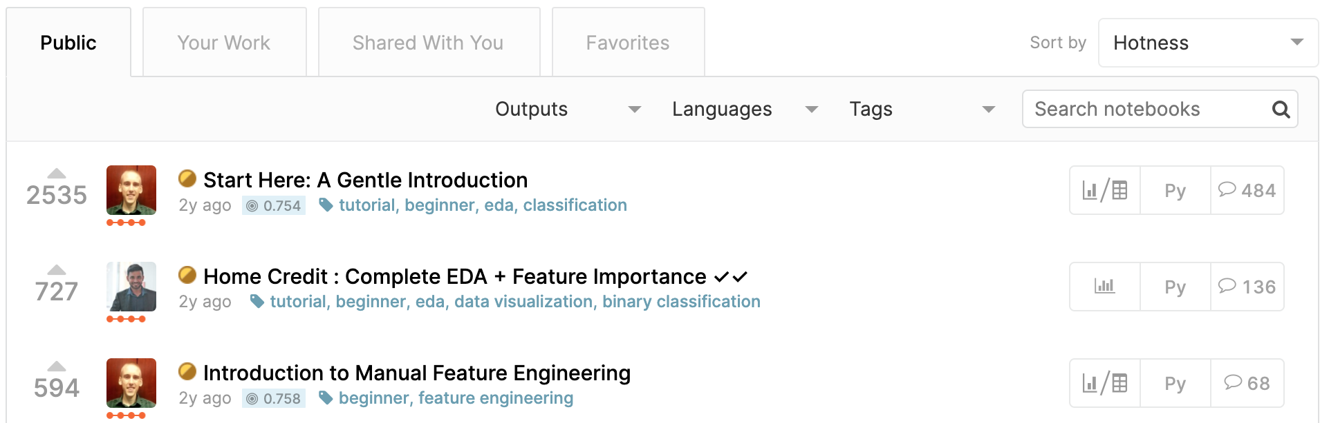
Problems
Lack of generated data artifacts management
Re-execution of existing notebooks
Top 3 notebooks of Home Credit Default Risk Kaggle Competition¹ generate
100s GBs of intermediate data artifact and are copied 10,000 times
Lack of data management in existing collaborative environment leads to 1000s of hours of redundant data processing and model training
https://www.kaggle.com/c/home-credit-default-risk
Notes:
1:30
A problem is lack of management of the generated data artifacts
The scripts contains hundreds of intermediate data artifacts
If users want to use one of these artifacts, they have to re-execute the entire notebook
Top 3 notebooks of a Kaggle competition generates more than 100 GB artifacts of intermediate artifacts and are copied 10000 times
Message
60 seconds

Slide 5

Collaborative ML Workload Optimizer
ML Workload
Client
Experiment Graph
Union of all the Workload DAGs
Vertices: data artifacts
Edges: operations
Materializer
Store data artifacts with high-likelihood of future reuse
Optimizer
Linear-time reuse algorithm
Finds optimal execution DAG
A
Parser
Workload DAG
Executor
Annotated DAG
B
1
2
5
1
Optimized DAG
Server
C
Optimizer
Materializer
C
B
Experiment Graph
A
Notes:
2:30
Collaborative ML Optimizer that can be integrated into existing collaborative platforms
On the client side (which can be inside the containers) we parse the workload script into a DAG
On the server side we optimize the workloads and once they are executed we annotate them with extra information which will for future optimizations
Specifically, 3 contributions
EG = union of all the workload dags
A materializer component to decide what artifacts to store, this is important as stated earlier the size of the artifacts are large and materializing everything is not possible
An optimizer that offers a reuse algorithm for finding the optimal execution DAG
70 seconds

Slide 6
Materialization Problem
Given a storage budget, materialize a subset of the artifacts in order to minimize the execution cost
Challenges:
Future workloads are unknown
Even if future workloads are known a priori, the problem is NP-Hard (Bhattacherjee, 2015)
Accommodating large graphs and fast number of incoming workloads
Notes:
3:40
Artifacts could be very large, we stated earlier 100s
Given a budget, select a subset to materialize
Challenges:
Unknown future workloads
NP hard
Large and fast incoming workloads typical in colab env
45 seconds

Slide 7
Materialization Algorithm
Server
run-time
For every artifact compute a utility value: size frequency
potential
Client
50,91
0.1
0.1
0.1
40,0.9
5,0.91
5,0.91
5
2
3
Materializer
Experiment Graph
10,0.9
3,0.91
3
0.05
0.1
0.1
1.5,0.91
0.5,0.0
23,0.9
4
4
2,0.9
Materialized artifact
Un-materialized artifact
Notes:
4:25
Mat algorithm assigns utility which has inverse relationship with size to penalize
Direct relationship to encourage
Run time heavy
High frequency
And high potential artifact, i.e., nodes that lead to high quality models
Materialize One by one sorted by utility
50 seconds

Slide 8
Storage-aware Materialization
Input Artifact
Output Artifact
Many duplicated columns in intermediate data artifacts
Feature selection operations
Feature generation operations
Apply column deduplication strategy
Feature
Selection
Storage-aware Materialization
while budget is not exhausted:
1. run materialization algorithm
2. deduplicate the materialized artifacts
3. update the size of unmaterialized artifact
Improves Storage utilization and Run-time
Notes:
5:15
While implementing
Intermediate data artifacts of ML have duplicated columns
Consider feature selection or generation
We extend our original algorithm by iteratively deduplicating
Improvement
45 seconds

Slide 9
Reuse Problem
Given EG and a new workload, find the set of workload artifacts to reuse from EG and the set of artifact to compute
Challenges:
Exponential time complexity of exhaustive search
Accommodating large graphs and fast number of incoming workloads, state-of-the-art has polynomial time complexity 𝓞(|𝒱|.|𝘌|²) (Helix, 2018)
Notes:
6:00
Given the EG and the materialized artifacts
For a new workloads, find the optimal plan
i.e., what nodes to load from eg, or compute in the client
Challenges:
50 seconds

Slide 10
Reuse Algorithm
A linear-time algorithm to compute optimal execution plan with a forward and backward pass on the workload DAG
Prune
train_2
train
Forward Pass
Backward Pass
Accumulate run-times
For every vertex
Load or compute
t_subset
y
top_feats_2
Prune unnecessary loaded vertices
top_feats
merged_feats
Materialized artifact
Un-materialized or do not exist in EG
model_3
Notes:
6:50
Linear time algorithm to compute in two passes
A new workload that has a new dataset train 2 and the existing data set
Combines them and trains a model
The marked vertices are materialized
During the forward pass
Traverse from the root
Accumulate run time
For every node if its accumulated run time is large than load, the we load it since it is cheaper
Alternatively, if the load is larger then we compute it
In the backward pass
Traverse from the leaf nodes
Prun any unnecessary loaded vertices
For example these two are not part of the computation graph
65 seconds

Slide 11
Evaluation
Workload
Baseline
Kaggle
Kaggle Home Credit Default Risk¹ Competition
9 source datasets
5 real and 3 generated workloads
Total of 130 GB artifact sizes
Helix
State-of-the-art iterative ML framework
Materialization Algorithm:
Only execution-time is considered
Nodes are not prioritized
Reuse Algorithm
Utilizes Edmonds-Karp Max-Flow algorithm, which runs in 𝓞(|𝒱|.|𝘌|²)
Naïve
No Optimization
https://www.kaggle.com/c/home-credit-default-risk
Notes:
7:55
Kaggle workload
Naïve baseline
Helix
State-of-the-art iterative ML Framework
Offers materialization and reuse algorithms
30 seconds

Slide 12
End-to-end Run-time
Repeated executions of Kaggle workloads (materialization budget = 16 GB)
Execution of Kaggle workloads in sequence (materialization budget = 16 GB)
Optimizing ML Workloads improves run-time up to 1 order of magnitude for repeated executions and 50% for different workloads
Notes:
8:25
Repeated runs of three Kaggle workloads
First run, EG empty → all are the same
Second run our optimizer and Helix outperform naïve
8 workloads in sequence
Our optimizer outperform both
Since mat budget is small and our materialization algorithm selects more beneficial artifacts for storage by considering their utility
60 seconds

Slide 13
Materialization Impact
Total run-time of the Kaggle workloads with different materialization strategies and budgets
Exploiting the artifacts characteristics, such as utility and duplication rate, improves the materialization process and improves the run-time by 50%
Notes:
09:25
Total run-time of 8 workloads under different budgets and materialization algorithms
Our algo, colabmat, outperforms helix by 20%
Once we consider the storage aware, it further reducides the run time
With small budget has similar to all materializer
The message:
45 seconds

Slide 14
Reuse Overhead
Overhead of different reuse algorithms for 10,000 synthetically generated workloads
Our linear-time reuse algorithm generates a negligible overhead in real collaborative environments where 1000s of workloads are executed
Notes:
10:10
To examine the overhead of reuse, we synthetically generate 10000 workloads which have similar DAGs to Kaggle workloads.
After the execution we have 80 (linear) 40 times smaller than helix (polynomial)
The message
40

Slide 15
Summary
ML Workload
Client
Optimization of ML workloads in collaborative environment through Materialization and Reuse
Improving run-time up to 10x
Store data artifacts with high-likelihood of future reuse and deduplicate ML artifacts
A linear-time reuse algorithm that outperforms the state-of-the-art by a factor of 40x
Parser
Workload DAG
Executor
Annotated DAG
1
2
5
1
Optimized DAG
Server
Optimizer
Materializer
Experiment Graph
Notes:
10:50
Summary
35 seconds
(11:15)

Slide 16
References
Bhattacherjee, Souvik, et al. "Principles of dataset versioning: Exploring the recreation/storage tradeoff." Proceedings of the VLDB Endowment. International Conference on Very Large Data Bases. Vol. 8. No. 12. NIH Public Access, 2015.
Xin, Doris, et al. "Helix: Holistic optimization for accelerating iterative machine learning." Proceedings of the VLDB Endowment 12.4 (2018): 446-460.
Jack Edmonds and Richard M. Karp. 1972. Theoretical Improvements in Algorithmic Efficiency for Network Flow Problems. J. ACM 19, 2 (April 1972), 248–264. https://doi.org/10.1145/321694.321699
Thomas Kluyver, Benjamin Ragan-Kelley, Fernando Pérez, Brian Granger, Matthias Bussonnier, et al. 2016. Jupyter Notebooks – a publishing format for reproducible computational workflows. In Posi- tioning and Power in Academic Publishing: Players, Agents and Agendas, F. Loizides and B. Schmidt (Eds.). IOS Press, 87 – 90.
Burns, B., Grant, B., Oppenheimer, D., Brewer, E., & Wilkes, J. (2016). Borg, omega, and kubernetes. Queue, 14(1), 70-93.

Slide 17
Evaluation (2)
Workload
Openml
Classification Task 31²
2000 scikit-learn pipelines
1.5 GB of artifact sizes

Slide 18
DAG Construction
Artifact
train
train = pd.read_csv('train.csv') # [ad_desc,ts,u_id,price,y]
ad_desc = train['ad_desc']
vectorizer = CountVectorizer()
count_vectorized = vectorizer.fit_transform(ad_desc)
print count_vectorized.head()
selector = SelectKBest(k=2)
t_subset = train[['ts','u_id','price']]
y = train['y']
top_features = selector.fit_transform(t_subset, y)
model_1 = svm.SVC().fit(top_features, y)
print model_1 # terminal vertex
X = pd.concat([count_vectorized,top_features], axis = 1)
model_2 = svm.SVC().fit(X, y)
print model_2 # terminal vertex
ad_desc
t_subset
y
Operation
5 s
cnt_vect
top_feats
Accuracy=0.91
model_1
X
40 MB
cnt_head
model_2
Notes:
3:30
Dag Construction
Scripts, left → DAG representation, vertices = artifacts, edges = operations
Annotate after execution → Artifact size → Operation run time → and model quality
Which we use in our materialization and reuse algorithms
30 seconds

Slide 19
DAG Construction
Source vertex
train
train = pd.read_csv('train.csv') # [ad_desc,ts,u_id,price,y]
ad_desc = train['ad_desc']
vectorizer = CountVectorizer()
count_vectorized = vectorizer.fit_transform(ad_desc)
print count_vectorized.head()
selector = SelectKBest(k=2)
t_subset = train[['ts','u_id','price']]
y = train['y']
top_features = selector.fit_transform(t_subset, y)
model_1 = svm.SVC().fit(top_features, y)
print model_1 # terminal vertex
X = pd.concat([count_vectorized,top_features], axis = 1)
model_2 = svm.SVC().fit(X, y)
print model_2 # terminal vertex
ad_desc
t_subset
y
Operation
cnt_vect
top_feats
model_1
X
40 MB
cnt_head
Terminal
vertex
model_2
Terminal
vertex
Notes:
3:30
Source vertex
Terminal Vertex
Operations are edges
50 seconds

Slide 20
DAG Annotation
50 MB
Edge run-time
0.91
train
40 MB
0.1 s
0.1 s
Vertex size
0.05 s
5 MB
0.9
0.91
ad_desc
t_subset
y
Vertex potential
Quality of the best reachable model
5 MB
5 s
2 s
0.91
3 MB
0.91
3 s
Model
Quality
10 MB
cnt_vect
top_feats
0.9
3 s
Accuracy=0.91
0.05 s
Model
Quality
model_1
0.1 s
0.1 s
4 s
1.5 MB
0.5 MB
cnt_head
X
0.91
0.0
Model
Quality
4 s
23 MB
0.9
Model
Quality
model_2
Accuracy=0.9
2 MB
0.9
Notes:
4:20
After a DAG is executed we annotate it
Operator run time on edge
Size of the artifact on vertex
Potential on vertex
50 seconds

Slide 21
Model Materialization and Warmstarting
Run-time of model benchmarking scenario

Slide 22
Impact of Model Warmstarting on Accuracy

Slide 23
Reuse Algorithm
A linear-time algorithm to compute optimal execution plan with a forward and backward pass on the workload DAG
train_2
train
t_subset
y
top_feats_2
top_feats
merged_feats
Materialized artifact
Un-materialized or do not exist in EG
model_3
Notes:
8:40
Linear time algorithm to compute in two passes
A new workload that has a new dataset train 2 and the existing data set
Combines them and trains a model
The marked vertices are materialized
40 seconds

Slide 24
Reuse Algorithm (Forward-pass)
Forward-pass
load cost = 0.06
Load < Acc
Load > Acc
Traverse from the source
Accumulate run-times
For every materialized node compare the accumulated run-time with the load-time
train
train_2
train
train_2
Acc = 0.1
Acc = 0.05
t_subset
t_subset
y
y
top_feats_2
top_feats_2
Acc = 2.1
top_feats
top_feats
merged_feats
merged_feats
Materialized artifact
Load < Acc
Un-materialized or do not exist in EG
Artifacts to execute
model_3
load = 1.5
model_3
Artifacts to load
Notes:
9:20
We start traversing and accumulate the run-times as we go along the edges
Any source node that is materialized such as train, we load it from the experiment graph
Any artifact that does not exist in EG (such as the ones from the new workloads), we need to execute them
For remaining workloads, we can decide whether to execute or load
If load time is greater than accumulate run time, then we execute since it is the less costly alternative
If load time is smaller than accumulate run time, then we load them from the experiment graph
At the end we end up with such a dag.
However, some nodes can be pruned
1:20

Slide 25
Reuse Algorithm (Backward-pass)
Backward-pass
Traverse backward from the terminal
For every loaded artifact, stop the traversal of its parents
Prune artifacts that are not visited
train
Stop Traversal
train_2
train
train_2
X
X
t_subset
t_subset
y
y
top_feats_2
top_feats_2
X
top_feats
top_feats
merged_feats
merged_feats
Artifacts to prune
Artifacts to execute
model_3
model_3
Artifacts to load
Notes:
10:40
We traverse backward from the terminals
For every loaded artifacts such these two, we stop the traversal of their parents.
Since the artifacts are loaded we don’t need their parents to compute them and can prune them
The final dag after backward pass looks like this
30 seconds

Slide 26
Materialization Algorithm
Server
run-time
For every artifact compute a utility value: size frequency
potential
Client
50,91
0.1
0.1
0.1
40,0.9
5,0.91
5,0.91
5
2
3
Materializer
Experiment Graph
10,0.9
3,0.91
3
0.05
0.1
0.1
1.5,0.91
Meta-data is always stored in EG
① Artifact size ③ Frequency
② Operator run-time ④ Potential
0.5,0.0
23,0.9
4
4
2,0.9
Materialized artifact
Un-materialized artifact
Notes:
Mat algorithm assigns utility
For every generated artifact yes/no
Meta data is always stored

Slide 27
Storage-aware Materialization
Many duplicated columns in intermediate data artifacts
Apply column deduplication strategy
train = pd.read_csv('train.csv') # [ad_desc,ts,u_id,price,y]
ad_desc = train['ad_desc‘]
t_subset = train[['ts','u_id','price‘]]
y = train['y']
train
ad_desc
t_subset
y
Storage-aware Materialization
while budget is not exhausted:
1. run materialization algorithm
2. deduplicate the materialized artifacts
3. update the size of unmaterialized artifact
Improves Storage utilization and Run-time
Notes:
6:50
ML data artifacts tend to have many duplicated columns
Example
We improve our materialization algorithm by adding a deduplication phase to our materialization algorithm
Which is as follows:
Run mat algo
Deduplicate, which reduces the size of the materializied artifacts and allowing us to materialize more
We iteratively perform these steps until the budget is fully exhausted
Improvement
1 minute

