Slide 1
Optimization of Machine Learning Workloads with Experiment Databases
Behrouz Derakhshan
Behrouz.derakhshan@dfki.de

Slide 2
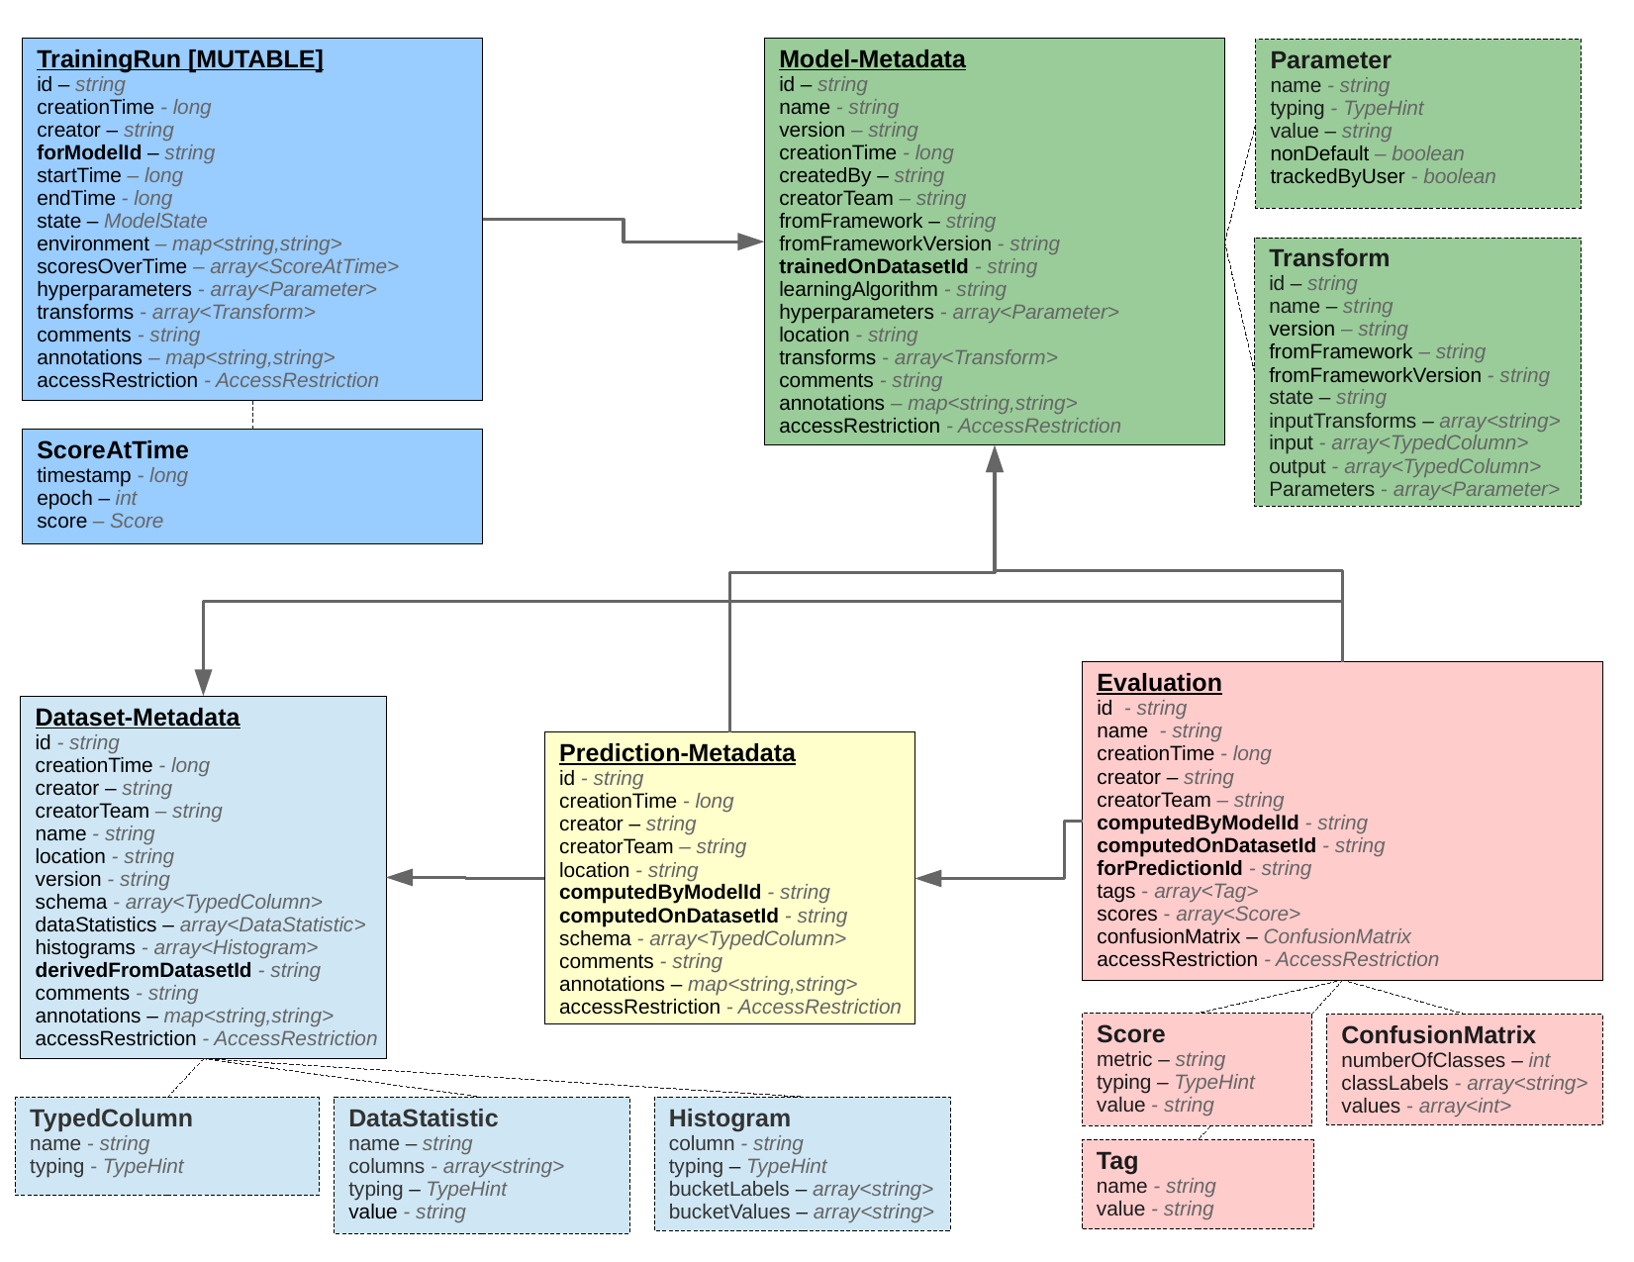
Experiment Database
Contains meta-data of machine learning experiments
Based on Schelter, et al., [1] database schema for storing experiments’ meta-data
Their meta-data extraction system collects information about the datasets, models, transformations, and evaluations
Database schema for storing declarative description of machine learning experiments [1]

Slide 3
Machine Learning Workloads
Next paper
Future Work
1. Interactive batch workload
2. Incremental Training Workload
3. Continuous Training Workload
Multi-user (from tens to thousands of users)
Primarily consists of repeated data preprocessing and data transformations
Aggressive Hyper-parameter tuning and model evaluation
Use case: OpenML[2], Kaggle[3]
Opportunities for Reuse, materialization, multi-query optimization, and warm-starting
Multi-user (tens of users)
Incremental improvement of existing data processing pipelines and ML models
Retrain models and pipelines (typically daily)
Use case : Industry
Speed up in data preprocessing, decreasing the search space of hyper-parameters, multi-model training, and warm-starting
Real-time (or near real-time) data processing
Online ML models
Use case : Industry
Speed up in data preprocessing, multi-model training, and fast detection of model quality degradation
The green color indicates how Experiment Database can help in optimizing the specific type of workload

Slide 4
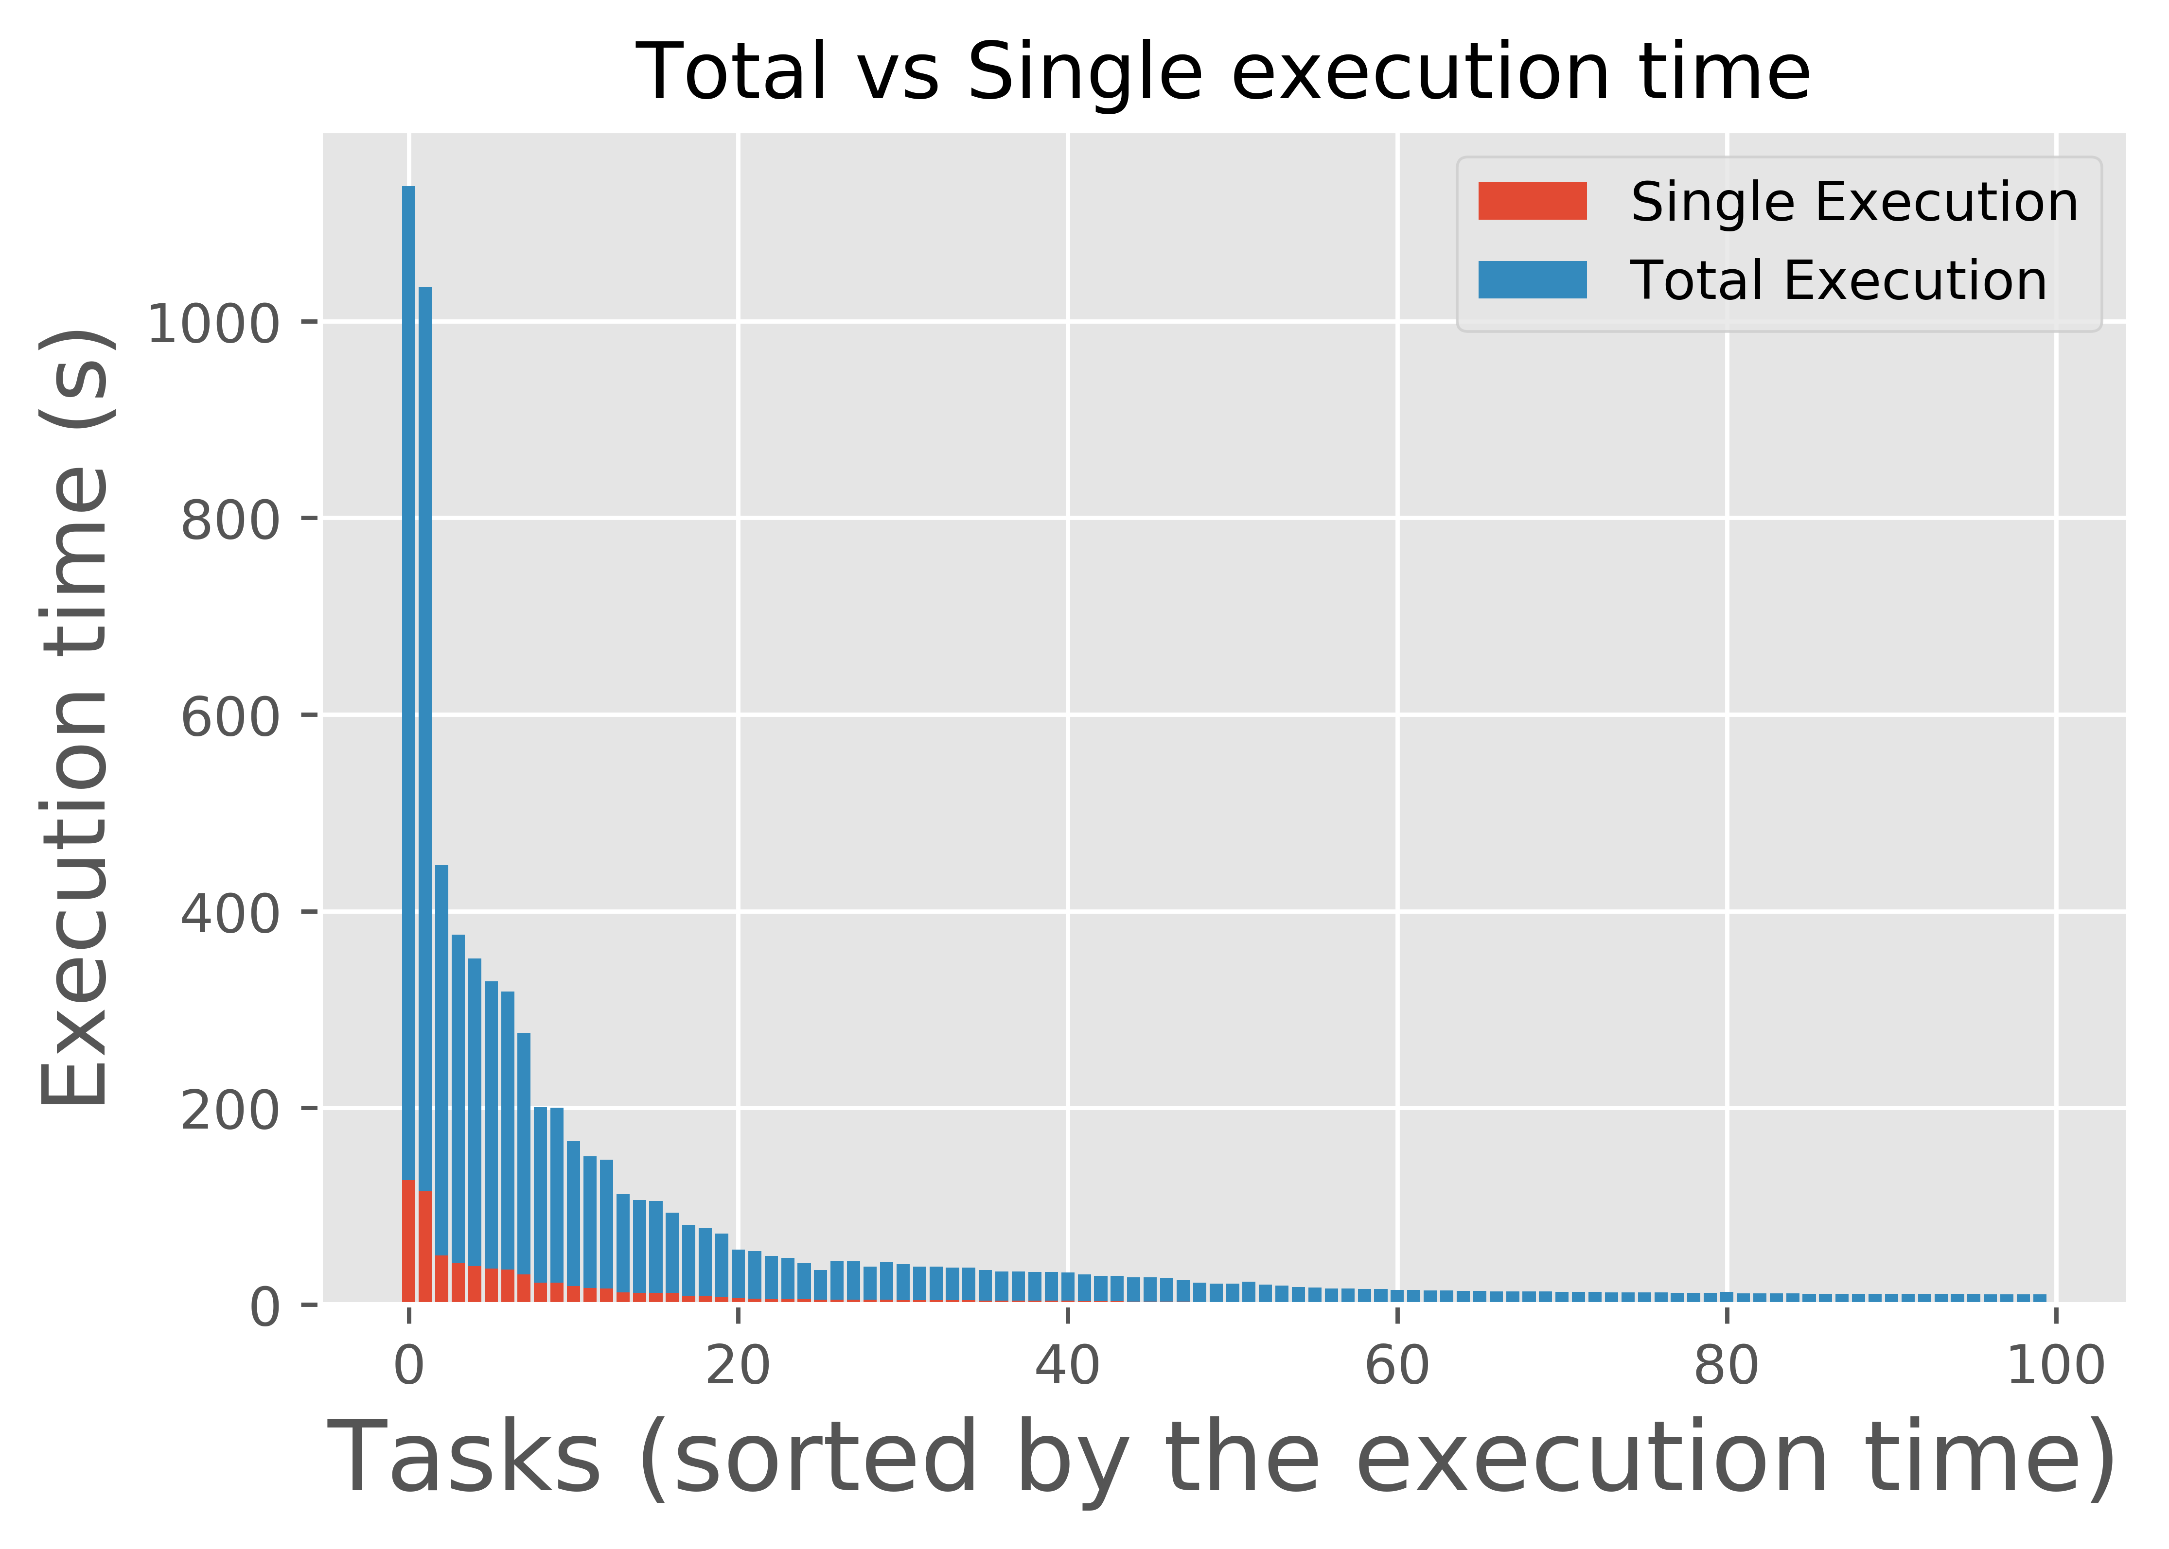
Plan for next Paper
VLDB 2018 (Deadline: 1st of March)
Focus on Workload 1 (Interactive batch)
Plan:
Develop a simple database based on [1]
Experiment:
Focus only on a few frameworks (scikit-learn, R mlr package*)
Popular Kaggle competitions, OpenML datasets and tasks
Report the reduction in the processing time and the development time
I currently have a paper under review for SIGMOD2018. Depending on the result of the review, this work may have to be pushed back to SIGMOD2019/VLDB2018
Early Results:
The Most popular pipeline in OpenML (scikit-learn) consists of:
Missing Value Imputer
Dimensionality reduction using PCA
Random Forest Classifier
It is repeatedly executed on 100 different tasks (average of 9 times on each task)
A simple reuse can save around 2 hours of processing time
This figure may include executions performed by bots, therefore, we cannot reach a conclusion about the reduction on the development time

Slide 5
References
[1] Sebastian Schelter, Joos-Hendrik Böse, Johannes Kirschnick, Thoralf Klein, Stephan Seufert, Automatically Tracking Metadata and Provenance of Machine Learning Experiments, Machine Learning Systems workshop at the conference on Neural Information Processing Systems (NIPS) 2017
[2] https://www.openml.org/
[3] https://www.kaggle.com/

