Slide 1
Before the workshop: Download PsychoPy
You can download PsychoPy as a standalone app (recommended if you have limited coding experience and/or mainly plan to use the Builder)
OR
If you already have Python and/or Anaconda installed, you can download PsychoPy manually via the terminal
https://www.psychopy.org/download.html

Slide 2
Using the PsychoPy Builder (GUI)
Susan Benear
COG Workshop July 10, 2020, PsycoPy pt. I

Slide 3
About the PsychoPy Builder
PsychoPy is an open-source software package that runs on python code and allows you to create computer-based tasks for stimulus presentation and data collection
PsychoPy is user-friendly and specifically designed for creating behavioral tasks for psychology and neuroscience
The Builder is simply PsychoPy’s graphical user interface (GUI), which allows you to design experiments using point-and-click methods
No coding experience or knowledge is required to use the Builder

Slide 4
Using the Materials Posted on GitHub
The “stim” folder on Github contains all necessary materials for designing your task
Inside the folder is:
The task itself (with the .psyexp extension)
The spreadsheet the task will be indexing (.csv)
The actual stimuli for the task – images (.jpg) and audio (.aiff)
The output of the task (in the “data” folder)
I recommend starting from scratch in the Builder and following along as I create the task on screen, but the .psyexp file is the completed file if you’d prefer to just click through the pre-made task
In the “data” folder within the “stim” folder, there is an .xlsx file, which I modified from the .csv file generated automatically as output from the Builder to demonstrate how to interpret it (because…it’s messy)

Slide 5
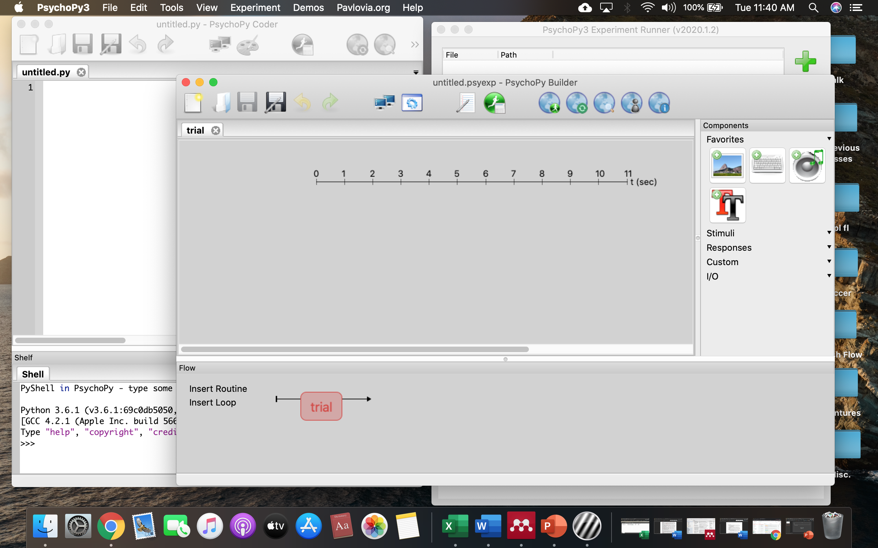
When you open PsychoPy from your Applications…
The Builder, Coder, and Experiment Runner windows will all open
The Builder is shown on top here
If you’d like to open the pre-made task, drag the .psyexp file from the “stim” folder to the striped PsychoPy icon

Slide 6
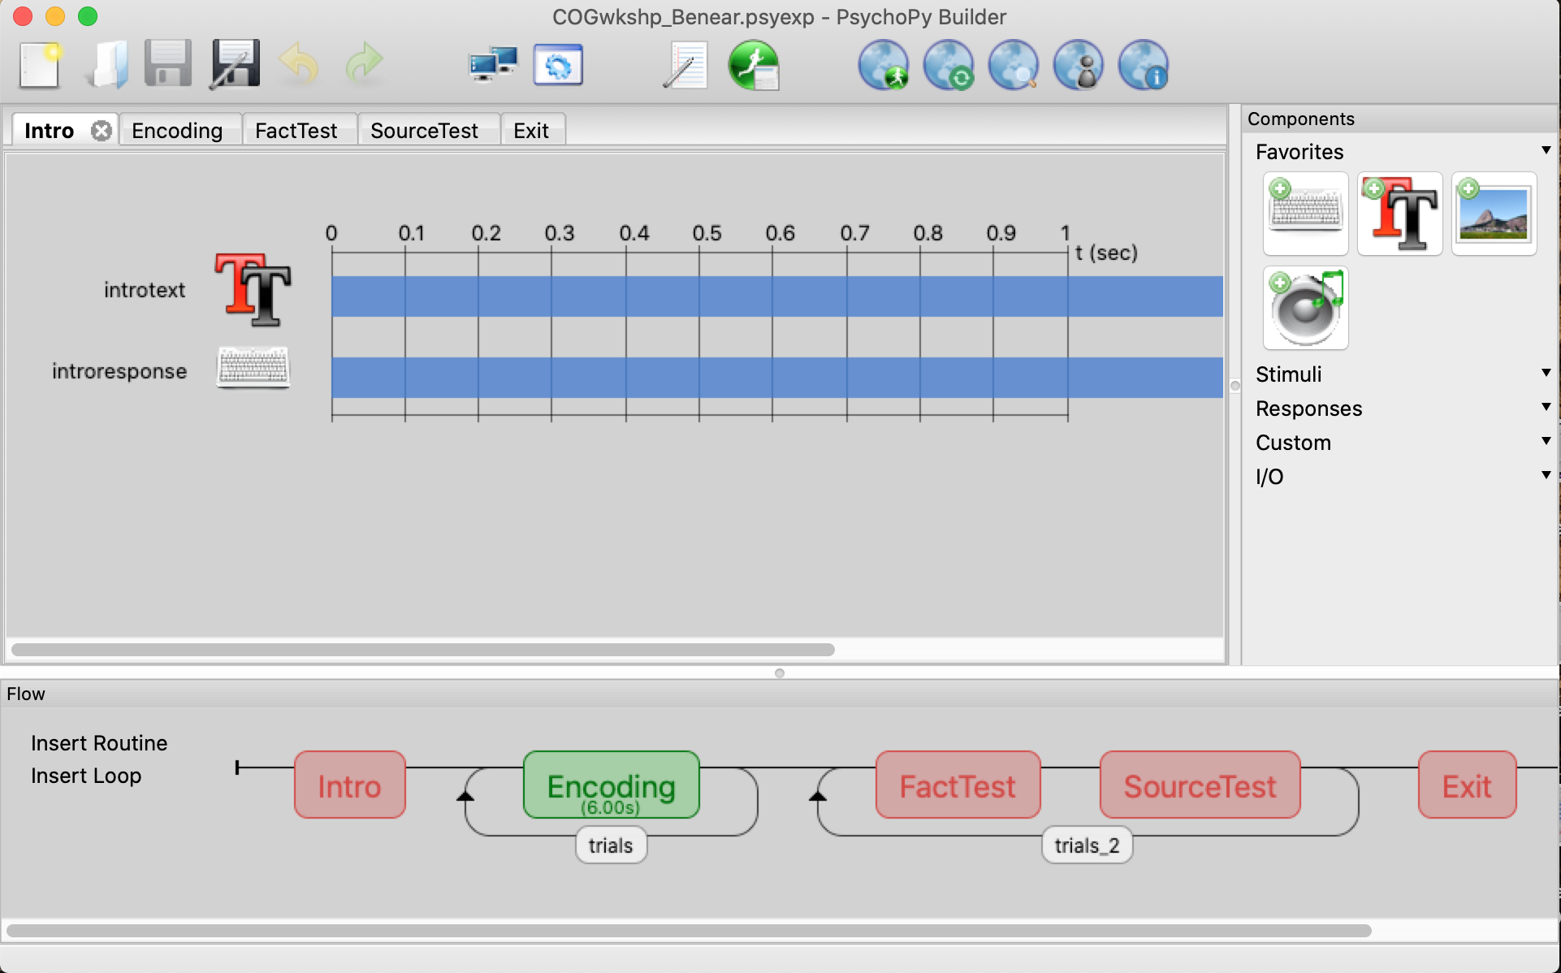
Plan for my portion of the workshop
I will teach you how to design a basic task using the Builder, which will include:
Explaining how to set up your stimuli folder and spreadsheet
Creating routines and loops in the Builder in order to:
Present images, audio, and text
Collect responses using the keyboard

Slide 7
Some notes on using the PsychoPy Builder
All stimuli, as well as your .csv file, must be in the same folder as your .psyexp file
The .csv file is essential – once you know what stimuli you will be using and how you want to set up your task, you must set up your spreadsheet accordingly
All variables pulled into PsychoPy are indexed based on the .csv column headers
If you want to use text that is pulled randomly just like the images and audio clips are pulled from your folder, you want to include this text in a column within your .csv
Fixed text like intro screens can be typed directly into the text box on PsychoPy, but if you want questions to be randomized or simply do not want to create a Routine for each individual question, create a column with all the text you want to pull within your .csv
Your stimulus files must be in a format that is compatible with PsychoPy – cannot use .pdf images or .mp3 audio

