Slide 1

neuroimaging in python
cog workshop 2022

Slide 2
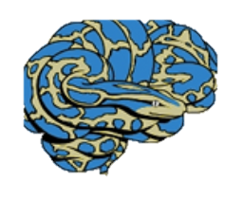
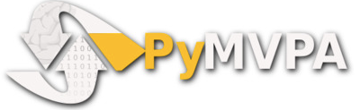
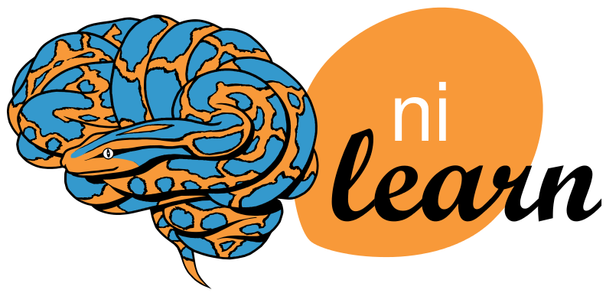

neuroimaging packages in python
Notes:
Flexiblity- change code by cells instead of the full script, see outputs right after code cell
Reproducibility- easy to share, export results as html for others without needing to run code
Quick- especially for la lot of data and/or a lot of subject data
Open source, free
Cons:
Have to know python enough to script and troubleshoot
New tools with bugs

Slide 3



nilearn- jupyter notebook
open notebook in terminal
download data
create design matrix
first-level contrasts
group-level beta maps
>
Notes:
Design matrix accounts for each condition and run of our task
First-level analysis compares conditions across all voxels for each single subject, in this step, we will smooth our data
Average activation across all subjects

Slide 4
nilearn resources
nilearn github
DartBrains
previous cog workshops
neurostars
stack overflow

