Slide 1
GIMME Tutorial COG 2023 Workshop
Group Iterative Multiple Model Estimation
Matt Mattoni, MA

Slide 2
Who This is For
Anyone interested in network analysis from intensive longitudinal data
GIMME is a novel method that addresses heterogeneity and can also uncover data driven subgroups
Ultimate goal is for more individually-precise networks, rather than group-averaged
Examples:
fMRI Effective Connectivity Networks
Nodes are BOLD time series from regions of interest (ROIs)
Ecological Momentary Assessment (EMA)
Nodes are variables collected numerous times longitudinally
Anything that has multiple variables observed often over time:
Economic trends, Google word searches, etc.

Slide 3
Acknowledgements
The information presented here was learned from public GIMME papers (see here) and open source materials such as (OSF docs).
I have further training from a Pitt Summer Methods workshop taught by Dr. Katie Gates (GIMME Developer), which I highly recommend.
I will be focusing on big-picture concepts and applied usage of GIMME. For more detailed information, you should leverage the resources noted above.

Slide 4
Roadmap
Background: Time Series Networks
Background: Heterogeneity and Ergodicity
GIMME Conceptual Introduction
Brief GIMME Formal Specification
Applied R Walkthrough (Data Formatting + GIMME Code)

Slide 5
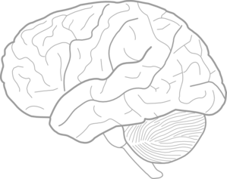
Background: Time Series Networks
Here, we are interested in intensive time series data
Not formally defined, but need numerous observations per person
Think 30-500+, not 5
Networks: Define interrelationships between variables over time
Nodes: Observed variables
Edges: Estimated associations between variables

Slide 6
Undirected vs. Directed
Are edges purely correlational , or is an effect of direction implied (causation)?
In fMRI world, directional edges model effective connectivity, rather than functional connectivity
Hypothesized model underlying observed correlations (See Friston 2011)
Dynamical Causal Modeling most common example
Numerous ways of modeling, here we will think about Granger Causality
Effect of node on another after accounting for each node’s autocorrelation (correlation with itself in time series)

Slide 7
Idiographic vs. Aggregate Networks
Networks estimated using data from a single individual are idiographic
Pros: 100% precision to the individual; individual-level inferences
Cons: Prone to noise, no group comparisons (e.g., clinical groups)
More commonly, we average data across individuals for aggregate networks
Pros: Reduce noise, enable group comparisons
Cons: Group-level networks may not represent individuals

Slide 8
Group Averaging
When we average across individuals, we presume that differences across individuals are quantitative (attributable to random error)
Aggregate network thus represents an “average” individual, with some error.
Not an assumption we think about too much..

Slide 9
Subj W
Subj X
Subj Y
Subj Z
Aggregate

Slide 10
The Heterogeneity Problem
When we average across individuals, we presume that differences across individuals are quantitative (attributable to random error)
Aggregate network thus represents an “average” individual, with some error.
However, this assumption does not hold if differences between individuals are qualitative
Heterogeneity in kind rather than degree
If there is substantial qualitative heterogeneity across individuals, the aggregate network will represent few, if any, of the individuals

Slide 11
Subj W
Subj X
Subj Y
Subj Z
Aggregate

Slide 12
Ergodicity
Statistical property where a group-level model can be used for individual-level inferences (Molenaar, 2004). “Group-to-Individual generalizability”
Requires that intra-individual variation = inter-individual variation
Homogeneity Across Individual Models & Stationarity over Time within individuals
Individual differences are quantitative & attributable to random error, not qualitative
Most psychological processes do not meet these criteria! (Fisher, 2018; Molenaar, 2004)
Violations prevent valid individual-level inferences
Group comparisons are making inferences from a model that does not apply to individuals
This is a critical limitation whenever we are interested in the individual (when are we not?)

Slide 13
Introducing: GIMME
Group Iterative Multiple Model Estimation
Goal is to create person-centered directional networks by explicitly accounting by inter-individual heterogeneity
Estimates group-level networks that represent individuals
Estimates individual-level networks that contain group-level information + individual-specific data
Options to identify data-driven subgroups, test confirmatory subgroups, assess multiple possible solutions, and more
Extension of extended unified structural equation modeling
Data-driven

Slide 14
GIMME: Group-Level
Individuals
Iteratively identifies paths present for >75% individuals
Group
3rd path not added!

Slide 15
GIMME: Subgroup-Level
Same process, but for subsets of similar individuals.
Built on group-level
Subgroup A
Subgroup B
Notes:
Walktrap community detection algorithm

Slide 16
GIMME: Individual-Level
Ind-X; Subgroup A
Ind-Y; Subgroup A
Ind-Z; Subgroup B
Identify individual-level paths on top of existing group models for each person
Notes:
Ultimately, each person has a network model that consists of group-level, subgroup-level, and individual-level connectivity paths

Slide 17
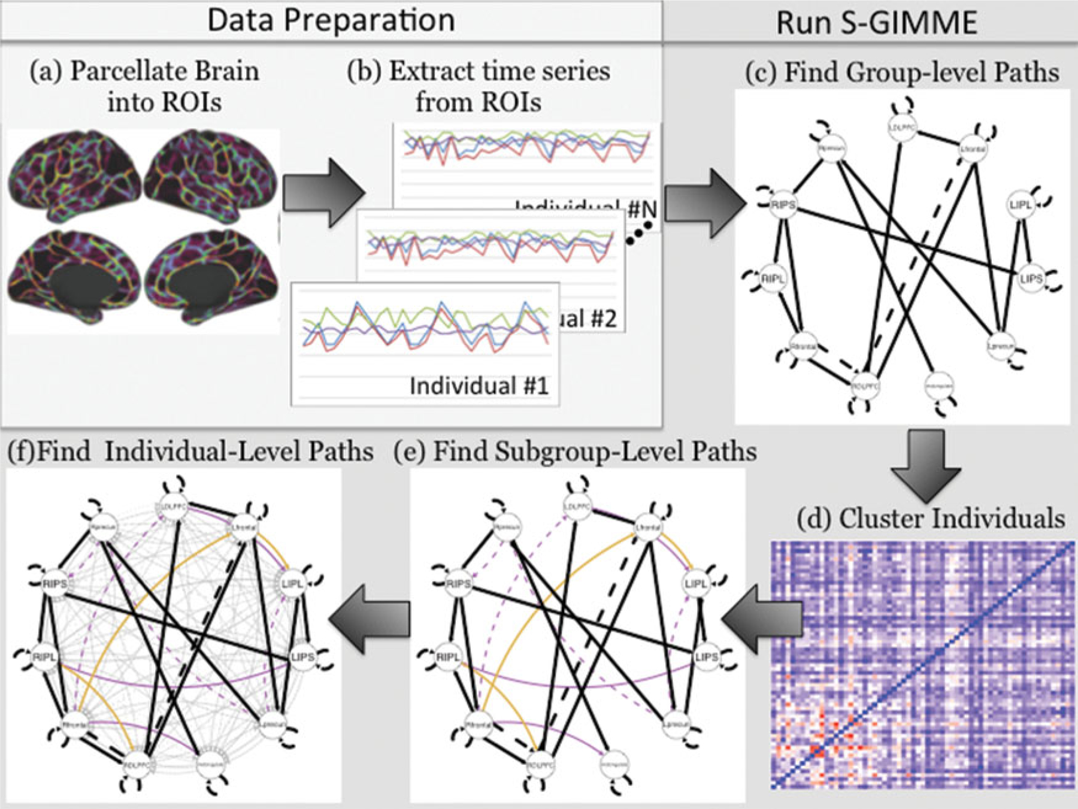
Summary (Subgroup-GIMME)
Gates et al. (2017) Neuroimage

Slide 18
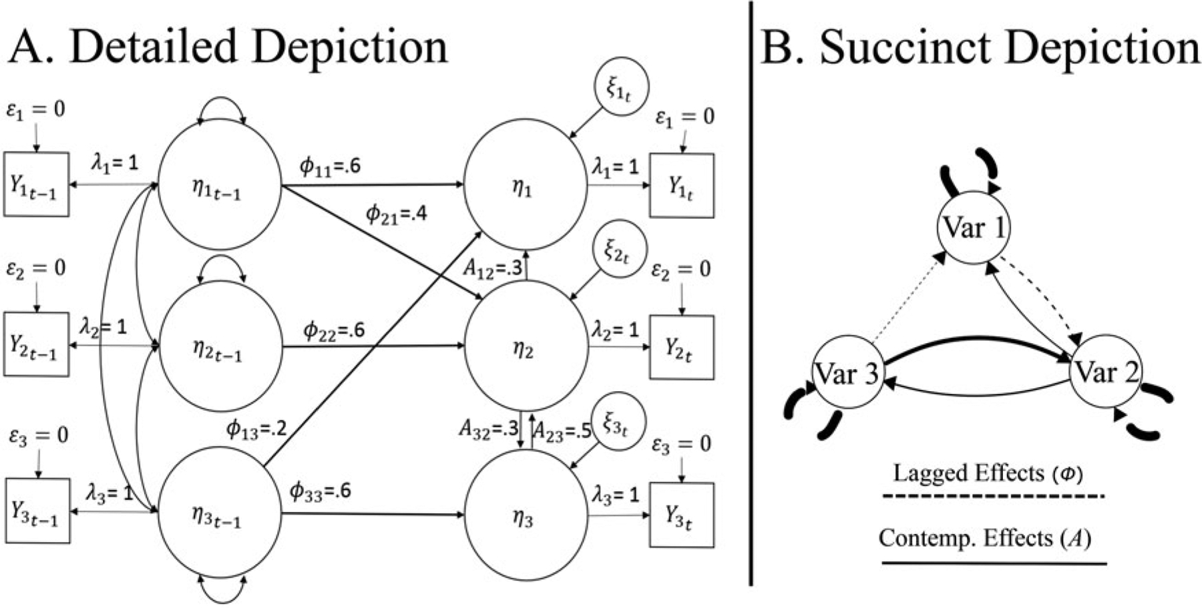
GIMME: Model Specification

Slide 19
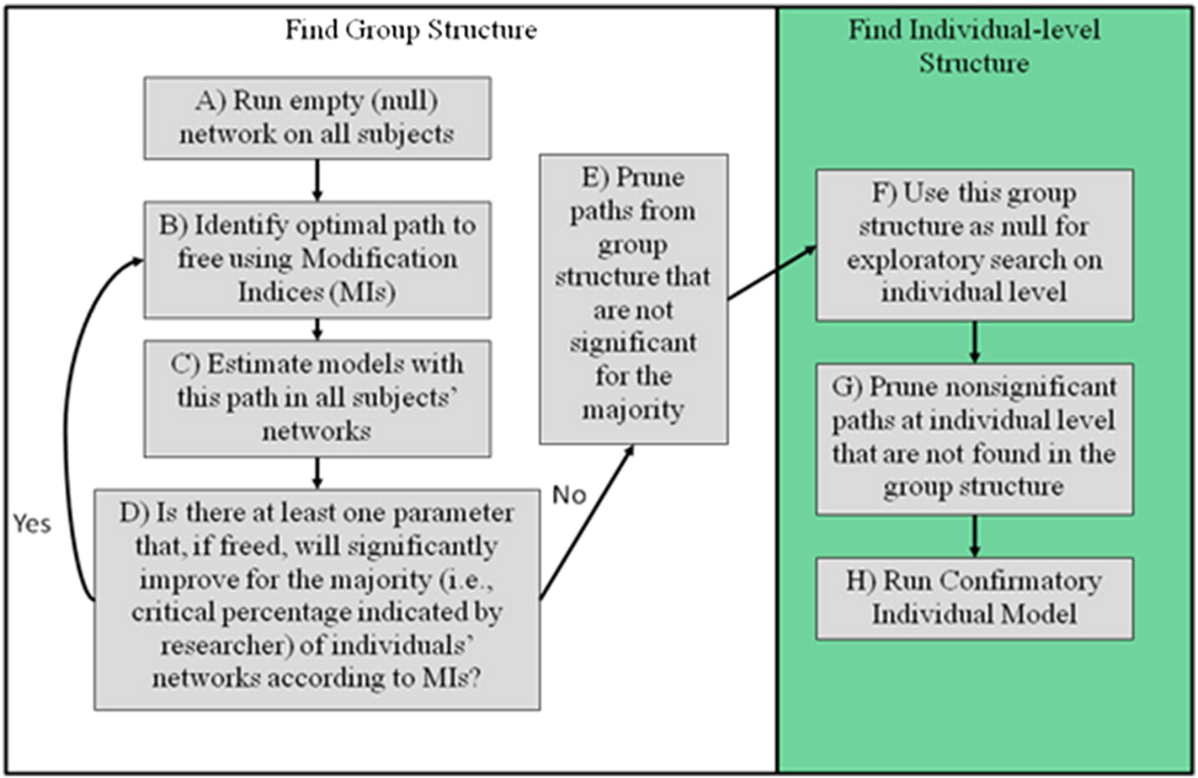
GIMME: Model Specification

Slide 20
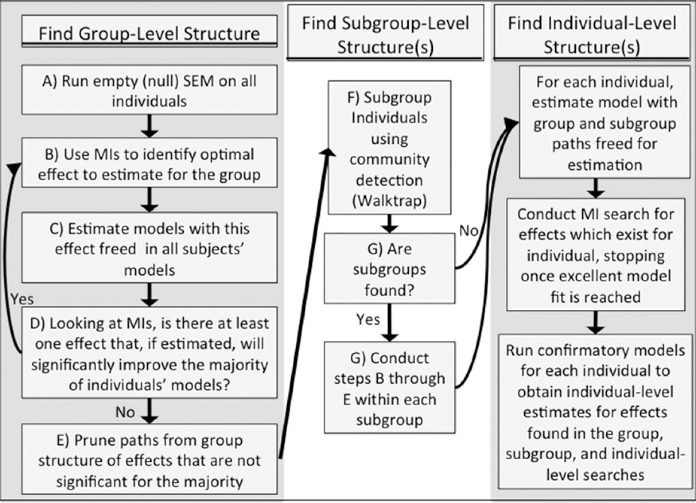
GIMME: Model Specification

Slide 21
Applied Walkthrough Outline
Data Formatting
Need a separate .csv file of time series data for each individual
Include column names, no row names. Same columns for all individuals
Missing data OK
GIMME Code
Pretty easy code, just understanding options
Consider extensions and downstream analyses

