Slide 1
Introduction to jsPsych
Temple University Coding Outreach Group (COG) Workshop
July 13, 2023

Slide 2
Objectives for today’s workshop
1) Introduce jsPsych as a software to create experimental tasks
2) Why jsPsych? Review pros/cons of using jsPsych
3) Learn how to integrate JavaScript, HTML, and CSS languages to build a jsPsych experimental task
HTML – Structures a web page
CSS – Stylize/customize elements that appear on the web page
JavaScript – Makes web pages interactive

Slide 3
Why jsPsych?
Free and open-source software for creating experiments that run in a web browser
Streamlines compatibility for online experiments
Intuitive framework for building experimental trials
Ample online resources (super helpful documentation and user community)

Slide 4
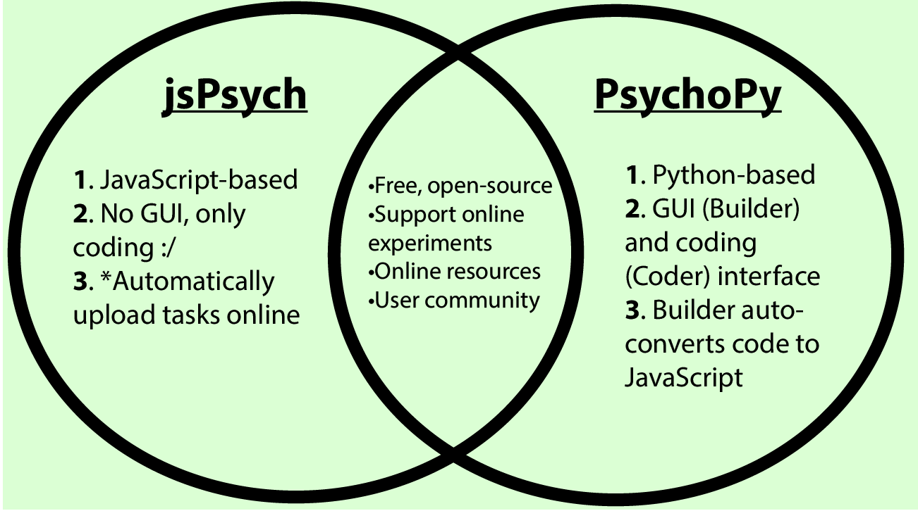
jsPsych or PsychoPy?

Slide 5
Experimental Task Overview
Setting up a jsPsych script in Visual Studio Code
Building an experimental trial
Integrating JavaScript, HTML, and CSS languages
Building a full experiment
Stimuli presentation
Collecting participant responses
Customizing task aesthetics
Randomizing experimental trials

Slide 6
Getting started
Download jsPsych 7.3.3
The jsPsych software is a set of files located in the Dist Archive folder at the following link: https://github.com/jspsych/jsPsych/releases/tag/jspsych%407.3.3
Download Visual Studio Code (Text editor that we will be using to write our script)
https://code.visualstudio.com/Download
Download the “jsPsych_workshop” folder from GitHub
You will save your jsPsych experimental task to this folder, so please make sure you remember where you saved this folder so you can access it!

