Slide 1
Introduction to jsPsych
Temple University Coding Outreach Group (COG) Workshop
July 13, 2023

Slide 2
Experimental Task Review
Set up a jsPsych script in Visual Studio Code
Built an experimental trial
Integrating JavaScript, HTML, and CSS languages
Built a full experiment
Stimuli presentation
Collecting participant responses
Customizing task aesthetics
Randomizing experimental trials

Slide 3
jsPsych compatibility with Pavlovia
Huge benefit of jsPsych is that online experiments run in JavaScript through web browsers!
In order to convert your local experiment to an online experiment, you need to make a few minor tweaks to your script:
Change pathways to load plugins
Add 2 plugins to connect your script to Pavlovia (online platform that hosts task scripts for online experiments)
jspsych-7-pavlovia-2021.js – Turns on/off connection with Pavlovia
jquery-2.2.0.min.js – works with jspsych-7-pavlovia-2021.js to establish Pavlovia connection
Add plugin to preload image files to avoid stimuli timing issues
Luckily, jsPsych’s preload plugin (plugin-preload.js) exists specifically for this!

Slide 4
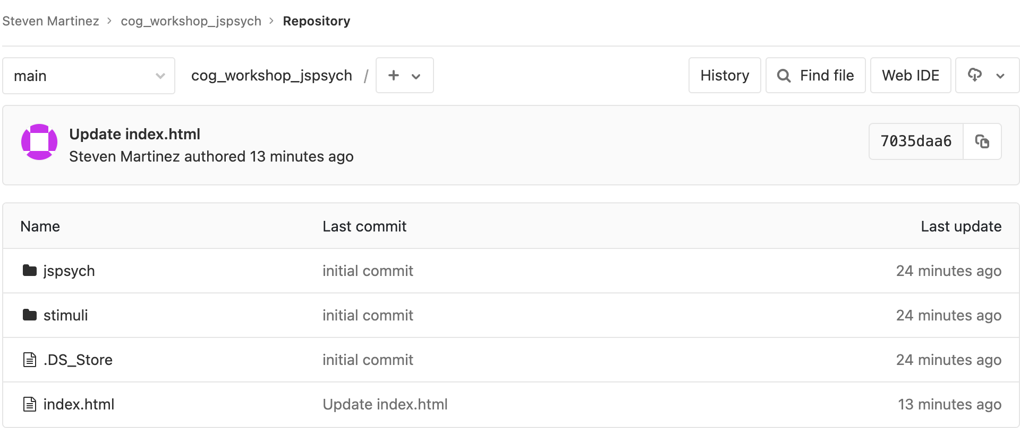
Online version of our experiment
The index.html file in the jsPsych_workshop folder is the online version of the experiment we built today!

Slide 5
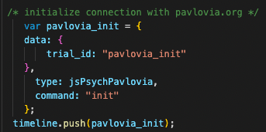
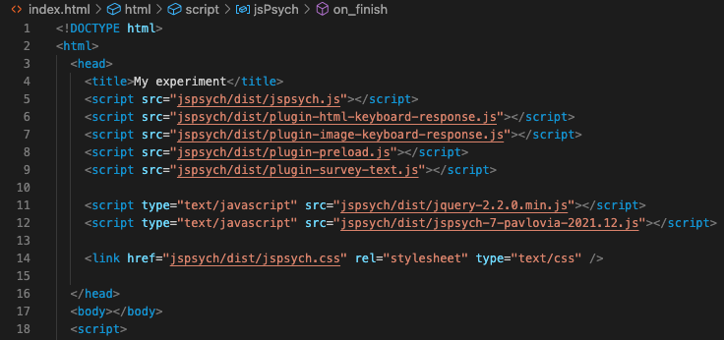
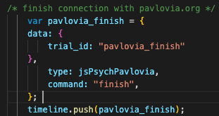
Jspsych-7-pavlovia-2021.12.js & jquery-2.2.0.min.js
Change plugin pathways
and add 2 required plugins
Start connection with Pavlovia
End connection with Pavlovia

Slide 6
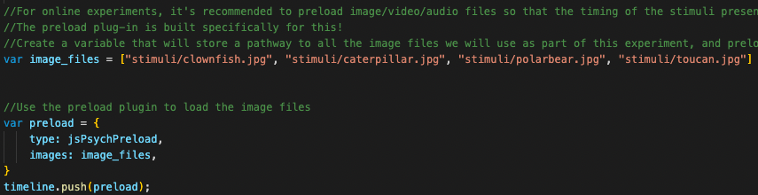
Preloading media files
Since the images are being pulled from Pavlovia onto different people’s web browsers, you want to make sure there are no issues with the stimuli presentation.
jsPsych’s preload plugin (plugin-preload.js) helps out with this!

Slide 7
Conclusion & General Notes
Yael Niv’s lab has a super helpful task repository, which also includes tutorials
Winson Yang has a great YouTube series for jsPsych tutorials
Caveat: Most jsPsych tutorials use an older version of jsPsych (jsPsych 6.0) which uses a different syntax structure for calling plugins compared to jsPsych >7.0
Scrimba has a really helpful (but long) JavaScript tutorial that does a pretty good job of instructing new users on how to integrate JavaScript, HTML, and CSS
jsPsych Discussion Forum
Super friendly forum for asking questions about jsPsych (I have asked some truly asinine questions on here and no has one judged me!!)

