Slide 1
Intro to Containers & Docker
SECTU
Daniel Fajardo

Slide 2
What is a dependency?
Third-party libraries, configuration, environment variables, etc.
Runtime
System & OS
OS kernel, system libraries (glibc, libssl, etc.), system utilities (time zones, certificates)
CPU architecture, specialized computing hardware
Hardware

Slide 3

The dependency iceberg
your code
the dependencies you think about
application libraries
vite
package.json
pyproject.toml
ffmpeg
database drivers
(pq, sqlite3)
native libraries (SSL, crypto, compression)
everything else
.env variables
system certificates
host operating system
computer architecture

Slide 4
Container philosophy
Ship the entire environment for the application
  Application files/binaries
  System libraries and utilities
Treat dependencies as explicit and immutable
  No dependency should be unknown
  No dependency should change without us knowing

Slide 5
Virtual Machines vs. Containers
Application
Application
Bins/Libs
Bins/Libs
VMs
App
App
App
Guest OS
Guest OS
Containers
Bins/Libs
Bins/Libs
Bins/Libs
Hypervisor
Container Engine
Host OS
Host OS
Server
Server

Slide 6
How containers work – namespaces, cgroups, and pivot_root
cgroups – restraining system resources for a process
  CPU throttling
  Memory limits
namespaces – what your process can see
  MNT – filesystem mount points
  PID – process counter & tree (hierarchical)
  NET – what networks are available
pivot_root – change a process's filesystem root
  Prevents container from seeing/interacting with host
  Applies to the MNT namespace of the process
    chroot applies only to the current process
PID 2
PID 3
MNT
PID
NET
MNT
PID
PID 2 NS
PID 3 NS
PID 1
MNT
PID
NET
PID 1 Namespace

Slide 7
How containers work – union file systems (UFS) and OverlayFS
Union file systems represent multiple "stacked" directories as a single file system
OverlayFS is a Linux file system implementation for UFS
  "lower-dir" - read only, bottom of stack
  "upper-dir" - read-write
  "merged" - view of unioned filesystem
merged
A
B
C
D
upper
D
B
lower
B
C
A
D

Slide 8
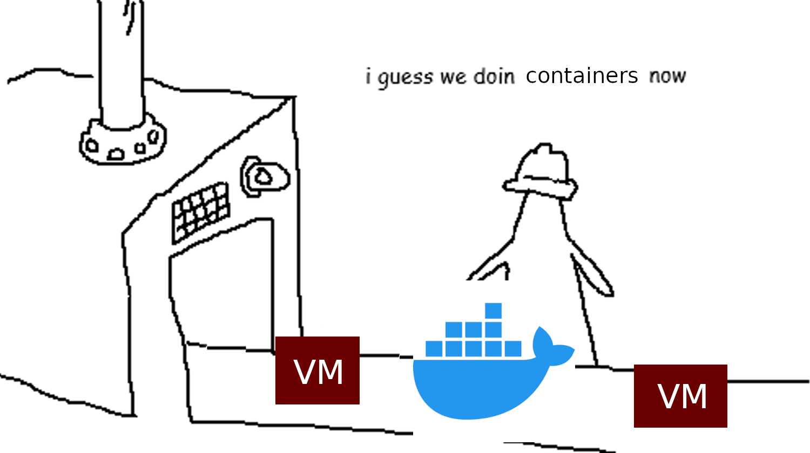

Slide 9
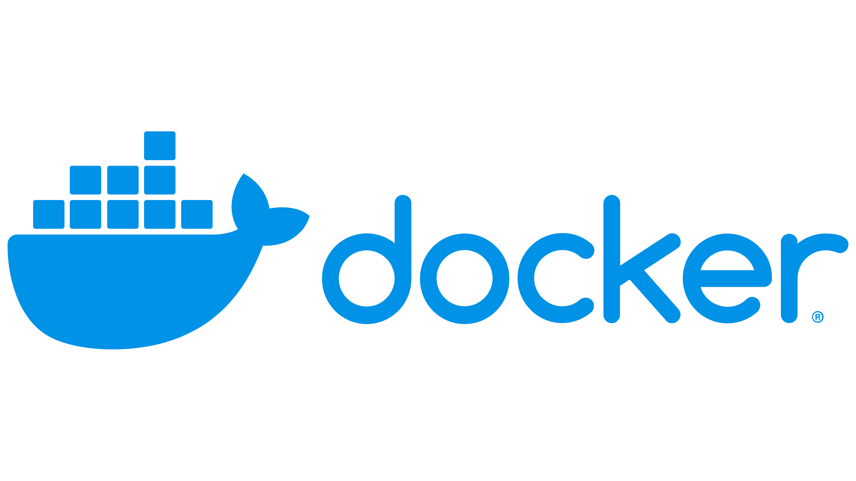
What is Docker?
Developers
Developer UX (CLI, Docker Desktop, Docker Compose)
Docker provides an easy UI/UX for managing containers and the Linux primitives around them
we need containers!
Docker Engine (container runtime, daemon, image builder, registry)
let me make containers
Host OS
Linux Kernel (cgroups, namespaces, OverlayFS)

Slide 10
Layers, Images, and Containers
"Layer" = change in filesystem
"Image" = stack of read-only layers
Docker represents the process of adding new layers using a Dockerfile
container file system
A
B
C
D
container writes
D
COPY . /app
C
read-only "image"
RUN npm install
B
FROM alpine:3.24
A

Slide 11
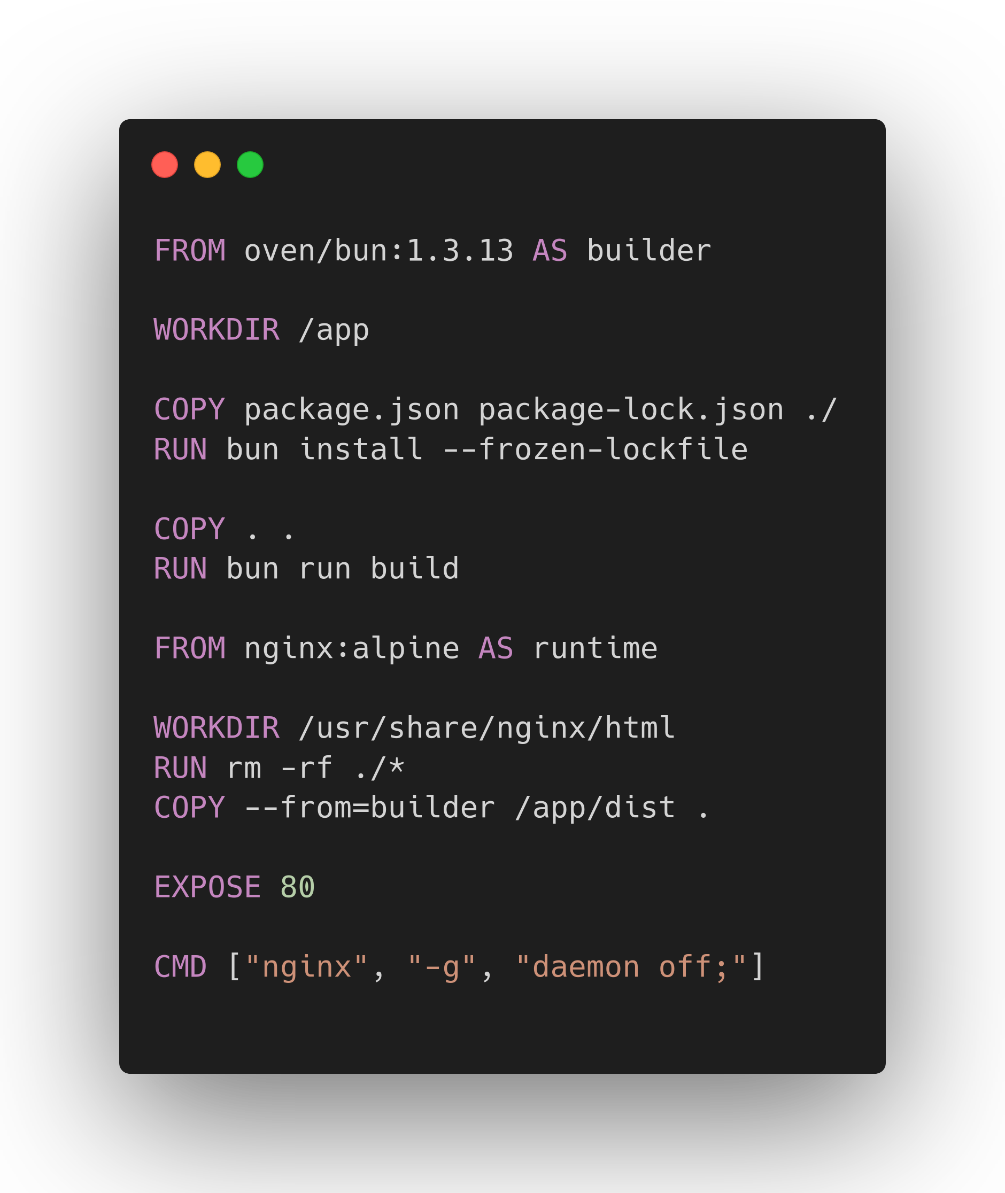
Anatomy of a Dockerfile
oven/bun is called the "base image"
Unchanged layers can be cached; good practice to treat package dependencies separately, since they change less than our code does
Multiple bases -> "multi-stage" build
Only the final stage is distributed for deployments, meaning you can make very small image sizes
"EXPOSE" is just for documentation, so ops teams know which port to use
"CMD" specifies the default arguments for the container's process

Slide 12
Demo: Containerize a Go backend

Slide 13
What if my application has multiple services?
Multi-service dependencies
  Databases
  Producer-consumer models
  Message Queues
  Caches
Tedious to manage all of this using Docker Desktop or Docker CLI

Slide 14
Docker Compose
Declarative YAML configuration for many services
Automatic hostname resolution (service "db" can now be connected to at host "db")
Easy manage using Docker CLI
services:
db:
...
frontend:
...
backend:
...
proxy:
...
connect to "frontend"
frontend
proxy
db
backend
connect to "backend"
connect to "db"
docker-compose.yml
multi-container app

Slide 15
Demo: Orchestrating a local app with Docker Compose

Slide 16
Summary
Dependencies come in many forms
Containers are just isolated processes
  Forces an app's dependencies to be explicit
Docker is a UI/UX abstraction over container management for developers
Create an image using a Dockerfile
Orchestrate multi-service apps using Docker Compose

Slide 17
Q/A & Resources
Demos, slides on GitHub: https://github.com/TU-Software/meetings/
Installing Docker on Windows: https://docs.docker.com/desktop/setup/install/windows-install/
Installing Docker on MacOS: https://docs.docker.com/desktop/setup/install/mac-install/
Docker documentation: https://docs.docker.com/
Docker Compose documentation: https://docs.docker.com/compose/

Slide 18
SECTU Links
Join the discord
Membership Roster

