Slide 2
Structure
Client-Side
Server-Side
Frontend
Application-Layer
Data-Layer
3DCityDB
Django
Apps:
- Districtgenerator
- citydb
citydb/buildings/<str:gmlid>
Cesium
citydb/timeseries/<str:gmlid>
REST-API
InfluxDB
districtgenerator/simulate/
Via HTTP GET-methods

Slide 3
Client-Side
Server-Side
Application-layer
Data-layer
Cesium App,
Express-Webserver
frontend
3DCityDB
Django 5.0 with
-citydb
- districtgenerator
citydb
djangodb

Slide 4
Triggering a simulation from the frontend
The districtgenerator can be triggered from the cesium frontend. After the simulation is done, the results are sent to the frontend and visulized.

Slide 5
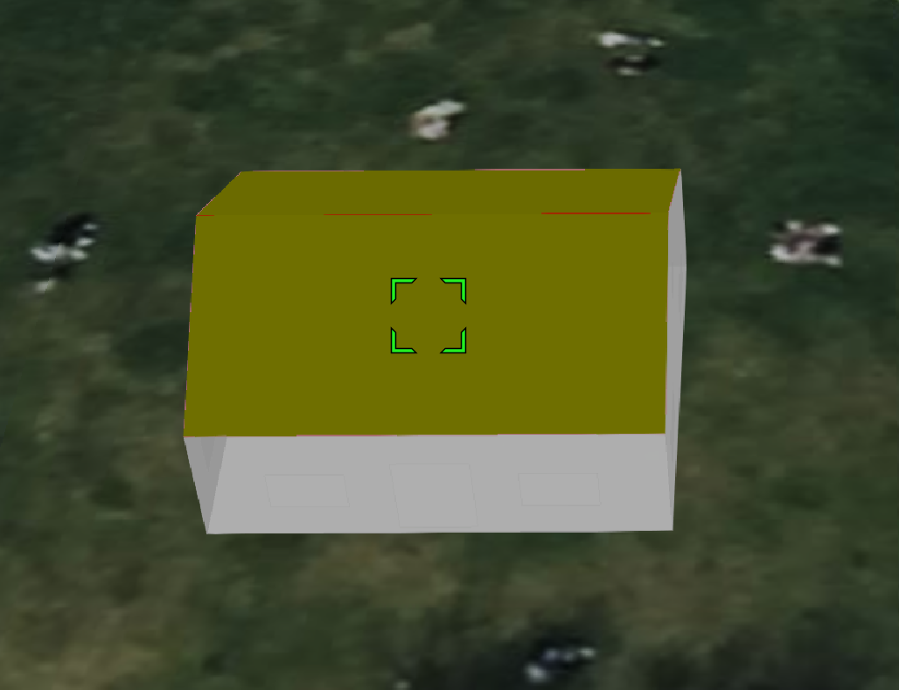
After clicking on the roof of the building the GML-ID of the building is extracted from the loaded KML-information.
Two GET-requests are sent to the djangodb backend:
- /citydb/buildings/<gmlid>
- /citydb/timeseries/<gmlid>

Slide 6
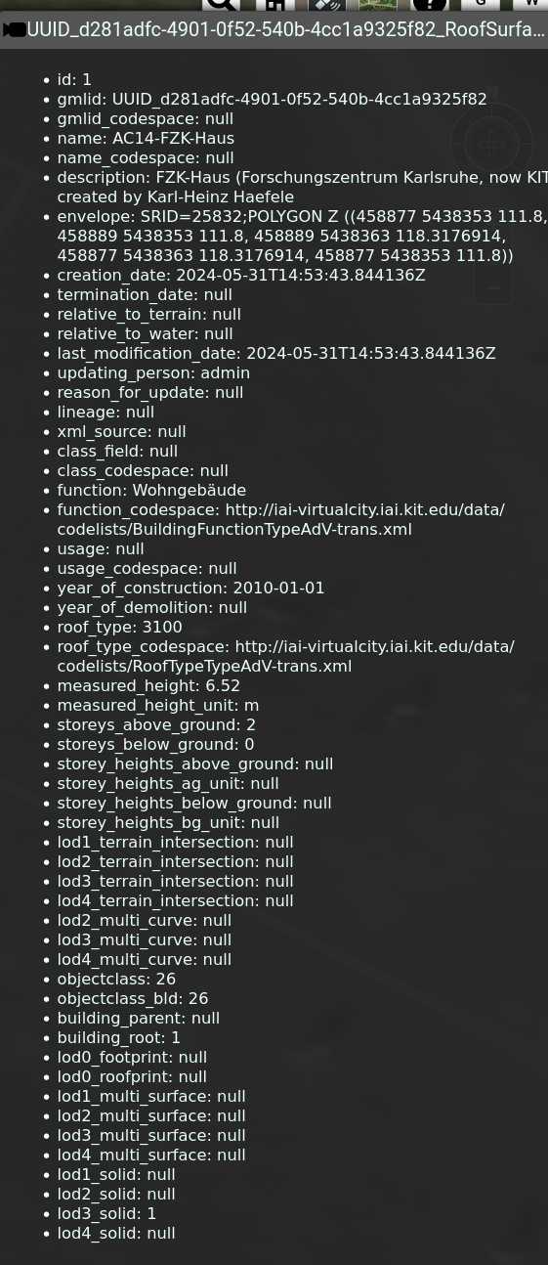
Response from endpoint buildings/ is put into container of the right side
Contains building meta-information

Slide 7
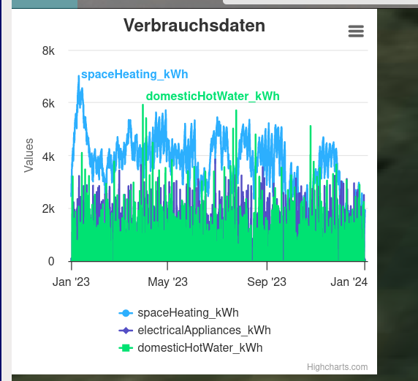
Response from /timeseries
endpoint is put into the graph on the left

Slide 8
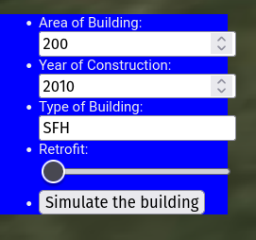
Form input container is shown on the left to set parameters for the districtgenerator simulation. Click on „simulate the building“ sends a POST-request to /districtgenerator/simulate, which starts a simulation on the backend.

Slide 9
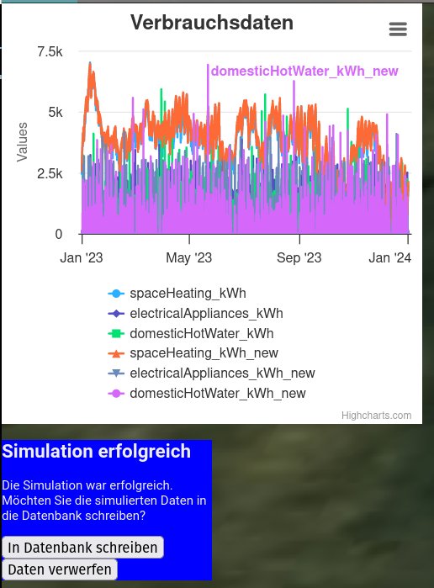
When simulation is done, the reposne contains the new timeseries
The timeseries are
also shown in the
graph.
By click on „in datenbank schreiben“ a POST-request to the endpoint „/citydb/timeseries/<gml-id>“ is sent, containing the new timeseries-data to be saved in the database.

