Slide 1
Software Product Line Evolution
Michael Nieke
September 1, 2017

Slide 2
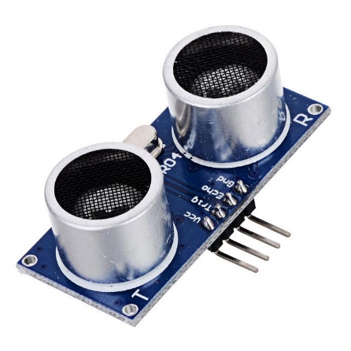
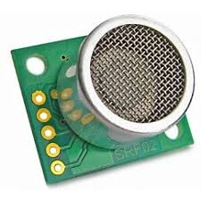

Solution-Space Evolution
Evolution
Driver update required!
Distance Sensor Driver
Updated Distance Sensor Driver

Slide 3

Solution-Space Evolution
Evolution
Driver update required!
→ Just replace it in the mapping!
How to support old hardware?
What to do with incompatibilities of other features to updated driver?
Distance Sensor Driver
Updated Distance Sensor Driver

Slide 4
Solution-Space Evolution Projected to Problem Space
Feature Versions (Capturing variability in space and time with hyper feature models, Seidl et al., VaMoS 2014)
Side Distance Sensor
1.0
2.0
Distance Sensor Driver
Updated Distance Sensor Driver

Slide 5
Evolution of Feature Models
Car
Distance Sensors
Smartphone Integration
Eco
Infotainment System
Assistance Systems
Infotainment System
Parking Assistance
Adaptive Cruise Control
Side Distance Sensor
Slow Front Distance Sensor
Fast Front Distance Sensor
Consumption Indicator
Smartphone Integration
Side Distance Sensor
Slow Front Distance Sensor
Fast Front Distance Sensor
Parking Assistance → Side Distance Sensor
Adaptive Cruise Control → Distance Sensors

Slide 6
Evolution of Feature Model Evolvable Elements
Features
Groups
Types of Features / Groups
Feature ↔ Group relations
Constraints
Feature Attributes
Car
Assistance Systems
Adaptive Cruise Control
Slow Front Distance Sensor
Fast Front Distance Sensor

Slide 7
Temporal Elements
To seamless integrate evolution in feature models: make evolution a first-class entity
Temporal Elements
Each Temporal Element has a Temporal Validity
Temporal Validities define the timespan in which an element is valid

Slide 8
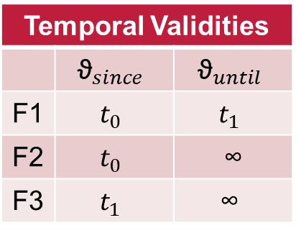




Temporal Elements
Root
Temporal Validity ϑ = [${\text{ϑ}}_{since}$;${\text{ϑ}}_{until}$)
F1
F2
F3
$$t_{0}$$
$$t_{1}$$
$$t_{2}$$

Slide 9
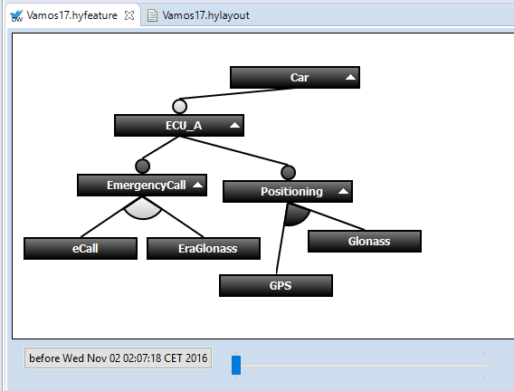
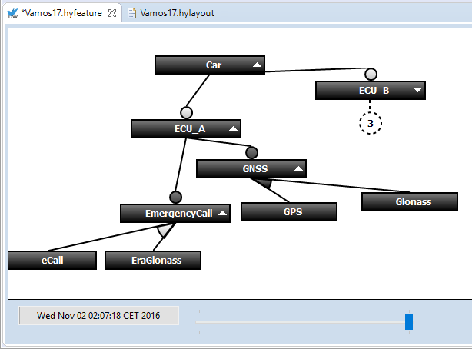
Temporal Feature Models in DarwinSPL

Slide 10

Temporal Constraints in DarwinSPL

Slide 11

Evolution Demo
https://github.com/HyVar/DarwinSPL

Slide 12
Task
Create the DeltaTalk feature model using DarwinSPL
(there is also an importer)
Do the following using a new evolution step!
Create two features „StrongEcryption“ and „SimpleEncryption“ in an alternative group under „Encryption“
„StrongEncryption“ should provide the „old“ 1337 encryption
„SimpleEncryption“ should reverse the text
→ Remap and create respective deltas

Slide 13
Evolution of Feature Model Evolvable Elements

