Slide 1
Context-Sensitive Software Product Lines
Michael Nieke
September 1, 2017

Slide 2







Running Example In-Car Emergency Call Systems

Slide 3





Running Example In-Car Emergency Call Systems – Different Countries
GPS
Glonass
eCall
ERA-Glonass
→ Spatial variability

Slide 4
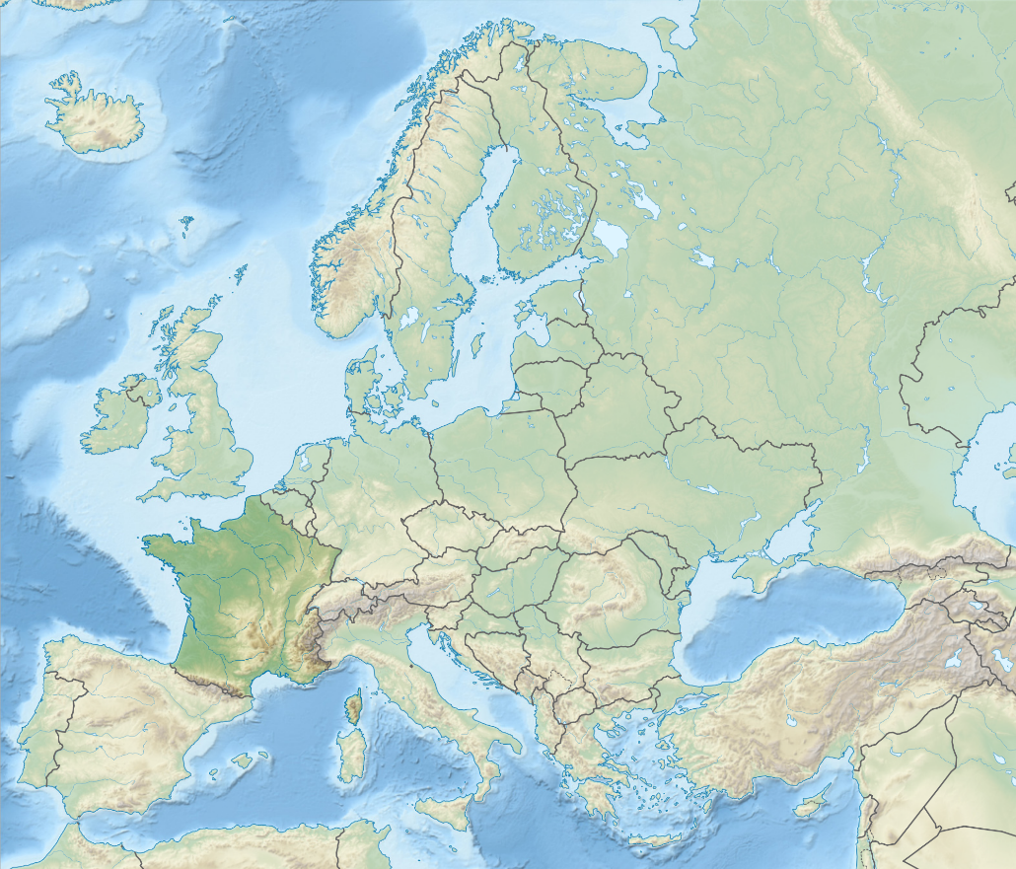



Running Example In-Car Emergency Call Systems – Context-Awareness
eCall
ERA-
Glonass
→ Contextual
variability

Slide 5




Context-Sensitive SPLs Capturing Context
Context of systems needs to be captured
Context may consist of various context information
3 types of context information with domains:
Boolean
Integer
Enum
(String)
A context is defined by values for context information

Slide 6


Context-Sensitive SPLs Context Sensitivity
Emergency Call
Systems need to adapt based on the context
For SPLs, this means feature selection needs to change
Multiple approaches:
Validity formulas (VF):
Enrich features with propositional formulas
A feature is selectable only if the VF evaluates to true
VF can relate context, attributes, and features
eCall
EraGlonass
eCall
Location = Europe
EraGlonass
Location = Russia

Slide 7
Context-Sensitive SPLs Context Sensitivity
Emergency Call
Systems need to adapt based on the context
For SPLs, this means feature selection needs to change
Multiple approaches:
Contextual cross-tree constraints:
Use context information in CTCs
Can require a feature to be seleted in a certain context
eCall
EraGlonass
Location = Europe → eCall
Location = Russia → EraGlonass

Slide 8
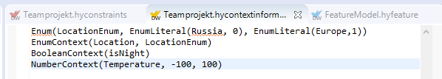
Context-Sensitive SPLs DarwinSPL – Context Information
Context information syntax:
Define enums and values: Enum(<EnumName>, EnumLiteral(<LiteralName>, <value>), EnumLiteral(<LiteralName>, <value>), …)
Define context information:
Boolean: BooleanContext(<Name>)
Enum: EnumContext(<Name>, <EnumName>)
Integer: NumberContext(<Name>, <min>, <max>)

Slide 9
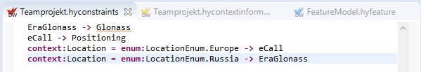

Context-Sensitive SPLs DarwinSPL –Contextual Constraints & Validity Formulas
Contextual Constraints:
Integrated in „normal“ constraint editor
Contextual information identified using „context:“ keyword
Enums identified using „enum:“ keyword → enum literal value: „enum:<enumName>.<literalName>
Syntax Validity Formulas:
<FeatureName> : <Validity Formula>
The validity formula itself is written as constraints

Slide 10

Demo
https://github.com/HyVar/DarwinSPL

Slide 11
Task
Create contextual information „Location“ with „USA“, „Europe“ and „else“ as values
In the USA, only „SimpleEncryption“ is allowed to be used, as the CIA wouldn‘t be able to crack the „StrongEncryption“
In Europe, the „StrongEncryption“ is mandatory
In the rest of the world, no specific encryption type is required

