Slide 1
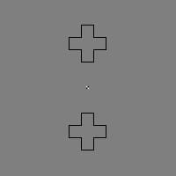
Neural Network Models of Visual Perception with Contour Adaptation

Slide 2
Gregory Francis – Contour Adaptation Model - Matlab
Extension of FACADE (Form-And-Color-And- Depth) “-” interconnected
Originally developed by Grossberg 1990, with additional stereoscopic vision and object recognition capabilities

Slide 3
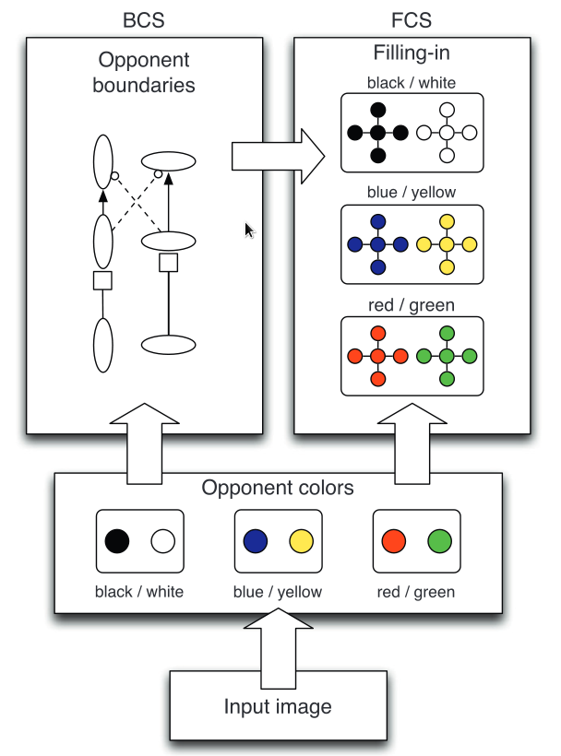
Model Breakdown
(as described by Francis)
Two complementary and interacting pathways.
Combines Feature Contour System (FCS) and Boundary Contour System (BCS) replicating physiological components.
BCS constrains FCS.
Contour Adaptation occurs in BCS

Slide 4
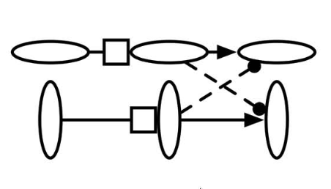
Boundary Contour System
Gated Dipole Circuit
Habituating neurotransmitter gate (box) depletes over time (≈ neuron activity)
Excitation within orientation (↑), Inhibition across orientations (¦)
Result is dynamic, orientation selective, time dependent representation of boundaries in an image

Slide 5

Feature Contour System
Filling-in Domains
Filling-in typically modeled by diffusion of brightness and color (However the diffusion equation computationally expensive)
Instead, connected regions are identified across the image from pixels in the immediate surround
Pixel color and brightness within these connected regions are averaged (“filled in”)

Slide 6
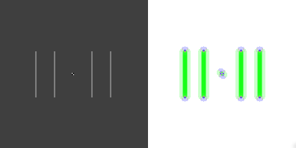
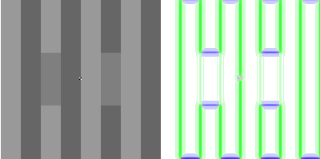
Code components
# evaluate function
LGNkernels()
for time in range(t):
timeCount= timeCount+1
createStimulus(time)
LGNcells()
simpleCell()
complexCell()
gateComp(time)
dipoleComp()
fillingFIDO()
saveImages()

Slide 7
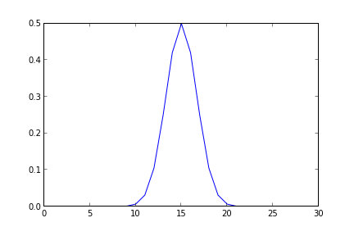
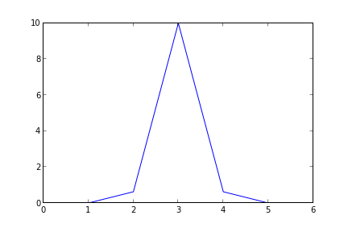
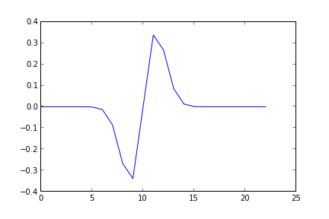
LGNkernels
Creates 2D Gaussian pulse filters for later use:
Inhibitory and Excitatory filters (C & E)
ODOG filters (F)

Slide 8
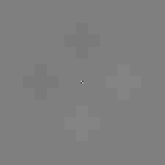
createStimulus
Input image created, various literature based examples
condition = “choice”
e.g. Crosses
Converted into RGB components
”wb” channel used predominately

Slide 9
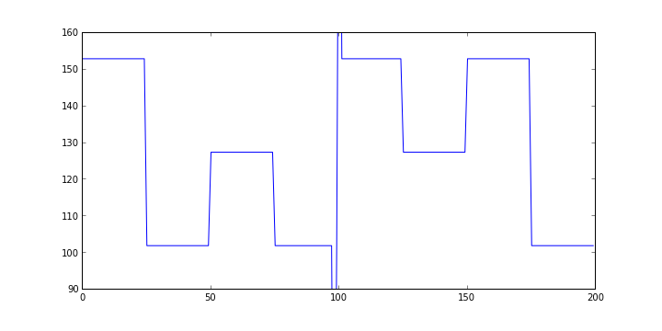
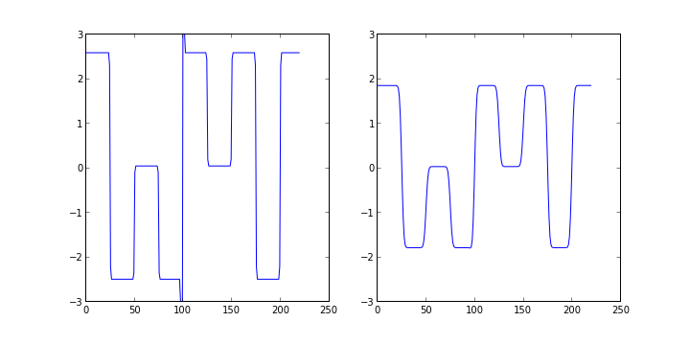
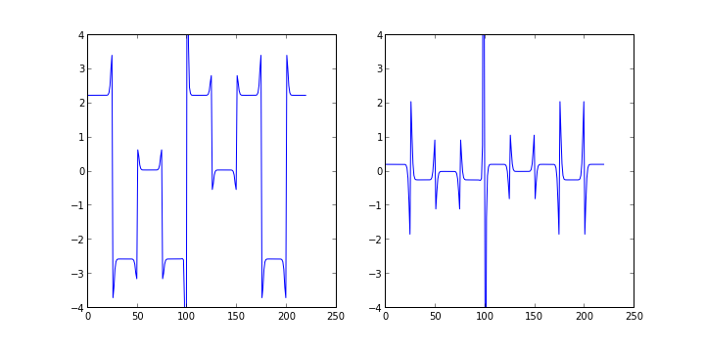
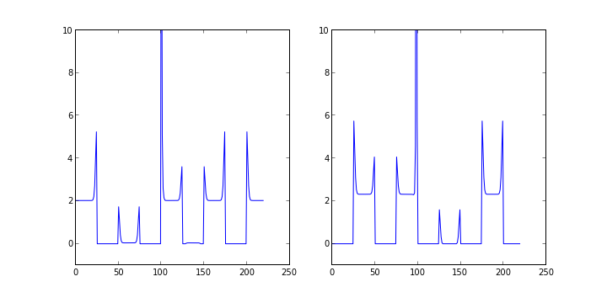
LGNcells
Inhibitory and Excitatory inputs at each pixel produced by convolving “wb” image channel with Inhibitory and Excitatory 2d Gaussian filters. Centers test gray as zero Reduces magnitude (inhibitory - smoothes)
Excitatory and Inhibitory inputs are summed into OnOff and OffOn Interiors of bars magnitudes are altered – edges stay constant Light bars darken, dark bars lighten
OffOn and OnOff combined and half wave rectified producing positive and negative signals. Dark bars ignored.. These are combined to produce output signal of LGN...

Slide 10
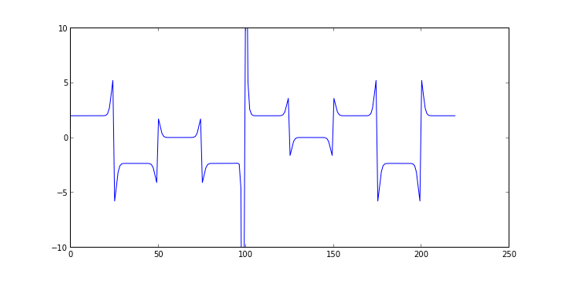
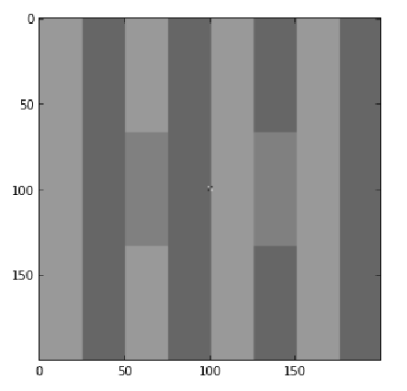
LGNcells output
Magnitude range of stimuli is reduced. Edges consist of sharp contrast spikes Test gray centered at zero

Slide 11
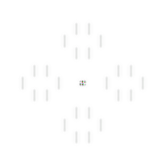
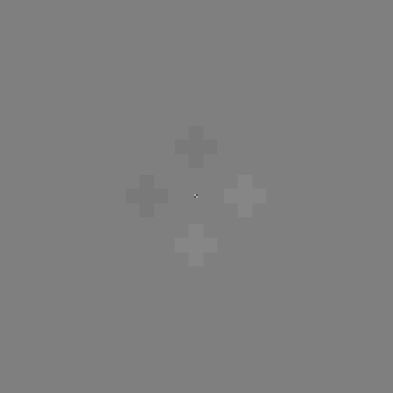
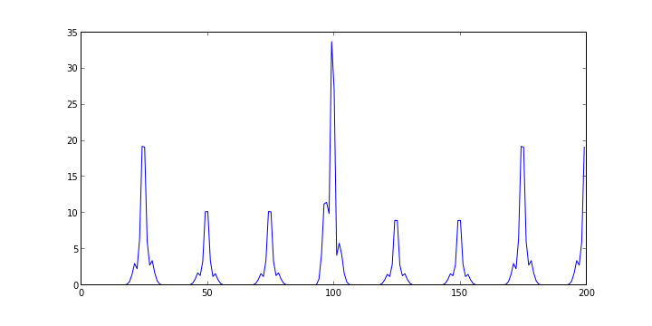
simpleCell
LGNcell output signal (image) convolved with Oriented-Difference-of- Offset-Gaussian (ODOG) filters created in LGNcells function

Slide 12
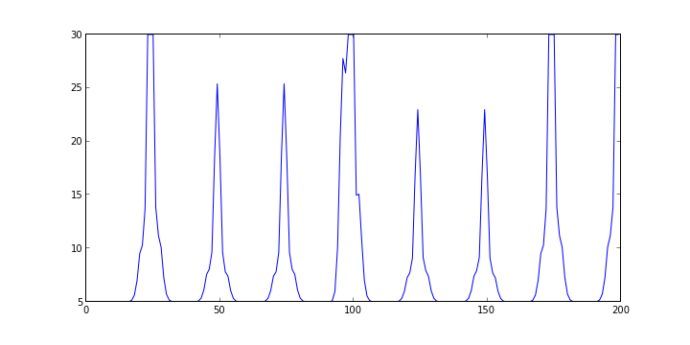
complexCell
4 Simple cell filter polarities summed into 2 directions
Threshold set ( maximum = 25 )
Tonic input added (boost magnitude by +5)
This represents the
boundary signal

Slide 13
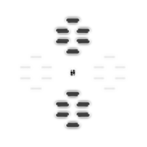
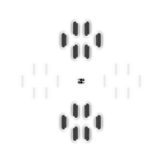
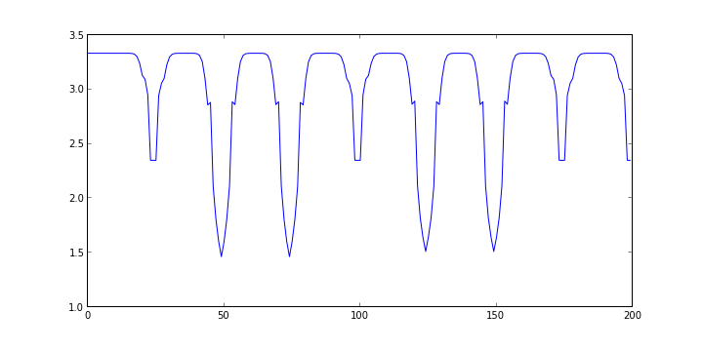
gateComp
Initiated on first time step
Produced by manipulating boundary signals
Boundary signal stronger when adapter present → gate weaker
“Habituating orientation-specific gates”

Slide 14
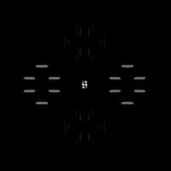
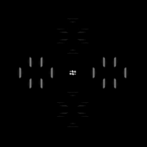
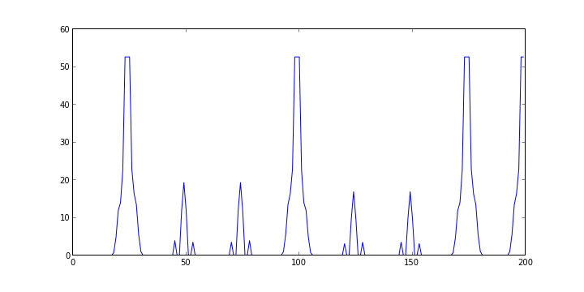
dipoleComp
Combines complexCell and gateComp signals with cross orientation weighting
Sig_h = (gate_h*complex_h) - (W*gate_v*complex_v ), W=0.5
Sig_v = (gate_v*complex_v) - (W*gate_h*complex_h ), W=0.5
Half wave rectified and threshold set to 50
Output of gate dipole circuit:

Slide 15
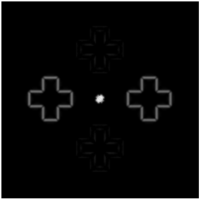
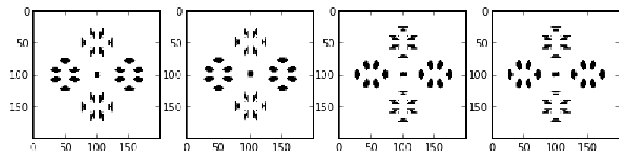
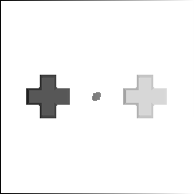
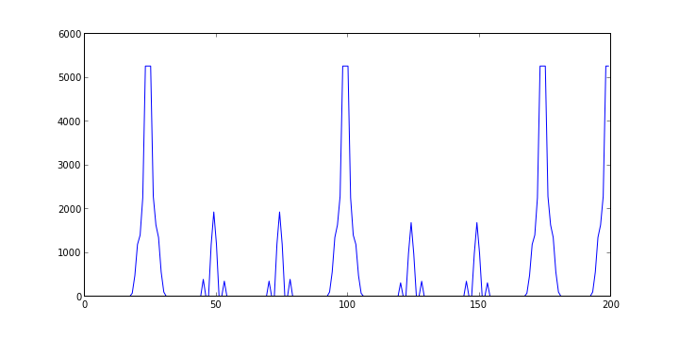
fillingFIDO
dipoleComp signal summed across orientations, amplified and a threshold set
Boundary structures used to identify distinct filling in domains.
A image formed with ISO-numerical regions (FIDOs)

Slide 16
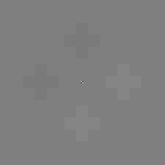
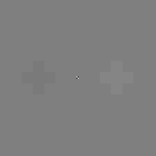
fillingFIDO
Using the initial stimulus as a base, the FIDO image is used to average across uniform regions.
Producing the output of the code.

Slide 17
saveImages
Save location and image type specified
Colors horizontal boundaries blue and vertical boundaries green for boundary image.

Slide 18
Creating a movie GIF
From the command line, go to the directory with the images and type:
convert -quality 100 -dither none -delay 10 -loop 0 All*.png Movie.gif

Slide 19
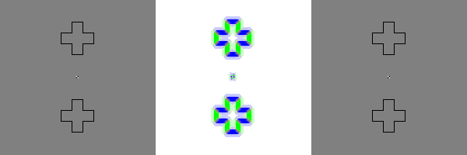
Final Output

Slide 20
Limitations
Not all stimuli match psycho-physical results
Brightness contrast not explained
Relatively simple stimuli
Currently only 2 orientations
Only works under low contrast conditions (<0.1)

Slide 21
Extensions
ISO-orientation surround suppression implementation

