Slide 1
Neural Network Models of Visual Perception
What they aim to do
Provide quantitative theoretical frameworks of visual perception
Use perceptual illusions to illuminate processing

Slide 2
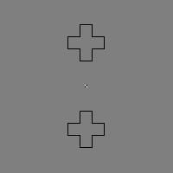
Contour Adaptation

Slide 3
Gregory Francis – Contour Adaptation Model
Extension of FACADE (Form-And-Color-And- Depth) “-” interconnected
Originally developed by Grossberg 1990, with additional stereoscopic vision and object recognition capabilities, inspired by Quantum Mechanical concepts.

Slide 4
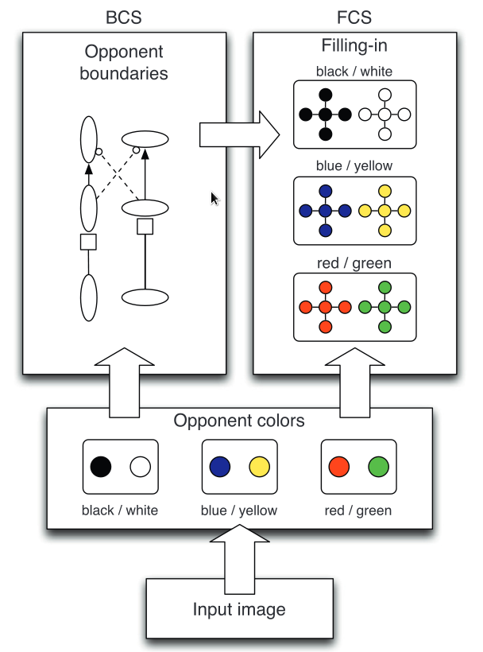
Model Breakdown
Two complementary and interacting pathways.
Combines Feature Contour System (FCS) and Boundary Contour System (BCS) replicating physiological components.
BCS constrains FCS.
Contour Adaptation occurs in BCS

Slide 5
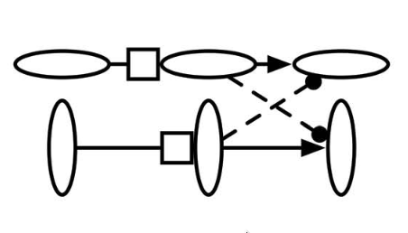
Gated Dipole Circuit
2 parallel orientation channels
Habituating neurotransmitter gate (box) depletes over time (≈ neuron activity)
Excitation within orientation (↑), Inhibition across orientations (¦)
Common Tonic input (mediates after responses)

Slide 6
Gated dipole Circuit components
LGN cells
Simple cells
Complex cells
Gates
Cross Orientation Dipole Competition

Slide 7
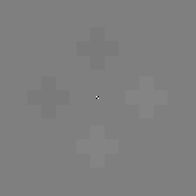
Code Breakdown
Input image [200x200]
condition = “choice”
e.g. Crosses
Converted into RGB components
”wb” channel used predominately

Slide 8
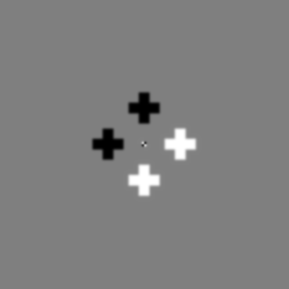
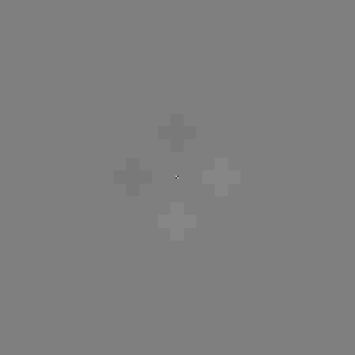
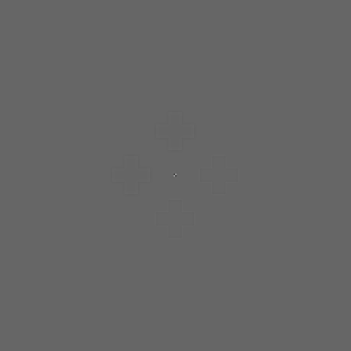
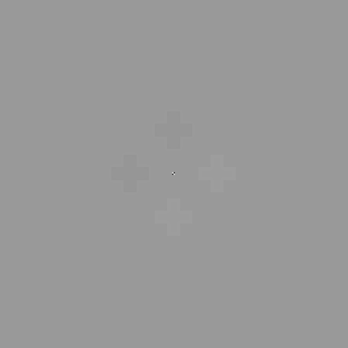
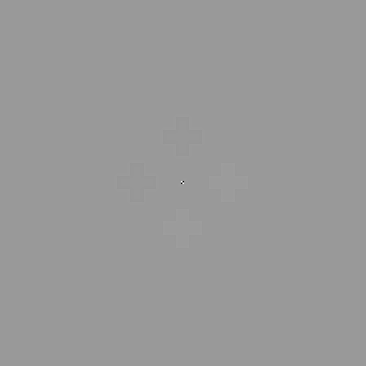
LGN cells
Inhibitory and Excitatory inputs at each pixel produced by convolving “wb” image channel with Inhibitory and Excitatory 2d Gaussian filters.
Excitatory and Inhibitory inputs are summed into OffOn and OnOff
OffOn and OnOff combined and half wave rectified producing positive and negative signals. These are combined to produce output signal of LGN

Slide 9
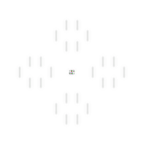
Simple Cell
LGN “wb” channel signal convolved with Oriented-Difference-of- Offset-Gaussian (ODOG) filters

Slide 10
Complex Cell
4 Simple cell filter polarities summed into 2 directions
Boundary upper limit set to 25 (/127)
Tonic input added
This represents the boundary signal

Slide 11
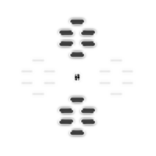
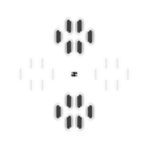
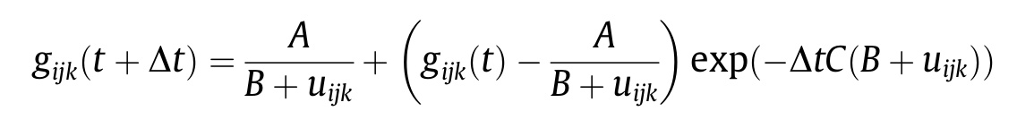
Gates
Initiated on first time step
Produced by manipulating boundary signals (u)
Boundary signal stronger when adapter present → gate weaker
Habituating orientation-specific gates

Slide 12
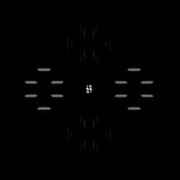
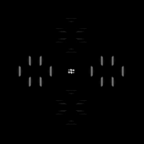
Cross Orientation Dipole Competition
V_1 = (gate_1*w1_1) - (W*gate_2*w1_2 ), W=0.5
Half wave rectify and threshold
Output of gate dipole circuit:

Slide 13
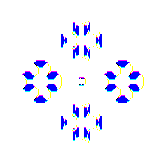
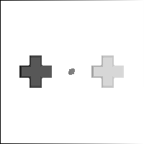
Filling-In-DOmains (FIDOs)
Diffusion of brightness and color (Diffusion equation slow to code)
Connected regions identified across image plane
Pixel color and brightness within connected regions are averaged

Slide 14
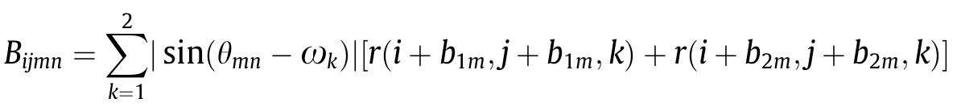
Region Connectors
Blocking signal

Slide 15
Filling-In
Insert code and describe
“The spatial pattern of these values was interpreted as the perceptual experience of the observer.”

Slide 16
Creating a movie GIF
From the command line, go to the directory with the images and type:
convert -quality 100 -dither none -delay 10 -loop 0 All*.png Movie.gif

Slide 17
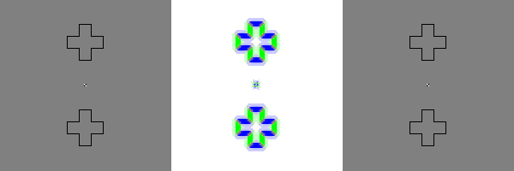
Final Output

Slide 18
Limitations
Simple input images

Slide 19
Extensions
Adding noise
ISO-orientation surround suppression implementation

