Slide 1
Software Testing and Reverse Engineering CS4110
Sicco Verwer, Andy Zaidman, Annibale Panichella, Gaetano Pellegrino, Mark Janssen, Arnd Hartmanns, Arie van Deursen

Slide 2
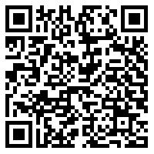
By helping us improve the 3TU Cyber Crime Science course, you participate in a raffle to win an Ipod Shuffle! How? 1. By filling in a short questionnaire now and in 5 months 2. Make sure you write down your ‘magic word’ so that you can participate in the raffle and claim the prize if you win. https://docs.google.com/forms/d/1yaAM1nI2nassZZKmQ6ZP_Pd0wgpTIKfzPwoUa_KwKVo/viewform?usp=send_form

Slide 3
Why?
Software is one of the most complex artifacts of mankind
Errors are easily made and hard to find
In this course, we study automated methods to help find these errors
Background:
Software Engineering
Artificial Intelligence
Machine Learning
Many Smart Tricks…

Slide 4
Setting
You are given a piece of software, does it work correctly?
2 subproblems:
What does it do?
Reverse engineering
What should it do?
Testing

Slide 5
Exercise: spot the bugs
int balance;
void decrease(int amount)
{
if (balance <= amount)
{
balance = balance – amount;
}
else
{
printf(“Insufficient funds\n”);
}
}
void increase(int amount)
{
balance = balance + amount;
}

Slide 6
Exercise: spot the bugs
int balance;
void decrease(int amount)
{
if (balance <= amount)
{
balance = balance – amount;
}
else
{
printf(“Insufficient funds\n”);
}
}
void increase(int amount)
{
balance = balance + amount;
}
should be >=

Slide 7
Exercise: spot the bugs
int balance;
void decrease(int amount)
{
if (balance <= amount)
{
balance = balance – amount;
}
else
{
printf(“Insufficient funds\n”);
}
}
void increase(int amount)
{
balance = balance + amount;
}
should be >=
what if amount is negative?
what if amount is negative?

Slide 8
Exercise: spot the bugs
int balance;
void decrease(int amount)
{
if (balance <= amount)
{
balance = balance – amount;
}
else
{
printf(“Insufficient funds\n”);
}
}
void increase(int amount)
{
balance = balance + amount;
}
should be >=
what if amount is negative?
what if amount is negative?
what if sum is too large for int?

Slide 9
Exercise: spot the bugs
int balance;
void decrease(int amount)
{
if (balance <= amount)
{
balance = balance – amount;
}
else
{
printf(“Insufficient funds\n”);
}
}
void increase(int amount)
{
balance = balance + amount;
}
should be >=
what if amount is negative?
what if amount is negative?
what if sum is too large for int?
How to do this for thousands of lines of code….

Slide 10
Different settings: code and tests
int balance;
void decrease(int amount)
{
if (balance <= amount)
{
balance = balance – amount;
}
else
{
printf(“Insufficient funds\n”);
}
}
void increase(int amount)
{
balance = balance + amount;
}
…
balance = 10; decrease(5);
assert(balance = 5);
increase(5);
assert(balance = 10);
…

Slide 11
Different settings: code and tests
int balance;
void decrease(int amount)
{
if (balance <= amount)
{
balance = balance – amount;
}
else
{
printf(“Insufficient funds\n”);
}
}
void increase(int amount)
{
balance = balance + amount;
}
…
balance = 10; decrease(5);
assert(balance = 5);
increase(5);
assert(balance = 10);
…
Typical question:
Are the tests sufficient?

Slide 12
Different settings: only code
int balance;
void decrease(int amount)
{
if (balance <= amount)
{
balance = balance – amount;
}
else
{
printf(“Insufficient funds\n”);
}
}
void increase(int amount)
{
balance = balance + amount;
}

Slide 13
Different settings: only code
int balance;
void decrease(int amount)
{
if (balance <= amount)
{
balance = balance – amount;
}
else
{
printf(“Insufficient funds\n”);
}
}
void increase(int amount)
{
balance = balance + amount;
}
Typical question:
What are good tests?

Slide 14
Different settings: obfuscated code
…
if(((((input.equals(inputs[2]) && (((a305 == 9) && (((a14.equals("f")) && cf) && a94 <= 23)) && (a185.equals("e")))) && a277 <= 199) && ((a371 == a298[0]) && (((a382 && (a287 == a215[0])) && (a115.equals("g"))) && a396))) && a47 >= 37)) {
cf = false;
a170 = a1;
a185 = "f";
a100 = ((((((a94 * a94)%14999)%14901) + -15097) / 5) + -2185);
System.out.println("X");
}
…

Slide 15
Different settings: obfuscated code
…
if(((((input.equals(inputs[2]) && (((a305 == 9) && (((a14.equals("f")) && cf) && a94 <= 23)) && (a185.equals("e")))) && a277 <= 199) && ((a371 == a298[0]) && (((a382 && (a287 == a215[0])) && (a115.equals("g"))) && a396))) && a47 >= 37)) {
cf = false;
a170 = a1;
a185 = "f";
a100 = ((((((a94 * a94)%14999)%14901) + -15097) / 5) + -2185);
System.out.println("X");
}
…
Typical question:
What does it do?

Slide 16
Different settings: binary executable
…
push ebp
mov ebp, esp
sub esp, 18h
mov [ebp-8], ebx
mov [ebp-4], esi
mov ebx, [ebp-8]
mov esi, [ebp-4]
mov esp, ebp
pop ebp
retn
…

Slide 17
Different settings: binary executable
…
push ebp
mov ebp, esp
sub esp, 18h
mov [ebp-8], ebx
mov [ebp-4], esi
mov ebx, [ebp-8]
mov esi, [ebp-4]
mov esp, ebp
pop ebp
retn
…
Typical question:
Can it be broken?

Slide 18
What will you learn
What is testing and reversing research?
State-of-the-art software testing and reversing tools
Apply these tools to real software:
Own projects
Open source software
Communication protocols
CrackMe and/or Malware

Slide 19
What will you do
Team up with two fellow students
Read papers on a chosen topic
Write a summary of these and at least 3 self-chosen papers
Present the topic
Answer questions
Ask questions on at least one other topic
Have fun in the lab
Apply techniques from your topic to real software
Report and present the results

Slide 20
Program
Week | Lecture, Lecture hall Chip |  | Lab, Dijkstrazaal, 9th
1 | 9 Feb | Today
2 | 16 Feb | Automated reversing
3 | 23 Feb | Test case generation
4 | 1 Mar | Paper presentations
5 | 8 Mar | Paper presentations
6 | 15 Mar | Binary Analysis | 18 Mar | Assistance
7 | 22 Mar | Modern software testing | 25 Mar | Assistance
8 | 29 Mar | TBA | 1 Apr | Assistance
9 | 5 Apr | Final presentations | 2 Apr | Finalizing
Lectures on Tuesday, 13:45 till 15:45
Lab sessions, start March 18th, Friday, 10:45 till 12:45
Lab connection to Twente via Skype/Double

Slide 21
Grading
Lab: 50%
Ability
Independence
Results
Report: 30%
Easy to understand explanation of complex techniques
Detailed presentation of results
Justified conclusions
Presentation: 20%
Capture content in slides
How to do science in reversing and testing
Answering/asking questions
NO EXAM!

Slide 22
Collaboration
Git:
https://github.com/TUDelft-CS4110
Slack:
https://cs4110.slack.com/
No use of Blackboard!

Slide 23
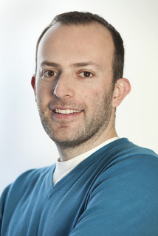
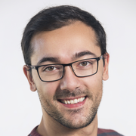
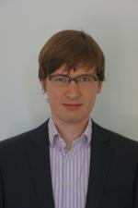


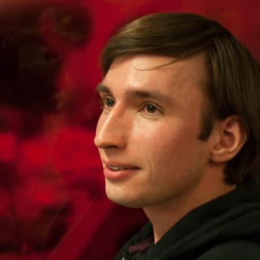
Topics
Tools for automated testing
Mutation analysis
Test case generation
and automated reverse engineering
Fuzzing
Concolic testing
State machine learning
Binary analysis
Twente

Slide 24
Mutation testing

Slide 25
Production code can be covered, yet the tests covering it might still miss a bug (i.e., the tests are not of sufficient quality)
Is there another way of looking into the quality of tests?

Slide 26
Mutation testing by example
Original
if( i >= 0 ) {
return "foo";
} else {
return "bar";
}
Test
Code is transformed, mutant introduced
Tests remain identical
Mutant
if( i < 0 ) {
return "foo";
} else {
return "bar";
}
Test
Scenario 1
→ Mutant alive
Scenario 2
→ Mutant killed

Slide 27
Some important questions…
What you will learn from reading the papers
What is mutation testing, what can it do for you?
Are these mutants representative of actual bugs?
What you will learn from working with Pitest
Take one of your former well-tested student projects and apply mutation testing to it. What do you find?
Take 2/3 open source projects of your choice, determine its test coverage and apply Pitest to it

Slide 28
Automated Test Case Generation
Search-Based Software Testing

Slide 29
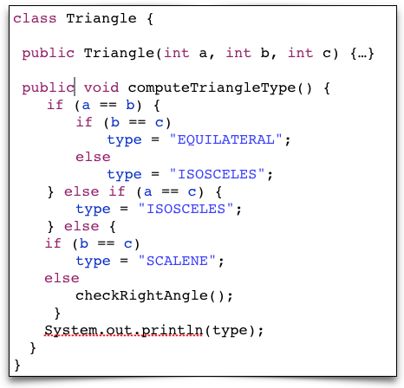
Traditional Testing
manual design of test cases / scenarios
Class Under Test

Slide 30
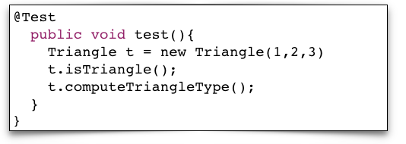
Traditional Testing
manual design of test cases / scenarios
Class Under Test

Slide 31
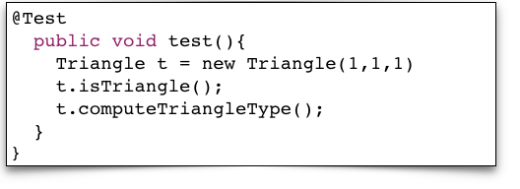
Traditional Testing
manual design of test cases / scenarios
Class Under Test

Slide 32
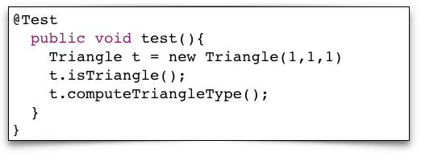
Traditional Testing
manual design of test cases / scenarios
Class Under Test

Slide 33
Traditional Testing
manual design of test cases / scenarios
Difficult!
(Find faults ?)
Laborious,
Time-consuming
Tedious

Slide 34
Traditional Testing
manual design of test cases / scenarios
Difficult!
(Find faults ?)
Laborious,
Time-consuming
Tedious
Search-Based Software Testing:
Automatic Generation of Test Cases
“It is not a human’s time being consumed”

Slide 35
Traditional Testing
manual design of test cases / scenarios
Difficult!
(Find faults ?)
Laborious,
Time-consuming
Tedious
Search-Based Software Testing:
Automatic Generation of Test Cases
“It is not a human’s time being consumed”
Search-Based Software Testing:
Using good fitness function to
reach/expose the faults

Slide 36

Evolutionary Testing
Evolution in Nature
Time

Slide 37
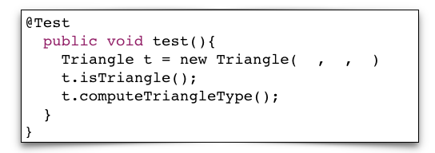
Evolutionary Testing
Evolving Tests
Evolution in Nature
Time

Slide 38
Evolutionary Testing
Evolving Tests
Evolution in Nature
Time

Slide 39
Evolutionary Testing
Evolving Tests
Evolution in Nature
Time

Slide 40
Evolutionary Testing
Evolving Tests
Evolution in Nature
Time

Slide 41
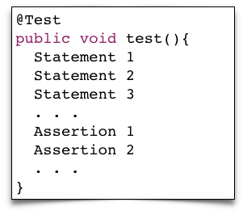
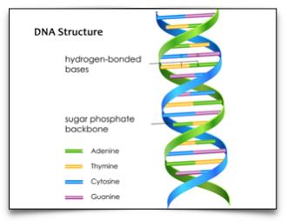
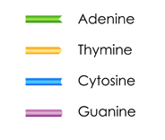
Evolutionary Testing
Basic Elements
Basic Elements

Slide 42
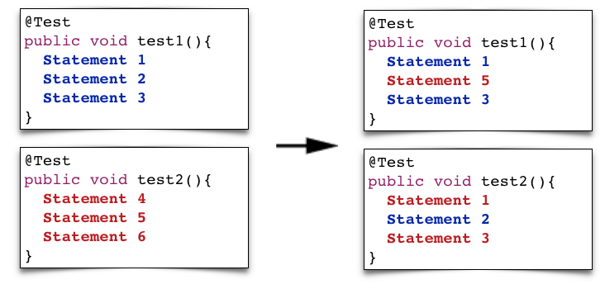
Evolutionary Testing
Recombination
Recombination
Parental
Tests
Recombined
Tests
Parental
DNA
Recombined
DNA

Slide 43
What will you learn?
From reading the papers:
What is evolutionary testing?
What are “fittest” tests?
3) Coverage?
From working with EvoSuite:
Take one of your former well-tested student projects and generate tests.
What are the differences between manual/automated tests in terms of coverage?
What are the differences between manual/automated tests in terms of “readability”?

Slide 44
Fuzzing

Slide 45
Security/penetration testing
Normal testing investigates correct behavior for sensible inputs, and inputs on borderline conditions
Security testing involves looking for the incorrect behavior for really silly inputs
Try to crash the system!
and discover why it crashed!
In general, this is very hard

Slide 46
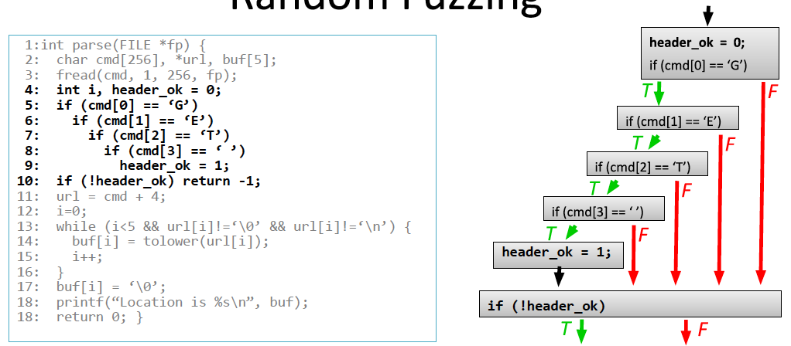
Fuzzing
Test different inputs at random, until the system crashes
What is the probability of reaching line 11 with random input?

Slide 47
Structured input
When input has to start with eg. ‘http’, testing all possible strings that start differently is a waste of time
Fortunately, we often know:
Example input files or strings
Protocol specifications, or test implementations
Solutions:
Generate random permutations from example files
Mutation-based fuzzing
Fuzz only values but keep in line with the specification
Protocol (generative) fuzzing

Slide 48
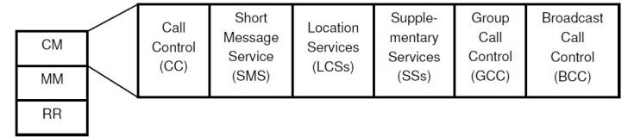
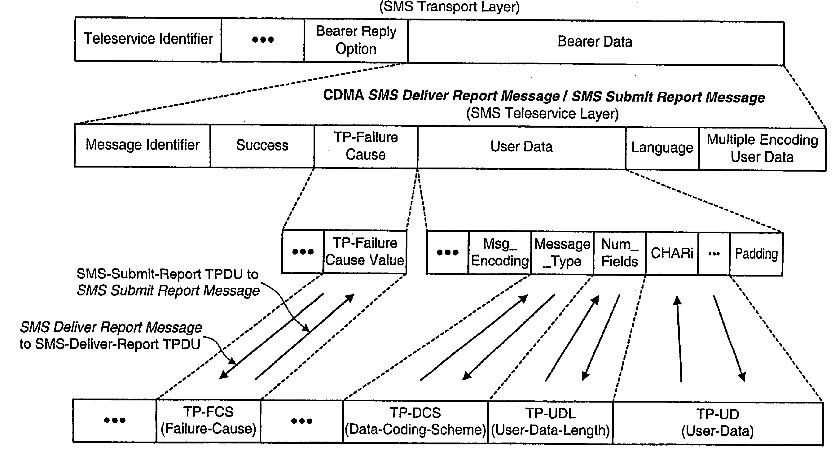
Example : GSM protocol fuzzing
GSM is an
extremely rich &
complicated
protocol
Example and slides from Erik Poll

Slide 49
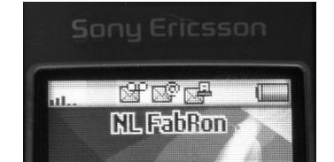
Example : GSM protocol fuzzing
Fuzzing SMS layer of GSM reveals weird functionality in GSM standard and on phones
eg possibility to send faxes (!?)
Only way to get rid if this icon: reboot the phone
you have a fax!

Slide 50
Example : GSM protocol fuzzing
Fuzzing SMS layer of GSM reveals weird functionality in GSM standard and on phones
eg possibility to send faxes (!?)
Only way to get rid if this icon: reboot the phone
you have a fax!
Fuzzing is a lot of fun!

Slide 51
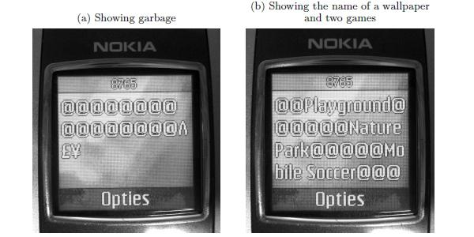
Example : GSM protocol fuzzing
More serious: malformed SMS text messages display raw memory content, rather than a text message

Slide 52
Concolic testing concrete and symbolic testing

Slide 53
Smarter fuzzing: use system code!
Can we automatically generate interesting input values?

Slide 54
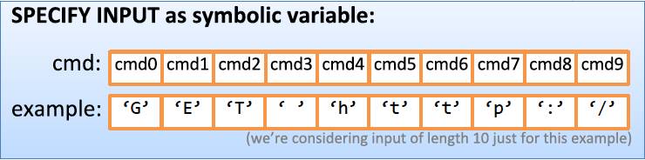
Path exploration
Try to assignments to all values in cmd that make the program reach line 11:
Represent all values as symbolic variables
Write down a formula describing all paths through the program that reach line 11

Slide 55
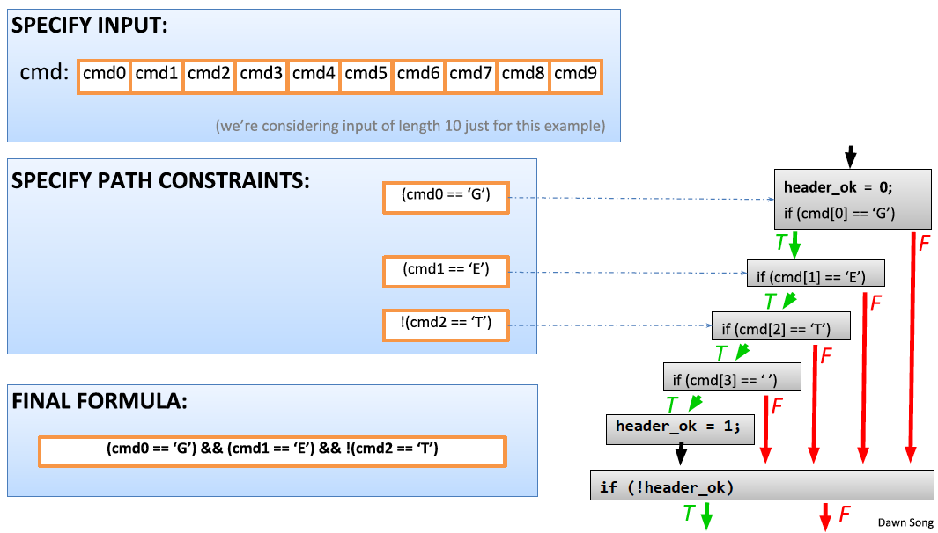
Path exploration
(cmd0 == ‘G’) & (cmd1 == ‘E’) & (cmd2 == ‘T’) & (cmd3 == ‘ ’)

Slide 56
Symbolic execution
Represent all inputs as symbolic values and perform operations symbolically
cmd0, cmd1, …
Path predicate: is there a value for command such that
(cmd0 == ‘G’) & (cmd1 == ‘E’) & (cmd2 == ‘T’) & (cmd3 == ‘ ’) ?
Provide all constraints to a combinatorial solver, eg. Z3
Answer: YES, with cmd0 = ‘G’, cmd1 = ‘E’, …, cmd9 = x
Only fuzz inputs that satisfy the provided answer!

Slide 57
Symbolic execution, example
m(int x,y){
x = x + y;
y = y – x;
if (2*y > 8) { ....
}
else if (3*x < 10){ ...
}
}
Write down the path predicate needed to reach this line

Slide 58
Symbolic execution, example
m(int x,y){
x = x + y;
y = y – x;
if (2*y > 8) {…
}
else if (3*x < 10){…
}
}
So, (N>=-4) & 3(M+N)<10
// let x == N and y == M
// x becomes N+M
// y becomes M-(N+M) == -N
// taken if 2*-N > 8, ie N < -4
// taken if N>=-4 and 3(M+N)<10

Slide 59
Some important questions…
What you will learn from reading the papers
What are fuzzing and concolic testing methods, what bugs can you find using them?
When is it beneficial to test concolicly?
What you will learn from working with AFL/Klee/Angr:
Take one of your former student projects, fuzz it and apply concolic testing. Can you make it crash? What are the bugs you find?
Test executable with known bugs, e.g. ImageMagick:
https://www.cvedetails.com/vulnerability-list/vendor_id-1749/Imagemagick.html
What are the bugs you find? Compare with CVE.

Slide 60
State machine learning

Slide 61
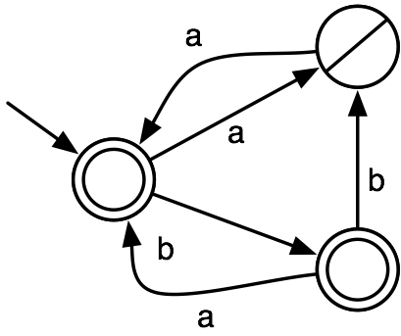
Deterministic Finite State Automata
, b
(a,-),(ab,+),(aa,+),(b,+),(bb,-),(bab,+)

Slide 62
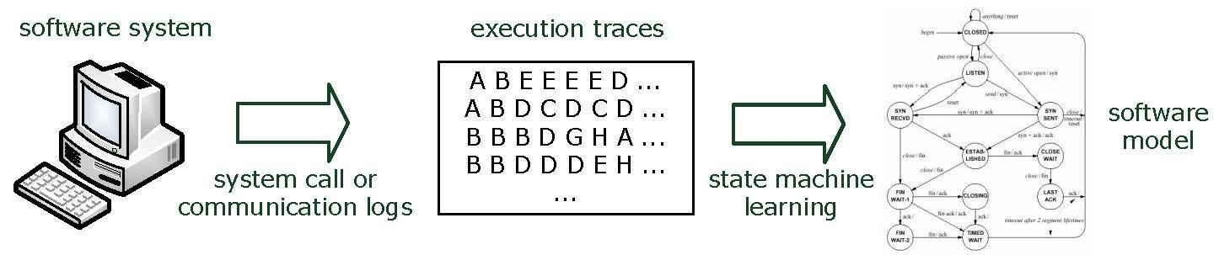
State machine learning
Passive learning

Slide 63
State machine learning
Queries (input)
Active learning

Slide 64
Why learn state machines?
Powerful analysis methods (e.g., model checkers) are available that can use learned models
Very intuitive models for software systems
Often we don’t have models of software components
Even when we have models, implementations are often wrong
Also been used for modeling:
Bioinformatics, music, physics, robotics, natural language, …

Slide 65
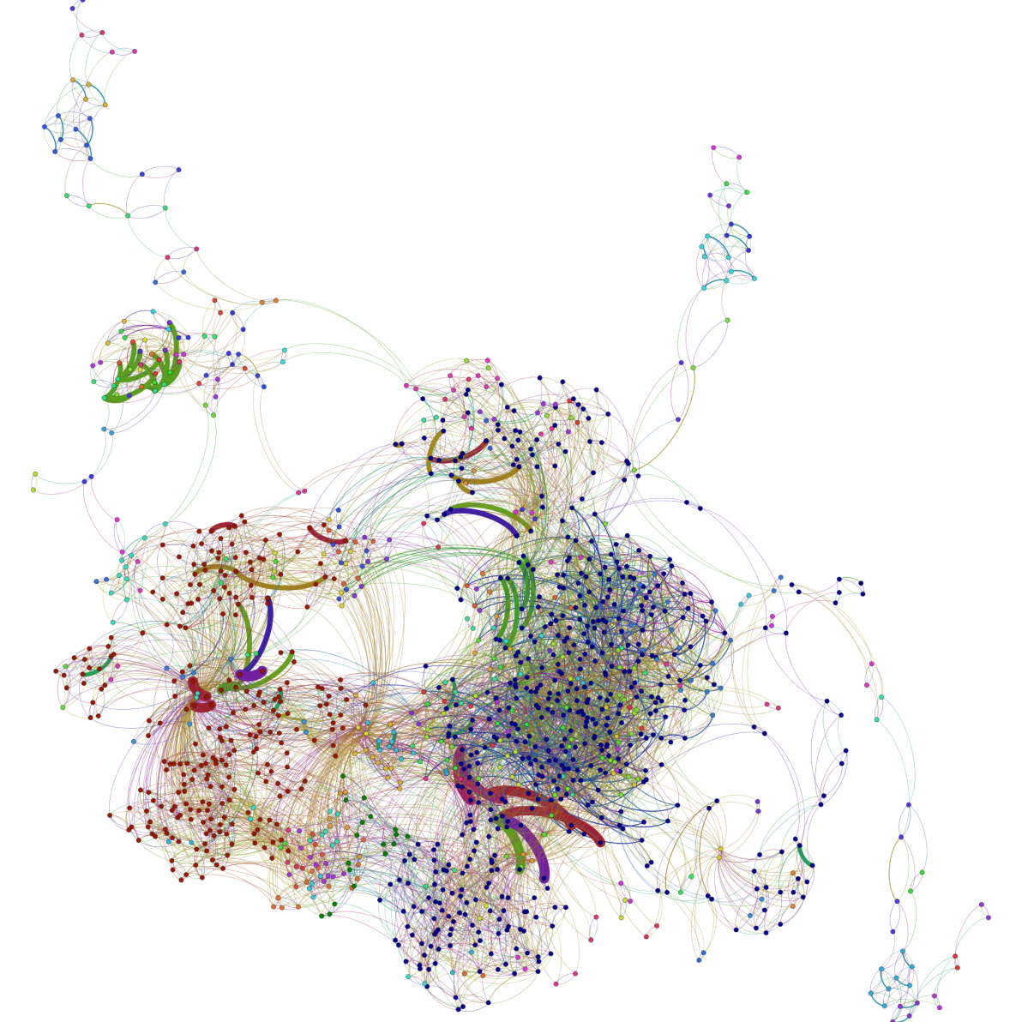
Printer controller
Notes:
Generated using Gephi tool

Slide 66
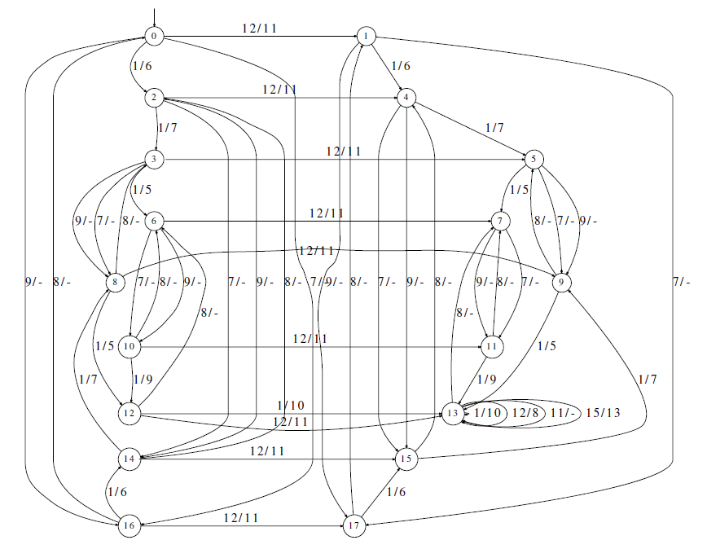
MegaD botnet protocol – Cho et al. 2010

Slide 67
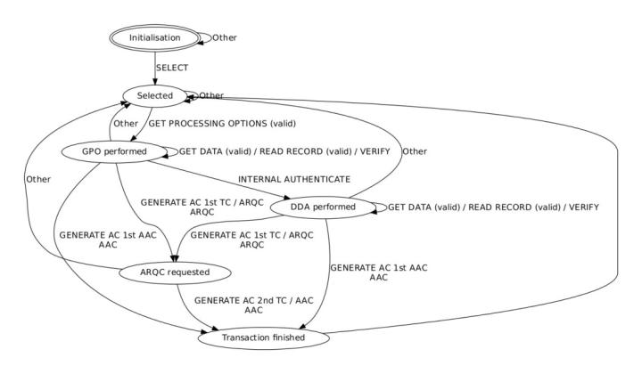
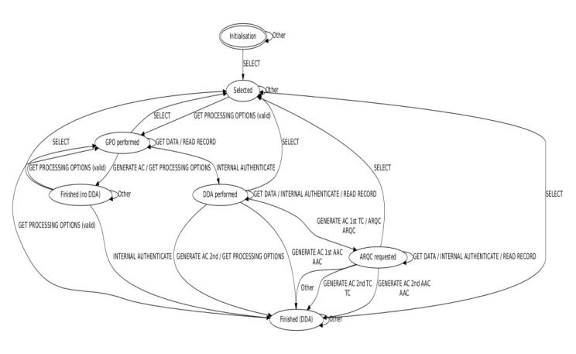
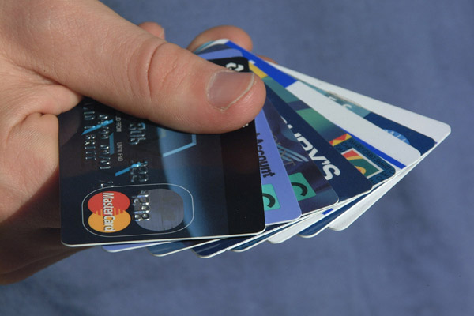
Rabobank Maestro
Bank cards
Volksbank Maestro
Aarts et al. 2013
Both passed a Meastro approved compliance test-suite presumably…

Slide 68
Some important questions…
What you will learn from reading the papers
Basic algorithms for learning state machines, and how to apply them in practice.
What you will learn from working with DFASAT/QSM/Learnlib:
If possible, investigate the state space of one of your former communication protocols.
Look at the protocol used by one/several of:
Tribler: http://www.tribler.org
A multi-agent environment interface: https://github.com/eishub
The transport layer security protocol (TLS)
A botnet, e.g., HLUX
Investigate the inferred state machine, do you see any problems?

Slide 69
Binary reverse engineering

Slide 70
Binary reverse engineering
int main() {
// main i/o-loop
while (1) {
// read input
char input = 0;
int ret = scanf("%c", &input);
if (ret == EOF)
exit(0);
else if (input >= 'A') {
// operate state machine
char c = step(input);
printf("%c\n", c);
}
}
}
Notes:
Sample program: state machine.

Slide 71
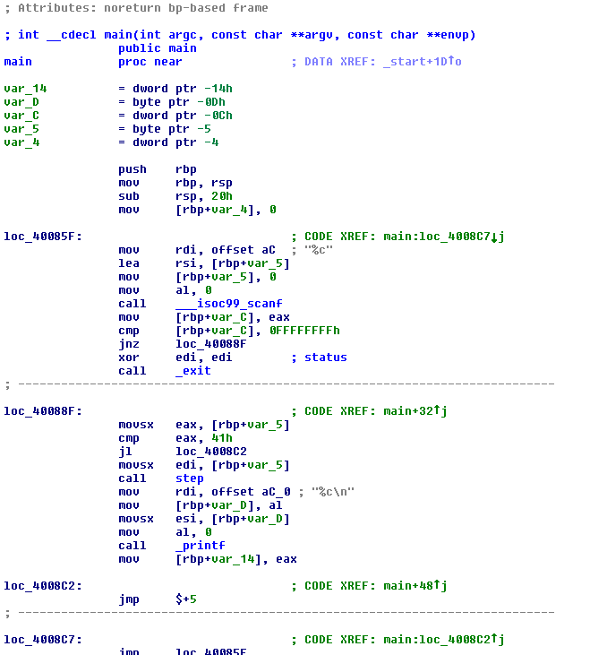
Binary reverse engineering (2)
Notes:
We compile this to an x86-64 binary with the Clang compiler wtihout any optimisations enabled. This binary is then disassembled using IDA Pro, result shown above. Even the functionality of a simple main function like this may not be immediately obvious.

Slide 72
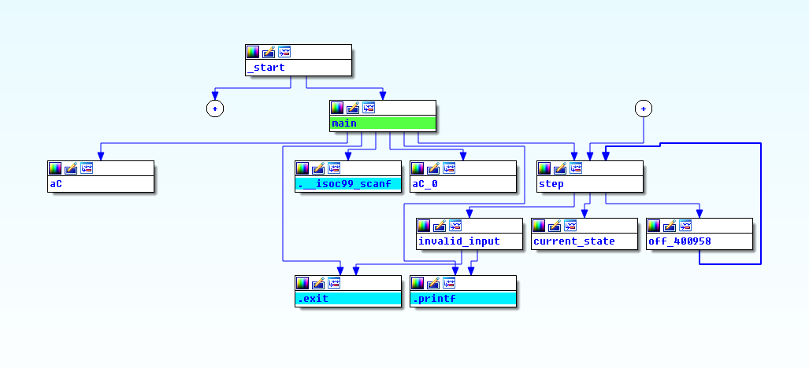
Binary reverse engineering (3)
Notes:
IDA Pro – Proximity view

Slide 73
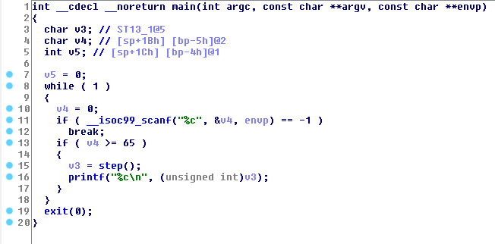
Binary reverse engineering (4)
Notes:
IDA Pro – Decompiler that creates (pseudo-) C code for easier understanding. Looks sort of like our original code, but again: this is without optimisations.

Slide 74
Some important questions…
What you will learn from reading the papers
State-of-the-art tools for understanding binary code, methods to circumvent analysis, and how to avoid those.
The benefit of visual analysis of code.
What you will learn from using IDA/Radare/Jakstab/GDB:
Compile one of your former projects with and without optimizations and obfuscation. Understand and label the obtained blocks of assembly.
Solve a crackme challenge.
Investigate malicious code.

Slide 75
In conclusion
Get an overview of state-of-the-art research in testing and reversing
Use testing and reversing tools in practice
Important for receiving a high grade is to not only apply these tools, but to demonstrate a good understanding of their output
We form groups on Github, please register:
https://classroom.github.com/group-assignment-invitations/1886dbaeef0c257ff5bd406016bc9eb1
Slides and papers/topics will be available at:
https://github.com/TUDelft-CS4110/syllabus
Also register on Slack, also for forming groups:
https://cs4110.slack.com/
Email/Slack if you need help forming a group:
a.e.zaidman@tudelft.nl

