Slide 1
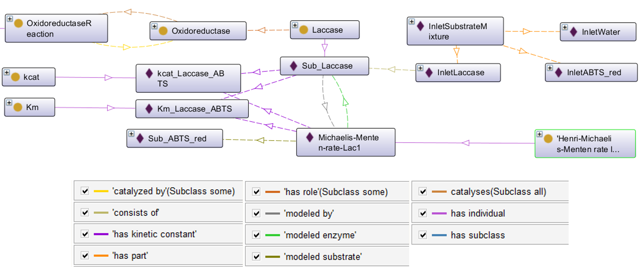
Process
Has characteristic
http://purl.obolibrary.org/obo/RO_0000053

