Slide 1
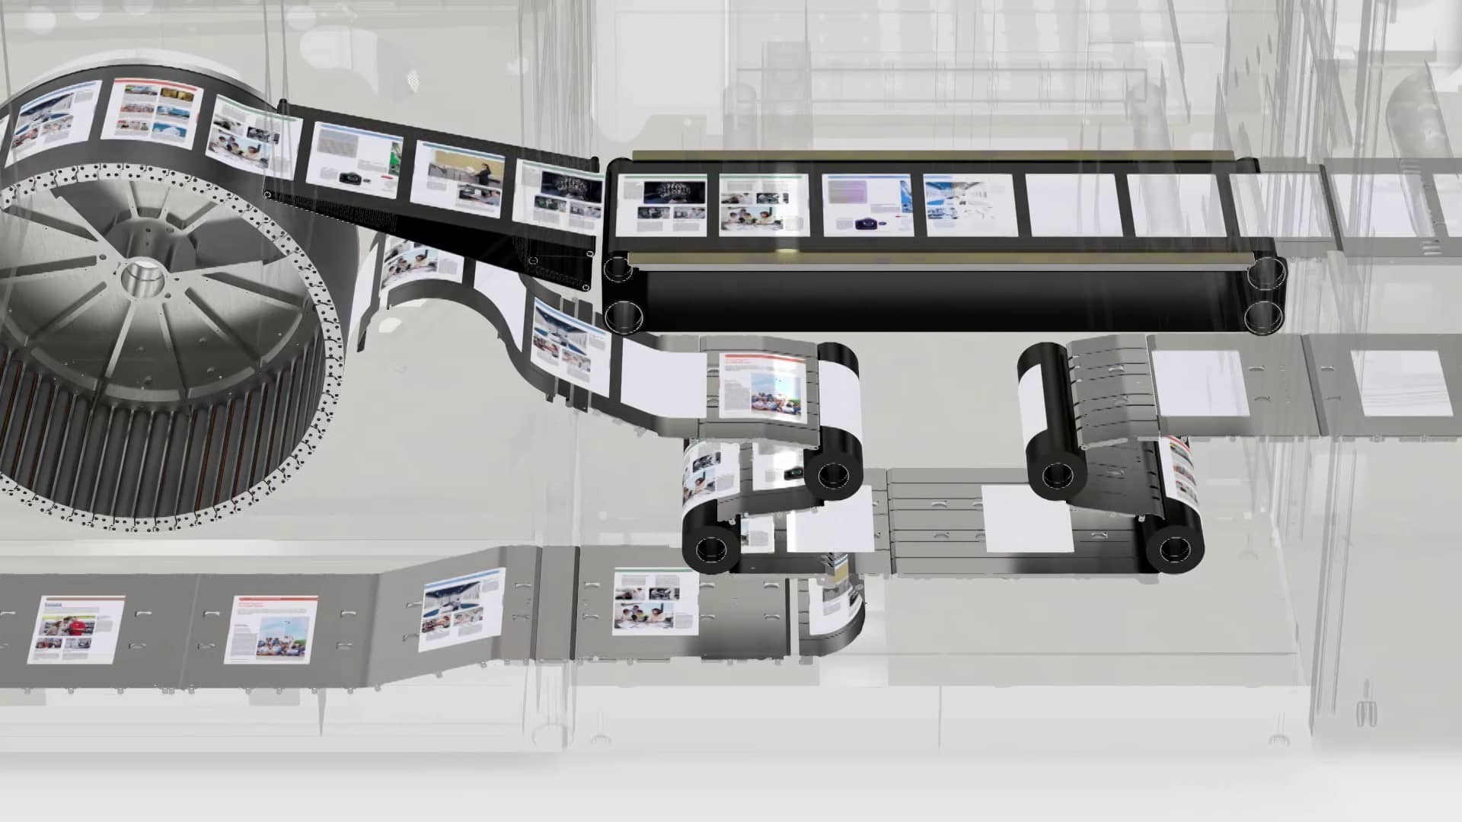

Flow-shop scheduling metrics
18-4-2018
Notes:
Welcome to this presentation on the ongoing work of TNO-ESI, TU/e and Océ on ‘how to design the paper path of a production printer”
My name is Joost van Pinxten, and my colleague Martijn Hendriks is here too.
A production printer is a large printer, that can print a PhD thesis every minute in high quality. That is 5 A4 pages per second! In the time of this presentation, a stack of 50cm high can be printed.

Slide 2
HCS Algorithm overview
sequence = create initial sequence
For each operation not in sequence do:
opts = create all possibly feasible options
opts = check feasibility(opts)
ranked = rank(opts)
select option(s) with smallest(/non-dominated) rank
Initial sequence may be:
All first passes up to last duplex (+ last duplex second pass etc.),
All second passes (+ first first pass in case it is duplex)

Slide 3
Generating options
Choose from ALL feasible options
Avoid generating infeasible options (a priori)
Evaluate feasibility of remaining options (longest path)
Infeasibility occurs due to:
positive cycles
violated deadlines
some can be detected beforehand
inconsistent orderings
should be avoided a priori!
changes required in operation times too far in the past
Scheduling horizon should be large enough (feasible options)
Scheduling horizon should be as small as possible (runtime)

Slide 4

Ranking
Assess (locally!) which option leads most likely to a short makespan
Intuitively:
Avoiding empty buffers (extremely expensive)
AND avoiding sequence dependent set-up times
Too greedy: no place left in buffer for large seq. dep. s.t.
Not greedy enough: buffer is left empty, penalty waiting on next sheet
Weighted ranking-heuristic imposes (almost) total ordering
Pareto-heuristic takes into account partial ordering
$$op{tion}_{a}≼op{tion}_{b}?$$

Slide 5
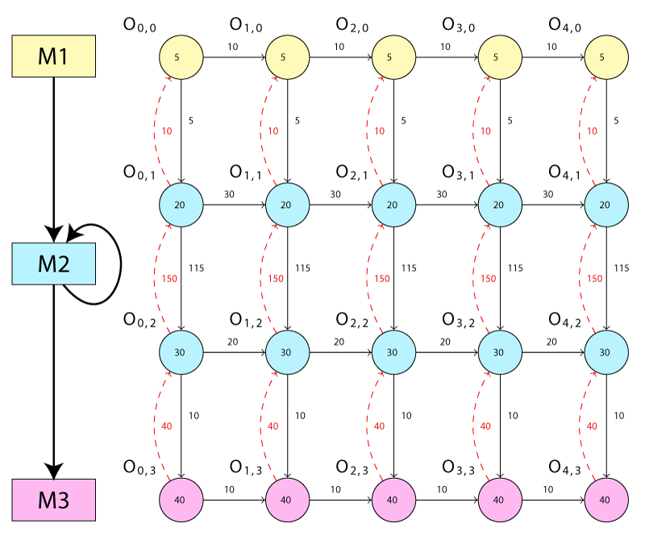
Sheet 1
Sheet 2
Sheet 3
Sheet 4
Sheet 5
Lower bound on the first print time of this sheet; can only be delayed more
Load
No future decision can delay the start time of O_{0,2} anymore
First pass
Second pass
Unload

Slide 6
Sheet 1
Sheet 2
Sheet 3
Sheet 4
Sheet 5
Lower bound on the first print time of this sheet; can only be delayed more
Load
No future decision can delay the start time of O_{0,2} anymore
First pass
Second pass
These re-entrant operations
still need to be executed !
Unload
Notes:
Due to the nature of the scheduling approach, the interleaved node cannot be delayed anymore. As the amount of work executed up to that point is the same, earlier will be better
The operation immediately following the interleaved node is the first moment the loop can be emptied.
There is work that has not been sequenced yet, and can still be delayed indefinitely.

Slide 7
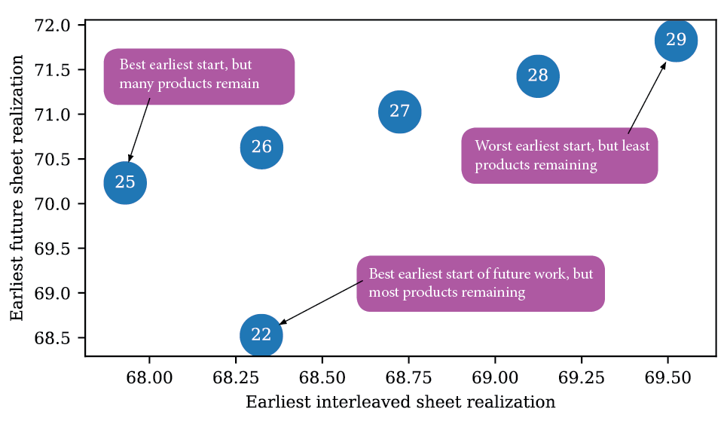
Trade-offs in sequences
Notes:
To avoid combinatorial explosion, we do not look at all possible future interleavings and which ones are productive.
To avoid making too greedy decisions, we keep trade-offs in the three rankings, which can all be optimal decisions at some point.

Slide 8
Unlikely that O_{1,1} will be delayed more
Sheet 1
Sheet 2
Sheet 3
Sheet 4
Sheet 5
Load
Future decisions can still delay the start time of O_{0,2}
First pass
Second pass
Unload

Slide 9
Sheet 1
Sheet 2
Sheet 3
Sheet 4
Sheet 5
Load
First pass
Second pass
Unload

Slide 10
Sheet 1
Sheet 2
Sheet 3
Sheet 4
Sheet 5
Load
First pass
Second pass
Unload

Slide 11
Sheet 1
Sheet 2
Sheet 3
Sheet 4
Sheet 5
Load
First pass
Second pass
Unload

Slide 12
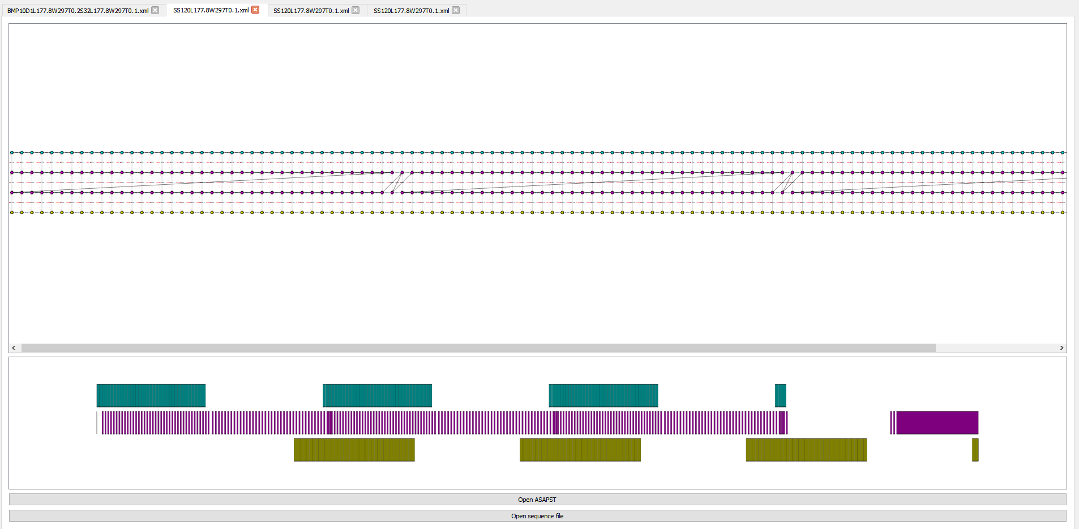

Slide 13
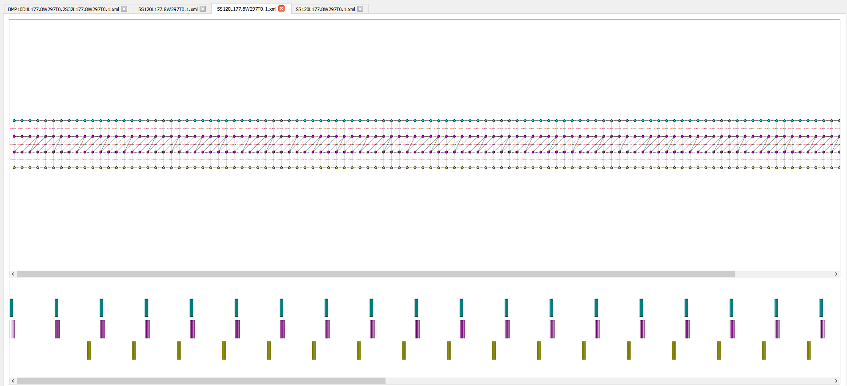

Slide 14
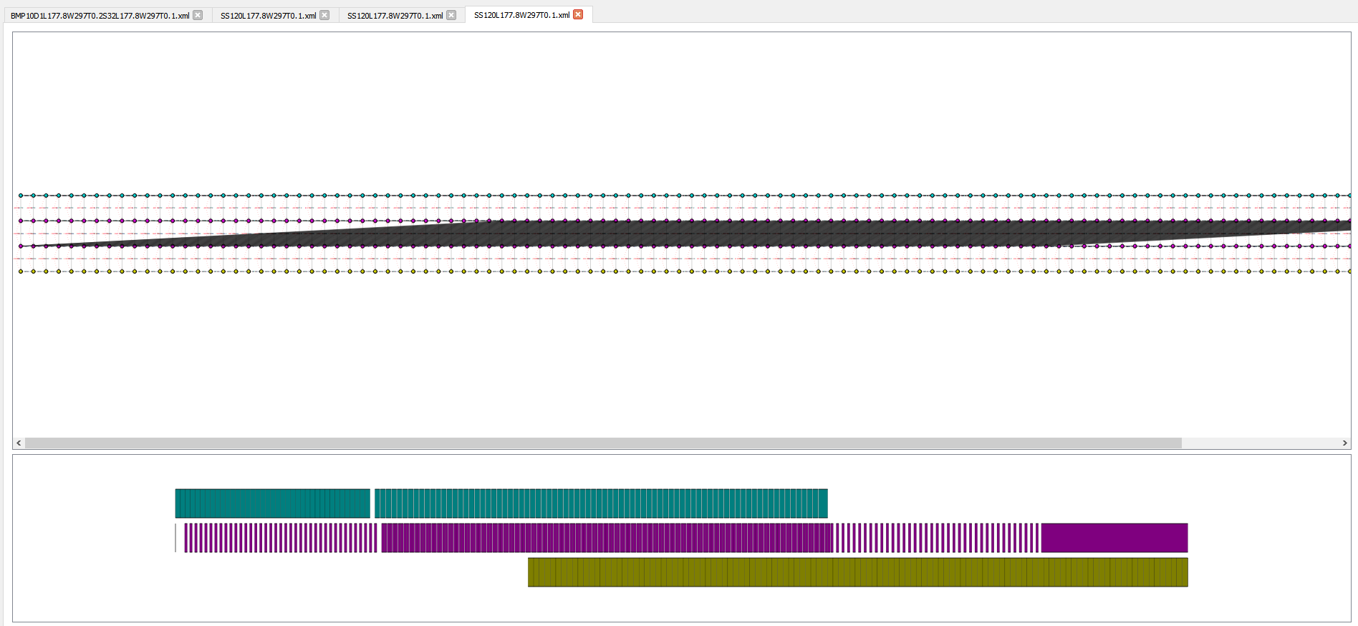

Slide 15
Homogeneous case
Max. nrOps,
Min. push, push_next
sheetProperties/SS120L177.8W297T0.1

Slide 16
Booklet case
Max. nrOps,
Min. push, push_next
bookletB/BSets5C1CL355.6CT0.2B19BL210BT0.1

