Slide 1
Costing Sheet Project
http://192.168.1.193/Webapi/Default.aspx

Slide 2
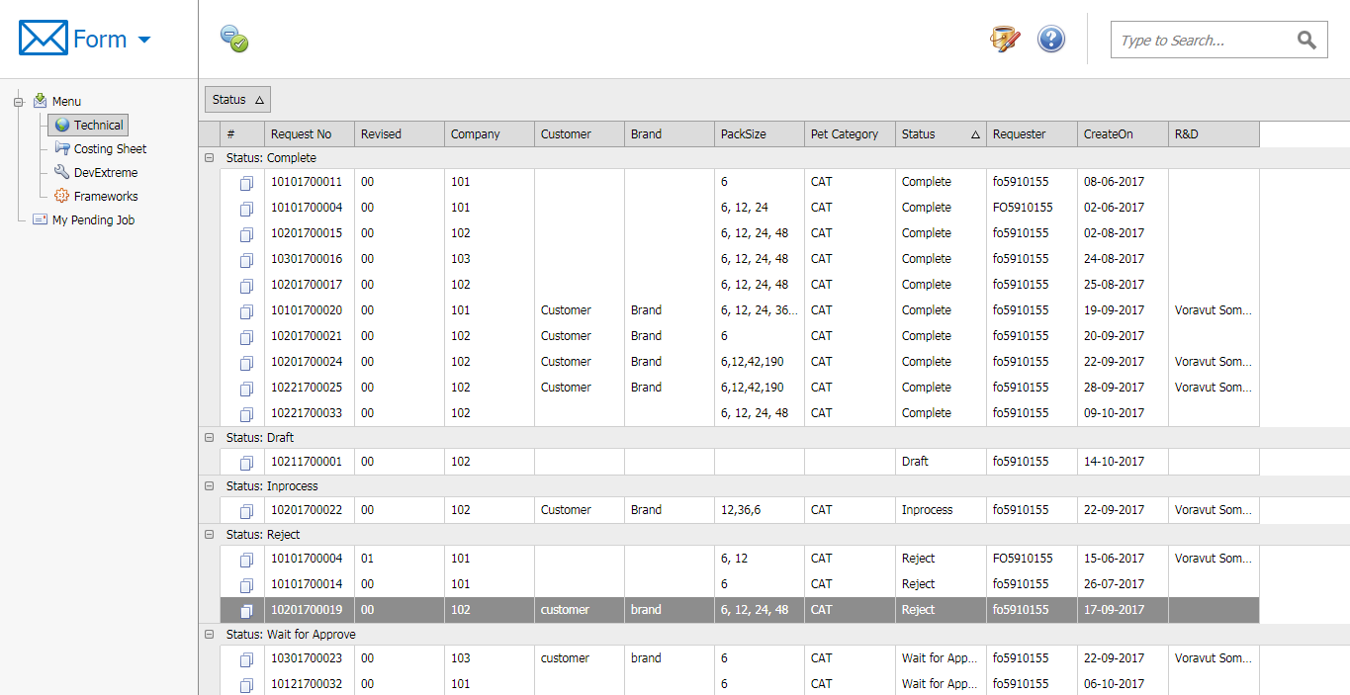
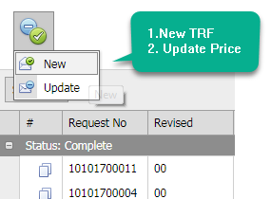
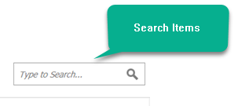
Create New TRF

Slide 3
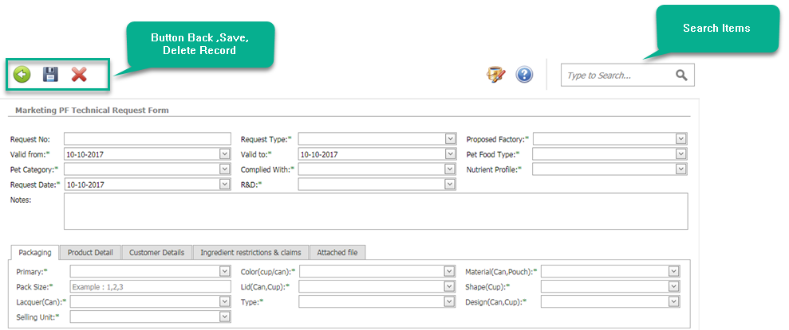
Create New TRF

Slide 4


Create New TRF
File upload process

Slide 5


Create New TRF

Slide 6
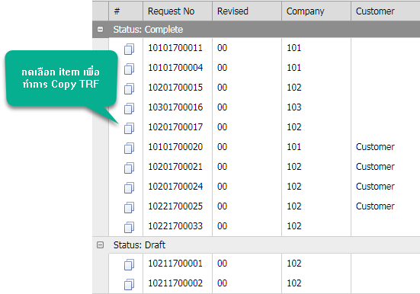
Copy TRF

Slide 7
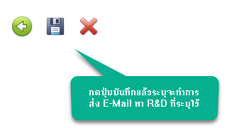
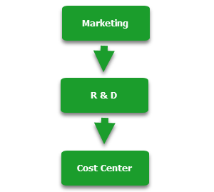
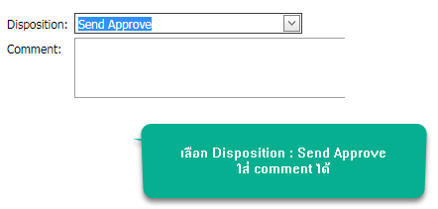

Step Approve TRF
Step Marketing
Step R&D ,Costing Center

Slide 8
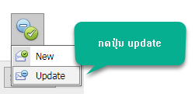
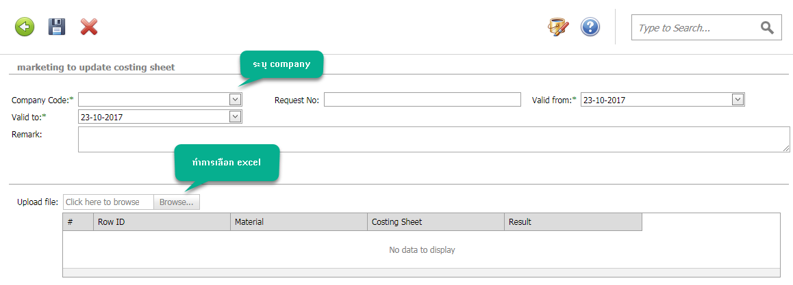
Update Price TRF

Slide 9
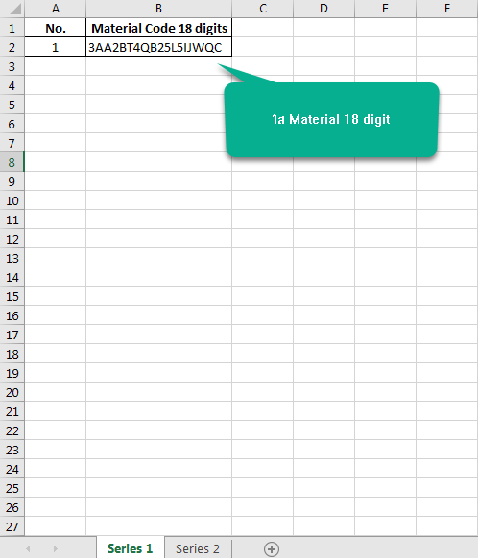
Update Price TRF

Slide 10

Update Price TRF

Slide 11
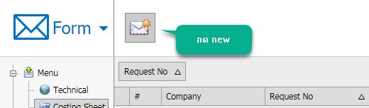
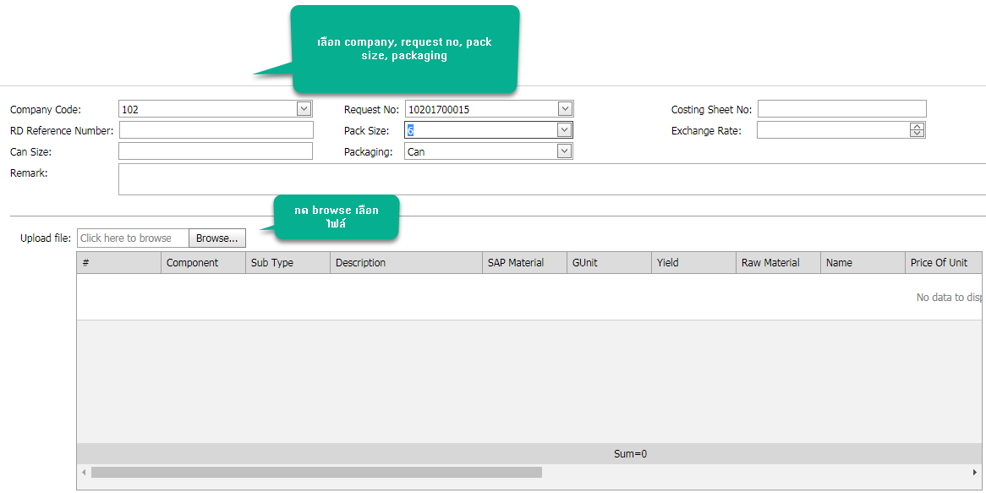
Create Costing Sheet

Slide 12
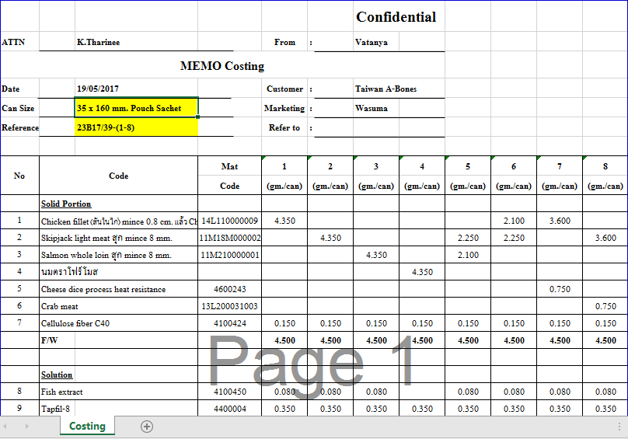
Create Costing Sheet

Slide 13

Create Costing Sheet

Slide 14
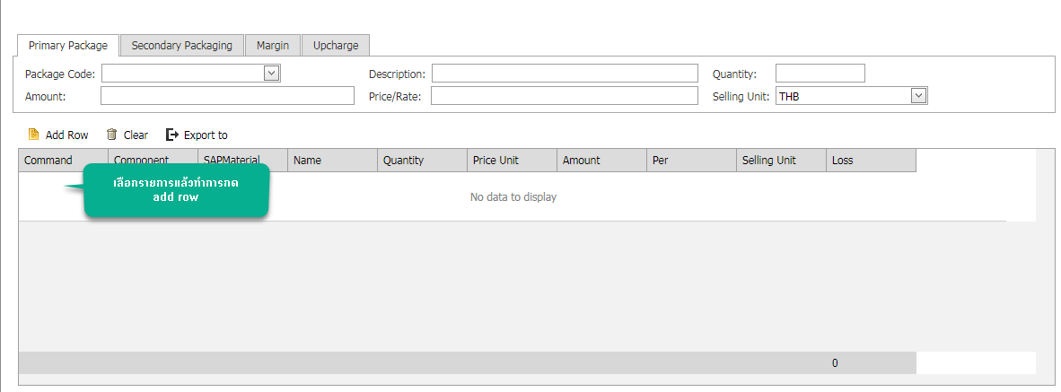

Create Costing Sheet

Slide 15
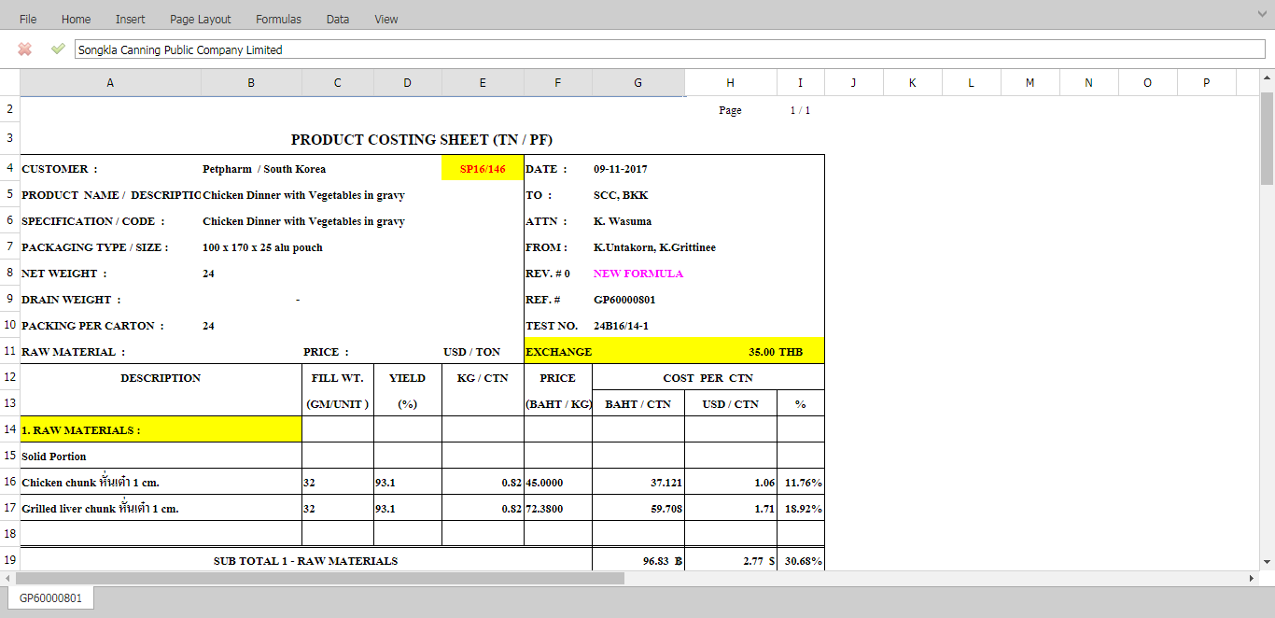
Create Costing Sheet

