Slide 1
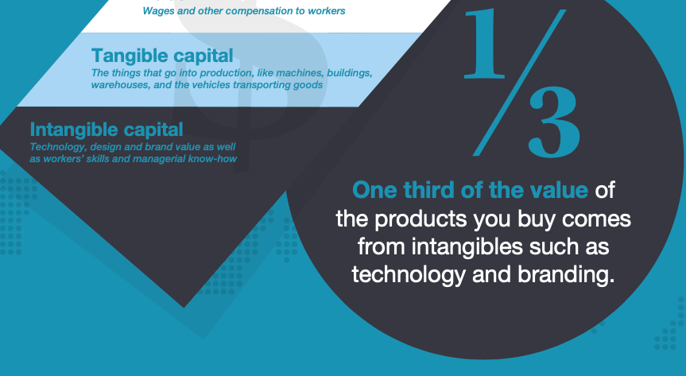
$
Labor
Wages and other compensation to workers
One thrid of the value of the products you buy comes from intangibles such as technology and branding.
⅓
Tangible Capital
Things that go into production, like machines,
buildings, warehouses, vehicles transporting goods…
Intangible capital
Technology, design and brand value as well as
workers’s skills and managerial know-how

Slide 2
25 %
Code Review
43 %
Commits
15 %
Issues
17 %
Pull Requests

