Slide 1
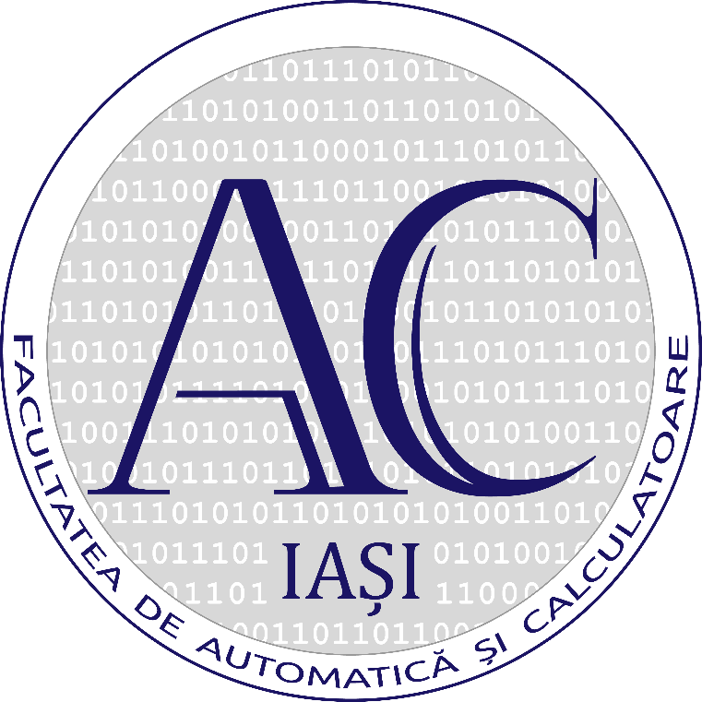

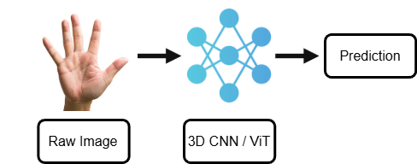
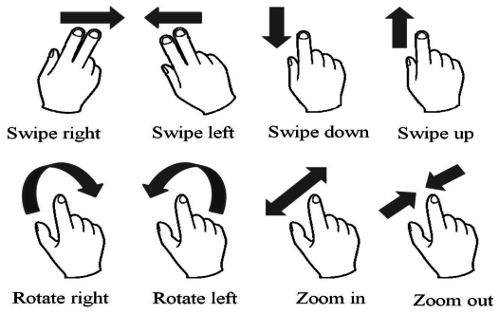
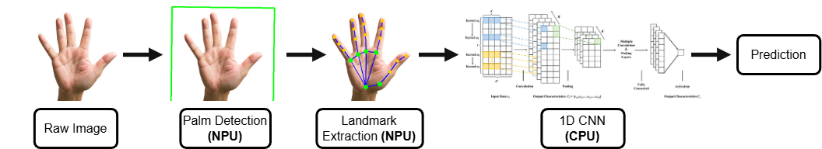
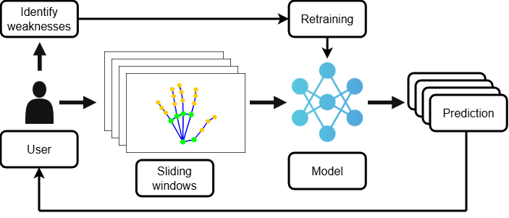
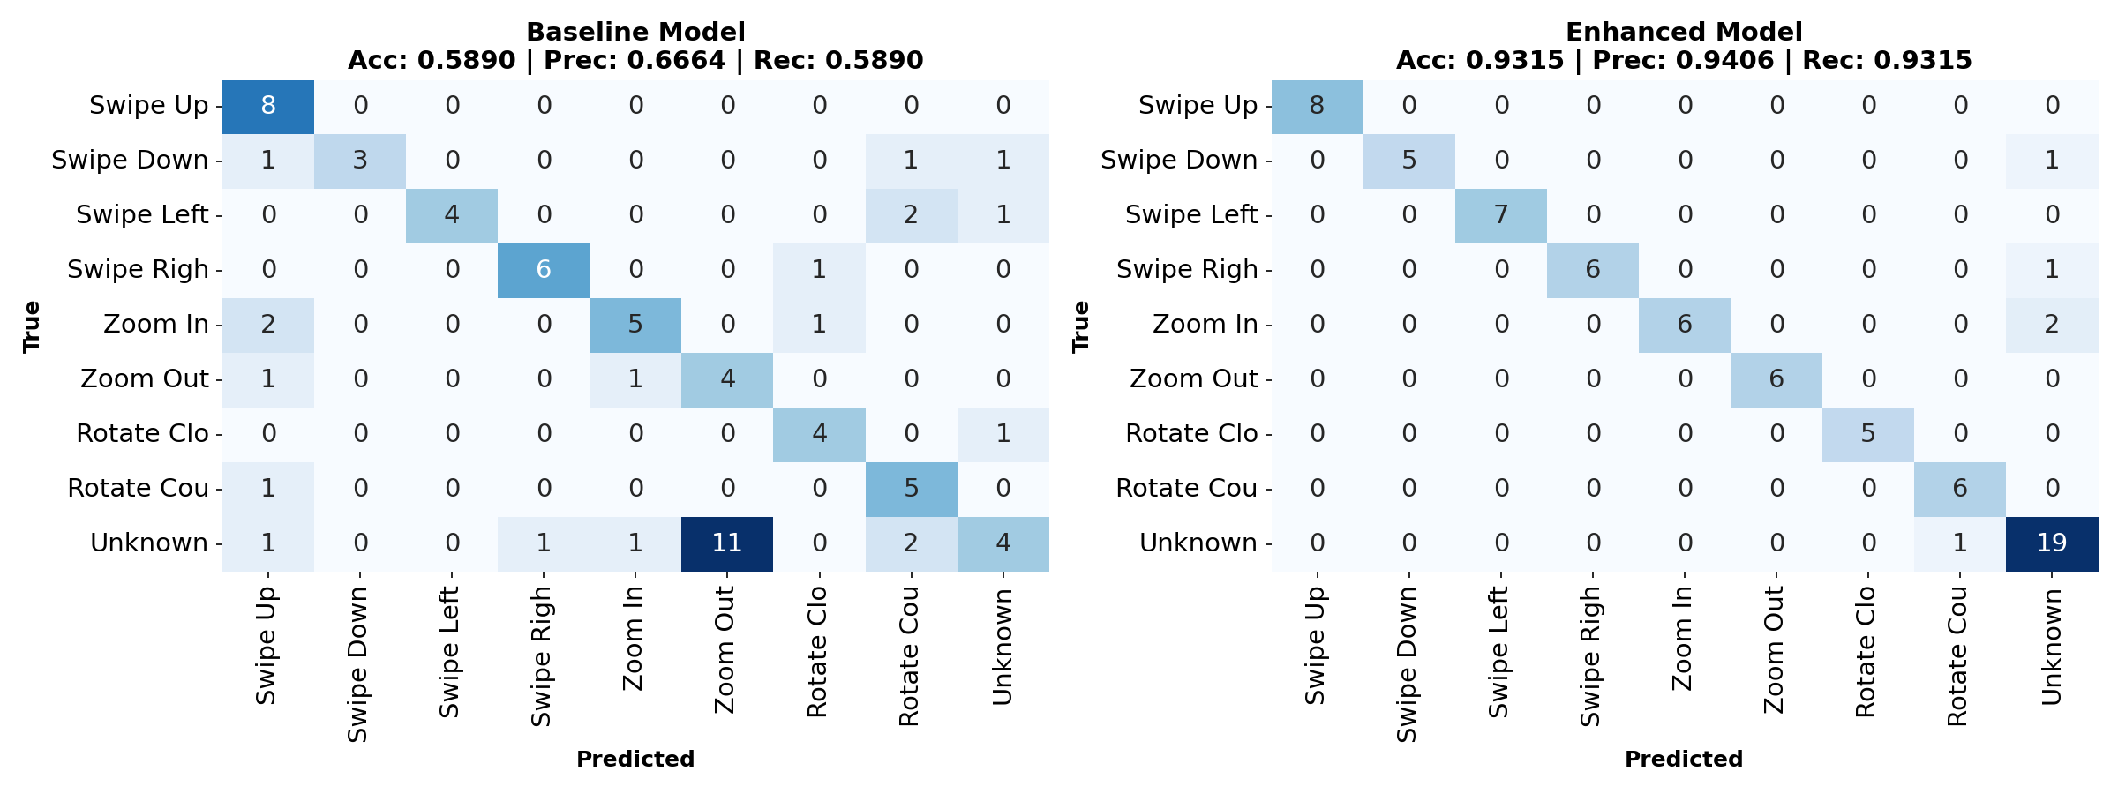
Efficient and Customizable Dynamic Hand Gesture Recognition for Edge Deployment
Victor Teslaru; Gabriel Pojoga
“Gheorghe Asachi” Technical University of Iasi
1. Problem & Scope
2. Data Pipeline & Dataset
Challenges:
Real-time performance on resource-constrained devices
Domain-specific vocabularies need custom datasets, no universal solution
Ambiguous user intent from natural movement hard to capture in the collection phase
Our solution:
Hierarchical pipeline (palm → landmarks → gesture)
Active learning, guides data collection to fix weaknesses
Collection:
Dynamic Time Warping [1] similarity to prevent redundancy
Interactive pose rotation augmentation with user validation
Linear interpolation for ≤2 missing frames, discard otherwise
Dataset:
8 gestures: Swipe (4), Zoom (2), Rotate (2)
10-frame sequences, 21 3D landmarks
Wrist and hand span normalized (position/scale-invariant)
Figure 1. End-to-end approach.
3. Model Design &
Edge Optimization
Figure 2. Dynamic hand gestures captured (taken from [2]).
Hierarchical architecture:
SSD-based palm detector [3], which reduces search space
21 key-points extraction for structured representation
NPU offloading for vision tasks
Quantized 1D CNN for temporal modelling [4]
Figure 3. Hierarchical architecture pipeline.
4. Deployment & Inference
5. Active Learning
Sliding window continuous inference:
Capture 10-20 frame sequences (user-paced)
Extract up to 7 overlapping inverse sliding windows, prioritizing recency
Classify each window independently using uncertainty thresholding
Filter out ambiguities through majority voting across valid predictions
Failure driven improvement:
Actual failure points from source (not hypothetical)
Multi-window anomalies caught automatically alongside natural movement
Can adapt to new user variation
Workflow:
Multiple window predictions
User reviews (labels / discards)
Diversity check + augmentation
Incremental dataset update
6. Evaluation metrics
Figure 4. Active learning workflow.
Benchmark: 73 gestures with various poses and sliding windows length
Baseline struggles with unknown class based only on thresholding
Active learning helps the model better define decision boundaries
Unknown gesture recall: 20% → 95% (4.75× improvement)
7. Privacy & Safety
Privacy preserving design:
Only 3D landmarks collected — No identity exposure
100% local processing (edge/desktop)
User retains full data control
Safety Features:
Explicit "Unknown" class for avoiding accidental triggers
Multi-window ambiguity detection
Figure 5. Model evaluation before and after active learning.
Contact
References
Victor Teslaru
Gabriel Pojoga
“Gheorghe Asachi” Technical University of Iasi
Email: victor.teslaru@student.tuiasi.ro
gabriel.pojoga@student.tuiasi.ro
H. Sakoe and S. Chiba, "Dynamic programming algorithm optimization for spoken word recognition," in IEEE Transactions on Acoustics, Speech, and Signal Processing, vol. 26, no. 1, pp. 43-49, February 1978, doi: 10.1109/TASSP.1978.1163055.
Tumuganti, Nagakarthik & Ahn, Eun & Bae, Yun & Choi, Jun. (2013). TCAM based pattern matching technique for hand gesture recognition. 368-369. 10.1109/ISOCC.2013.6864052.
Zhang, F., Bazarevsky, V., Vakunov, A., Tkachenka, A., Sung, G., Chang, C. L., & Grundmann, M. (2020). Mediapipe hands: On-device real-time hand tracking. arXiv preprint arXiv:2006.10214.
TensorFlow Team. "Post-training quantization," TensorFlow Lite Documentation, 2023. https://www.tensorflow.org/lite/performance/post_training_quantization

