Slide 1


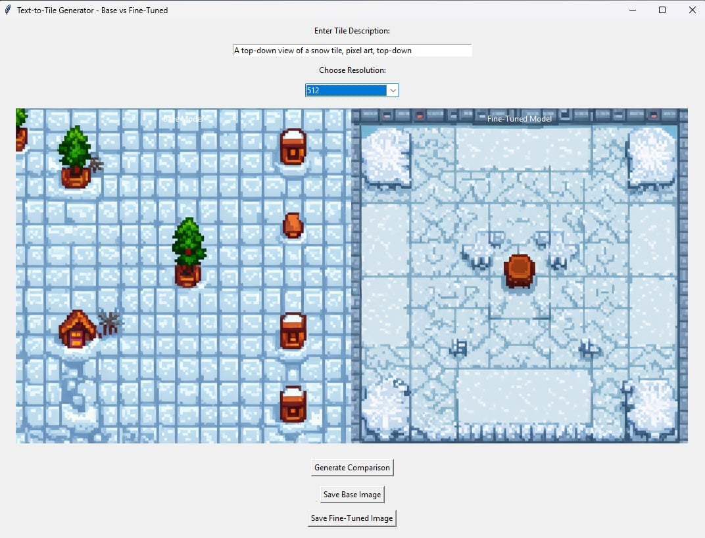
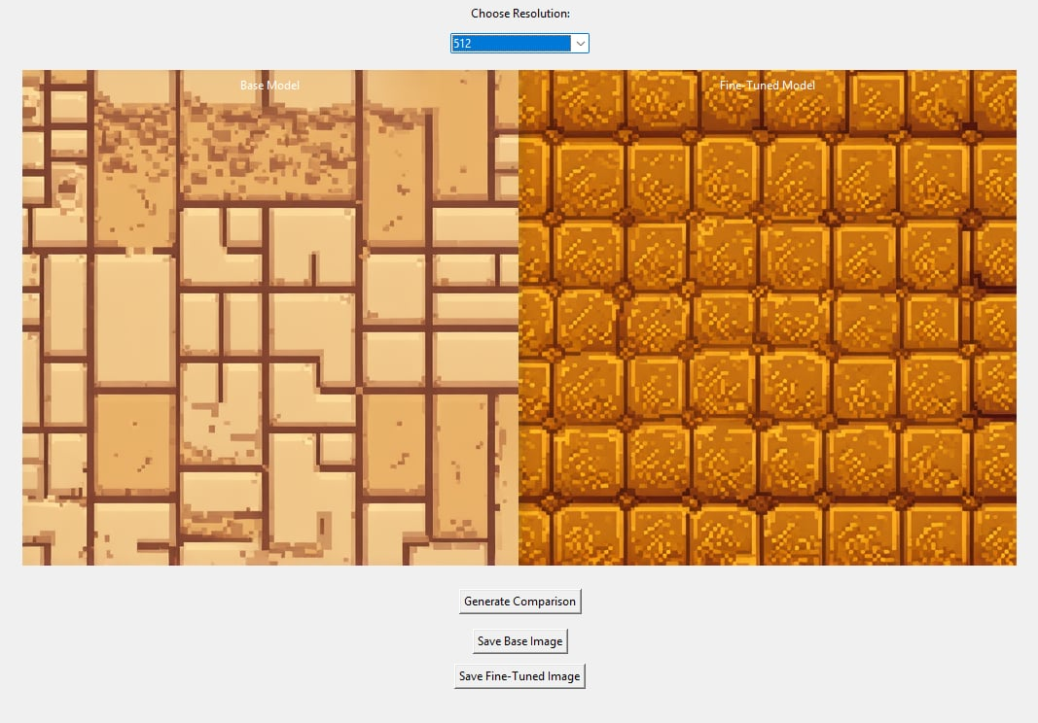


Text-to-Tile: Fine-Tuning Stable Diffusion 3.5 for
2D Game Tile Generation
Nejneriu Mihai |Adrian Nazîru
Gheorghe Asachi Technical University, Faculty of Automatic and Computer Engineering
Abstract
Methods
Generating 2D game tiles from text prompts is a key challenge combining computer vision and natural language processing. Small tiles (e.g., 16×16 pixels) form terrains, floors, and decorations in pixel art games. While models like Stable Diffusion generate high-quality images, they are not specialized for minimal, seamless pixel art textures.
In this project (Text-to-Tile), we fine-tune Stable Diffusion 3.5 Medium using LoRA (Low-Rank Adaptation) for pixel art tile generation. We build a custom pixel art dataset with captions and upscale small tiles to fit the model’s input, enabling efficient fine-tuning without full retraining.
This poster presents the architecture, fine-tuning process, and results, showing how generative models can help game developers create assets faster and more creatively.
We fine-tune a latent diffusion model by modifying only low-rank attention components: query, key, value, and output projections. This selective adaptation lowers training cost while effectively specializing the model for pixel art generation.
The dataset contains over 1000 pixel art tiles, each paired with a caption. To match input resolution, 16×16 tiles are upscaled to 512×512 using nearest-neighbor interpolation, preserving clarity.
Training uses PyTorch with Hugging Face Diffusers and PEFT for efficient updates. We train 50 epochs using the AdamW optimizer at a 1e-4 learning rate with mixed-precision (fp16).
Evaluation uses side-by-side comparisons, assessing prompt alignment, texture consistency, and tiling performance for game use.
Figure 3. Fine-tuning improves tileability, structure and prompt alignment:
Base model (left) vs. Fine tuned model (right)
Limitations
This study used a simplified loss function (pixel-level reconstruction) instead of the full diffusion noise objective, which may limit the fidelity of learned textures.
The dataset was relatively small and focused on a narrow style, potentially constraining generalization. No quantitative evaluations were conducted, so assessments rely on qualitative side-by-side visual comparisons.
Introduction
Results and evaluation
Generating pixel art tiles from text involves transforming language inputs into low-resolution visual outputs that meet constraints like seamless tiling, minimal complexity, and consistent style. Unlike photorealistic image generation, pixel art requires precise control over local pixel arrangements and repeatable edges suitable for game use.
The system models the conditional relationship between an input text description and the corresponding image, where the output is a structured 16×16 pixel grid that must align semantically with the input while maintaining spatial regularity. Standard image generation models, built for high-resolution or complex outputs, are not optimized for such small, pattern-driven tasks.
This work addresses the challenge by fine-tuning only the attention layer components, adjusting cross-modal interactions with minimal added parameters. This approach allows targeted adaptation without full-model retraining, balancing specialization and computational efficiency.
Our contributions include a customized dataset preparation pipeline, an optimized training process, and an evaluation framework assessing coherence, tiling consistency, and alignment with input prompts, showing how large generative models can be specialized for narrow, structured visual tasks.
We evaluated the fine-tuned Stable Diffusion 3.5 model using qualitative and functional comparisons against the base model. A custom Tkinter GUI was built to input prompts and generate paired outputs (base vs. fine-tuned), enabling side-by-side visual assessment.
Test prompts included domain-specific descriptions such as “snow tile, pixel art, top-down” and “stone or rock tile, pixel art, top-down.” The fine-tuned model consistently produced simpler, tileable textures, avoiding non-repeating patterns and photorealistic artifacts seen in the base model.
Key improvements were observed in spatial consistency, prompt alignment, and pixel art fidelity, especially for simple materials like dirt, snow, and water. The model showed enhanced control over visual style with minimal parameter overhead, validating the effectiveness of LoRA adaptations.
Future quantitative evaluations (e.g., texture tiling coherence scores or user preference studies) are planned to further benchmark performance.
Application Impact
Adapting large diffusion models for pixel art unlocks new opportunities for developers, artists, and designers.
This approach speeds up asset pipelines, reduces manual work, and provides scalable tools for generating consistent textures. It also shows the potential of combining low-rank fine-tuning with diffusion models for niche creative tasks in gaming and media.
Conclusions
We adapted Stable Diffusion 3.5 to generate pixel art tiles by applying LoRA fine-tuning on a focused dataset. The fine-tuned model produces tileable, stylized textures aligned with text prompts, addressing limitations of the base model.
This work demonstrates how lightweight fine-tuning can transform a general model into a specialized creative tool, enabling adaptation for narrow domains like game development.
Future improvements include using better training objectives, enforcing seamless tiling, and expanding the dataset. This approach provides developers with faster, scalable tools for generating consistent, high-quality game assets and opens new possibilities for artists and designers.
Figure 3. Qualitative Comparison Between Model Outputs
Figure 1. Base Model
Output Example
Figure 2. Fine-Tuned Model
Output Example
Contact
References
Email: mihai.nejneriu@student.tuiasi.ro
Email: adrian-marian.naziru@student.tuiasi.ro
Stability AI, Stable Diffusion 3.5 Medium – Model Card.” Hug-ging Face, 2024. [Online]. Available: https://huggingface.co/stabilityai/stable-diffusion-3.5-medium.
Hugging Face, LoRA Training.” Diffusers Documentation, 2023. [On-line]. Available: https://huggingface.co/docs/diffusers/main/en/tutorials /using_peft_for_inference.
StabilityAI REST API (v2beta) - Stability AI Developer Platform. [On-line]. Available: https://platform.stability.ai/docs/api-reference.
Stabilityai/stable-diffusion-3.5-medium (Hugging Face repository).[Online]. Available: https://huggingface.co/stabilityai/stablediffusion-3.5-medium
O. Mishra, “Stable Diffusion Explained. How does Stable diffusionwork...”, Medium, Jun. 8, 2023. [Online]. Available: https://medium.com/@onkarmishra/stablediffusion-explained-1f101284484d.
LoRA (Low-Rank Adaptation) in Diffusers. [Online]. Available:https://huggingface.co/docs/diffusers/main/en/tutorials/using_peft_for_inference.

