Slide 1
Time-aware Point-of-interest Recommendation
CS6670-Topics in Data Mining
Group#11
T.Ujjieve - CS16BTECH11039
P.Ramkishan - CS16BTECH11029
A B S Harsha - CS16BTECH11002
S.Shanmukha Rao - CS16BTECH11034

Slide 2
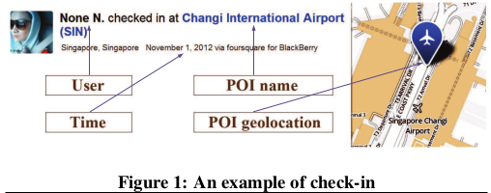
Introduction:
A point of interest (POI) is a specific point location that someone may find interesting and be willing to check in.
Objective of POI recommendation is to discover new places.

Slide 3


Used two real-world datasets
Foursquare (Singapore)
Number of Users : 2353
Number of Interested Places : 5000
Number of Total Check INs : 194,108
Gowalla (california,Nevada)
Number of Users : 10,162
Number of Interested places : 24,250
Number of Total Check INs : 456,988

Slide 4
Foursquare :
The foursquare contains 3 datasets:
The first dataset is about restaurants in NYC. It contains 3112 users and 3298 venues with 27149 check-ins and 10377 tips .
The second dataset is about NYC and Tokyo check-ins. t contains 227,428 check-ins in New York city and 573,703 check-ins in Tokyo
The third dataset is about a global check-in dataset. It contains 33,278,683 checkins by 266,909 users on 3,680,126 venues (in 415 cities in 77 countries). Those 415 cities are the most checked 415 cities by Foursquare users in the world, each of which contains at least 10K check-ins).

Slide 5
Gowalla:
This dataset was collected from Gowalla, a popular location-based social network, which has more than 600,000 users since November 2010 and was acquired by Facebook in December 2011.
In practice, we used the Gowalla APIs to collect the user profiles, user friendship, location profiles, and users’ check-in history made before June 1, 2011.
Finally, we have obtained 36,001,959 check-ins made by 319,063 users over 2,844,076 locations. The locations in Gowalla are grouped into 7 main categories, i.e., Community, Entertainment, Food, Nightlife, Outdoors, Shopping and Travel, and each main category consists of several subcategories.

Slide 6
How to recommend Places to Users ?
Content based recommendation :
Where recommendations are based on context of places user visits
Which may not be used in POI recommendations because
It's hard to carefully hand pick attributes for each place for all the users
Collaborative based recommendation :
Item - Item recommendation (Place -Place recommendation)
User - User recommendations
Based on user user similarity , predictions are made
Its Performance is better than item-item and contentBased

Slide 7
Problems with existing methods
It is observed that users tend to follow a pattern according to time slots i.e its best to recommend a dinner at night rather than morning and gym at morning , evening rather than afternoon
Existing methods fail to capture those time aware patterns of users.
THEREFORE A NEW APPROACH IS TAKEN

Slide 8
Observations
Temporal Behavior :
Time based pattern mining
Eg :many users visit a pub at midnight but very few users visit a library at the same time, then the pub should be given a higher priority than the library when we recommend POIs for a user to visit at midnight.
Spatial Influence (Including temporal popularity):
users tend to visit nearby POIs, and thus the POIs visited by users often form spatial clusters , this information should be used to enhance POI recommendations
Users tend to visit popular POI’s

Slide 9
Data PreProcessing
Converting each checkIn to UTP cube
Shape of dataMatrix is (#Users , #Locations , #timeSlots)
Dividing into 24 time slots and binning it on the basis of hour (not minutes 19:59 goes to 19 slot)

Slide 10
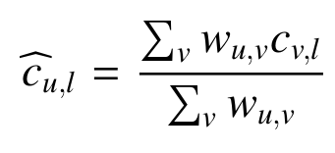
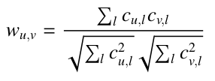
User-based Collaborative filtering:
It’s the recommendation score that u will check-in a POI l that u have not visited before.
It’s the weighted average of check-in for a users at POI l with weights as cosine similarity of that user and u.
Where
Ĉu,l is the user collaborative score
Wu,l is the weight for user v

Slide 11
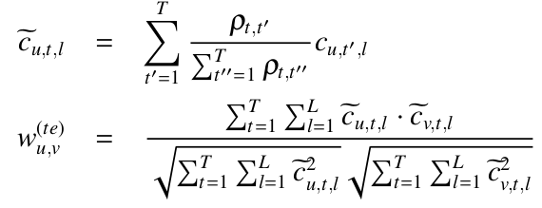

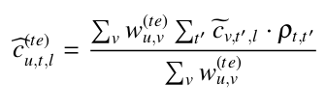
Incorporating Temporal Influence:
Where is similarity between time slots ,
Cut’l is checkIn Value by user u at time Slot t’ at location l
Wu,v is similarity matrix between users
Is final recommendation
Score
Notes:
helko

Slide 12
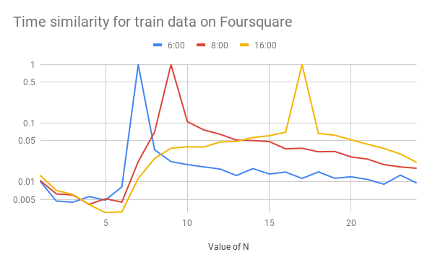

Slide 13
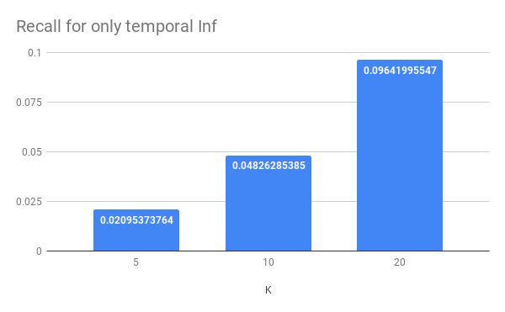

Slide 14

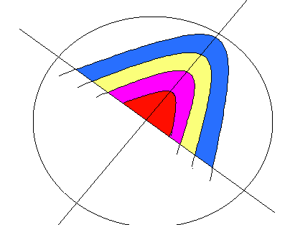
CALCULATION OF WILLINGNESS
The willingness is calculated by dividing the distances into regions and incrementing the count for each poi lying in the region.
The count is instantiated with 2.
Least square regression method is applied
Value of K obtained : [-2.23069687]
Value of A : 10.40793976121805

Slide 15
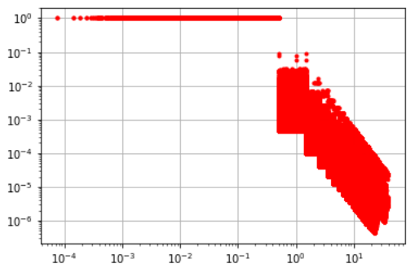

Slide 16




Spatial Influence:
wi is willingness of user to visit a dis far away POI
P( Lj | Li ) is prob that a user visited Li will visit Lj after visiting Li
Beta is tunable parameter
Pt( L ) = prob that user visits Location L at timeSlot t
Is final recomendation score with spatial Influence

Slide 17
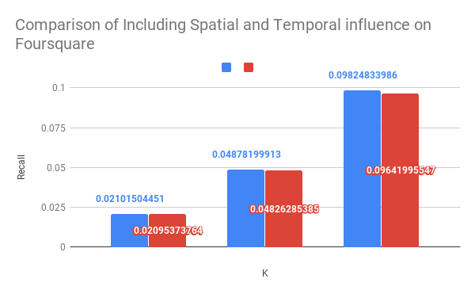
Alpha = 0.8
Alpha = 1

Slide 18
Final Score :
A Unified Framework of Collaborative Recommendation enhancing temporal Behaviour and naive Bayes approach for Spatial behaviour
SE = Spatial Influence based recommendation with Popularity Enhancement
alpha = tunable parameter ranges in [0,1]
Unified Score = alpha * UTE + (1-alpha) * SE

Slide 19
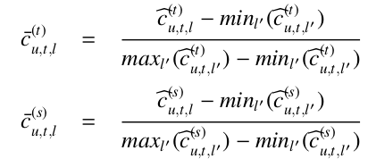

Unified Framework:

Slide 20
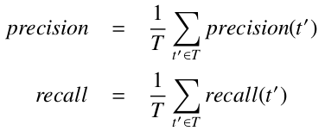
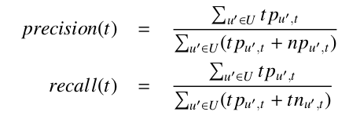
Experiments:
The overall precision and recall are calculated by averaging the pre-
cision and recall values over all time slots, respectively:
The precision and recall for time slot t are calculated as follows:

Slide 21
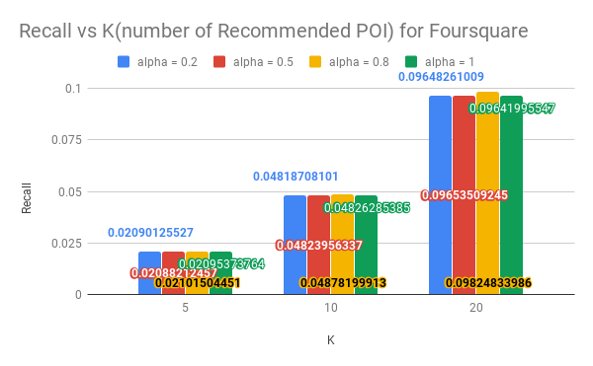
AVERAGE RECALL

Slide 22
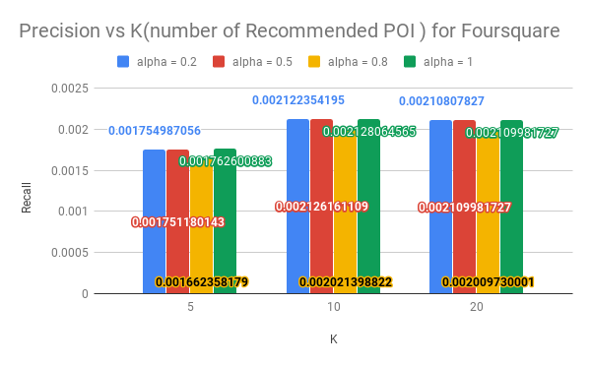
AVERAGE PRECISION

Slide 23
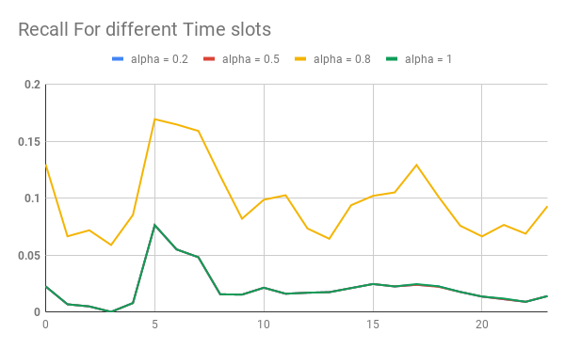

Slide 24
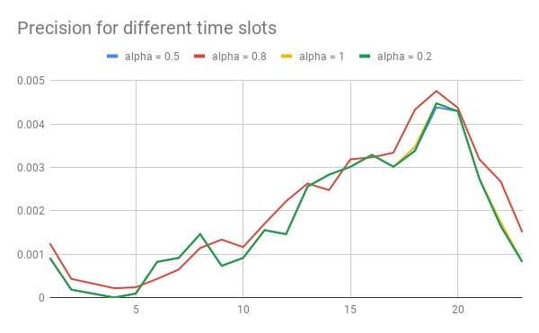
OBSERVATION:
The precision for midnight slots is very less given the lesser no. of check Ins for those time slots.
The precision for evening slots is high since most activity happens and more check Ins available
Notes:
The precision when incorporating both spatial and temporal influence is high for important time slots like evening and morning from 7:00

Slide 25
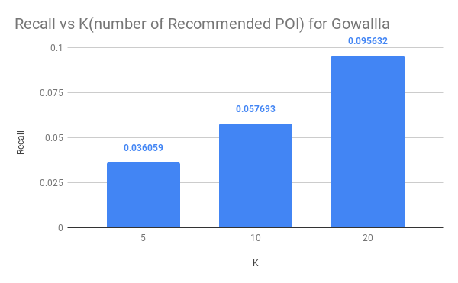
AVERAGE RECALL

Slide 26
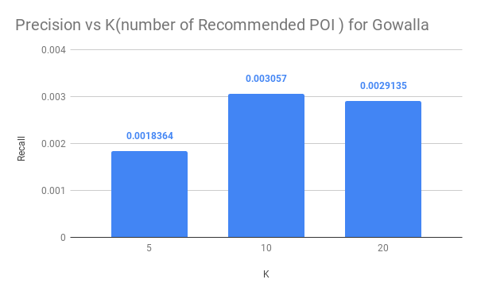
AVERAGE PRECISION

Slide 27
THANK YOU !!

