Slide 1

GM2 Case Study
Cab Investment Firm
01/08/2021

Slide 2
BACKGROUND
XYZ is a private equity firm in US. Due to remarkable growth in the Cab Industry in last few years and multiple key players in the market, it is planning for an investment in Cab industry.
Objective: Provide actionable insights to help XYZ firm in identifying the right company for making investment.
The analysis will provide information about the following:
Data Understanding
Forecasting profit and number of rides for each cab type
Finding the most profitable Cab company
Recommendations for investment

Slide 3
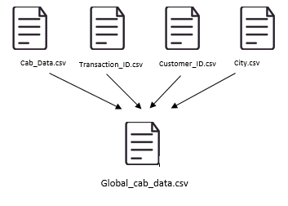
DATA EXPLORATION
19 Features( including 7 derived features)
Timeframe of the data: 2016-01-01 to 2018-12-31
Total data points : 359,392
Assumptions:
Outliers are present in Price Charged feature but due to
unavailability of trip duration details ,we are not treating this as outlier.
Profit of rides are calculated keeping other factors constant and only
Price Charged and Cost of Trip features used to calculate profit.
Users feature of city dataset is treated as number of cab users in the city.
we have assumed that this can be other cab users as well(including Yellow and Pink cab)

Slide 4
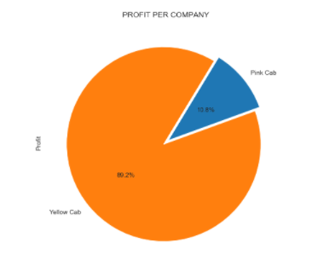
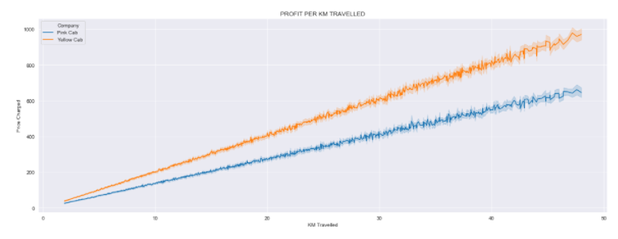

PROFIT ANALYSIS

Slide 5
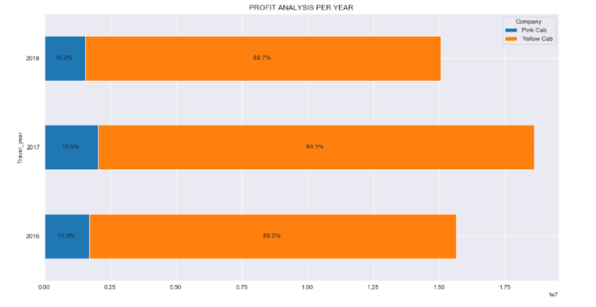
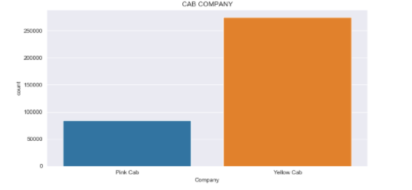
YEARLY PROFIT
Yellow cab company made 89% of profit while the Pink cab company has only 19% of the total profit made each year and has more users

Slide 6
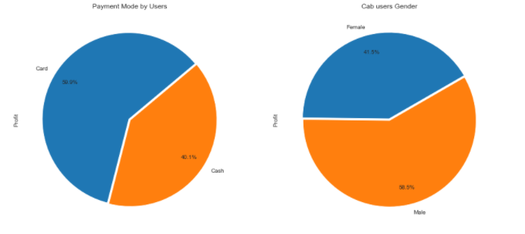
PROFIT ANALYSIS PAYMENT MODE AND GENDER WISE
Most cab users are male and represent 58% of total users and their preferred payment mode is Card with a 59.9%

Slide 7
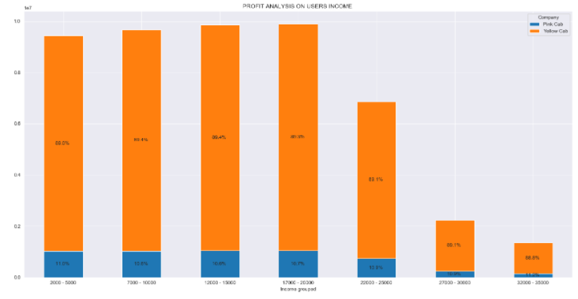
PROFIT ANALYSIS INCOME WISE
Yellow cab company made more than 85% of profit on the different income class

Slide 8
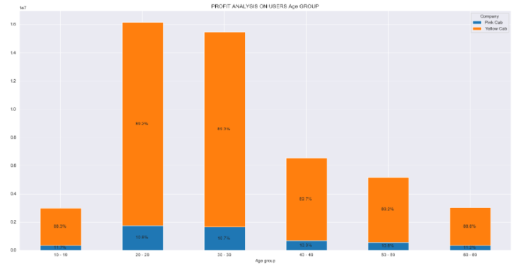
PROFIT ANALYSIS AGE WISE
Most cab users age from 20 to 39 years old
Yellow cab users made closely 88% to the total profit made on each group
Pink cab company has the remaining 12%

Slide 9
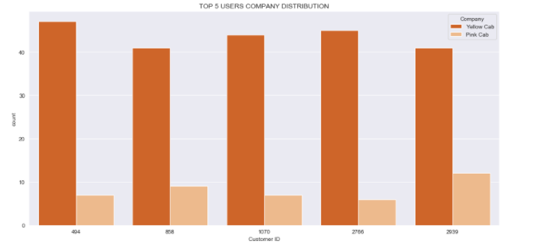
TOP 5 CUSTOMER ANALYSIS
The top 5 customer whose Customer ID are displayed below the chart
In each 50 rides from both company they all had more than 40 rides with Yellow cab and merely 10 rides from Pink Cab

Slide 10
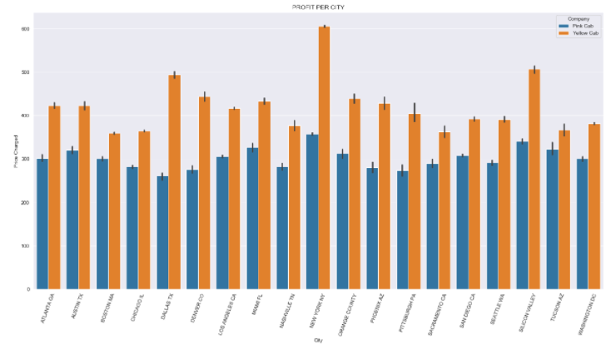
PROFIT ANALYSIS CITY WISE

Slide 11
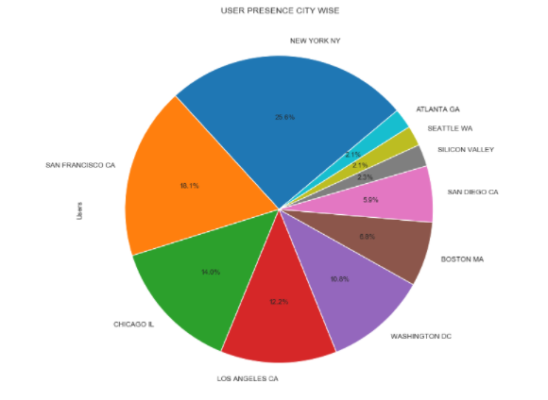
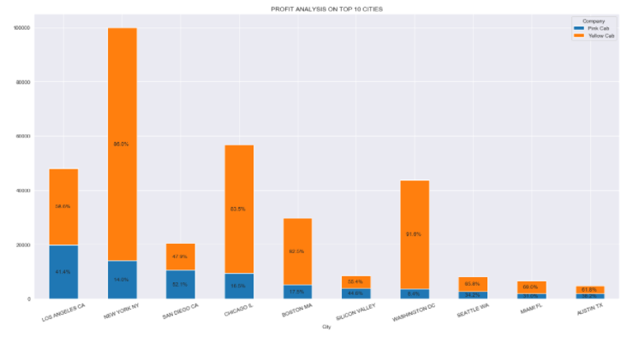
PROFIT ANALYSIS CITY WISE
The chart above shows the top 10 city with most users and NYC has 26% the total users and the bar chart shows that yellow cab made more profit in the most popular city with a total of 86% while pink cab shares only 14% of each city’s profit.

Slide 12
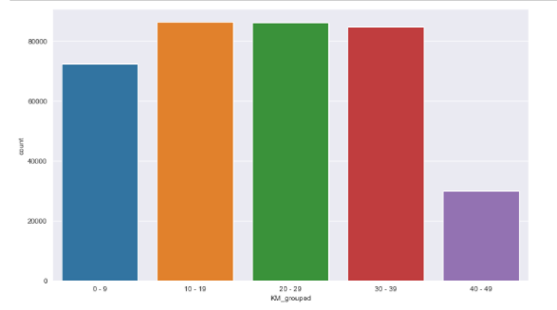
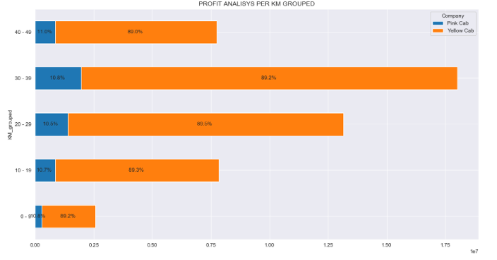
PROFIT ANALYSIS KM TRAVELLED WISE
Most cab users took a trip of 10 to 39 km.
Most of them travelled with Yellow cab company
Yellow cab made closely 89% of the total profit made on each KM group

Slide 13
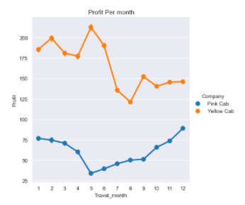
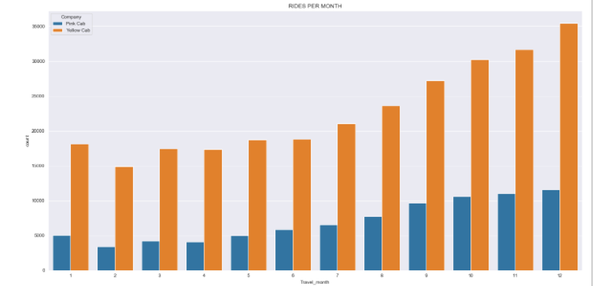
MONTH PROFIT AND RIDE ANALYSIS

Slide 14
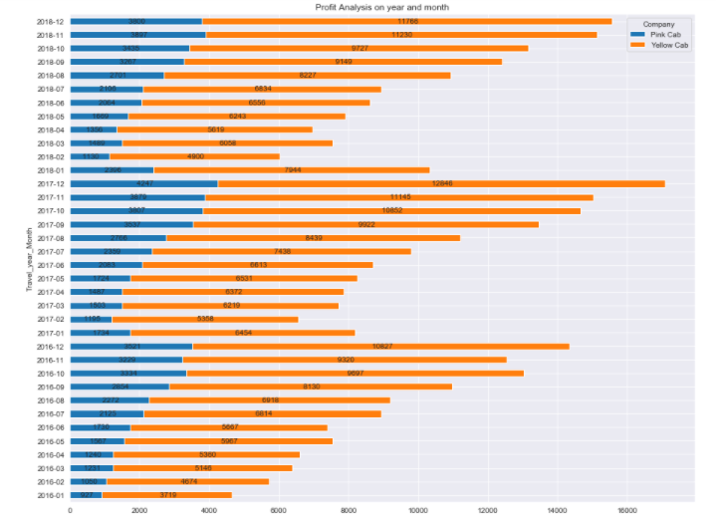
PROFIT ANALYSIS ON YEAR MONTH
Most cab users took trip by the end of the year during December and November
Most of them travelled with Yellow cab company
Yellow cab has more users and it is the preferred cab company
Pink cab Company has the minimum number of customer through out the year

Slide 15
RECOMMENDATIONS
We have evaluated both the cab companies on following points and found Yellow cab better than Pink cab:
Customer Reach: Yellow cab has higher customer reach in all the 20 cities. Yellow cab Company has more users in populated cities such as New York City.
Customer Retention: The top 5 users that has 50 rides with both Company, they had more than 40 rides with Yellow cab and closely 10 rides with Pink Cab. Cab users prefer travelling with Yellow cab Company.
Age wise Reach: Yellow cab has customer in all age group and it’s been observed that it’s even popular in 60+ age group as equally as it’s in 18-25 age group.
Average Profit per KM: Yellow cab’s average profit per KM is almost three times the average profit per KM of the Pink cab.
Income wise Reach: Both the cabs are very popular in high and medium income class but here also Yellow cab is performing better than Pink cab in offering their services to any class.
Company Availability: Most cab users travelled mostly in December and November and choose Yellow cab over Pink cab Company because they Yellow cab has 3times the number of Pink cab customers.
On the basis of above point, we will recommend Yellow cab Company for investment.

Slide 16

Thank You

