Slide 1
Methods for Test Time and Test Data Volume Reduction
Ondřej Novák

Slide 2
Outline
Complex circuits testing problems
Built-in random patterns generators
Mixed-mode testing approaches
Compresed patterns and on-chip decompressors
Output response analysers
Special architectures

Slide 3
How to facilitate testing?
Classical approach:
SOC
Tester
Test
Patterns
Core under Test (CUT)
Responses
Test Access
Mechanism -TAM

Slide 4
Complex Design Testing Problems
Limited memory on ATE (more powerful ATE, truncated vector sets)
Long upload time (tens of minutes necessary for reloading test sets)
Limited Test Access Mechanism (TAM) bandwidth (number of input channels multiplied with the frequency capability is insufficient – long test time)

Slide 5
Built-In Self Test
chip
Test
Patterns
CUT
start
TPG
Tester
signature
Responses
SA
Narrow
TAM

Slide 6
BIST
Concurrent (EDAC, NMR, totally self-checking checker, etc.)
  −Coding or modular redundancy techniques (fault tolerance)
  −Instantaneous correction of errors caused by temporary or permanent faults
Non concurrent(diagnostic routines)
  Carried out while a system is in an idle state

Slide 7
non concurrent
BIST
CUT exercising
CUT output response analysis
exhaustive
patterns
deterministic
patterns
(Weighted) random patterns
time based compaction
space based compaction
Test pattern decompression
mixed patterns application
Highly integrated BIST

Slide 8
non concurrent
BIST
CUT exercising
CUT output response analysis
exhaustive
patterns
deterministic
patterns
(Weighted) random patterns
time based compaction
space based compaction
Test pattern decompression
mixed patterns application
Highly integrated BIST

Slide 9
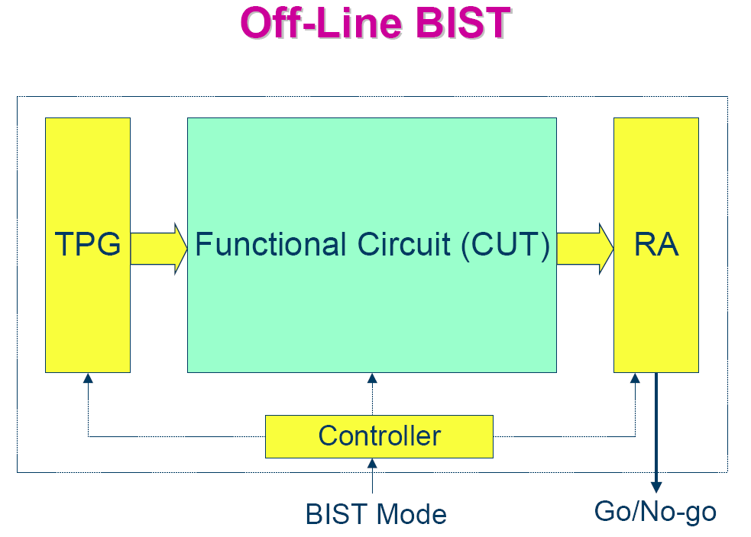
zdroj: Cheng-Wen Wu, NTHU

Slide 10
Test Patern Types Used in BIST
deterministic patterns – stored in a special on-chip or off-chip memory, possibility of pattern compression
algorithmically generated deterministic patterns – regular structure testing (memories)
pseudorandom, pseudoexhaustive, weighted random patterns
mixed patterns – output sequence of a special decompressing automaton is modified with the help of stored patterns

Slide 11
Random Test Pattern Generators in BIST
Random patterns
  Linear Feedback Shift Registers (LFSR)
  necessary to use a phase shifter for using parallel output bit as patterns
  Cellular automata (CA)
Weighted random patterns
  LFSRs + output weight modification
  Automata generating patterns with modified weights

Slide 12
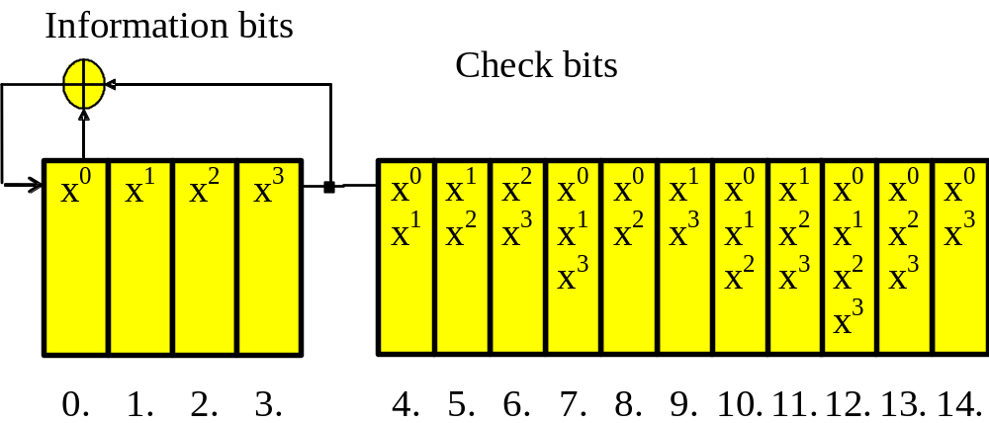
Patterns generated in an LFSR
- structural dependences
LFSR behavior example

Slide 13
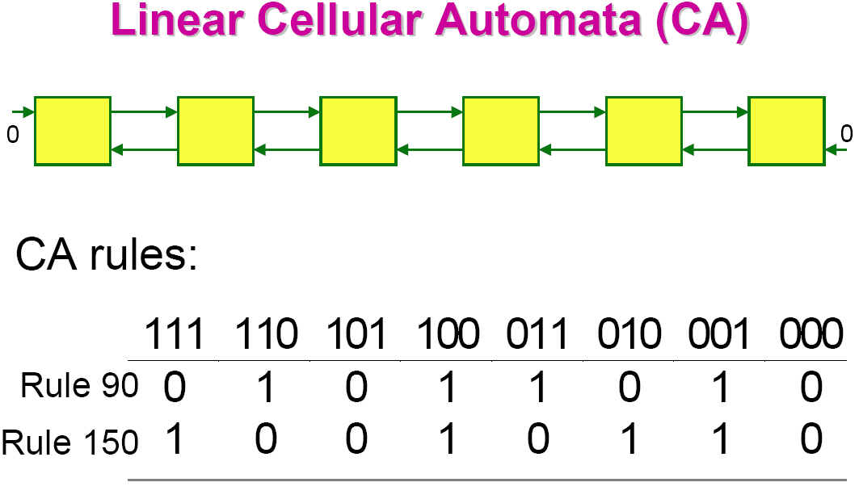
zdroj: Cheng-Wen Wu, NTHU

Slide 14
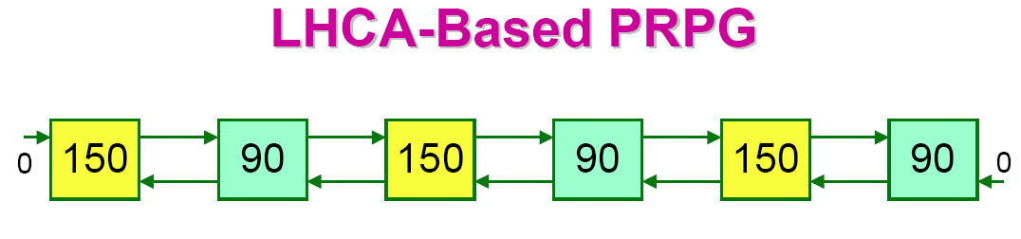
Most popular CA PRPG: interleaved cells with rules 150 and 90, respectively
  􀂾Called linear hybrid CA (LHCA)
  􀂾As LFSR, aliasingprobability = 1/2n
  􀂾Higher hardware overhead than LFSR
  􀂾No global feedback lines
zdroj: Cheng-Wen Wu, NTHU

Slide 15
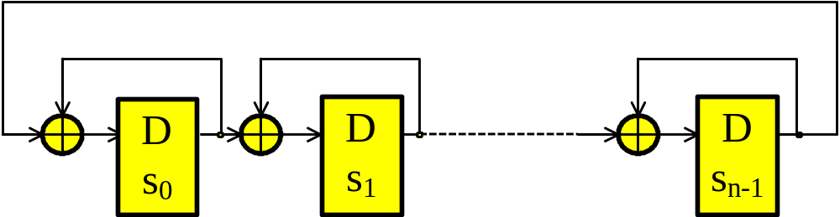
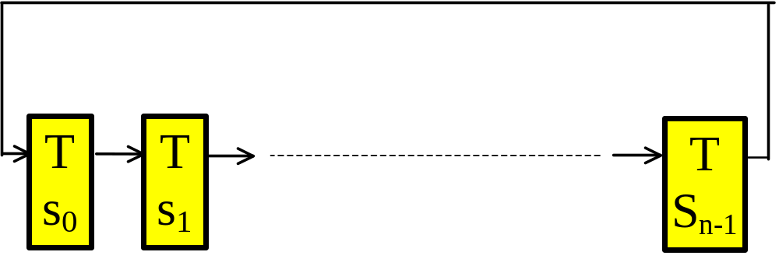
Cellular Automata (CA)
CA behavior example

Slide 16
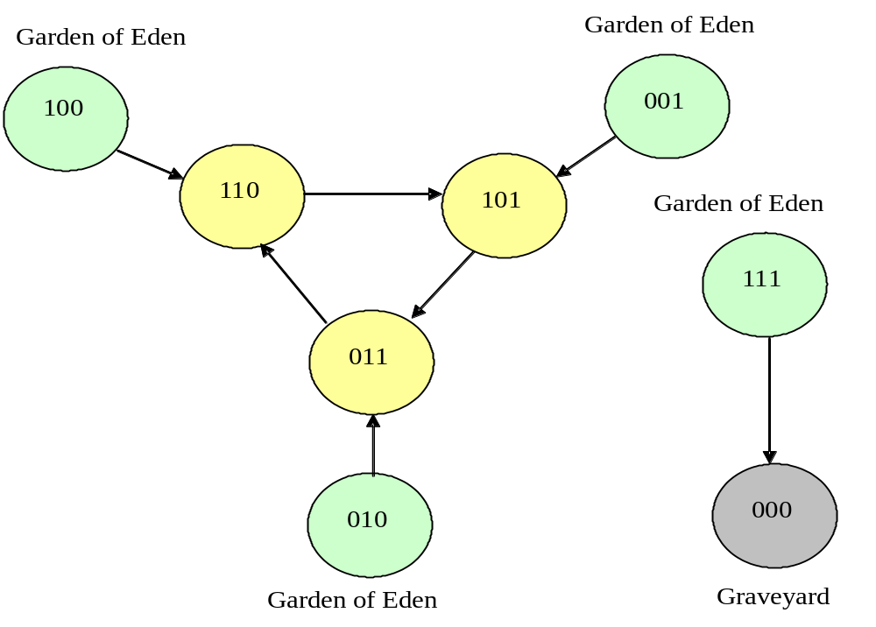
CA state transition diagram

Slide 17
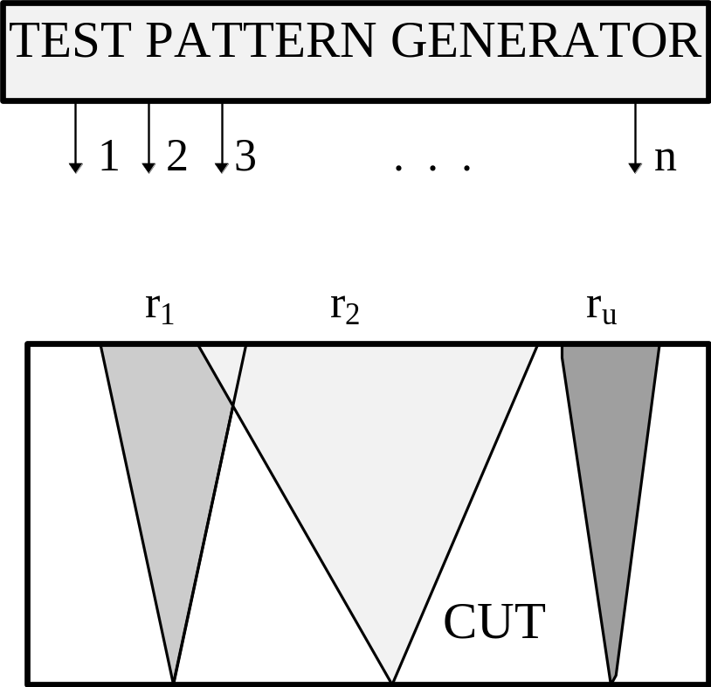
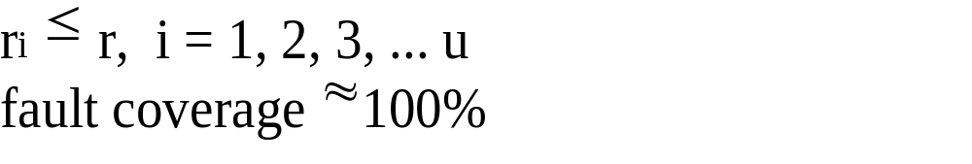
(n,r) exhaustive testing

Slide 18
Pseudoexhaustive Test Sets
100 % probability of detecting considered faults
relatively long test sequences
for large systems not practical

Slide 19
Comparison of LFSR and CA ability of (n,r) exhaustive test sets creating
LFSR pseudoexhaustive test pattern quality
CA pseudoexhaustive test pattern quality

Slide 20
Weighted Random Testing
improves random testing
input-oriented weights
pattern-oriented weights

Slide 21
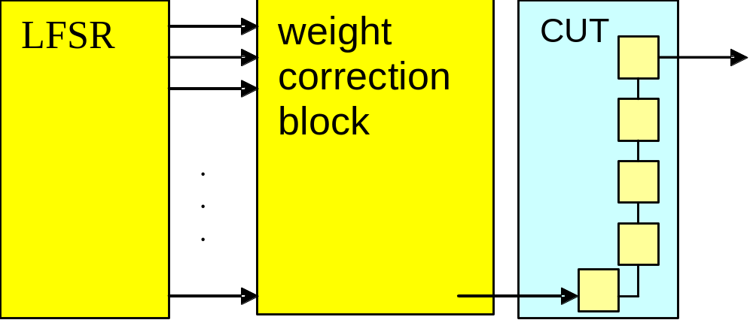
weighted pseudorandom test patterns
LFSR behavior demonstration

Slide 22
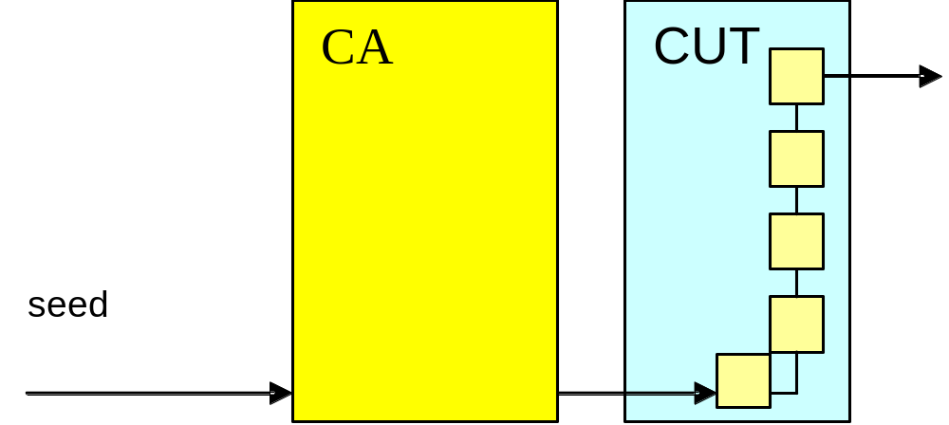
weighted random test patterns generated in CA
CA behavior demonstration

Slide 23
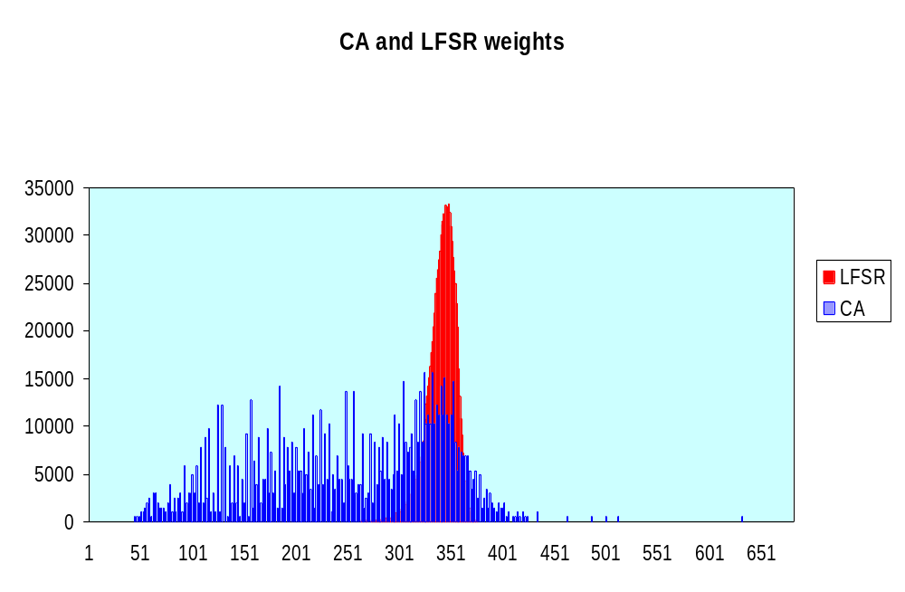

Slide 24
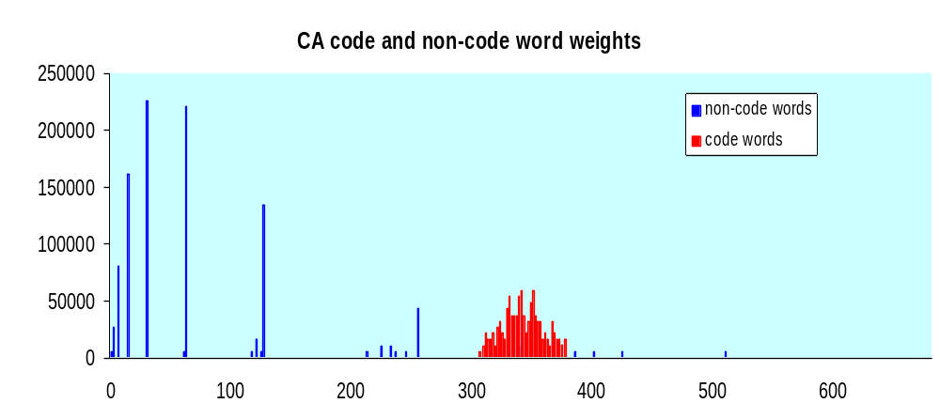

Slide 25
Problem of Random Resistant Faults
Circuit | # Fault Count | # Random Patterns | Equi-probable Rand. Patt. | Input- Oriented Weighted Rand. Patt. | Pattern Oriented Weigthed Rand. Patt.
 |  |  | # faults | # faults | # faults
C2670 | 2,408 | 2,000 | 290 | 50 | 51
 |  | 10,000 | 290 | 19 | 6
 |  | 50,000 | 279 | 6 | 2
c7552 | 6,876 | 2,000 | 365 | 165 | 212
 |  | 10,000 | 292 | 47 | 93
 |  | 50,000 | 218 | 25 | 29

Slide 26
Outline
Complex circuits testing problems
Built-in random patterns generators
Mixed-mode testing approaches
Compresed patterns and on-chip decompressors
Special architectures
Conclusions

Slide 27
Mixed-mode testing
chip
Start
Test Patterns
Tester
TPG
CUT
test patterns
signature
Responses
ORA

Slide 28
Mixed Patterns generators
Generators of random and deterministic patterns:
  bit-fixing or bit-flipping automaton (CUT dependent architecture)
  parallel LFSR outputs manipulations (CUT dependent architecture)
LFSRs, CAs, other automata with reseeding, partial reseeding
Decoders of compressed tester sequence

Slide 29
On-chip mixed random-deterministic pattern generators have to be designed uniquely for the considered CUT ...
Nowadays trend: use stored pattern seeds and universal „non-intrusive“ test pattern decompressors

Slide 30
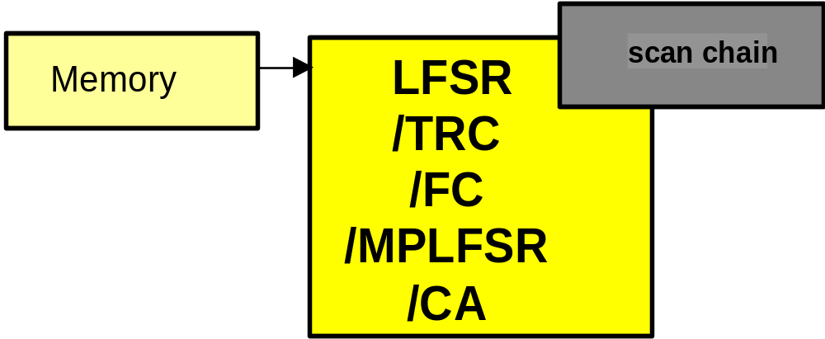
Mixed-mode techniques based on automaton reseeding:
Store different automata seeds in the ATE memory
reseed the decompression automaton
patterns with demanded values of care-bits will be generated within an automaton output sequence

Slide 31
Structure of the Test Sequence
Autonomous generation of approx.10 000 random test patterns,
Fault simulation – fault list reduction
feeding the automaton model with a deterministic pattern seed,
Test patterns obtained by performing a limited number of automaton clock cycles together with the scan chain shifts
fault simulation - fault list reduction
If fault coverage unsuficient – feeding with the next deterministic seed

Slide 32
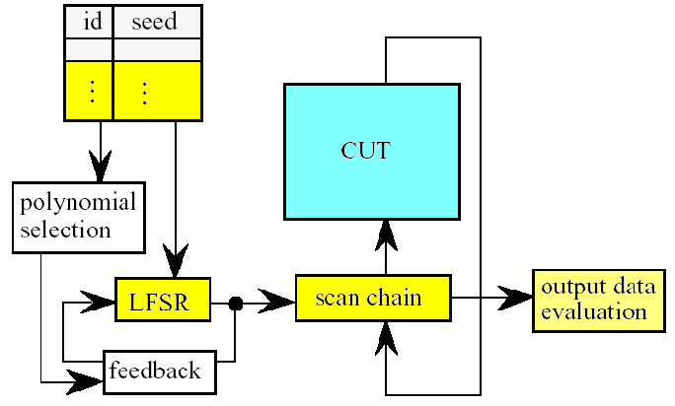
MP LFSR [HELL95]
ATE memory
On-chip

Slide 33
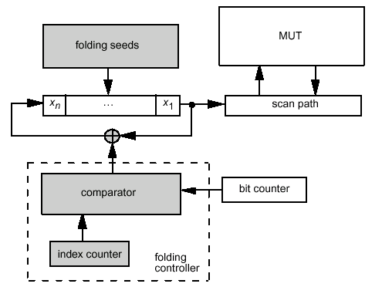
Folding counters [HELL00]

Slide 34
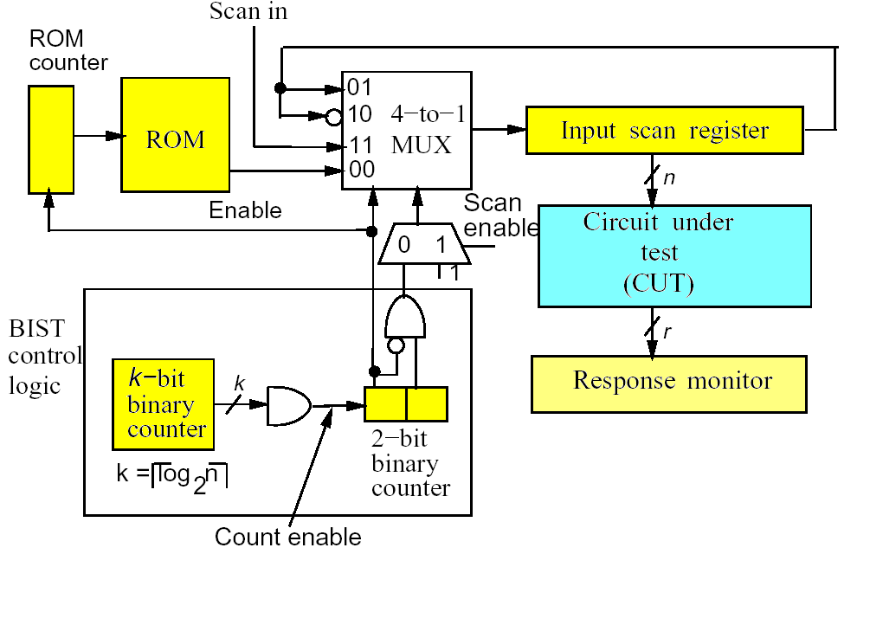
Twisted ring counter [CHAK99]

Slide 35
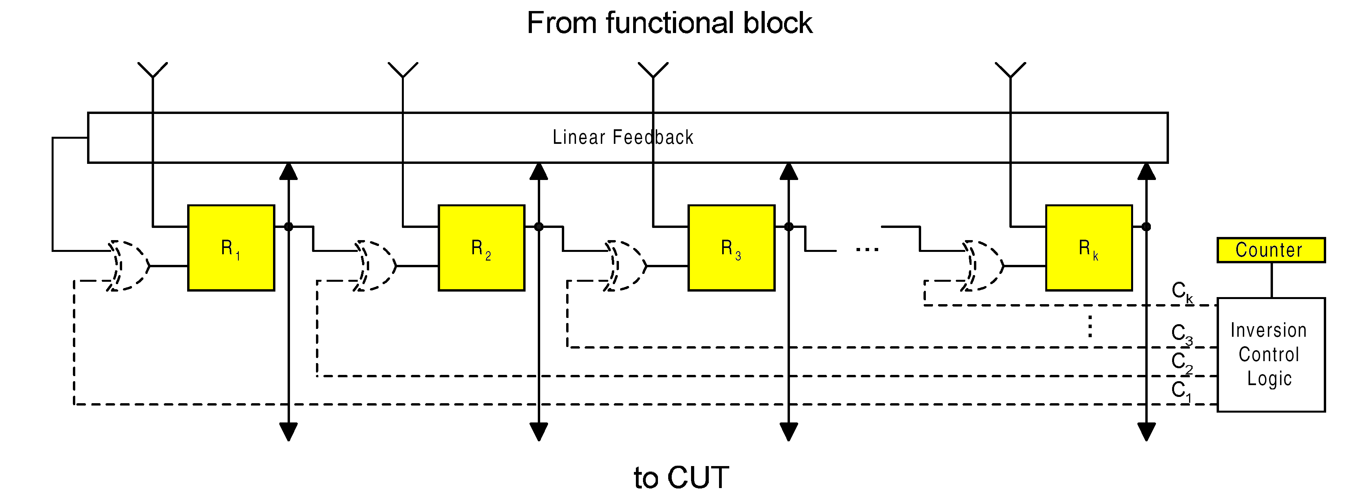
Reseeding Technique for LFSR-based Test Pattern Generation [KALI01]

Slide 36
Metods for multiple scan chain designs:
Scan Chain Concealment [RAO03]
Short outer SC, long hidden scan chains
Seed vectors are decompressed into longer parallel vectors (test patterns)
The ratio between seed bits and test pattern bits depends on the number of dont care bits in originally generated test patterns.

Slide 37
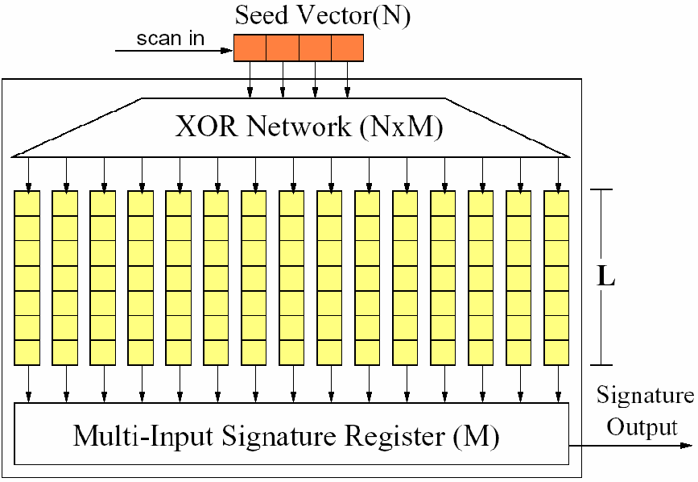
Scan Chain Concealment, overlapping the seed vectors
Sequence of (overlapped) seeds
Outer scan chain
hidden scan chains

Slide 38
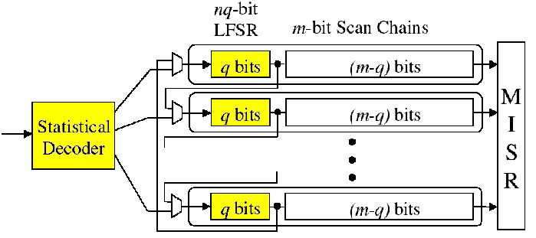
Reseeding with a seed compression [KRIS02]

Slide 39
Compacted and Compressed Test Sets
Compacted test sets: Original ATPG patterns are merged . Resulting patterns detect multiple faults and do not contain don’t care bits while the test set fault coverage remains unchanged.
Compressed test sets: Pre-computed (compacted?) test set is transformed into a smaller test set, which can be transmitted and decompressed without any information loss.

Slide 40
Deterministic Test Pattern Compression
chip
Test pattern generation compaction and compression
Tester
ATPG
Test
Patterns
Seeds
Seeds
Decompressor
Memory
Test Patterns
CUT
CUT Responses
Signatures
ORA
Narrow
TAM

Slide 41
Test data compression techniques goal: reduce memory requirements, speed up ATE-SoC interaction, increase likelihood of detecting non-modelled faults.
Compression methods
Simple Compression Methods – do not require information about the CUT
Combined Compression Methods – interaction with fault simulator, pattern generator, own test compaction

Slide 42
Dictionary Based Compression
Huffman coding (May be optimal - difficult decoding)
Golomb coding, Frequency-Directed-Run-Length (FDR) coding and its alternatives
Combination of more codes (Packet based compression, …)

Slide 43
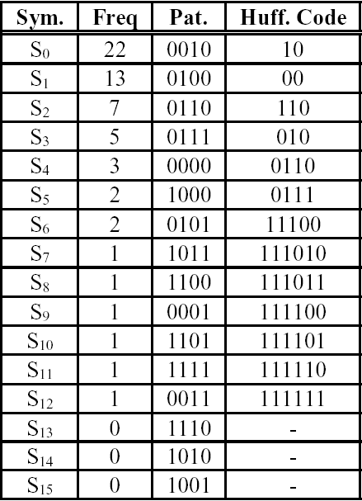
Huffmann codes, statistical coding [ABHI99]
variable length codewords represent fixed-length blocks of bits in a data set

Slide 44
FDR codes [CHAK03]
Ordered test sequence, the next pattern differs with the previous one in a minimal number of bits
Difference vector sequence T_{diff}
T_{diff} ={t₁, t₁ XOR t₂, t₂ XOR t₃, … t_{n-1} XOR t_{n}}
A run length is a stream of 0s terminating with a 1
Frequency of runs of different lengths can be estimated. FDR code can be fitted to the run length distribution

Slide 45
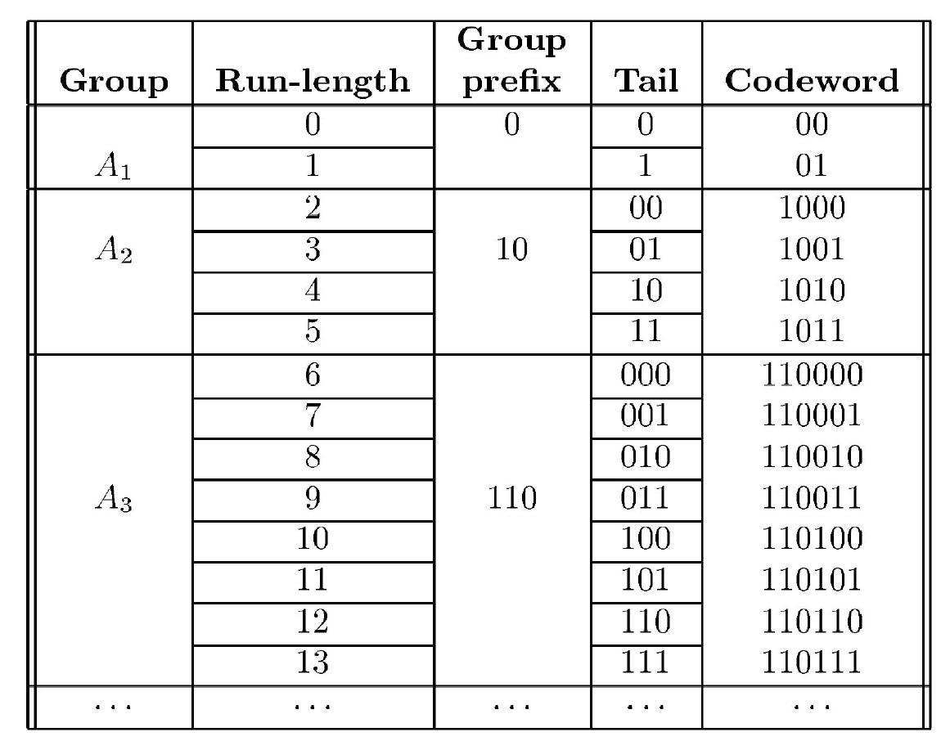

Slide 46
Packed-based Input Test Data Compression
Packet - sequence of 0s, 1s and don't care bits with a fixed length
Data packet types: Zero Match – 00, One Match – 01, Pseudo-random Match – 10, No Match – 11
Grouping of packets - Huffman code
Encoded sequence consists of code type, number of packets in a group of packet, in case of “No match” + original packet

Slide 47
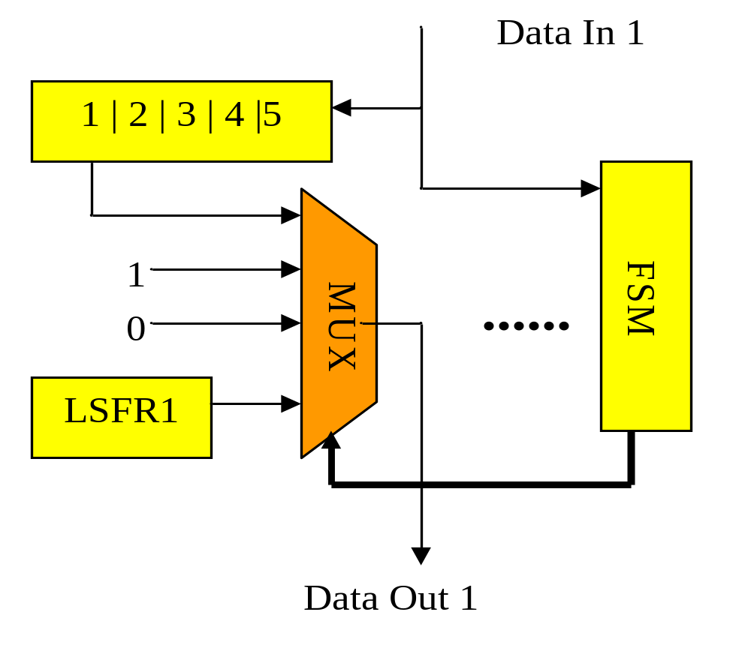
Example of the Decompression Unit: Packet-based code [VOLK02]

Slide 48
Compression Techniques Using Subsidiary Data from ATPG
LFSR, MP LFSR, CA, folding counters, twisted ring counters (…) reseeding, reseeding with pattern compression, ...
Test pattern overlapping

Slide 49
Test Pattern Overlapping
It is possible to perform test pattern compaction and pattern overlapping together – memory reduction
Unmodified input part of the scan chain is used for pattern decompression
Scan based sequential circuits – test-per-clock additional hardware or RESPIN architecture demanded

Slide 50
1
0
0
0
0
1
1
1
0
1
0
1
D
D
D
D
D
10000
01000
00100
00010
10001
11000
11100
01110
10111
01011
10101
11010
input part of the scan chain
compressed test sequence
test patterns applied on the CUT inputs
ATE memory

Slide 51
Creation of the Pattern Overlapping Test Sequence
Feeding the CUT scan chain with the first pattern
Fault simulation –fault list reduction
Choosing the most suitable next pattern that can be obtained by minimum number of scan chain shifts
Fault simulation, if fault coverage insufficient – concatenate next patterns

Slide 52
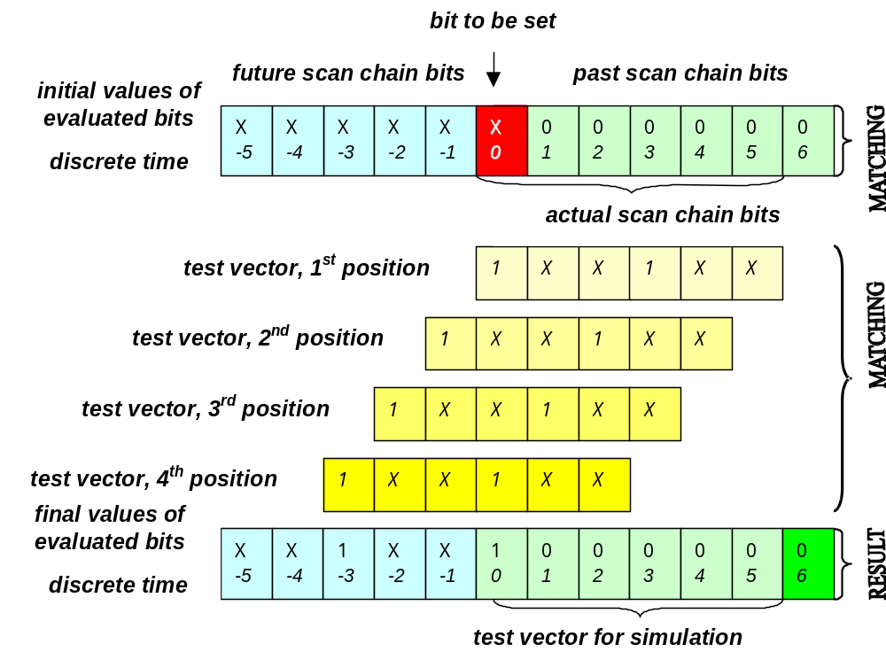

Slide 53
COMPAS algorithm
Minimized overlapped test pattern sequence
Fault simulation after creation of each new scan chain bit
http://iko.kes.vslib.cz

Slide 54
Reconfigurable Illinois Scan Architecture [PAND02]
Broadcast scan mode X serial scan mode
Minimization of the number of serial scan patterns
Reconfigurable architecture enables to switch dynamically between the two scan modes. Medium number of bits in a pattern is reduced

Slide 55
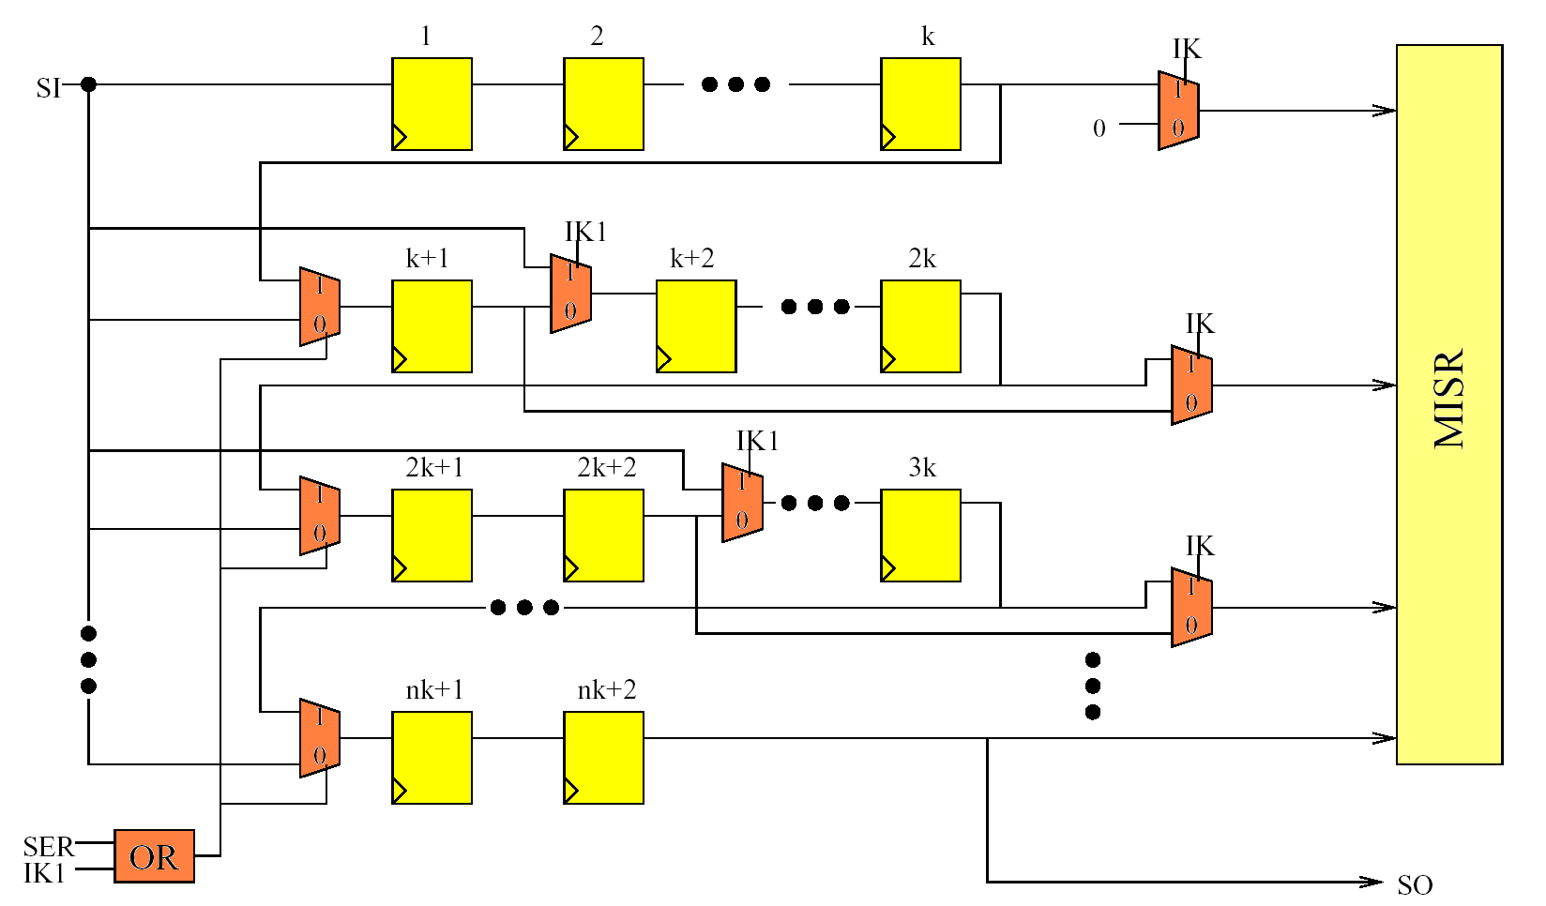
Illinois Scan Architecture

Slide 56
Reusing Scan Chains for Test Pattern Decompression (RESPIN) [SCHA02]
Embeded Tester Core – a SoC that is transformed into pattern buffer
CUT – core under test
The chains of the ETC and CUT form wide TAM
The wire between the tester and the mpx input is the narrow TAM

Slide 57
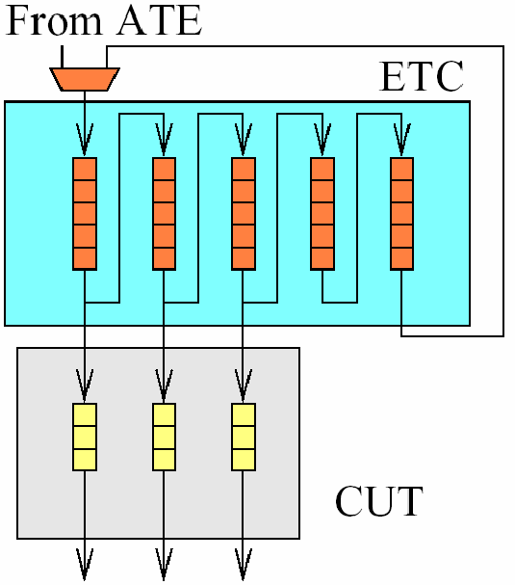
RESPIN architecture [SCHA02]

Slide 58
tc
from ATE
1
0
6
1st ETC chain
4
2
1st CUT chain
7
M
I
S
R
5
3
1
5
2nd ETC chain
3
1
6
4
2
2nd CUT chain

Slide 59
Comparison of Different Compression Methods*
Circuit name | MinTest [HAMZ 98] | Stat. Coding of Test Cubes [ABHI99] | LFSR Reseed ing [KRIS02 ] | Illinois Scan Arch. [PAND02] | FDR Codes [CHAN01] | Linear Decompres-sors [ BAY03] | RESPIN ++ [SCHA02] | COMPAS [NOVA01]
 | # bits | # bits | # bits | # bits | # bits | # bits | # bits | # bits
s13207 | 163,100 | 52,741 | 11,285 | 109,772 | 30,880 | 19,608 | 26,004 | 3,968
s15850 | 58,656 | 49,163 | 12,438 | 32,758 | 26,000 | 12,024 | 32,226 | 6,493
s38417 | 113,152 | 172,216 | 34,767 | 96,269 | 93,466 | 54,207 | 89,132 | 20,282
s38584 | 161,040 | 128,046 | 29,397 | 96,056 | 77,812 | 28,120 | 63,232 | 6,150
* methods which do not use random testing
phase were compared only

Slide 60
BIST TPG Conclusions
Random resistant faults have to be tested by deterministic test patterns
Mixed-mode BIST is a good compromise between low hardware overhead demand and the cost of testing (memory, time)
Initial random testing is sometimes unacceptable because of big number of performed clock cycles

Slide 61
Conclusions, cont.
For different method comparison we have to take into account:
  quality of test set
  number of stored bits
  number of clock cycles during a test session (Random testing phase? )
  amount of additional hardware for test
  complexity of test control
  repeatability of the diagnostic equipment for different designs

Slide 62
non concurrent
BIST
CUT exercising
CUT output response analysis
exhaustive
patterns
deterministic
patterns
(Weighted) random patterns
time based compaction
space based compaction
Test pattern decompression
mixed patterns application
Highly integrated BIST

Slide 63
Output Response Analysis
Comparison (stored expected responses)
Concentration (XOR tree)
Counting (counts 1, 0, transitions)
Signature analysis (SA, MISR)
Accumulator sum (allows parameter variations)
Parity check (XOR tree + flip-flop)
fault aliasing = two or more faults resulting in a correct result

Slide 64
Signature analysers (SA, MISR)
Internal XORs
x⁰
x¹
x²
input
External XORs
x⁰
x¹
x²
input
Approx. probability of signature aliasing 2^{-n}
Primitive polynomials reduce aliasing
Repeating test sequence in reverse order reduces aliasing
Primitive polynomials detect single errors, other polynomials detect burst errors and multiple errors.

Slide 65
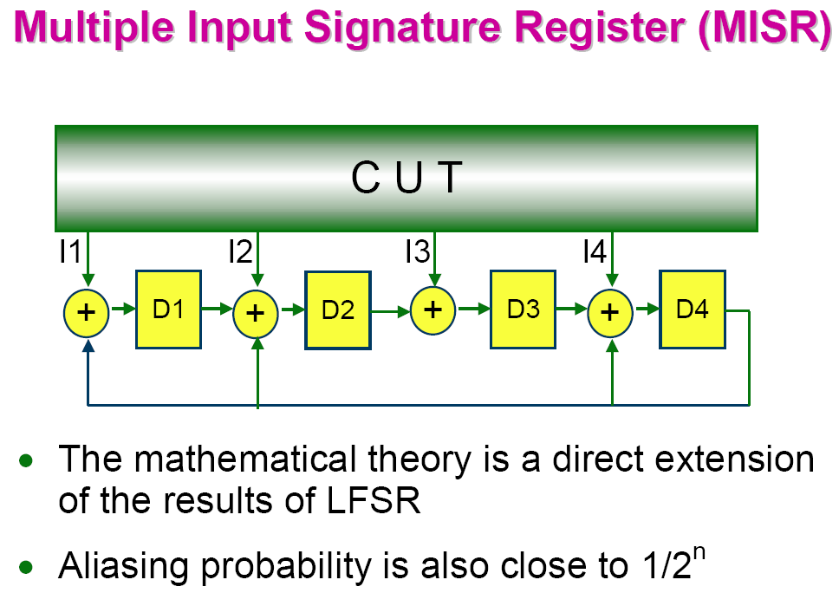
zdroj: Cheng-Wen Wu, NTHU

Slide 66
System
Test Controller
Board
Test Controller
Board
Test Controller
Board
Test Controller
Chip
Architektura BIST
Chip
Test Controller
Chip
Test Controller
Chip
TPG
Test Controller
TPG
CUT
TPG
CUT
ORA
  CUT
ORA
ORA

Slide 67
General scheme of the BIST architecture
Primary Inputs
Primary Outputs
Output Response Compaction
Pattern Generator
0
1
CUT
Comparator
ROM
Test Controller
Good/Faulty Signal
Start Test

Slide 68
STUMPS architecture
primary inputs
primary outputs
Combinational part of the CUT
0
1
Test Pattern Generator
MISR
Chain 1
Chain 2
...
Chain n
BIST controller

Slide 69
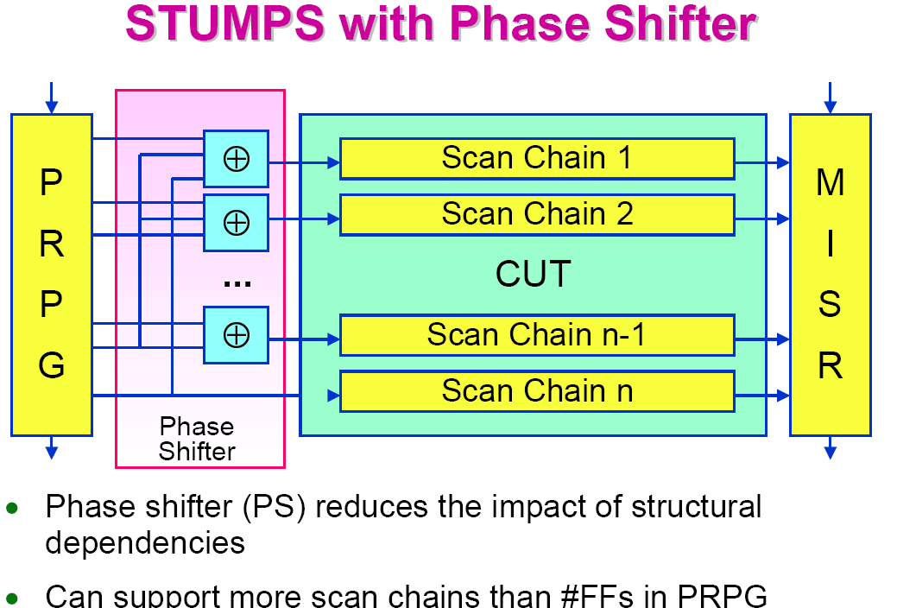
zdroj: Cheng-Wen Wu, NTHU

Slide 70
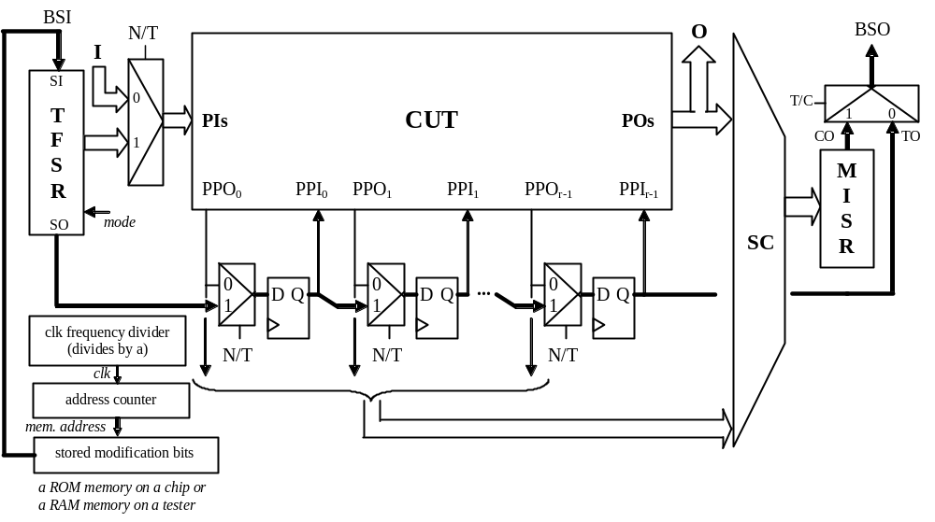
Test-per-clock BISTwith zero fault aliasing
Novak O., Pliva Z., Nosek J., Hlawiczka A., Garbolino T., Gucwa K., : Test-Per-Clock Logic BIST with Semi-Deterministic Test Patterns and Zero-Aliasing Compactor, Kluwer Academic Publishers - Journal of ElectronicTesting: Theory and Applications 20, 2004

Slide 71
Built-In Logic Block Observers
4 modes of BILBO register function:
D flip-flops
Autonomous LFSR
Input compacting LFSR
Scan chain
BILBO 1
combinational circuit 1
BILBO 2
combinational circuit 2

Slide 72
Circular Self-Test BIST architecture
Combinational part of the CUT
0
1
0
1
0
1
D
D
D
BIST controller
Start BIST
BIST
done

Slide 73
HILDO
CUT
non-linear logic
function
Shift register
linear feedback
non-linear feedback

Slide 74
Questions
What is the number of undetectable faults for HILDO and Circular BIST?
Is it possible to find a solution of HILDO for real circuits? (Problem of CPU time)
In what extent do we have to take care about fault alising?

Slide 75
References
[ABHI99] Abhijit Jas, Jayabrata Ghos-Dastir, and Nur A. Touba: Scan Vector Compression/Decompression Using Statistical Coding. Proc. VTS 1999
[BAY03]Bayraktaroglu, I. and Orailoglu, A.: Decompression Hardware Determination for Test Volume and Time Reduction through Unified Test Pattern Compaction and Compression. Proc. of VTS 03
[KOEN91] Koenemann, B.: LFSR – Coded Test Patterns for Scan Designs. Proc. ETC, 1991
[CHAK99] Chakrabarty, K. – Murray, B.T. – Iyengar, V.: Built-in Test Pattern Generation for High-Performance Circuits Using Twisted-Ring Counters. Proc. of VTS 1999
[HELL95] Hellebrand, S. - Rajski, J.- Tarnick, K S.- Venkataraman, S. - Courtois, B.: Built-In Test for Circuits with Scan Based on Reseeding of Multiple-Polynomial Linear Feedback Shift Registers. IEEE Trans. on Comp., vol. 44, No. 2, February 1995
[HELL00] Hellebrand, S., - Liang, H.G. – Wunderlich, H.J.: A mixed mode BIST scheme based on reseeding of folding counters. Proc. of ITC, 2000C
[CHAN01] Chandra, A. – Chakrabarty, K.:Frequency/Directed Run Length (FDR) Codes with Application to System/on/Chip Test Sata Compression. Proc. of VLSI Test Symp., 2001
[HAM98] Hamazaoglu, I. - Patel, J.H.: Test Set Compaction Algorithms for Combinational Circuits. Proc. of International Conf. on Computer-Aided Design, November 1998
[NOVA01] Novák, O., Nosek, J. : Test Pattern Decompression Using a Scan Chain. DFT Symp, 2001
[[KRIS02] Krishna, C.V., Touba, N.A.: Reducing Test Data Volume Using LFSR Reseeding with Seed Compression. Proc. of ITC 2002, pp321-330
[LI03] Li, L - Chakrabarty K.:Test Data Compression Using Dictionaries with Fixed-Length Indices. VTS, 2003
[PAND02] Pandey, A. R. – Patel, H. J.: Reconfiguration Technique for Reducing Test Time and Test Data Volume in Illinois Scan Architecture Based Designs. Proc. IEEE VLSI Test Symp, 2002
[RAO03] Rao, W., Oraiologlu, A.: Virtual Compression through Test Vector Stitching for Scan Based Designs. DATE 2003
[SCHA02] Schafer, Dorsch, R., Wunderlich, H.J.: RESPIN++- Deterministic Embedded Test. Proc. European Test Workshop, 2002, pp. 37-42
[VOLK02] Volkerink, E.H., Koche, A. and Mitra S.: Packet-based Input Test Data Compression Techniques. Proc. of ITC, 2002, pp. 154-163

