Slide 1
APEM Monthly Meeting
24.01.2024

Slide 2
Agenda
Project updates

Slide 3
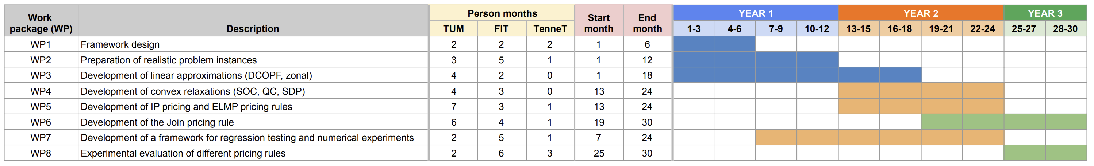
Timeline
We are here

Slide 4

Project updates
Nodal model:
Refactoring, changed output format from .txt to .csv.
EUPHEMIA:
Data conversion US $→$ EU bidding language*
For each seller: generate all feasible commitment patterns $→$ min uptime constraint
$⇒$ Exclusive group with ${O(2}^{\left|T\right|})$ block orders $→$ min production
For each block order: multiple linked block orders $→$ cost curve
Problem: too many orders
Next: Orders aggregation

Slide 5

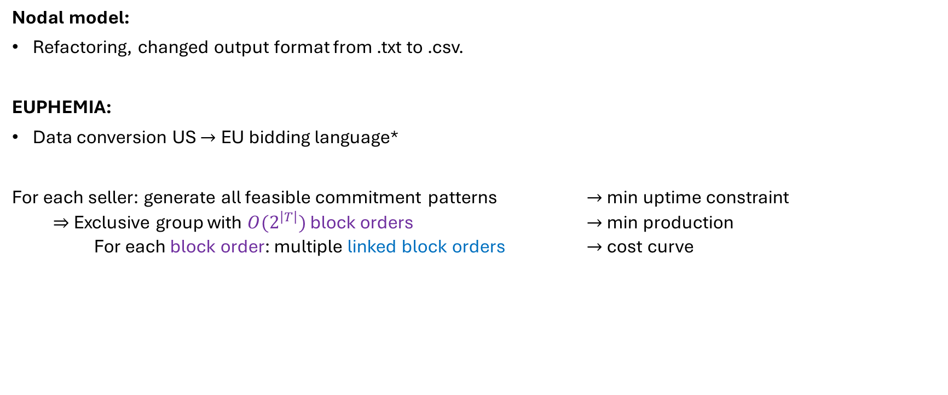
Project updates
Nodal model:
Refactoring, changed output format from .txt to .csv.
EUPHEMIA:
Data conversion US $→$ EU bidding language*
For each seller: generate all feasible commitment patterns $→$ min uptime constraint
$⇒$ Exclusive group with ${O(2}^{\left|T\right|})$ block orders $→$ min production
For each block order: multiple linked block orders $→$ cost curve
Problem: too many orders
Next: Orders aggregation
*Conversion possible under certain assumptions

Slide 6
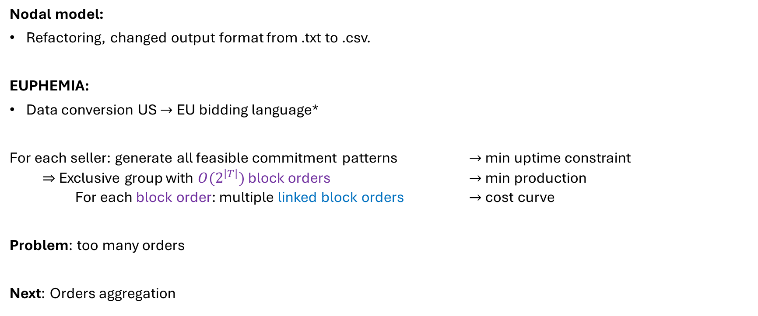
Project updates
Nodal model:
Refactoring, changed output format from .txt to .csv.
EUPHEMIA:
Data conversion US $→$ EU bidding language*
For each seller: generate all feasible commitment patterns $→$ min uptime constraint
$⇒$ Exclusive group with ${O(2}^{\left|T\right|})$ block orders $→$ min production
For each block order: multiple linked block orders $→$ cost curve
Problem: too many orders
Next: Orders aggregation
*Conversion possible under certain assumptions

