Slide 1
APEM Monthly Meeting
26.02.2025

Slide 2
Agenda
Project updates
Demo

Slide 3
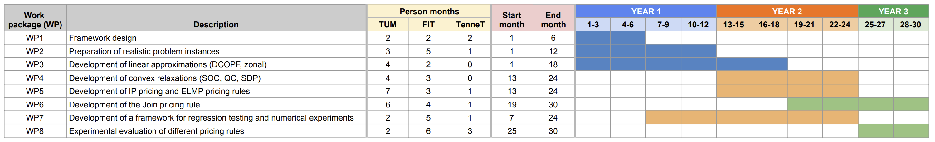
Timeline
We are here

Slide 4
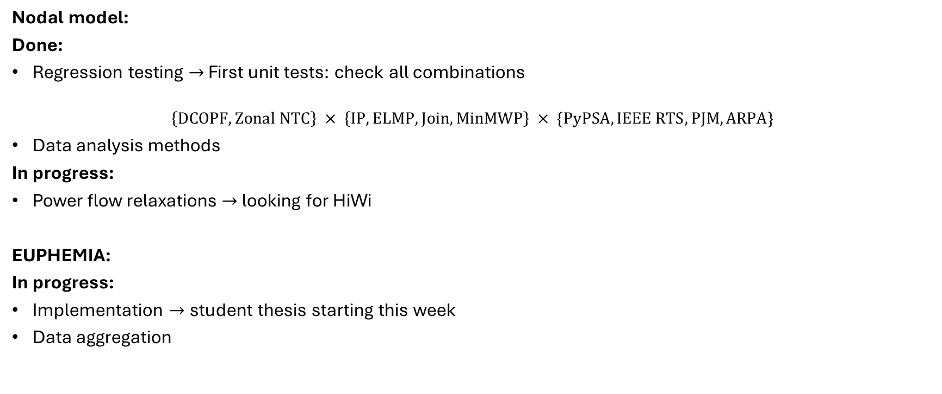
Project updates
Nodal model:
Done:
Regression testing $→$ First unit tests: check all combinations
$$\left\{DCOPF, Zonal NTC\right\} × \left\{IP, ELMP, Join, MinMWP\right\} × \{PyPSA, IEEE RTS, PJM, ARPA\}$$
Data analysis methods
In progress:
Power flow relaxations $→$ looking for HiWi
EUPHEMIA:
In progress:
Implementation $→$ student thesis starting this week
Data aggregation
Problem: too many orders

Slide 5
Demo

