Slide 1
Let's Equip Our Future House in 3D!
Outfitting a Mars Habitat: A 3D Print Challenge

Slide 2
Challenge Overview
The challenge aims to help astronauts on a one-year mission exploring the Mars planet.
Astronauts will use the 3D printers they have to craft the necessary tools and items required to survive and work.

Slide 3
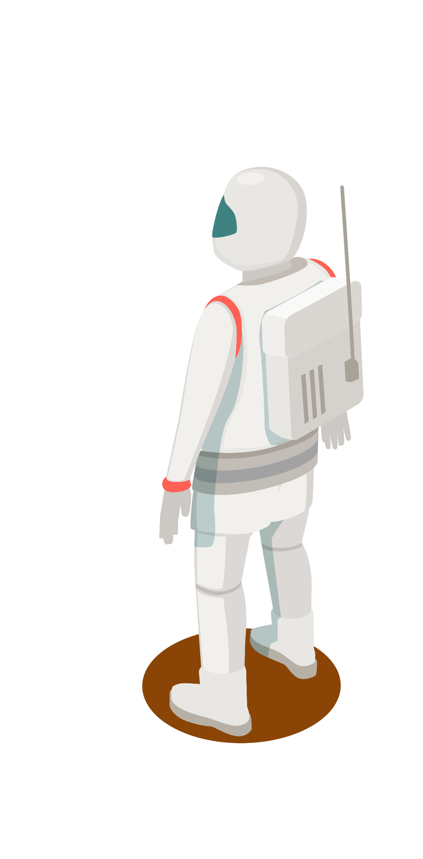
Our Strategy
Since you cannot carry everything you need from Earth and
to sustain the astronaut's life on the red planet,
our team dug into different hazards astronauts will encounter
and organized them into categories.
After, we created a list of solutions to overcome the challenges by
designing 3D–printed useful objects and tools.

Slide 4
Sectors
Work
Fourniture
Quality of life & Health & Higiene (Malek)
Work goggles
Wire Saw
Hammer and shovel
Loft and suspended bed,,,
Weightlifter
Hair brush,,,
Exploration
Emergency
OTHER
Portable telescope,,,
Heating element
Screw on bottle citrus juicer,,,
Wrist brace,,,

Slide 5
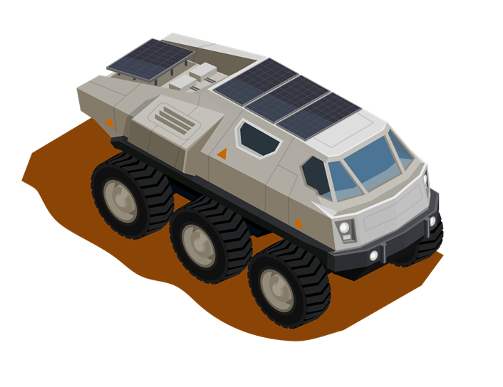
Software Tool : SolidWorks

Slide 6

INTRODUCTION

Slide 7
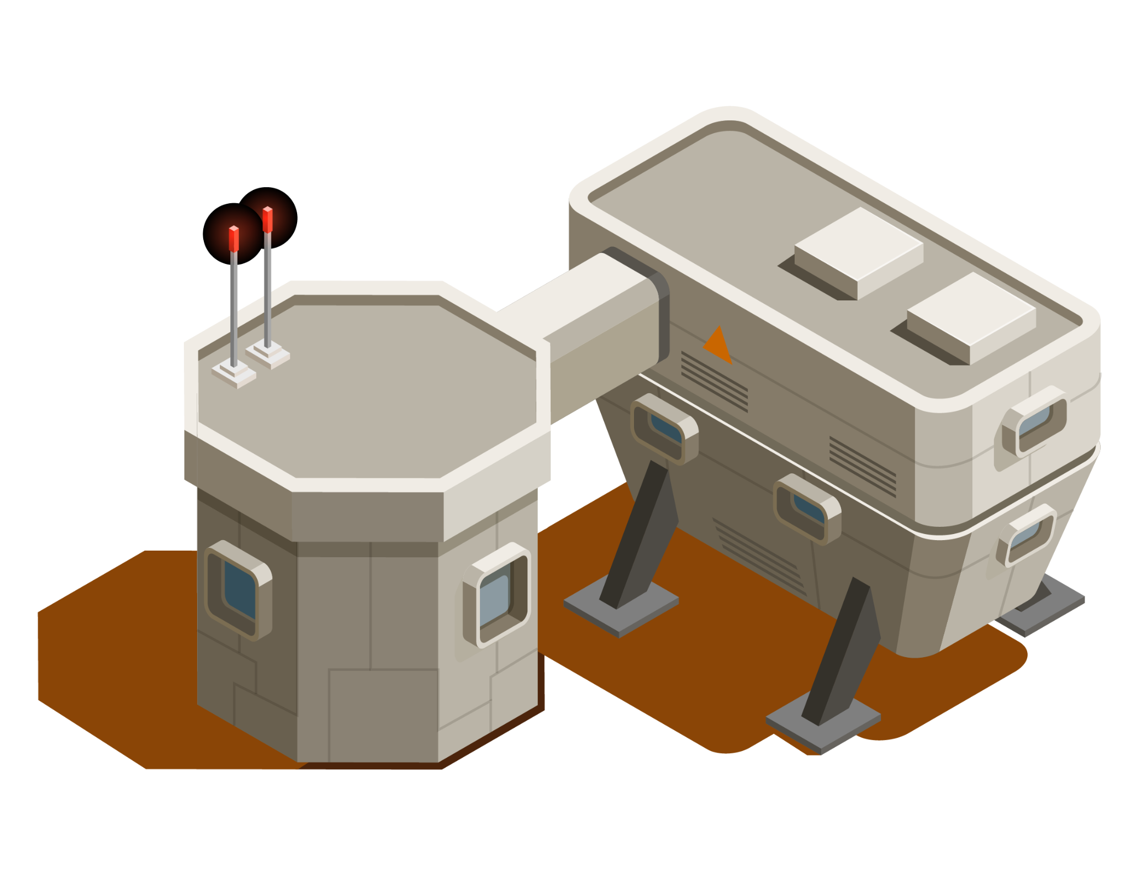
Meet TUNSA Space Robotics Team
Elyes Khechine
Afef Salhi
Nesrine Abidi
Firas Raouin
Malek Sghaier
Sarra Mannai

Slide 8
Resources

