Slide 1
We build our future planet with 3d models
Outfitting a MARS HABITAT : A 3D Print Challenge

Slide 2
Challenge Overview
The challenge aim is to help the astronaut on his one-year mission in exploring the Mars planet.
The astronaut will use the 3D printers to craft the necessary tools and items required to survive and work.

Slide 3
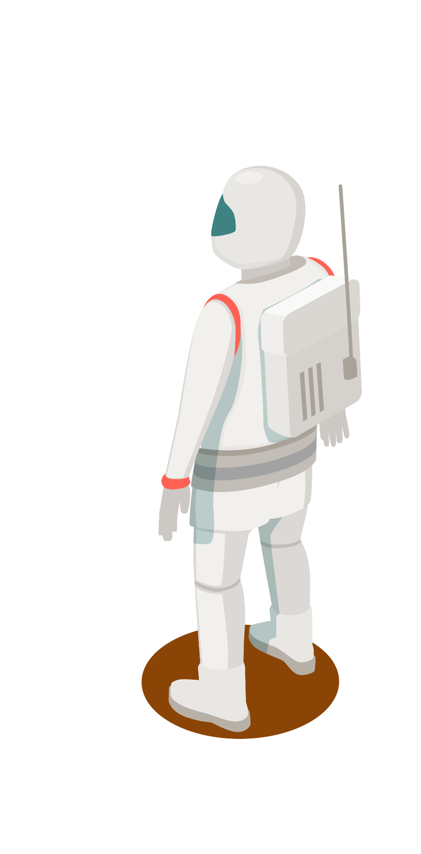
Our Strategy
As the astronaut has limited resources, he/she must :
Use available resources to generate new ones (solar panels to generate energy/available water).
Create multifunctional objects

Slide 4
Sectors
Work/Items
Fourniture/Items
Quality of life & Health & Higiene/Items
Work goggles
Wire Saw
Hammer and shovel
Loft and suspended bed,,,
Weightlifter
Hair brush,,,
Exploration/Items
Emergency/Items
OTHER
Portable telescope,,,
Wrist brace,,,
Heating element
Screw on bottle citrus juicer,,,

Slide 5
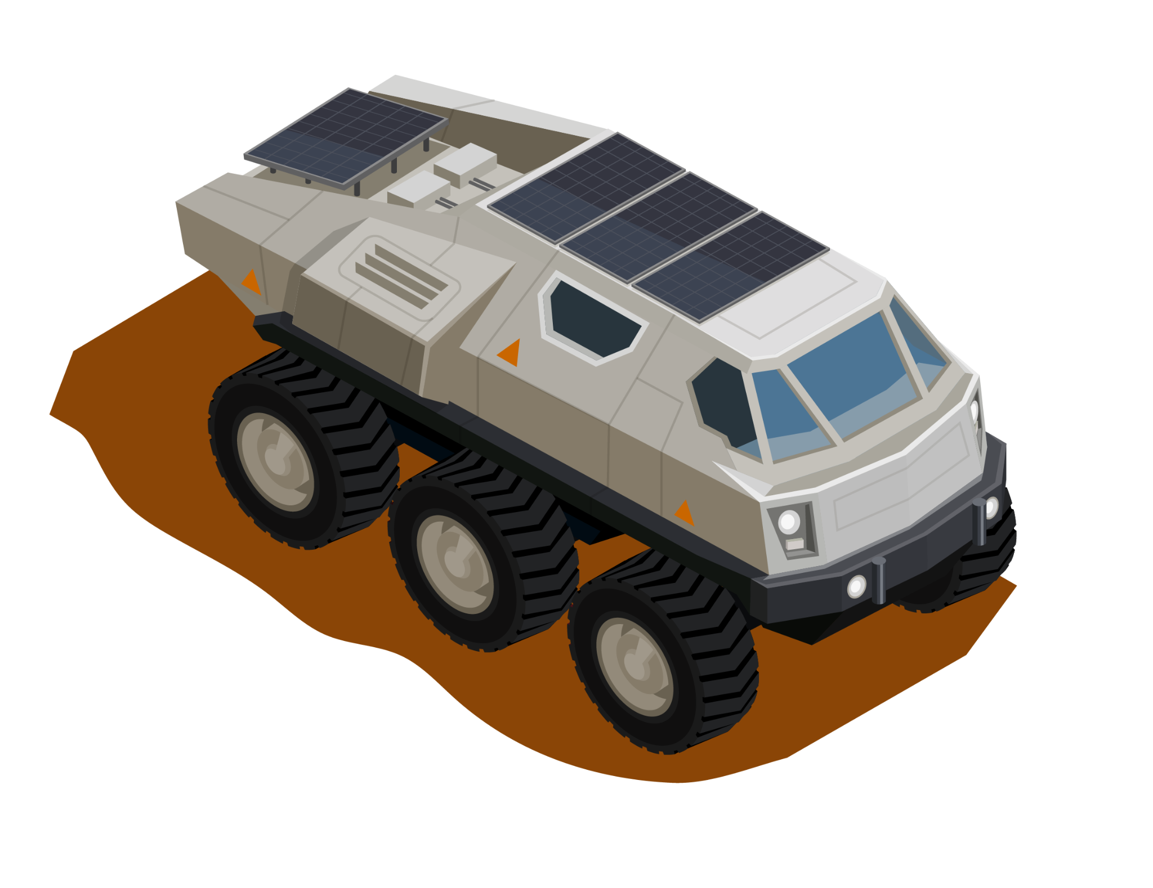
Software Tool : SolidWorks

Slide 6
INTRODUCTION
Mercury is the closest planet to the Sun and the smallest one in the Solar System—it’s only a bit larger than our Moon. The planet’s name has nothing to do with the liquid metal since it was named after the Roman messenger god, Mercury

Slide 7
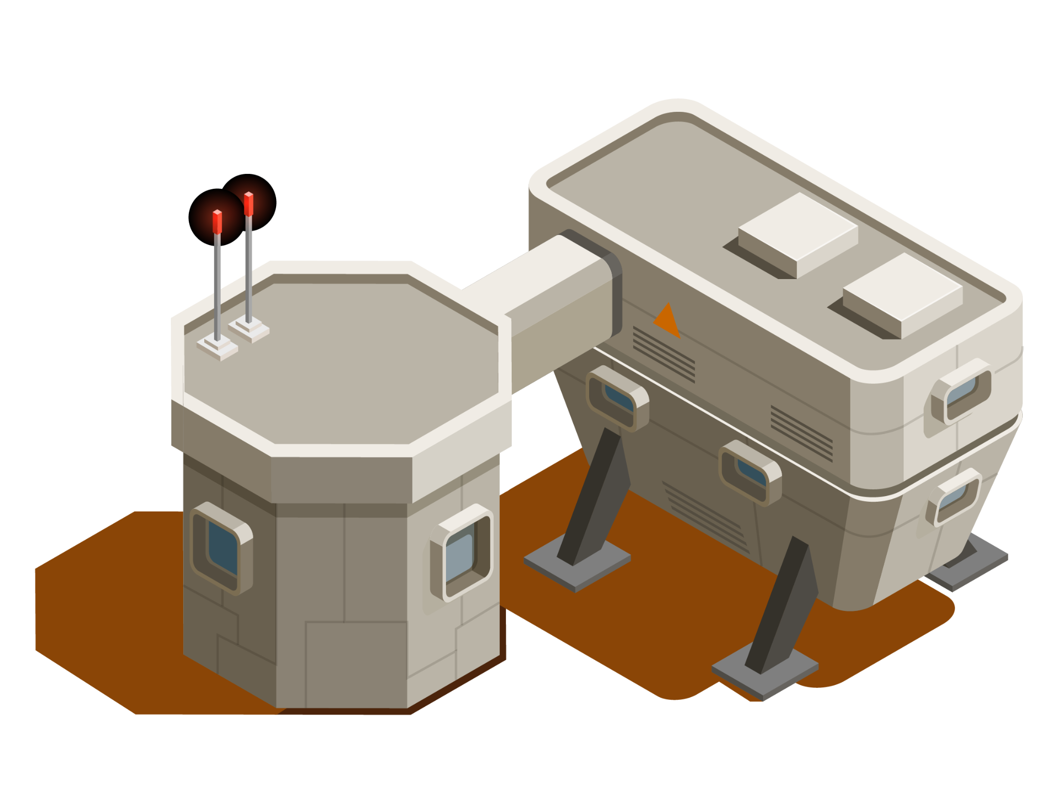
Meet TUNSA Space Robotics Team
Elyes Khechine
Afef Salhi
Nesrine Abidi
Firas Raouin
malek-sghaier
Sarra Mannai

Slide 8
Resources
VECTOR
https://www.thingiverse.com/thing:4941713
https://www.thingiverse.com/thing:3367564International trade concept with flat design

