Slide 1


SPACE ROBOTICS WORKSHOP
DuAxel Presentation
Ousema Boulila
Mayar Boulila
Belkis Akaichi
Fadi Masoud
Ghofrane Trabelsi
Yosser Abbessi
Mariem Ajroud
Osama Alsahil
Ranim Ben Sik Ali
Presented by:

Slide 2

TABLE OF CONTENTS
01
Introduction (30s)
02
Mission Objectives (45s)
03
Rover Design and Technology (60s)
04
Challenges of Interplanetary Travel (30s)
05
Landing and Deployment (45s)
- Begin with an attention-grabbing opening statement about humanity's fascination with space exploration.
- Introduce the rover's destination planet and its significance in the solar system.
- Briefly outline the main objectives of the presentation
If the rover has not been deployed yet:
- Explain the future plans of landing the rover on the planet
- Explain the deployment process
If the rover has already been deployed:
- Explain the landing process, from atmospheric entry to touchdown, using techniques like parachutes or thrusters.
- Describe the steps taken to safely deploy the rover onto the planet's surface.
06
Prototyping and Mission Readiness (45s)
- Highlight the primary goals of sending the rover to the planet.
- Emphasize scientific discoveries, such as studying the planet's geology, atmosphere, and potential signs of life.
- Most importantly, mention how the mission contributes to our understanding of the universe.
- Discuss the preparation and testing stages on Earth before launching the rover.
- Explain the rigorous testing procedures, including simulations and prototypes.
- Highlight the importance of mission readiness and potential challenges faced during testing.
07
Future Implications (30s)
- Describe the rover's physical design, including its size, shape, and mobility mechanisms.
- Explain the advanced technology onboard, such as cameras, spectrometers, and sample collection tools.
- Highlight how these technologies enable the rover to perform its tasks remotely.
- Discuss how the insights gained from this mission can shape future space exploration endeavors.
- Touch upon possibilities such as human colonization, resource utilization, or follow-up missions.
- Conclude with a sense of wonder and excitement about the ongoing exploration of the cosmos.
Conclusion (15s)
08
- Discuss the difficulties of sending the rover to the planet, including the vast distance, communication delays, and harsh space environment.
- Mention the innovative solutions used to ensure the rover's safe arrival and functioning on the planet's surface.
- Summarize the key points of the presentation.
- End with an inspiring statement about the importance of pushing the boundaries of knowledge and exploration.
2

Slide 3
01
Introduction
3

Slide 4
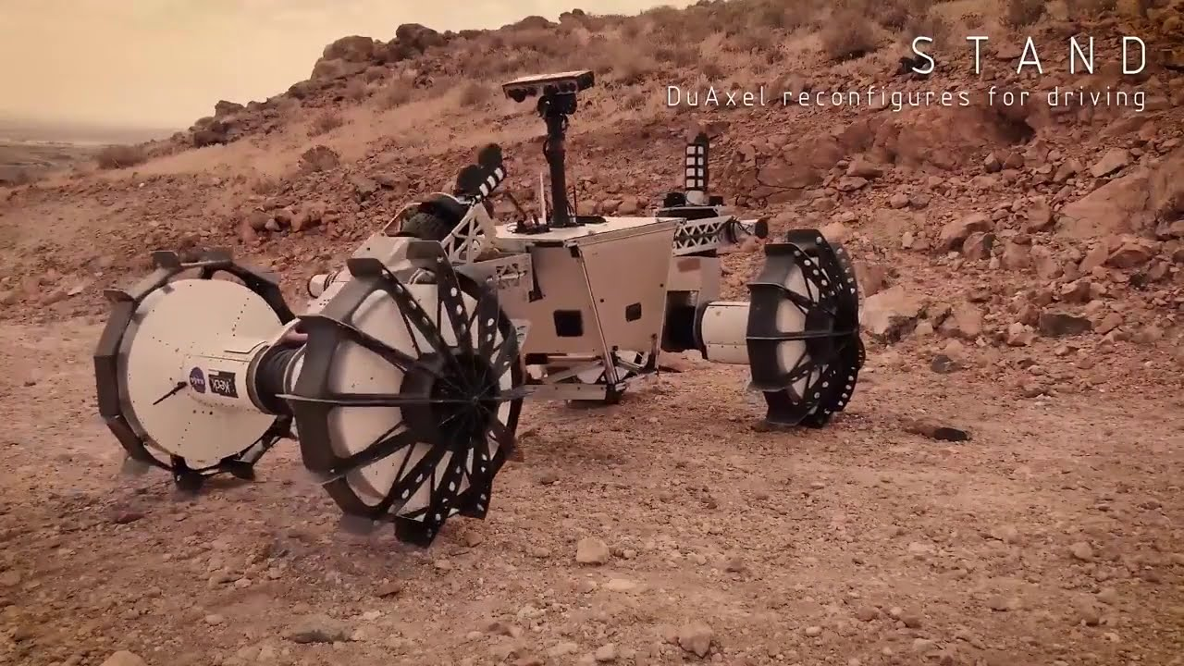
Introduction
Space is an astronomical domain , humans dedicated a lot of effort into discovering facts about it using advanced technologies and robots such as space rovers, these revolutionary Machines can go places others could only dream of.
One of them is the NASA's DuAxel rover which has the potential destinations to moon Mars and asteroids. In this presentation we'll learn more about DuAxel and it's main uses in general as you have seen in our table of content
4
Notes:
which makes earth a more livable planet,
which is the most explored planet in our solar system

Slide 5
02
Mission Objectives
5

Slide 6

MISSION OBJECTIVES
6
Notes:
DuAxel robotic mission
Access high risky planetary terrains
Investigate in Mars and the moon
collect samples and take stereoscopic pics / determine if streaks are caused by water
Long distances, around hazards → DuAxel is able to explore
Rough terrain unlike any rover before it

Slide 7
03
Rover Design and Technology
Welcome to the word of DuAxel’s technical marvels!
7

Slide 8
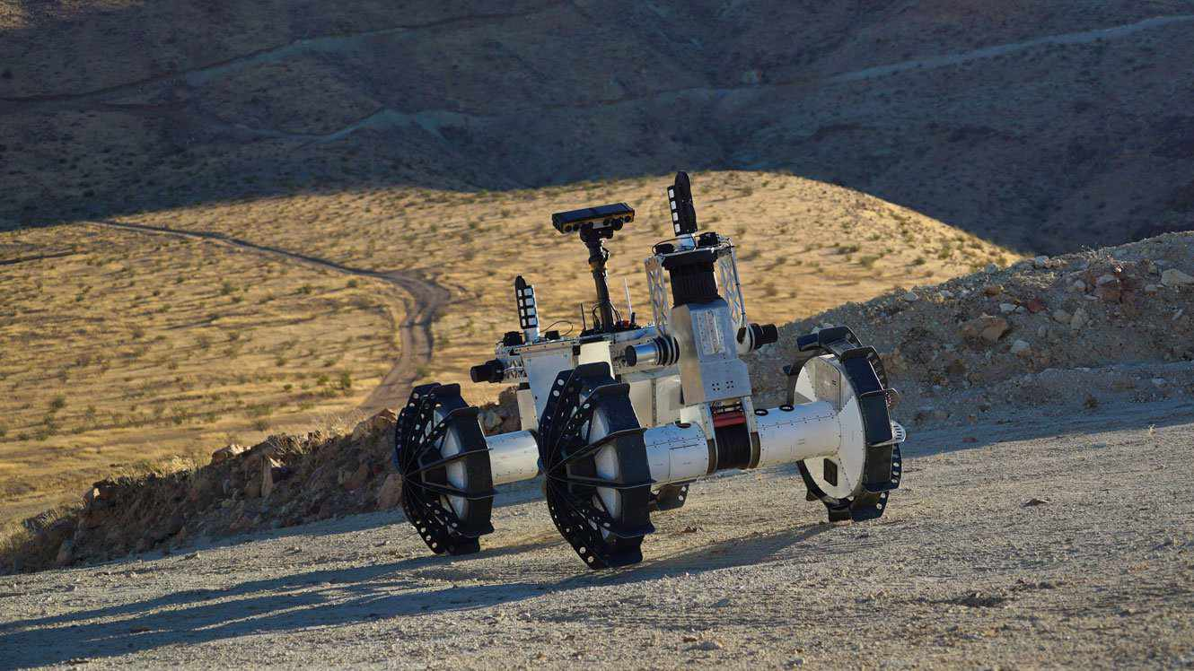
ROVER DESIGN AND TECHNOLOGY
8

Slide 9
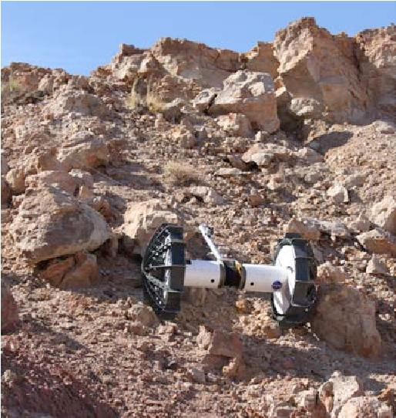

Slide 10
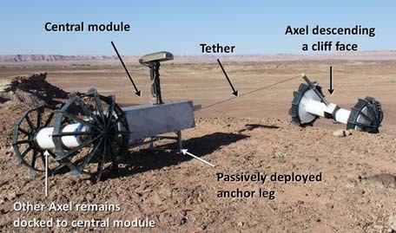

Slide 11
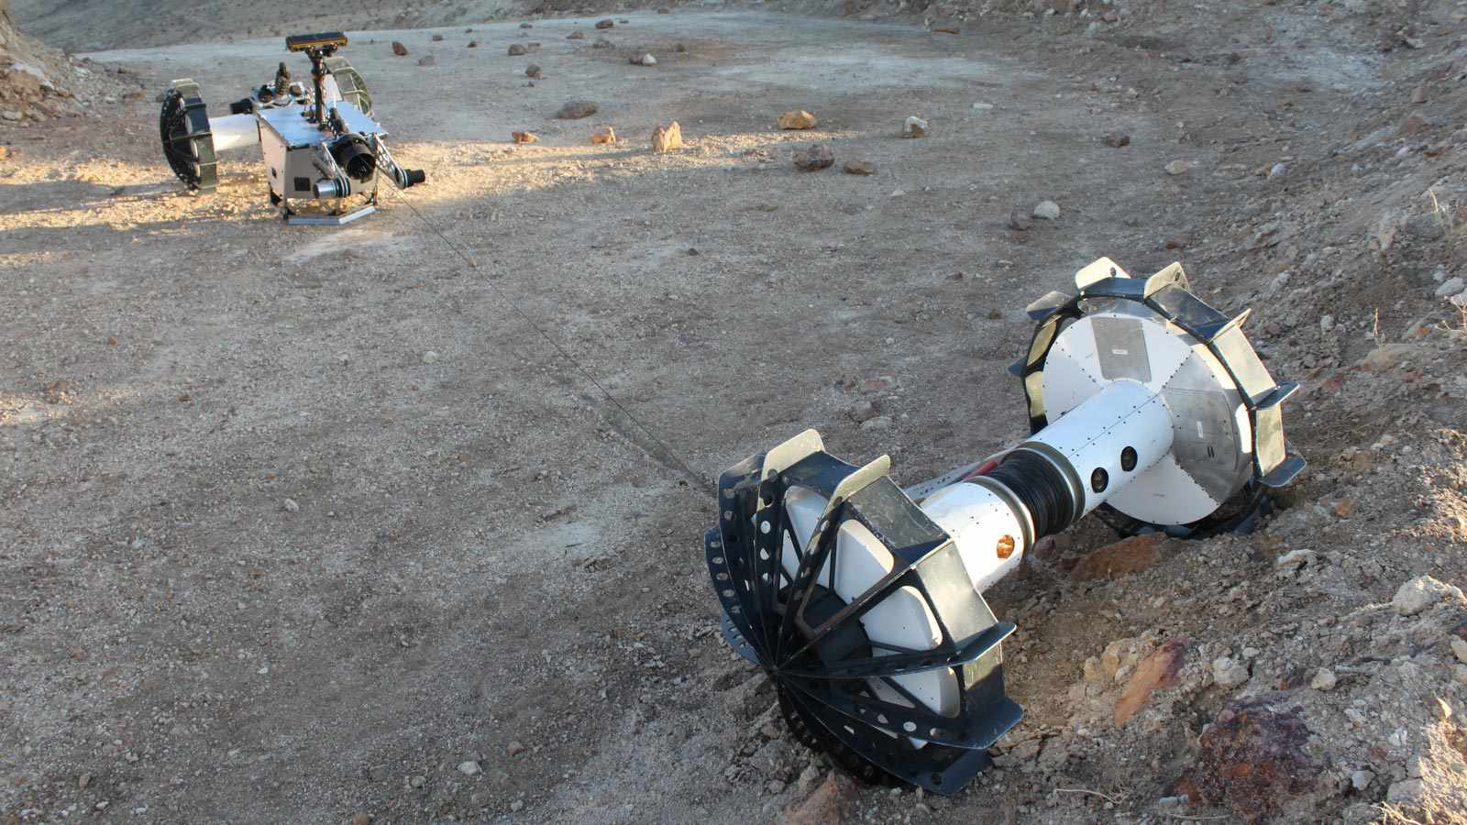

Slide 12
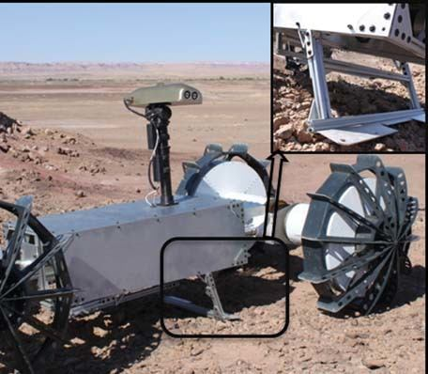

Slide 13
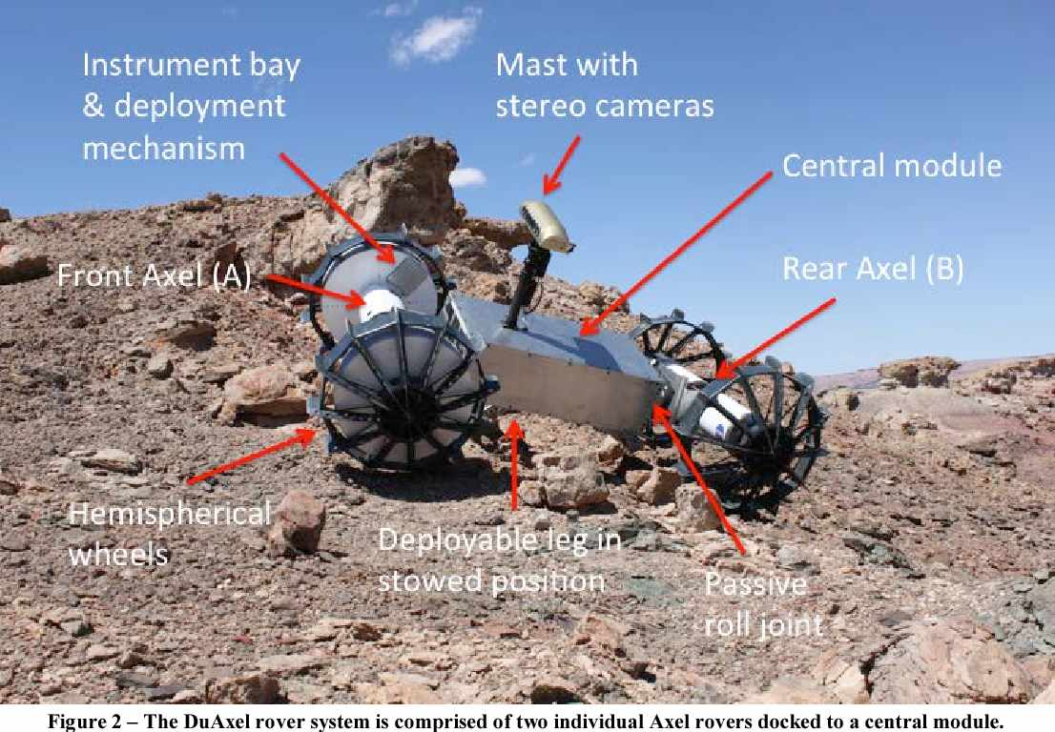

Slide 14
04
Challenges of Interplanetary Travel
10

Slide 15
CHALLENGES OF INTERPLANETARY TRAVEL
Let’s now move on to the most important topic, the risk of Interplanet travel :
First things first , In deep space Astronauts are exposed to high energy particles that can damage DNA and increase cancer risks.
Also , long term exposure can weaken bones and muscles.
Finally , interplanetary travel means long periods of isolation and this occurs so many mentally problems.
11

Slide 16
05
Landing and Deployment
12

Slide 17
LANDING AND DEPLOYMENT
Well DuAxel has not Been deployed yet:
But we will talk about future plans of landing on others planet
Our rover is created to resist all the difficult terrains is made of two_wheeled vehicles .
This rover is an evolsystemution of the Axel , a versatile family of single-axle rovers designed to access high-risk terrain on planetary surfaces, such as steep slopes, boulder fields, and caves – areas that would be challenging or inaccessible for current rovers in use it also designed to descend crater sides and near-vertical cliffs on the Moon , Mars and beyond
13

Slide 18
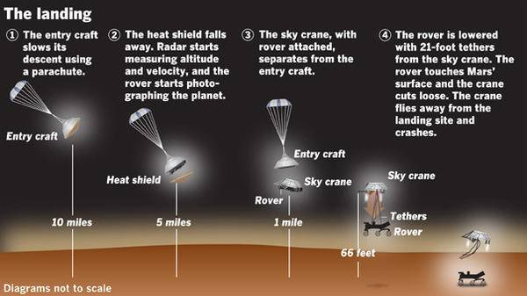
LANDING AND DEPLOYMENT
As a normal rover DuAxel has his normal steps of landing :
13

Slide 19
06
Prototyping and Mission Readiness
14

Slide 20
PROTOTYPING AND MISSION READINESS
NASA jet propulsion laboratory in southern California put the modular rover through a series of challenges to test the versatility of its design.
A rover trundles over rocky terrain ,it's four metal wheels clattering along until they encounter a seemingly insurmountable hazard. "DuAxel performed extremely well in the field ,successfully demonstrating its ability to approach a challenging terrain ,anchor and then undock it's tethered Axel rover" said a robotics technologist at JPL
15

Slide 21
07
Future Implications
16

Slide 22
FUTURE IMPLICATIONS
While Duaxel was mainly created for exploring areas that could be challenging or inaccessible for current rovers such as Mars, it can also shape futur space exploration endeavors by
Opening acces to many more extreme terrain
That hasn't yet been explored in the solar system such as mercury and even the icy world
17

Slide 23
Conclusion
In conclusion, the DuAxel rover, with its dual mobility and advanced technology, represents a crucial step in exploring challenging terrains on celestial bodies and shaping the future of space exploration. Embracing the spirit of pushing our limits, symbolizes our unwavering commitment to discovering the unknown and expanding the frontiers of human understanding.
18

Slide 24
THANKS!
Do you have any questions?
19

