Slide 1


SPACE ROBOTICS WORKSHOP
Guidebook
Elyes Khechine
Mohamed Yessine Ksibi
Firas Raouin
Malek Sghaier
Prepared by:

Slide 2

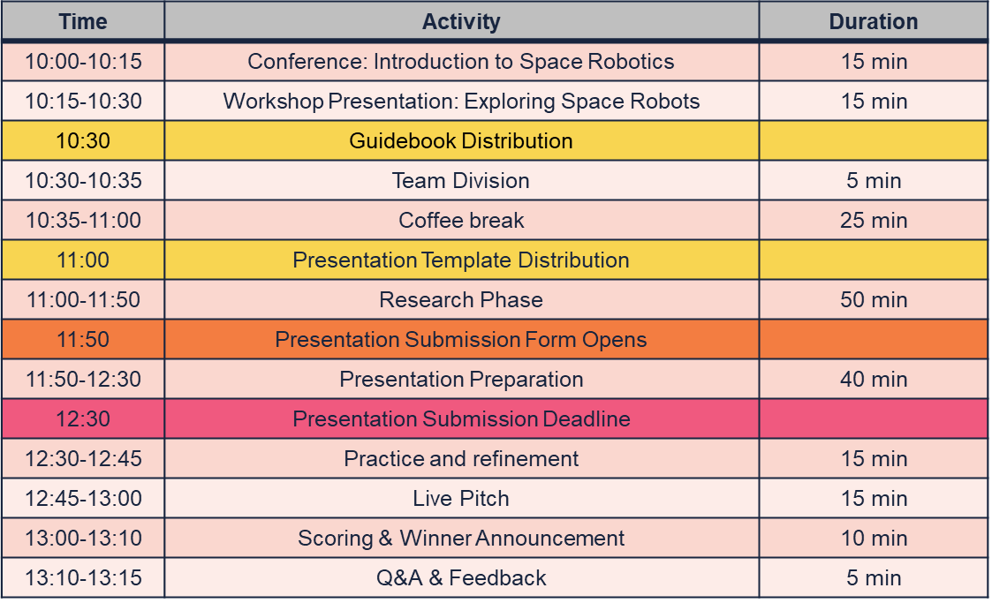
WORKSHOP PLAN

Slide 3
In this Guidebook, we will explain:
WORKSHOP RULES
TIPS & TRICKS
TASKS & SCORING
2

Slide 4
01
Workshop Rules
2

Slide 5
WORKSHOP BEHAVIORAL RULES
Respect and Collaboration: Treat fellow students, mentors, and organizers with respect. Collaborate effectively within your group.
Device Sharing: Share devices (laptops, tablets, smartphones) within your group if some members do not have access to one. Ensure equal participation.
Attendance: Attend all workshop activities promptly. Notify organizers if you have to leave temporarily.
Conflict Resolution: Address any conflicts within your group calmly and constructively. Seek help from mentors if needed.
3

Slide 6
WORKSHOP ENVIRONMENTAL RULES
Quiet Workspace: Maintain a quiet and focused workspace in the classroom to respect your peers' concentration.
Environmental Responsibility: Keep your workspace clean and organized. Dispose of trash properly.
Respect Time Limits: Adhere to the allocated time limits for breaks, research, and practice sessions to optimize workshop productivity.
Internet Usage: Use the internet responsibly for research purposes only. Avoid distractions and non-work-related websites.
4

Slide 7
02
Tips & Tricks
to make this a successful workshop!
5

Slide 8
GENERAL TIPS
Mentor Interaction: Respect your mentor's guidance and insights. Ask questions when in doubt and be open to their assistance.
Participation and Engagement: Actively participate in discussions, Q&A sessions, and reflections. Share your insights and learn from others.
Feedback: Provide constructive feedback to your peers and accept feedback graciously. It helps everyone improve.
6

Slide 9
RESEARCH TIPS
Effective Keyword Selection: When searching for information online, choose specific keywords related to your assigned space robot. For example, if your robot is designed for Mars exploration, use keywords like "Mars rover technology," "Mars rover mission objectives," or the robot's specific name.
Advanced Search Operators: Utilize Google's advanced search operators to refine your results. For instance, use quotation marks (" ") to search for an exact phrase or minus sign (-) to exclude specific terms. For example, "Mars rover" -Curiosity will help you find information about Mars rovers other than Curiosity.
Explore Official Sources: Look for information on official space agency websites such as NASA, ESA, JAXA, or ISRO. These sources often provide detailed technical documentation, mission updates, and press releases that can be valuable for your research.
Video Summarization Tools: To quickly grasp the key points of a lengthy video, consider using video summarization tools like "Kapwing" or "InVideo." These tools can provide concise summaries of video content, saving you time.
Text Summarization Tools: Use online text summarization tools like "SMMRY" or "SummarizeBot" to extract the main ideas and key details from lengthy articles or research papers.
Boolean Logic: Employ Boolean operators (AND, OR, NOT) to enhance your search results. For example, "Mars rover AND technology" will help you find articles that discuss both Mars rovers and their technologies.
7

Slide 10
PRESENTATIOON TIPS (1)
Presentation Etiquette: During live debates, adhere to good presentation practices, such as clear speaking, time management, and effective communication.
Clear and Concise Slides: Keep your presentation slides clear and concise. Avoid cluttering slides with excessive text or graphics. Each slide should convey one key point.
Visual Aids: Use visuals such as images, diagrams, and infographics to illustrate complex concepts. For example, include a labeled diagram of your space robot's components.
Bullet Points: Present information using bullet points or numbered lists for easy readability. Use these lists to highlight key features or specifications.
Practice Delivery: Rehearse your part of the presentation multiple times to ensure smooth delivery. Practice speaking clearly and confidently.
8

Slide 11
PRESENTATIOON TIPS (2)
Time Management: Allocate a specific amount of time for each aspect of the space robot you're discussing. We have included a recommended time for each section in the table of tasks.
Storyboarding: Plan the flow of your presentation with a storyboard. This helps ensure a logical sequence of information and smooth transitions between speakers.
Cite Your Sources: Properly cite your sources within your presentation. Include a slide at the end with a list of references and links to the articles or websites you used.
Use Presenter Notes: If you are using presentation software like PowerPoint, utilize presenter notes to jot down important reminders or talking points to keep you on track during your segment.
9

Slide 12
RECOMMENDED RESEARCH WEBSITES
Google https://www.google.com
Wikipedia https://en.wikipedia.org/wiki/
YouTube https://www.youtube.com/
European Space Agency https://www.esa.int/
NASA Mars Exploration https://mars.nasa.gov/
NASA Solar System Exploration https://solarsystem.nasa.gov/
NASA Space Place https://spaceplace.nasa.gov/
Phys (News) https://phys.org/
Space (News) https://www.space.com/
eoPortal https://www.eoportal.org/
National Air and Space Museum https://airandspace.si.edu/
NASA Jet Propulsion Laboratory https://www.jpl.nasa.gov/
Keck Institute for Space Studies https://kiss.caltech.edu/
MDPI (Research Papers) https://www.mdpi.com
Google Scholar (Research Papers) https://scholar.google.com/
Semantic Scholar (Research Papers) https://www.semanticscholar.org/
Research Gate (Research Papers) https://www.researchgate.net/
IEEE Xplore (Research Papers) https://ieeexplore.ieee.org/Xplore/home.jsp
10

Slide 13
03
TASKS & SCORING
11

Slide 14
WORKSHOP TASKS
01
Introduction (30s)
02
Mission Objectives (45s)
03
Rover Design and Technology (60s)
04
Challenges of Interplanetary Travel (45s)
05
Landing and Deployment (45s)
- Begin with an attention-grabbing opening statement about humanity's fascination with space exploration.
- Introduce the rover's destination planet and its significance in the solar system.
- Briefly outline the main objectives of the presentation
If the rover has not been deployed yet:
- Explain the future plans of landing the rover on the planet
- Explain the deployment process
If the rover has already been deployed:
- Explain the landing process, from atmospheric entry to touchdown, using techniques like parachutes or thrusters.
- Describe the steps taken to safely deploy the rover onto the planet's surface.
06
Prototyping and Mission Readiness (60s)
- Highlight the primary goals of sending the rover to the planet.
- Emphasize scientific discoveries, such as studying the planet's geology, atmosphere, and potential signs of life.
- Most importantly, mention how the mission contributes to our understanding of the universe.
- Discuss the preparation and testing stages on Earth before launching the rover.
- Explain the rigorous testing procedures, including simulations and prototypes.
- Highlight the importance of mission readiness and potential challenges faced during testing.
07
Future Implications (45s)
- Describe the rover's physical design, including its size, shape, and mobility mechanisms.
- Explain the advanced technology onboard, such as cameras, spectrometers, and sample collection tools.
- Highlight how these technologies enable the rover to perform its tasks remotely.
- Discuss how the insights gained from this mission can shape future space exploration endeavors.
- Touch upon possibilities such as human colonization, resource utilization, or follow-up missions.
- Conclude with a sense of wonder and excitement about the ongoing exploration of the cosmos.
Conclusion (15s)
08
- Discuss the difficulties of sending a rover to another planet, including the vast distance, communication delays, and harsh space environment.
- Mention the innovative solutions used to ensure the rover's safe arrival and functioning on the planet's surface.
- Summarize the key points of the presentation.
- End with an inspiring statement about the importance of pushing the boundaries of knowledge and exploration.
12

Slide 15
WORKSHOP SCORING
3 pts
Mission Objectives
3 pts
Rover Design and Technology
Challenges of Interplanetary Travel
2 pts
2 pts
Collaboration
1 pt
Time Management
3 pts
Behavior
2 pts
Presentation Quality
2 pts
Landing and Deployment
3 pts
3 pts
Prototyping and Mission Readiness
3 pts
Public Speaking
Overall Success of the Pitch
3 pts
Future Implications
13

Slide 16
THANKS!
Do you have any questions?
elyes.khechine@tunsa.org
+216 92 901 601
TUNSA Website

