Slide 1
VEHICLE CONTROL UNIT
Primary Researches

Slide 2
Levels of Autonomous Driving
1
2
3
4
5
Driver assistance
partial automation
conditional automation
High automation
Full automation
cruise control, lane departure warning, and emergency brake assistance.
The human driver still monitors the environment and supervises the support functions.
The system can drive without the need for a human to monitor and respond but might ask a human to intervene
These systems can fully drive themselves under certain conditions. The vehicle won’t drive if not all conditions are met
Full automation, the vehicle can drive wherever, whenever.

Slide 3
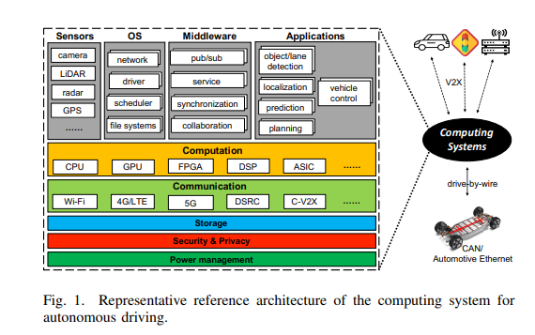
Vehicle Control Unit:
The vehicle control unit (VCU) is defined as the brain of the self-driving car.
After summing up the input from all sensors, the VCU is very capable of making decisions and giving instructions to be carried out.

Slide 4
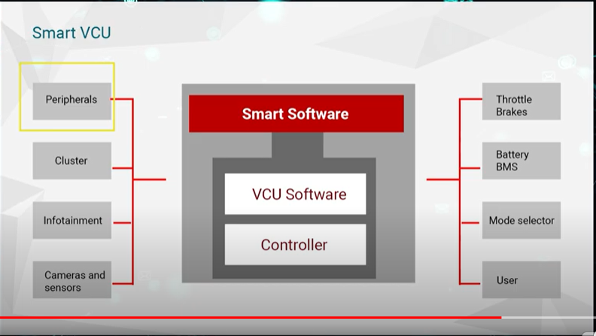
Smart VCU Architecture
Unlike traditional VCU , smart VCU’s are connected to all the parts of the vehicule , it can be connected to internet and driven by AI aswell .
this offers a huge number of possibilities :
Predictive maintenance of equipment , driver behaviour and vehicle security

Slide 5
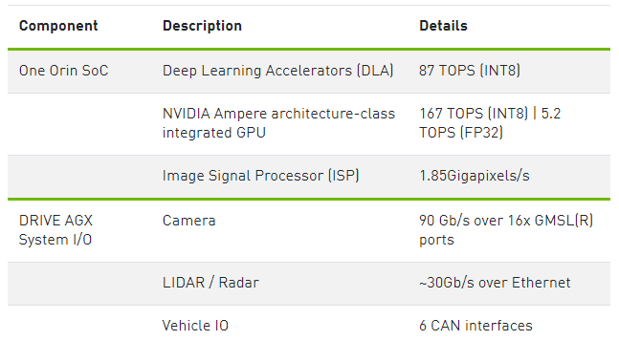
Hardware For Self-Driving Cars
1- NVIDIA DRIVE HYPERION
NVIDIA DRIVE Hyperion is an end-to-end development platform and reference architecture for designing autonomous vehicles (AV). It includes multiple DRIVE AGX Orin Developer Kits, each powered by an Orin SoC delivering up to 254 TOPS, a variety of sensor modalities to enable 360-degree surround view, and extra compute power to offload data recording and replay.

Slide 6
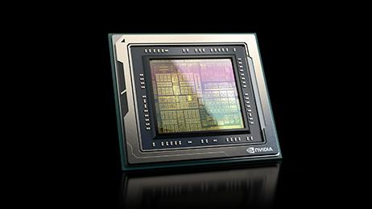
2- NVIDIA DRIVE Orin
The NVIDIA DRIVE Orin™ SoC (system-on-a-chip) delivers 254 TOPS (trillion operations per second) and is the central computer for intelligent vehicles. It’s the ideal solution for powering autonomous driving capabilities, confidence views, digital clusters, and AI cockpits. The scalable DRIVE Orin product family lets developers build, scale, and leverage one development investment across an entire fleet, from Level 2+ systems all the way to Level 5 fully autonomous vehicles.

Slide 7
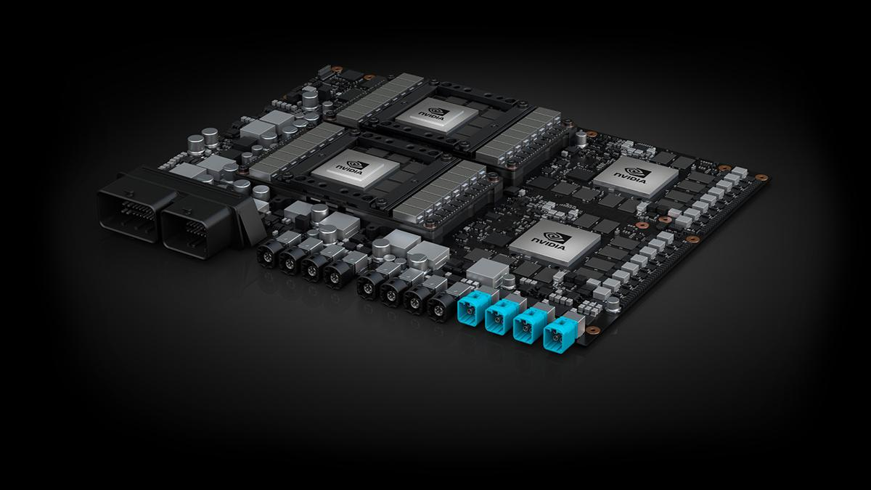
3-NVIDIA DRIVE AGX Xavier
This system is designed for Level 2+ advanced driver assistance systems and Level 3 automated driving, delivering 30 trillion operations per second (TOPS). At its core is the auto-grade Xavier SoC, the first of its kind in production. It incorporates six different types of processors for running redundant and diverse algorithms for AI, sensor processing, mapping, and driving.

Slide 8
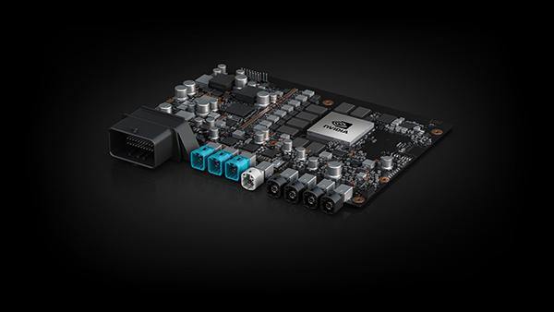
4-NVIDIA DRIVE AGX Pegasus
This AI computer leverages the power of two Xavier SoCs and two NVIDIA Turin GPUs, and is built for Level 4 highly automated driving and Level 5 autonomous driving and robotaxis—achieving an unprecedented 320 TOPS for safe driverless operation.

