Slide 1

Preliminary Design Report
Robotaxi 2022

Slide 2
Preliminary Design Report
Emphasis should be placed on the software design process, acquired skills, and unique aspects of the design. The task to be performed by the autonomous vehicle should be briefly explained and general information about the performance of the vehicle that will perform this task should be conveyed.
Summary
01
An organizational chart showing the work sharing during the Robotaxi Autonomous Vehicle design process and who is working should be shown. The work packages to be used in the vehicle design process should be shown with a "timeline graphic”. Also, the main work packages should be briefly described with their requirements and objectives.
Team Organization
02
The vehicle must support electronic steering (steer-by-wire), electronic accelerator (pedal-by-wire) and electronic brake (brake-by-wire) functionality. In this section of the report, detailed information should be given about the vehicle to be used, focusing on autonomous driving interfaces.
Vehicle Features
03
In the works to be carried out within the scope of the competition, those with unique features in terms of design and/or software should be targeted. Whether these targets have been achieved or not will be evaluated in the detailed design report.
Originality
04

Slide 3
Preliminary Design Report
In this section, information will be given about the sensors (lidar, radar, camera, etc.) to be used in the vehicle. Information should be given about the number of sensors, their location on the vehicle, how much volume the sensors can cover around the vehicle for autonomy purposes, and the sensor fusion algorithms used.
Sensors
05
Information about the control unit intended to be used in the vehicle should be conveyed. Wireless communication system should be explained. Control software features must be transferred.
Vehicle Control Unit (VCU)
06
In this section, information should be given about the autonomous driving algorithms used in the vehicle, such as the recognition of traffic signs and lane tracking.
Autonomous Driving Algorithms
07
During the test phase and during the competition, the precautions to be taken for possible dangerous situations will be determined and information about the vehicle systems planned for this will be conveyed.
Security Precautions
08

Slide 4
Preliminary Design Report
The video of the realized simulation will be uploaded to YouTube before the date specified in the specification and its name/link will be included in this section of the report. Team information should be included in the video to be uploaded. No changes will be made on the video after the date specified in the specification. This video is considered as proof of concept of the simulation.
Simulation
09
References
10
You should specify the resources, websites, trainings, books, articles, etc. you have used in this section.

Slide 5
PDR TASK DEPENDENCIES
Stage I
Stage II
Stage III
Stage IV
VCU
Sensors
Vehicle Features
Structure
Algorithms
Simulation
Security Precautions
Report Writing

Slide 6
PDR TASK PARTITIONING
Team Member | VCU | Sensors | Vehicle Features | Structure | Algorithms | Simulation | Security Precautions | Report Writing
Afef Salhi
Ameni Jellali
Amin Guesmi
Fadhel Essid
Fatma Zahra Trabelsi
Hadil Sridi
Hamza Jmii
Nesrin Abidi
Oussama Jouni
Racem Ghorbel
Mohamed Yassine Bouaziz
Wael Aissaoui
Elyes Khechine

Slide 7
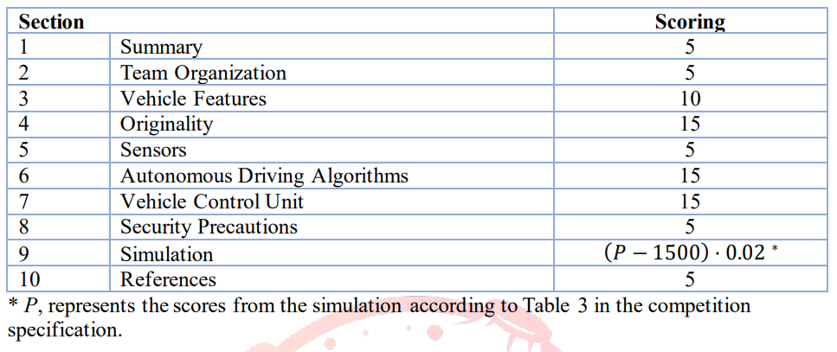
Preliminary Design Report Scoring

Slide 8
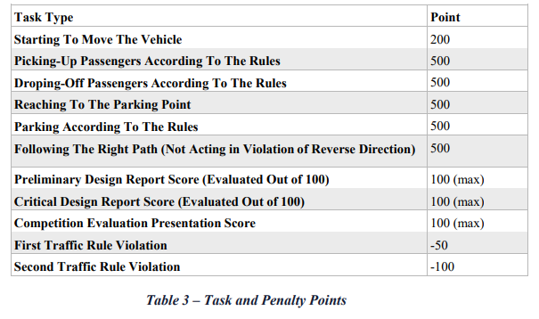
Overall Competition Scoring

Slide 9
Simulation Video Evaluation
Creating a racing track in any simulation environment
Creation of the vehicle and sensors in accordance with the specified technical requirements
in the simulation environment
Performance of tasks (will be shown through the selected simulation program during the presentation)
The results of the study should be sufficient and meaningful, supported by graphics and figures
As a result of the student's preliminary design work, the plan and program for the future stages
Modern engineering software and hardware selection/use
Required background work and analysis
Including the necessary technical data (all technical data must be included in the preliminary design report)
Professional presentation skills
Presentation video durations will be a maximum of 10. It should be noted that video durations will not be flexible. Teams have to explain the simulations they include in their reports during the presentation video.
Preliminary design report and presentation video will be evaluated according to the template to announced on the website. The teams to be supported will be determined according to the score ranking that will be formed by the evaluation of the preliminary design report and presentation as stated in the appendix.

Slide 10
TUNSA’s Martian Autonomous Robotaxi System (TUNMARS)
Pre-Phase A
Feasibility Study
Phase A/B
Preliminary design
Phase C
Critical Design
Phase D
Phase E
D.1: Production & Functional Test
D.2: Environmental tests
E.1: Competition & Lessons Learned
E.2: Improvement
Budget Estimation
PDR Task Plan
Task Partitioning
Task Dependencies
- Detailed Vehicle Engineering Study
- Part Ordering & Manufacturing
- Algorithms Deployment & Testing
- Full Simulation
- Elementary Assembly
- Mission Deployment
- Competition Feedback
- Brainstorming
Next-gen Design
- Next-gen Design Plan
Target
- Vehicle Preliminary Design
- Vehicle Features
- Vehicle Components Selection
- Algorithms Conception
- Preliminary Architecture
- Elementary Simulation
- Full Part Assembly
- Design Tweaking
- Algorithm Refinement
- Functional Testing
- Mission Testing
- Optimization
March 7th
March 15th
April 1st
May 20th
July 25th
September
TUNSA Space Robotics 2022

