Slide 1
Customer Segmentation Using Machine Learning
A Professional ML Project Presentation

Slide 2
Project Introduction
Objective: Segment customers based on behavior to improve marketing & business strategy.

Slide 3
Data Collection
Dataset of 20,000 records including Age, Gender, Income, Spending Score, Transactions, Recency.

Slide 4
Data Cleaning
Handled missing values • Removed duplicates • Adjusted inconsistent entries

Slide 5
EDA
Performed distribution plots, gender count, and feature relationship analysis.

Slide 6
Scaling
Applied StandardScaler to normalize features before clustering.

Slide 7
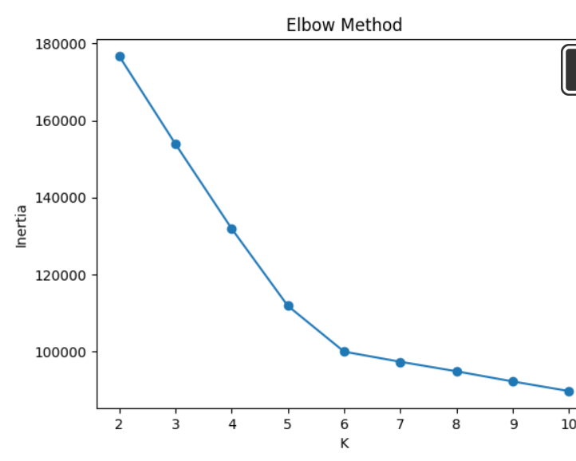
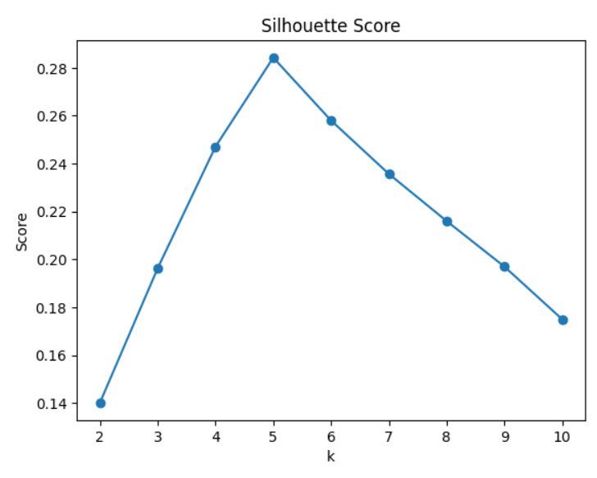
Optimal Cluster Selection
Used Elbow & Silhouette Score to find best K value.

Slide 8
K-Means Clustering
Segmented customers into meaningful groups.

Slide 9
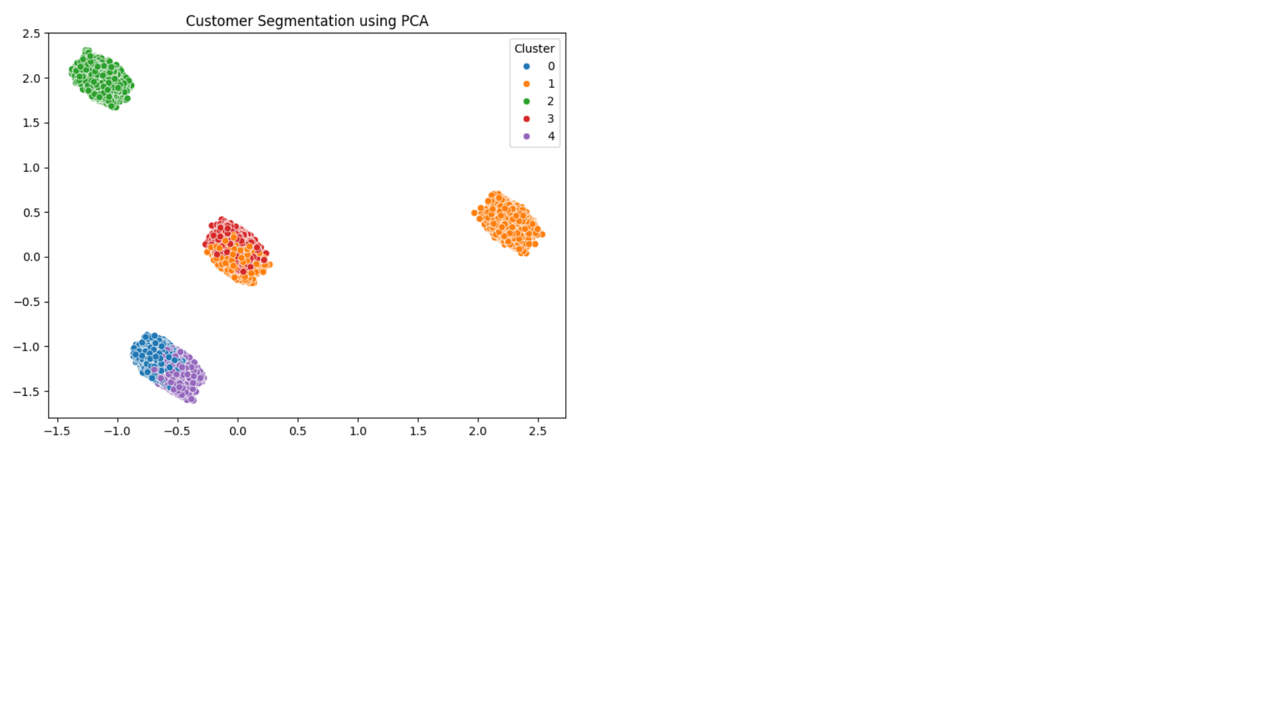
PCA Visualization
Used PCA to visualize clusters in 2 dimensions.

Slide 10
Cluster Profiling
Identified key behaviors of each customer segment.

Slide 11
Conclusion
Segmentation enables targeted marketing, better personalization, and growth.

Slide 12
Cluster Size Visualization (Example)

