Slide 1
Department of Computer Science and Engineering
JP Nagar, Kothanur, Bengaluru - 560076
REAL-TIME DROWSINESS DETECTION USING MACHINE LEARNING FOR ENHANCED ROAD SAFETY
Academic year 2024 – 2025 Even (6th) semester
Mini Project (21CSMP67)
Final Review Presentation
Presented by:
Aymaan Khan – 1RF21CS020
Ayush Prajapati – 1RF21CS022
Bhoopalam AVS – 1RF21CS023
Tushar Arora – 1RF21CS116
Under the Guidance of:
Dr. Roopashree S
Assistant Professor
Dept. of CS&E
RVITM

Slide 2
CONTENTS
Introduction
Background
Objective
Literature Survey
Methodology Overview
Dataset
Implementation
Expected outcome of the mini project
References

Slide 3
INTRODUCTION
BACKGROUND
Driver drowsiness is a significant cause of road accidents worldwide.
Traditional methods to counteract this issue include roadside tests and in-vehicle monitoring, but these methods often lack real-time detection and immediate response capabilities.
OBJECTIVES
Face and Eye Detection with Forehead Dot Tracking: Utilizes HOG+SVM to detect the driver’s face in real-time, identifies eyes to monitor their state (open or closed), and tracks the distance between the forehead and the steering wheel to detect drowsiness.
Prolonged Blink Detection with Audio Alert: Employs the Eye Aspect Ratio (EAR) to determine prolonged eye closure and triggers alarms based on specific drowsiness indicators.

Slide 4
LITERATURE SURVEY
Year | Title | Author(s) | Description | Advantages | Drawbacks
2023 | Algorithm Optimization for Rockfalls Alarm System Based on Fiber Polarization Sensing | Saverio Pellegrini , Giuseppe Rizzelli and Roberto Gaudino | This system swiftly detects mountain hazards, ensuring efficient and cost-effective monitoring for safer infrastructure. | Distributed Sensing Discrete Sensing Interferometric techniques | Low reliability Coverage Maintenance Real-time requirements
2023 | A New Alarm System Developing Approach Through Graph Modeling | KOUROSH PARSA , MAUREEN HASSALL , MOHSEN NADERPOUR,MOBIN POURREZA4 AND FAHIMEH RAMEZAN | They enhanced their alarm system with AGM, seamlessly integrating it with the Tennessee Eastman Process Simulink model. This validation of AGM's accuracy in representing abnormal event progression led to fine-tuning the alarm system. | AGM provides real-time capabilities for commissioning purposes AGM captures all alarm activation paths to failure | Tuning alarm setpoints Memory saturation Communication failure
2023 | Efficient and compact face descriptor for driver drowsiness detection | Abdelmalik Moujahid , Fadi Dornaika , Ignacio Arganda-Carreras , Jorge Reta | Driver drowsiness detection is improving with compact face texture analysis, including face detection, feature extraction, and classification. Experiments on the NTHUDDD dataset show promising results. | Computer vision based systems to monitor driver fatigue. Forwarding looking cameras to monitor driving patterns | Lack of ground truth label of test dataset Output hindered when Night-glasses are involved Dataset is far from characterizing a real situation
2023 | Smart Alarm System | Chiranjit Das,Chirag Bhatt, Uvesh Belim,TahaBhatia, Jinil patel | Increasing automotive population raises accident risks from drowsiness. This paper compares methods like OpenCV for drowsiness detection to aid in selecting effective techniques. Keywords: Drowsiness, Face Detection, OpenCV. | Smartphone Based Approach Desktop Based Approach Highly robust algorithms which had a significant compatibility range. | Detecting detailed features can be a major challenge Real-time results with low error is also a major challenge
2020 | Real-Time Facemask Recognition with Alarm System using Deep Learning | Sammy V. Militante and Nanette V. Dionisio | COVID-19 spreads through respiratory droplets, emphasizing the need for preventive measures like masks and sanitizers. Deep learning achieves 96% accuracy in mask detection, aiding in real-time recognition and containment efforts. | 96% validation accuracy was achieved during the training of the CNN model. Alarm prompt generated on not wearing a facecmask | Researchers recommend a different optimizer, enhanced parameter settings, fine-tuning, and using adaptive transfer learning models.

Slide 5
LITERATURE SURVEY
Year | Title | Author(s) | Description | Advantages | Drawbacks
2023 | DeepFake on Face and Expression Swap | SAIMA WASEEM,SYED ABDUL RAHMAN SYED ABU BAKAR, BILAL ASHFAQ AHMED, ZAID OMAR , TAISEER ABDALLA ELFADIL EISA, AND MHASSEN ELNOUR ELNEEL DALAM | Deepfakes, the highly realistic AI-generated videos produced through advanced deep learning techniques, raise concerns about deception and manipulation. This study thoroughly examines creation methods, detection approaches, and guides future research for robust solutions in combating deepfake threats and preserving media authenticity and trustworthiness in the digital age. | To achieve high-fidelity face swapping, SimSwap [62] introduced the ID injection module GANs (Generative Adversarial Networks) represent an optimized approach for deep learning-based manipulation and effectively improve the quality of deepfakes. Variational Autoencoders (VAE) to generate separate latent vector embeddings for hair and face regions,. | , FSGAN struggles to preserve target image attributes such as image resolution and the face shape of the source identity. . Common occlusions such as hair, glasses, and hands can obscure the source’s or the target’s face, causing visual inconsistencies and artifacts in the face swap results.
2023 | Chinese Face Dataset for Face Recognition in an Uncontrolled Classroom Environment | NIANFENG LI ,XIANGFENG SHEN , LIYAN SUN,ZHIGUO XIAO , TIANJIAO DING ,TIANSHENG LI , AND XINHANG LI | The study addresses the challenge of face verification in uncontrolled environments due to varying camera angles. A new Chinese face dataset (UCEC-Face) collected from real classroom surveillance videos is introduced, containing 7395 images of 130 subjects. Experimental results with existing face verification models like OpenFace and ArcFace show a lower accuracy of 69.7%, highlighting the need for improved models for Asian face verification in real-world settings. | The dataset UCEC-Face is s obtained by purchasing classroom surveillance videos from different schools, and we filtered the surveillance videos to obtain 35 surveillance videos that met the conditions of an uncontrolled environment. On this basis, manual filtering and data enhancement operations were obtained. | The proposed UCEC-Face dataset is more challenging than other existing face datasets, such as Yale, LFW, and PubFig
2023 | A Real-Time Face Detection Method Based on Blink Detection | HUI QI,CHENXU WU,YING SHI, XIAOBO QI1,KAIGE DUAN , AND XIAOBIN WANG | This paper introduces a real-time face detection method for face anti-spoofing, addressing photo fraud attacks and illumination challenges in video recognition. The method combines image texture features from the LBP algorithm, ResNet network for facial feature extraction, an attention mechanism for enhancement, and BiLSTM for temporal characteristics. SPP pooling is used for local and global feature fusion, improving detection accuracy | . Experimental results on NUAA, CASIA-SURF, and CASIA-FASD datasets show high accuracy levels of 99.48%, 98.65%, and 99.17%, respectively. The method proposed in this paper has a good effect on the accuracy of anti-spoofing real-time face recognition | Efficiently separating brightness and reflected light features from RGB images to further improve model performance
2023 | Face Recognition and Face Detection Benefits and Challenges | Roweida Remone Tizee February and Ms. Sushree Sasmita Dash | This research paper explores the history and differences between face detection and recognition, discussing benefits, challenges, and the feasibility of using face detection for automated attendance in educational settings. | Feedback from 34 Namibian educators indicates willingness to adopt such systems | Challenges remain for widespread implementation.
2020 | Deep Learning Implementation of Facemask and Physical Distancing Detection with Alarm Systems | Militante SV and Dionisio NV | deep learning-based system for detecting face masks and enforcing physical distancing, showcased at the 2020 ICVEE conference. | Their approach integrates alarm systems to enhance safety measures in public settings, illustrating advancements in AI application for public health protocols | Various deep learning techniques can be added for better accuracy

Slide 6
LITERATURE SURVEY
Year | Title | Author(s) | Description | Advantages | Drawbacks
2024 | Driver Identification and Detection of Drowsiness while Driving | Sonia Díaz-Santos,Óscar Cigala-Álvarez,Ester Gonzalez-Sosa,Pino Caballero-Gil and Cándido Caballero-Gil | This paper introduces an innovative approach that combines facial recognition and drowsiness detection technologies with IoT capabilities, aimed at enhancing vehicle security and driver safety. The project includes two phases: facial recognition for driver authentication and continuous eye monitoring for real-time drowsiness detection, utilizing edge computing. | This study highlights the potential of these innovations in revolutionizing automotive security and accident prevention within intelligent transport systems. | Hit Mis-identifying Failure
2024 | AI-Based Advanced Approaches and Dry Eye Disease Detection Based on Multi-Source Evidence: Cases, Applications, Issues, and Future Direction | Mini Han Wang*, Lumin Xing, Yi Pan*, Feng Gu, Junbin Fang, Xiangrong Yu*, Chi Pui Pang, Kelvin Kam-Lung Chong*, Carol Yim-Lui Cheung, Xulin Liao, Xiaoxiao Fang, Jie Yang, Ruoyu Zhou, Xiaoshu Zhou, Fengling Wang, and Wenjian Liu* | This study explores the potential of Artificial Intelligence (AI) in early screening and prognosis of Dry Eye Disease (DED), aiming to enhance the accuracy of therapeutic approaches for eye-care practitioners. | This study explores the potential of Artificial Intelligence (AI) in early screening and prognosis of Dry Eye Disease (DED), aiming to enhance the accuracy of therapeutic approaches for eye-care practitioners. | In CFS,c linically, there is a kind of risk to use this method since the injection of fluorescent agent may cause eye allergy. In OSDI the questionnaire results may be subjective with low accuracy, which is also time-wasting and resourceconsuming.
2024 | Driver Drowsiness Multi-Method Detection for Vehicles with Autonomous Driving Functions | Horia Beles, Tiberiu Vesselenyi, Alexandru Rus, Tudor Mitran * , Florin Bogdan Scurt † and Bogdan Adrian Tolea | The article outlines various approaches to developing a fuzzy decision algorithm designed for monitoring and issuing warnings about driver drowsiness. | Trigger warnings if the driver is identified as being in a drowsy state. . In cases where the driver does not respond to the warnings, the ADAS (advanced driver assistance systems) system should intervene, assuming control of the vehicle’s commands. | The detection accuracy could be seriously affected by many factors like: driver movements, environment influence, interior of the car, etc.
2024 | IoT-Assisted Automatic Driver Drowsiness Detection through Facial Movement Analysis Using Deep Learning and a U-Net-Based Architecture | Shiplu Das ,Sanjoy Pratihar,Buddhadeb Pradhan, Rutvij H. Jhaveri and Francesco Benedetto | The main purpose of a detection system is to ascertain the state of an individual’s eyes, whether they are open and alert or closed, and then alert them to their level of fatigue. As a result of this, they will refrain from approaching an accident site. | People can be promptly alerted in real time before the occurrence of any calamitous events affecting multiple people. | More testing will be required to produce accurate results on its performance with the portability feature, enabling further use with hardware supplies.
2024 | Ultra-Wide Band Radar Empowered Driver Drowsiness Detection with Convolutional Spatial Feature Engineering and Artificial Intelligence | Hafeez Ur Rehman Siddiqui, Ambreen Akmal, Muhammad Iqbal, Adil Ali Saleem, Muhammad Amjad Raza , Kainat Zafar, Aqsa Zaib,Sandra Dudley,Jon Arambarri,Ángel Kuc Castilla and Furqan Rustam | This research aims to address the crucial need for real-time and accurate drowsiness detection to mitigate the impact of fatigue-related accidents. | The ensemble classifier RF-XGB-SVM, which combines Random Forest, XGBoost, and Support Vector Machine using a hard voting criterion, performed admirably with an accuracy of 96.6%. The proposed approach was validated with a robust k-fold score of 97% and a standard deviation of 0.018, demonstrating significant results | Future research could investigate the integration of other sensor modalities for improved detection, as well as the deployment of the system in real-world driving scenarios for comprehensive validation.

Slide 7
LITERATURE SURVEY
Year | Title | Author(s) | Description | Advantages | Drawbacks
2024 | Eye-LRCN: A Long-Term Recurrent Convolutional Network for Eye Blink Completeness Detection | Gonzalo de la Cruz , Madalena Lira , Oscar Luaces , and Beatriz Remeseiro | The paper introduces Eye-LRCN, a method for detecting eye blinks and their completeness using a combination of a Siamese CNN for feature extraction and a bidirectional LSTM for sequence learning. | Outperforms state-of-the-art methods in blink and blink completeness detection, effectively handles class imbalance and small sample sizes. | The method's performance heavily relies on a computationally intensive feature extractor, and there are challenges with timeframe variation in video data.
2024 | Novel Transfer Learning Approach for Driver Drowsiness Detection using Eye Movement Behaviour | HAMZA AHMAD MADNI, ALI RAZA , RUKHSHANDA SEHAR , NISREAN THALJI , LAITH ABUALIGAH | The paper introduces a novel VGLG (VGG16-LGBM) approach for detecting driver drowsiness using eye movement imagery, combining VGG-16 for feature extraction and LGBM for feature generation. | Achieves 99% accuracy in drowsiness detection with fast processing time (0.00829 seconds) and improved performance through hyperparameter tuning and k-fold validation. | The study's effectiveness in real-world scenarios is not yet validated on human subjects, and the method's practical deployment within real-time applications remains to be tested.
2023 | Face Fatigue Feature Detection Based on Improved D-S Model in Complex Scenes | JIANFENG CAI, XU LIAO , JUNBO BAI , ZHEN LUO, LI LI, AND JUNJIE BAI | The paper proposes an improved D-S evidence theory-based algorithm for detecting facial fatigue signs in drivers, integrating eye, mouth, and head pose analysis using Dlib. | Achieves 93.8% accuracy, effectively handling lighting and occlusion issues in complex environments. | Challenges include non-uniform experimental standards and environmental impacts like night detection and lighting variations.
2023 | Blinks in the Dark”: Blink Estimation With Domain Adversarial Training (BEAT) Network | Seonghun Hong, Yonggyu Kim, and Taejung Park | The BEAT network utilizes domain-adversarial training to detect eye blinks in diverse and poor lighting conditions, enhancing robustness through domain-invariant feature extraction. | Achieves state-of-the-art performance and high inference speed, with improved generalization across various domains and stable training via gradient regularization. | The approach's effectiveness and practicality in real-world consumer applications, particularly on mobile devices, remain to be fully validated.
2023 | Fusion of EEG and Eye Blink Analysis for Detection of Driver Fatigue | Mohammad Shahbakhti, Matin Beiramvand , Erfan Nasiri,Somayeh Mohammadi Far , Wei Chen, Jordi Solé-Casals ,Michal Wierzchon , Anna Broniec-Wójcik , Piotr Augustyniak and Vaidotas Marozas | The paper presents a driver fatigue detection method using a single prefrontal EEG channel and eye blink analysis, employing the AdaBoost classifier for high accuracy. | Achieves reliable detection with high sensitivity, specificity, and accuracy, and offers improved user comfort by using a single EEG channel. | The effectiveness of the method is dependent on the robustness of parameters tuned for different databases, which might limit generalizability.

Slide 8
LITERATURE SURVEY
Year | Title | Author(s) | Description | Advantages | Drawbacks
2024 | Reliable Eye-Blinking Detection With Millimeter-Wave Radar Glasses | Emanuele Cardillo , Luigi Ferro , Sapienza, and Changzhi Li | The study employs a 120-GHz mm-wave Doppler radar integrated into glasses to detect intentional eye blinks, facilitating communication for patients with neurodegenerative diseases. | Offers compact size, low computational cost, privacy preservation, and immunity to varying light conditions compared to optical methods. | Effectiveness can be impacted by random body movements and the need for precise radar positioning.
2023 | Real-Time Deep Learning-Based Drowsiness Detection:Leveraging Computer-Vision and Eye-Blink Analyses for Enhanced Road Safety | Furkat Safarov , Farkhod Akhmedov , Akmalbek Bobomirzaevich Abdusalomov , Rashid Nasimovand Young Im Cho | This study proposes a drowsiness detection system using deep learning and computer vision algorithms, focusing on eye-blink patterns and facial landmarks for real-time analysis. | Achieved high accuracies (95.8% for drowsy-eye detection, 97% for open-eye detection) with real-time analysis of eye movements and facial expressions. | Lack of detailed algorithm descriptions and comprehensive evaluation metrics, such as sample size and statistical analysis, may limit replicability and robustness assessment.
2023 | Real-Time Machine Learning-Based Driver Drowsiness Detection Using Visual Features | Yaman Albadawi , Aneesa AlRedhaei ,Maen Takruri | This study proposes a non-invasive, real-time driver drowsiness detection system using visual features from facial landmarks, achieving 99% accuracy with the RF classifier. | High accuracy and real-time detection with non-invasive methods. | Performance may be affected by lighting conditions, necessitating the use of advanced cameras.
2021 | DRIVER DROWSINESS DETECTION USING ENSEMBLE CONVOLUTIONAL NEURAL NETWORKS ON YAWDD | Rais Mohammad Salman Mahbubur Rashid Rupal Roy Md Manjurul Ahsan Zahed Siddique | This study uses four different Convolutional Neural Network (CNN) models to detect driver drowsiness from video images, highlighting the superior performance of an Ensemble CNN approach. | Achieves high F1 scores, the F1-scores for CNN1, CNN2, and CNN3 are 0.92, 0.90, and 0.912, respectively, whereas an F1 value of 0.935 indicates improved performance when ensemble methods are used. | Needs further validation on large, imbalanced datasets and across different datasets for broader applicability.
2019 | Needs further validation on large, imbalanced datasets and across different datasets for broader applicability. | WANGHUA DENG1 AND RUOXUE WU | DriCare is a system that detects driver fatigue by analyzing facial expressions such as yawning and blinking using video images and facial key point detection. | Achieves high accuracy (around 92%) and operates almost in real-time without requiring additional devices on the driver. | The system's performance might be affected by varying lighting conditions and occlusions in the video feed.

Slide 9
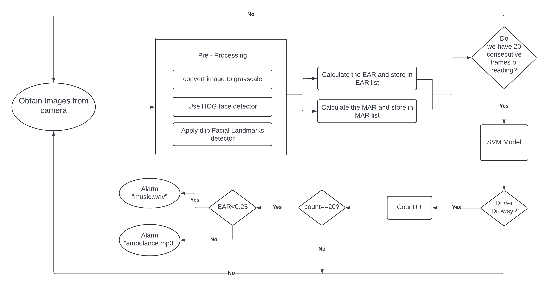
METHODOLOGY OVERVIEW
System Design:
Video Capture and Frame Extraction: Captures live video feed from webcam; continuously extracts frames.
Preprocessing: Resizes frames, converts to grayscale; uses Dlib HOG for face, eyes, mouth, and nose bridge detection.
Feature Extraction: Calculates EAR, MAR; identifies a nose bridge point for head position monitoring.
Alert Mechanism: Monitors EAR for prolonged eye closures, MAR for yawning, and nose bridge position for head nodding detection.
Real-time Processing: Uses a moving window concept for instant decision updates.

Slide 10
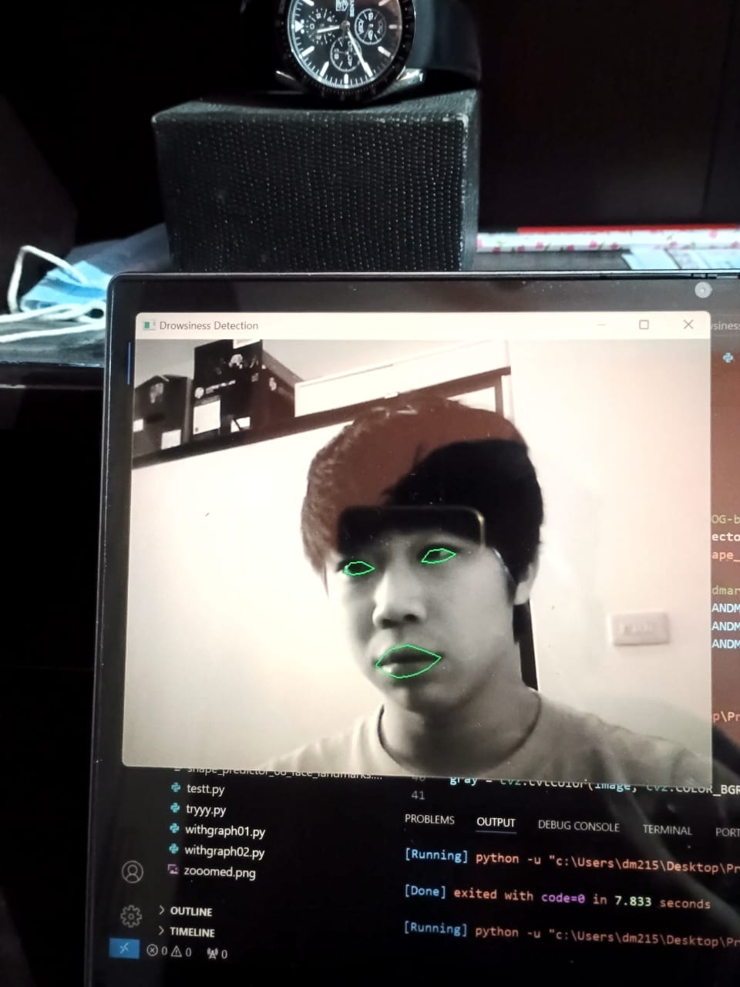
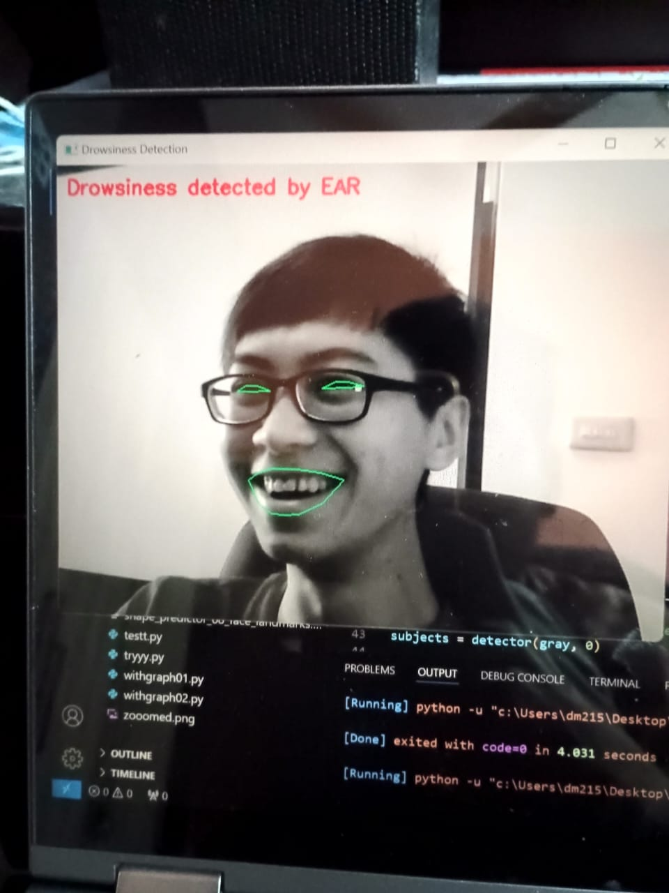
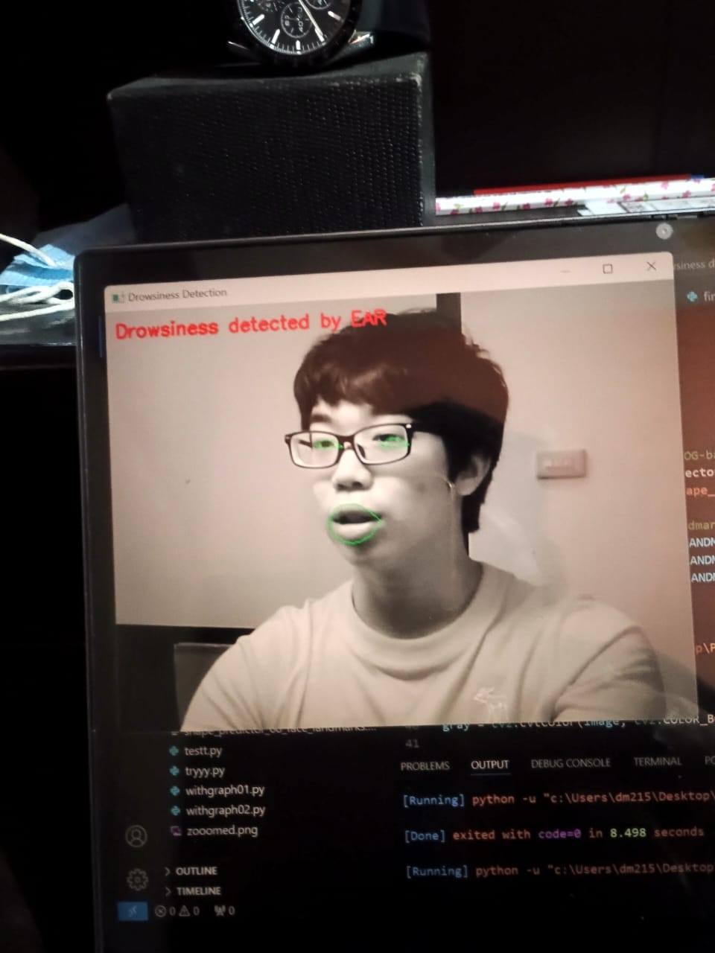
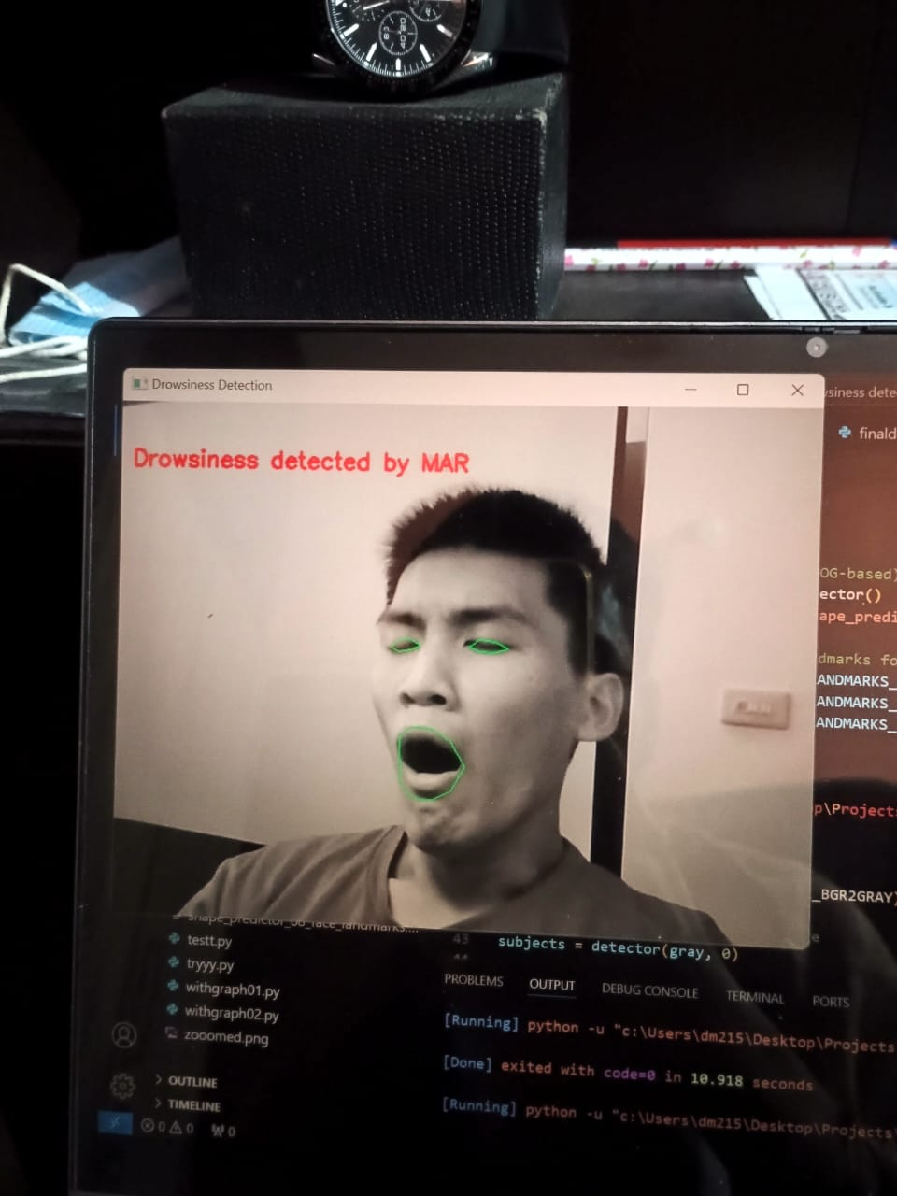
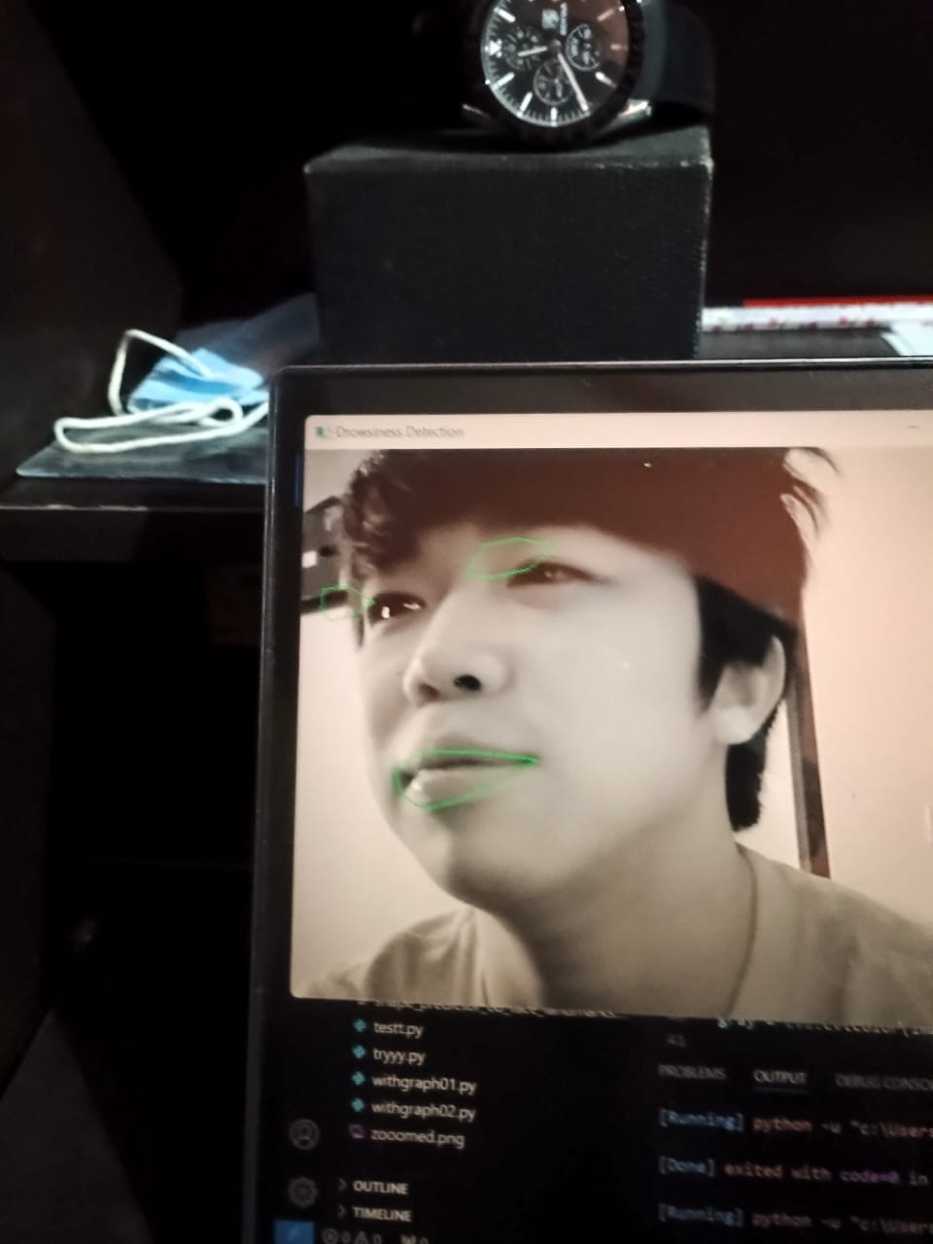
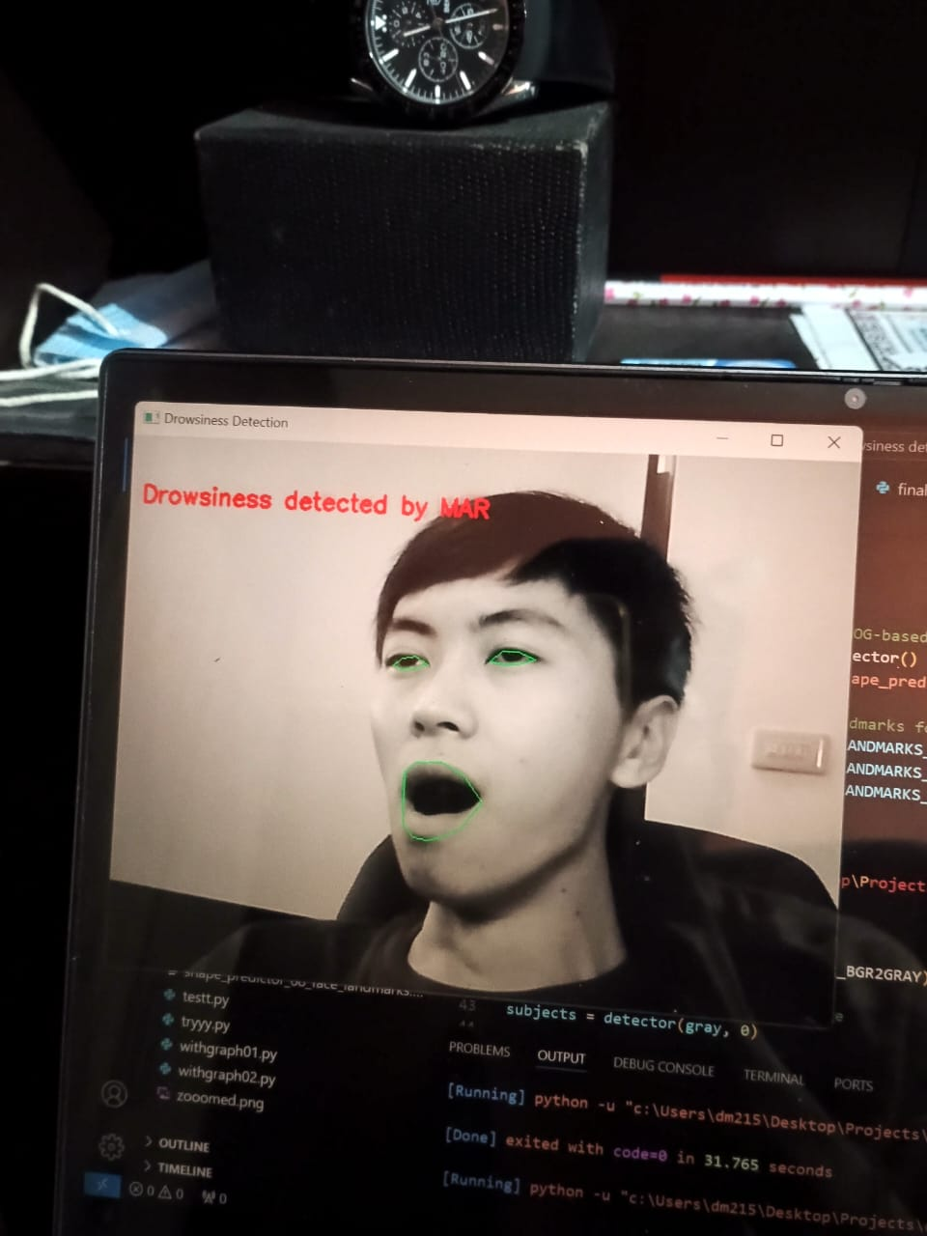
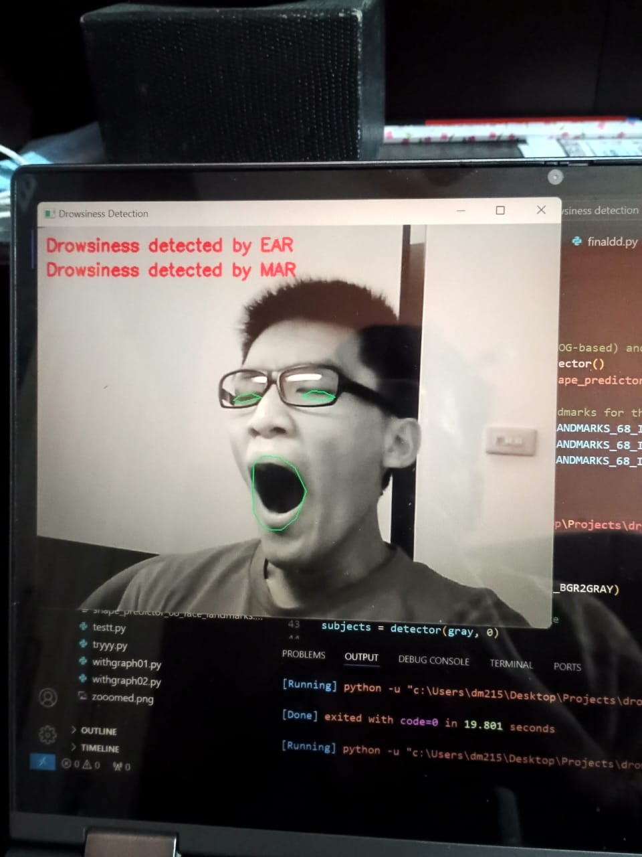
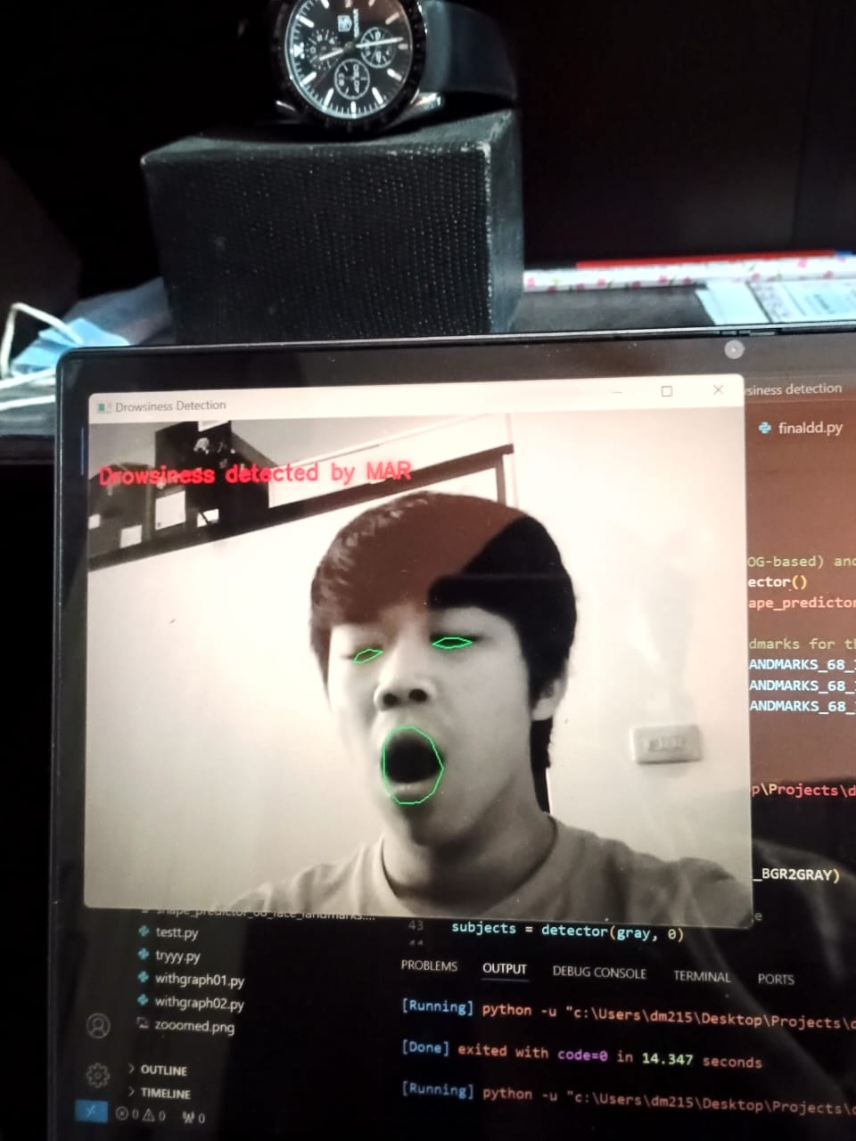
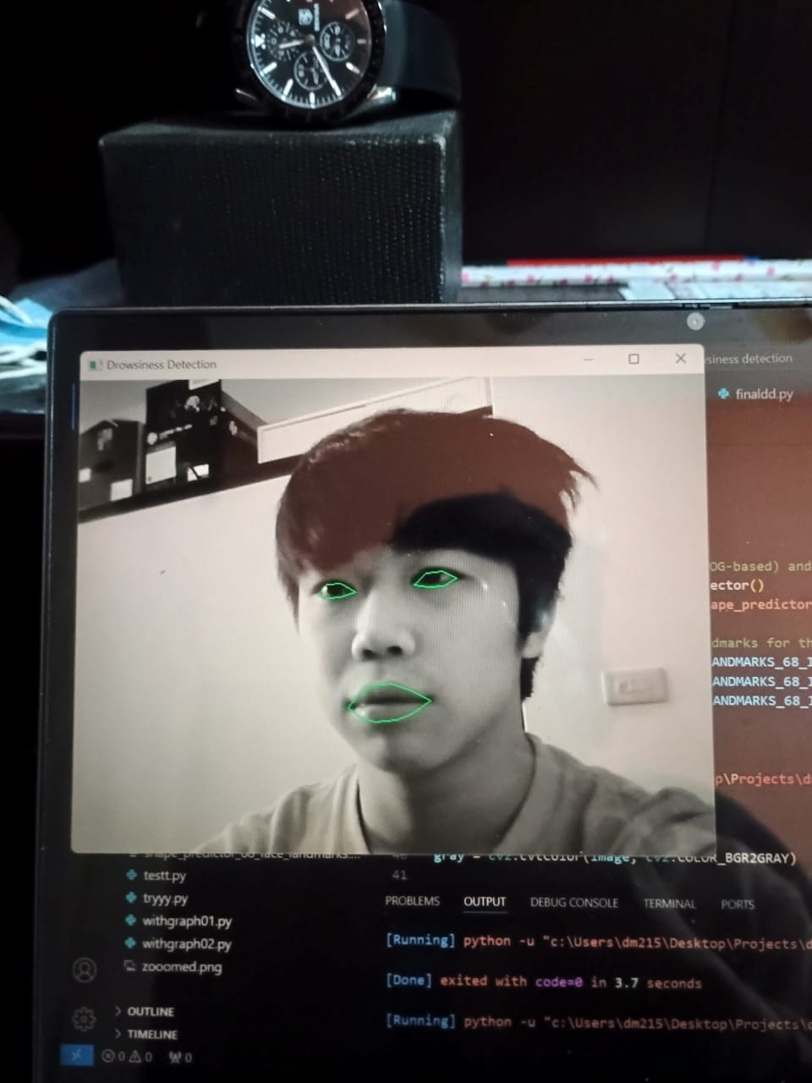
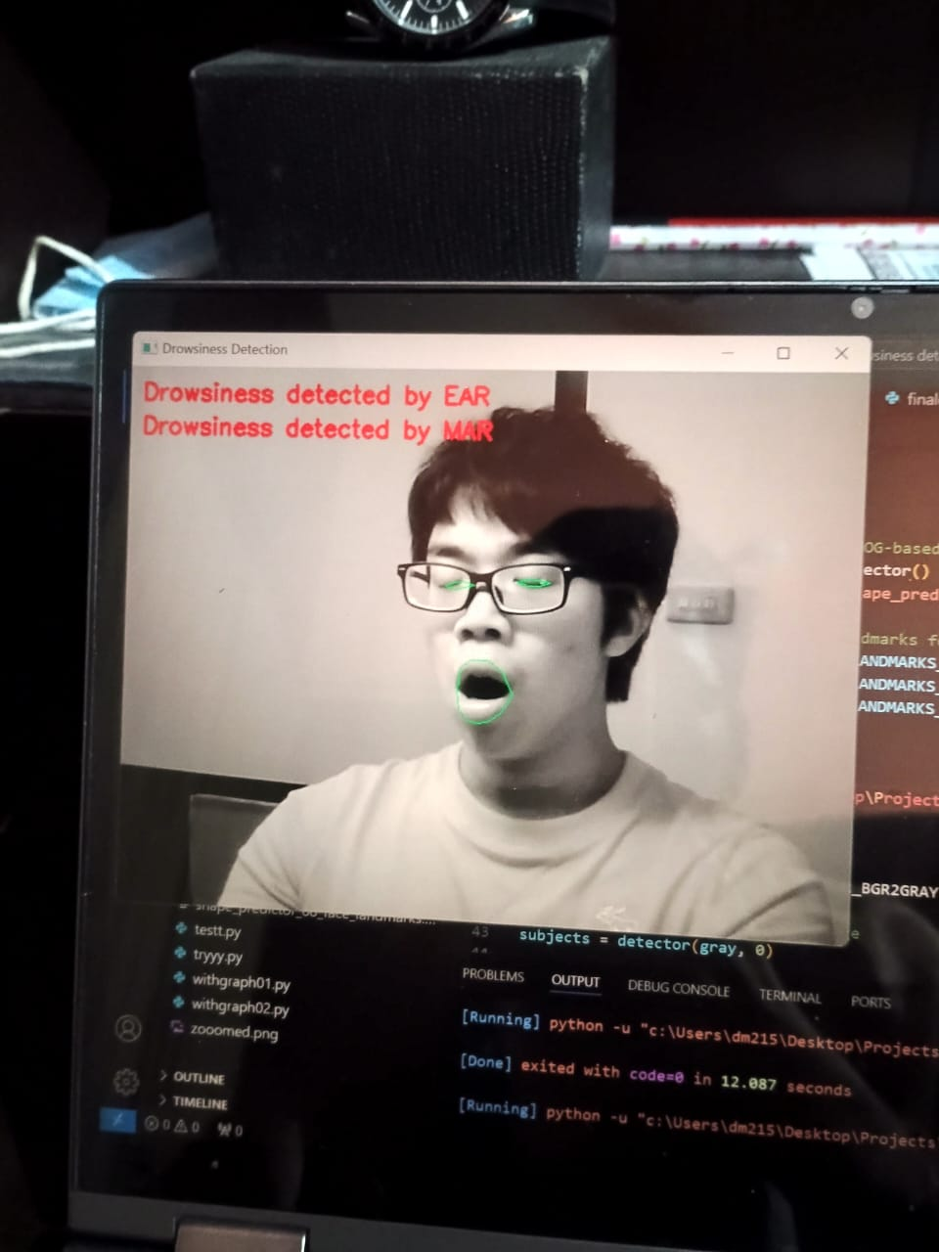
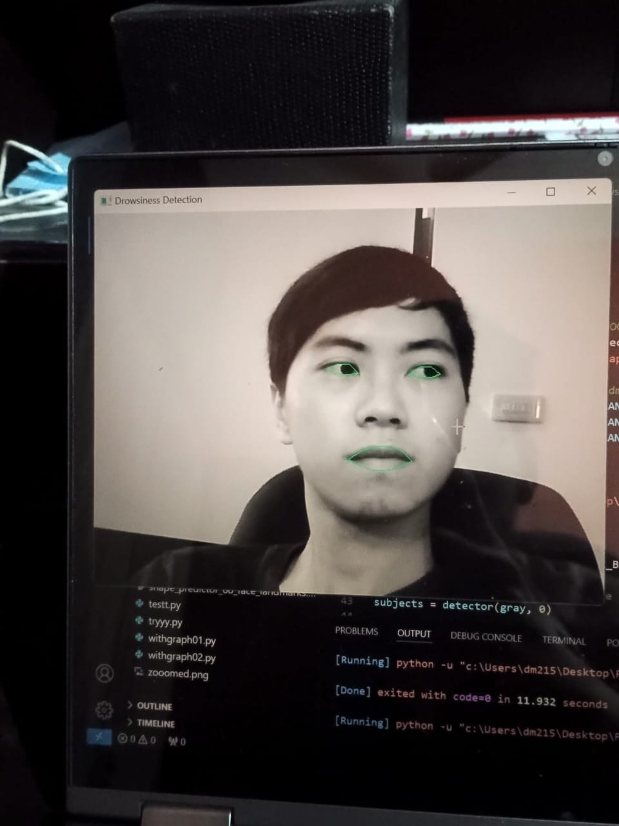
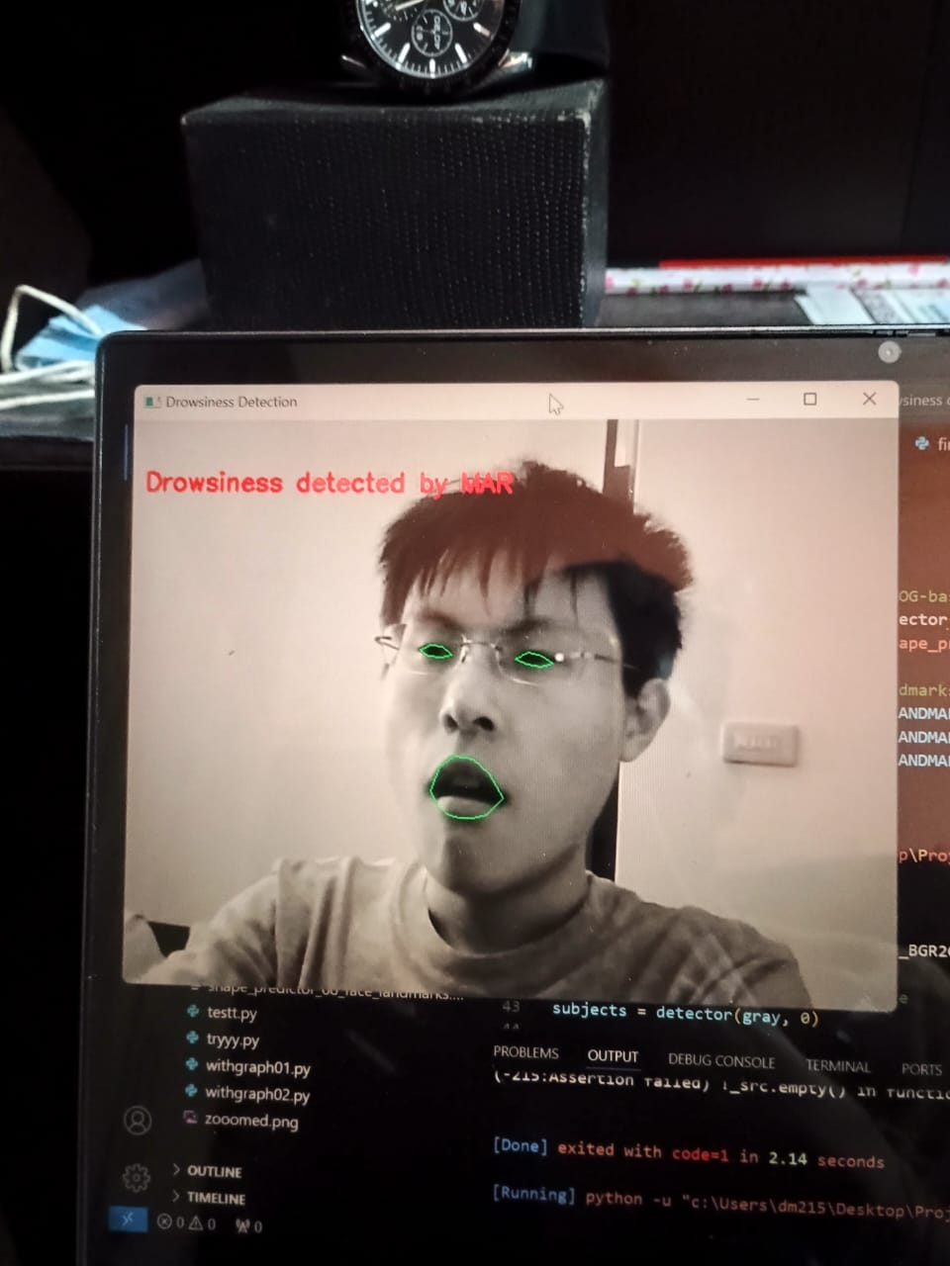
DATASET
Dataset:
Source and Composition: Custom dataset inspired by NTHUDDD with 12 JPG images (640x480 pixels).
Subjects: 7 subjects of different nationalities, real-time images of truck drivers.
Categories: Drowsiness and non-drowsiness images in separate folders.

Slide 11
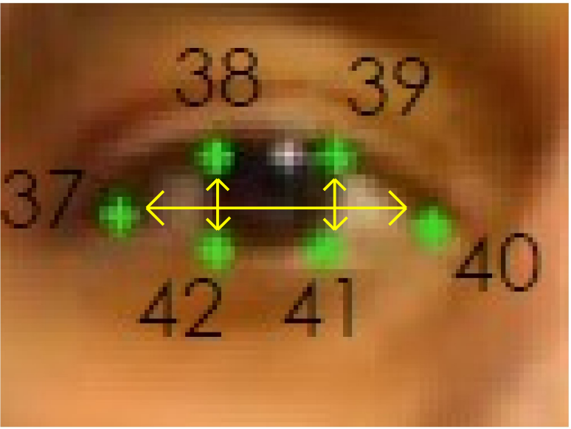
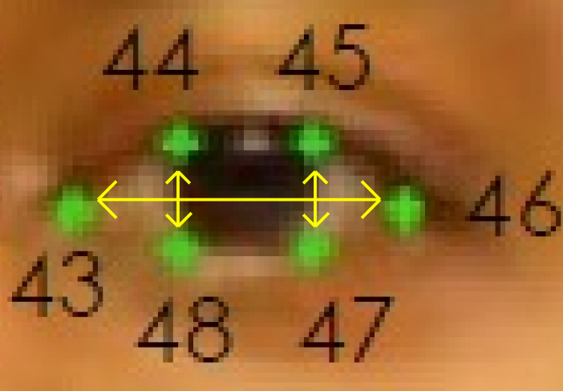
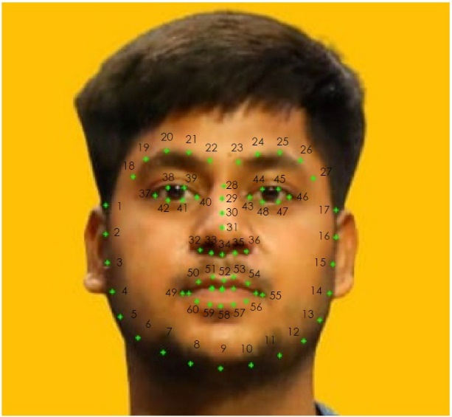
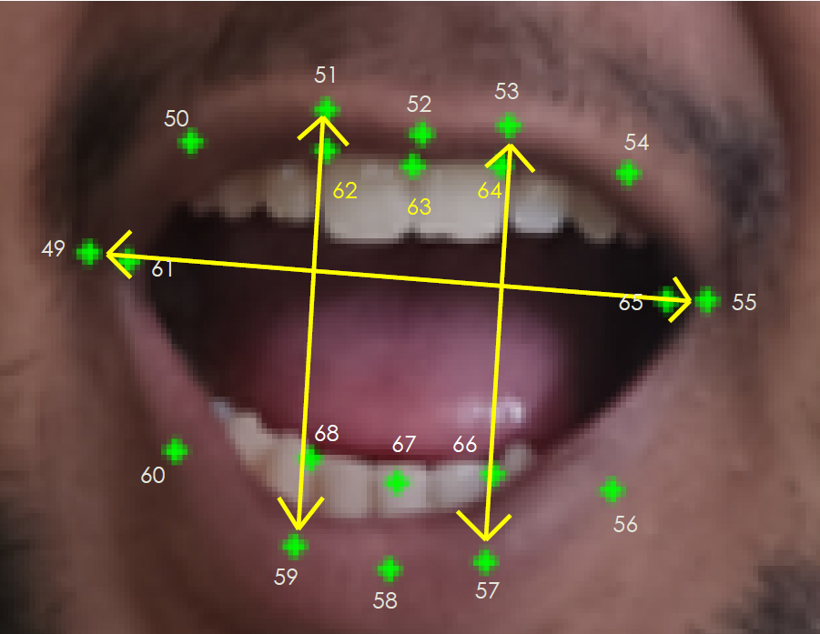
IMPLEMENTATION
1. EYE ASPECT RATIO(EAR):
2. MOUTH ASPECT RATIO(MAR):

Slide 12
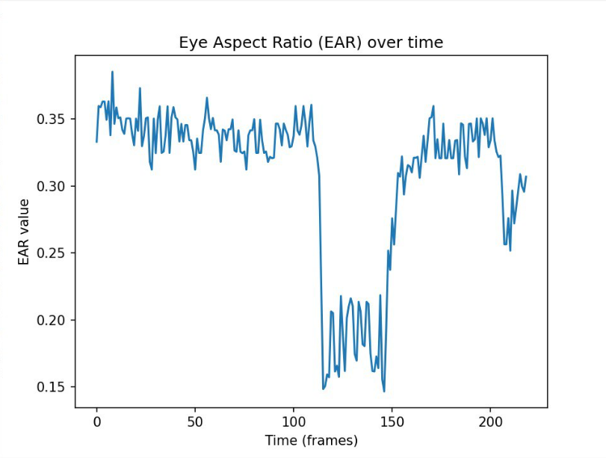
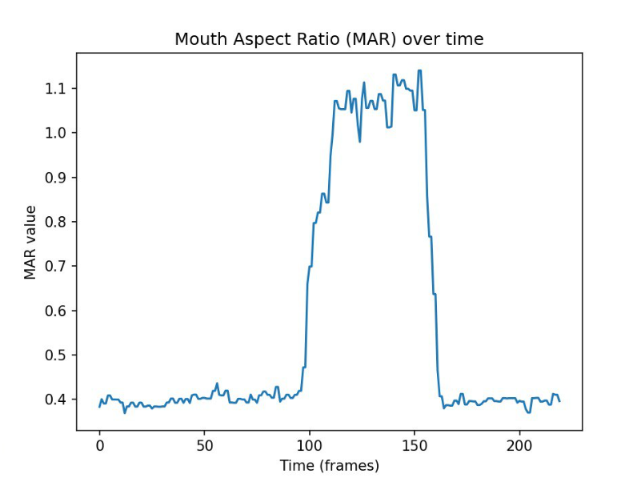

Slide 13
EXPECTED OUTCOME OF THE MINI PROJECT
Significance of Driver Drowsiness: Recognizes driver drowsiness as a major global factor in road accidents, threatening public safety.
Limitations of Traditional Measures: Highlights the inadequacy of traditional countermeasures in providing real-time detection and immediate responses.
Real-Time Detection System: Introduces a new system developed using advanced image processing and machine learning techniques.
Analysis Techniques: Utilizes facial feature analysis, eye state monitoring, and head movement tracking for accurate drowsiness detection.
Immediate Alerts: Aims to deliver instant alerts to prevent accidents and improve road safety.
Integrated Methods: Combines face detection (HOG+SVM), eye detection, blink detection, forehead dot tracking, and audio alerts for a comprehensive solution.
Enhanced Effectiveness: Offers a more reliable and effective approach compared to current methods.

Slide 14
References
[1] S. V. Militante and N. V. Dionisio, ‘Real-time facemask recognition with alarm system using deep learning’, in 2020 11th IEEE Control and System Graduate Research Colloquium (ICSGRC), 2020, pp. 106–110.
[2] A. Moujahid, F. Dornaika, I. Arganda-Carreras, and J. Reta, ‘Efficient and compact face descriptor for driver drowsiness detection’, Expert Systems with Applications, vol. 168, p. 114334, 2021.
[3] K. Parsa, M. Hassall, M. Naderpour, M. Pourreza, and F. Ramezani, ‘A New Alarm System Developing Approach through Graph Modeling’, IEEE Access, 2023.
[4] S. Pellegrini, G. Rizzelli, M. Barla, and R. Gaudino, ‘Algorithm Optimization for Rockfalls Alarm System Based on Fiber Polarization Sensing’, IEEE Photonics Journal, 2023.
[5] C. Das, C. Bhatt, U. Belim, T. Bhatia, and Others, ‘Smart Alarm System (Drowsiness Detection System Review Paper)’.
[6] S. Waseem, S. R. Abu-Bakar, B. A. Ahmed, Z. Omar, and T. A. E. Eisa, ‘DeepFake on Face and Expression Swap: A Review’, IEEE Access, 2023.
[7] N. Li et al., ‘Chinese face dataset for face recognition in an uncontrolled classroom environment’, IEEE Access, 2023.
[8] H. Qi, C. Wu, Y. Shi, X. Qi, K. Duan, and X. Wang, ‘A real-time face detection method based on blink detection’, IEEE Access, vol. 11, pp. 28180–28189, 2023.
[9] S. S. Dash, ‘Face Recognition and Face Detection Benefits and Challenges’, no. July, pp. 177–191, 2023.
[10] S. V. Militante and N. V. Dionisio, ‘Deep learning implementation of facemask and physical distancing detection with alarm systems’, in 2020 third international conference on vocational education and electrical engineering (ICVEE), 2020, pp. 1–5.

Slide 15
Thank You!

