Slide 1


Sarvajanik Education Society Sarvajanik College of Engineering & Technology, Surat. Department of Computer Applications Academic Year: 2025– 26
A Project On
“Car Inventory Management System”
Presented By :
Tushit Maisuriya ( ET25MTCA097 )
Dhruvinsinh Solanki ( ET25MTCA130 )
Jevil Patel ( ET25MTCA106 )
MCA | Sem-1
Under the Guidance of
Prof. Veer Pachchigar

Slide 2
Car Inventory Management System
Presented By : Tushit Maisuriya
Dhruvinsinh Solanki
Jevil Patel

Slide 3
INDEX
Project Abstract
Objective
Source Code
Screenshot
Test cases
Conclusion
References

Slide 4
PROJECT ABSTRACT
A console-based program made in C++.
Helps manage cars Inventory, suppliers, staff, and sales easily
Different access for Admin, Staff, and Suppliers
Keeps track of stock, sales, and supplier requests
Saves time and reduces mistakes
Shows how programming can solve real business problems.

Slide 5
OBJECTIVE
The main objectives are:
Improve stock monitoring and supplier communication.
Provide role-specific functionalities for Admin, Staff, and Suppliers.
Automate car inventory management.
Generate detailed reports for informed decision-making.
Enhance security with role-based access and password management.
• Improve stock monitoring and supplier communication
• Provide role-specific functionalities for Admin, Staff, and Suppliers
• Automate car inventory management
• Generate detailed reports for informed decision-making
• Enhance security with role-based access and password management

Slide 6
SOURCE CODE
1.1 Role Login :
bool login(string username, string password) {
string getUsername, getPassword;
int attempts = 1;
char ch;
while (attempts < 4) {
cout<<endl;
getUsername.clear();
getPassword.clear();
cout << "Enter username: ";
cin >> getUsername;
cout << "Enter password: ";
while ((ch = getch()) != 13) {
getPassword.push_back(ch);
cout << "*";
}

Slide 7
if (getUsername == username && getPassword == password) {
cout << endl << "Login Successful!"<<endl;
return true;
} else {
cout << endl << "? Invalid credentials!"<<endl<<endl;
attempts++;
}
}
cout << "?? Too many failed attempts! Please wait 30 seconds...\n";
this_thread::sleep_for(chrono::seconds(30));
return false;
}

Slide 8
1.2 Admin Menu :
void Admin::menu(){
system("cls");
cout<<endl<<endl;
cout << setw(110) << "|| ADMIN MENU ||" << endl;
line();
cout << setw(120) << "1. PRODUCT MANAGEMENT \t 2. STOCK MANAGEMENT" << endl<<endl;
cout << setw(121) << "3. SUPPLIER MANAGEMENT \t 4. STAFF MANAGEMENT" << endl<<endl;
cout << setw(109) << "5. REPORTS \t\t 6. CHANGE PASSWORD" << endl<<endl;
cout << setw(86) << "7. LOGOUT" << endl<<endl;
line();
}
Note :
This is the primary control menu that opens as soon as the Admin logs in.
It connects all the major parts of the project, like Products, Stock, and Staff.
The user just types a number (1 to 7) to switch between different screens easily.

Slide 9
1.3 Product Management Menu :
void Admin::productMenu(){
cout<< endl<<endl;
cout << setw(110) << " || PRODUCT MANAGEMENT || " << endl;
cout<< endl;
cout<< setw(110) <<"1. Add Product \t\t 2. Edit Product"<<endl<<endl;
cout<< setw(113) <<"3. Delete Product \t\t 4. View Product"<<endl<<endl;
cout<< setw(84) <<"5. Back"<<endl<<endl;
line();
}
Note :
This menu handles all basic database actions: adding, viewing, editing, and deleting items.
Allows the admin to keep the product list accurate and up to date.
Option 5 allows the user to safely return back to the main Admin screen..

Slide 10
1.4 Stock Management Menu :
void Admin::stockMenu(){
cout<< endl;
cout << setw(110) << "|| STOCK MANAGEMENT ||" << endl;
cout<< endl;
cout<< setw(91) <<"1. VIEW STOCK "<< setw(50) <<" 2. VIEW PRODUCT RESPONSE"<<endl<<endl;
cout<< setw(109) <<"3. REQUEST SUPPLIER FOR PRODUCT "<< setw(16) <<" 4. BACK"<<endl<<endl;
line();
}
Note :
Allows the admin to check current stock quantities instantly.
Features a built-in option to request stock replenishment from vendors.
Option 4 provides a quick route back to the previous menu level.

Slide 11
1.5 Supplier Management :
void Admin::staffSupplierMenu(string role){
cout<< endl;
if (role == "supplier") role = "SUPPLIER";
else if(role == "staff") role = "STAFF";
cout << setw(96) << "|| " << role <<" MANAGEMENT ||" << endl;
cout<< endl;
cout<< setw(88) <<"1. Add new "<<role<< setw(25) <<" 2. Edit "<< role <<" Details"<<endl<<endl;
cout<< setw(87) <<"3. Update "<< role <<" Credential "<< setw(31) <<"4. Active/Deactive Status"<<endl<<endl;
cout<< setw(85) <<"5. View "<< role <<"\t\t\t 6. Exit"<<endl<<endl;
line();
}
Note :
Uses a single function template to manage both external suppliers and internal staff profiles.
Handles adding profiles, updating login credentials, and viewing records.
Features an active/deactive switch to temporarily suspend or enable records instantly.

Slide 12
1.6 Reports :
void Admin::reportMenu(){
cout<< endl;
cout << setw(107) << "Reports" << endl;
cout<< endl;
cout<< setw(93) <<"1. Stock Report"<< setw(35) <<"2. Supplier Report"<<endl<<endl;
cout<< setw(96) <<"3. Purchase Report"<< setw(21) <<"4. Back"<<endl<<endl;
line();
}
Note :
Collects and displays core business metrics on demand.
Generates three distinct statement types covering inventory, vendor engagement, and procurement.
Leverages layout padding to output tabular, structured report layouts directly to the console window.

Slide 13
1.3 Staff Menu :
void staffRole(){
system("cls");
cout <<endl<<endl;
cout << setw(108) << "Choice Role" << endl<<endl;
cout << setw(100) << "1. Sales Manager";
cout << "\t 2. Sales Person" << endl<<endl;
cout << setw(91) << " 3. EXIT" << endl<<endl;
line();
}
Note :
Provides access points to different views depending on the staff type selected.
Splits the workflow into administrative oversight roles and operational floor roles.
Uses screen clearing commands to keep the console look tidy and structured..

Slide 14
1.2 Sales Manager Menu :
void Manager::SalesManagerMenu(){
system("cls");
cout<<endl<<endl;
cout << setw(110) << "|| SALES MANAGER MENU ||" << endl;
line();
cout << setw(120) << "1. VIEW PRODUCT \t 2. SALES REQUEST" << endl<<endl;
cout << setw(121) << "3. VIEW SALES REPORT\t 4. REQUEST SUPPLIER" << endl<<endl;
cout << setw(109) << "5. RESPONSE OF SUPPLIER PRODUCT\t\t 6. CHANGE PASSWORD" << endl<<endl;
cout << setw(86) << "7. LOGOUT" << endl<<endl;
line();
}
Note :
Provides middle-management access to track store operations without giving full Admin rights.
Connects sales trends directly to stock requests and supplier confirmations.
Features an explicit self-service utility for updating password credentials locally.

Slide 15
1.3.2 Saler Menu :
void Staff::SalesPersonMenu(){
cout<<endl<<endl;
cout << setw(110) << "|| SALES PERSON MENU ||" << endl;
line();
cout << setw(90) << "1. VIEW PRODUCT " << setw(37) <<" 2. SELL PRODUCT" << endl<<endl;
cout << setw(108) << "3. VIEW STATUS OF SELLING PRODUCT " << setw(25) <<" 4. CHANGE PASSWORD " << endl<<endl;
cout << setw(84) << "5. LOGOUT " <<endl<<endl;
line();
}
Note :
A dedicated portal for everyday store employees to execute transactions quickly.
Allows staff to check product availability and log item sales instantly.
Gives individual floor workers the ability to update their unique login password.

Slide 16
1.4 Supplier Menu :
void Supplier::menu(){
cout<<endl<<endl;
cout << setw(110) << "|| SUPPLIER MENU ||" << endl;
line();
cout << setw(98) << "1. VIEW STOCK REQUEST"<< setw(37) <<"2. SUPPLY PRODUCT TO STORE" << endl<<endl;
cout << setw(100) << "3. VIEW SUPPLY HISTORY "<< setw(28) <<"4. CHANGE PASSWORD" << endl<<endl;
cout << setw(98) << "5. PRODUCT MANAGEMENT" << setw(20) << "6. LOGOUT" << endl<<endl;
line();
}
Note :
A distinct security layer designed for external supply partners.
Enables vendors to accept incoming restock requests and dispatch merchandise.
Provides full transparency to review completed delivery logs and change account passwords.

Slide 17
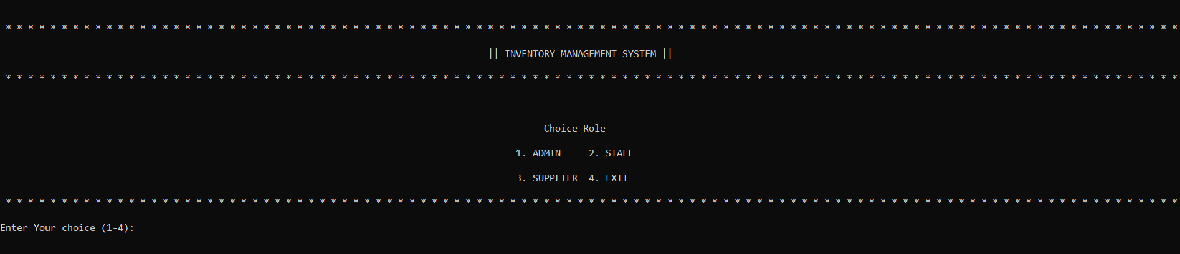
SCREENSHOT
Figure 1.1 : Login Role :

Slide 18
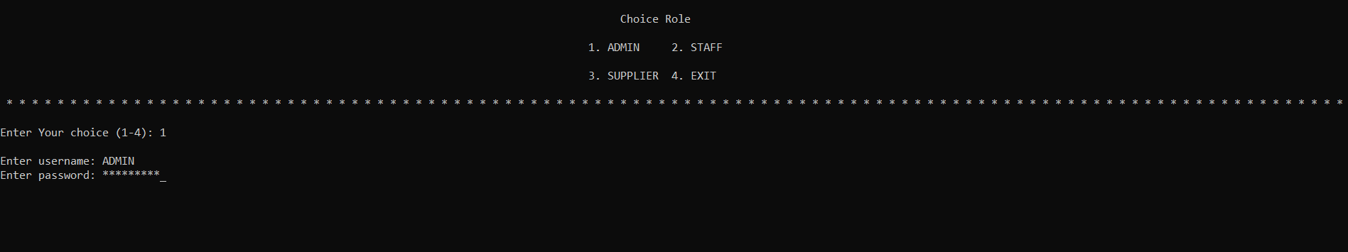
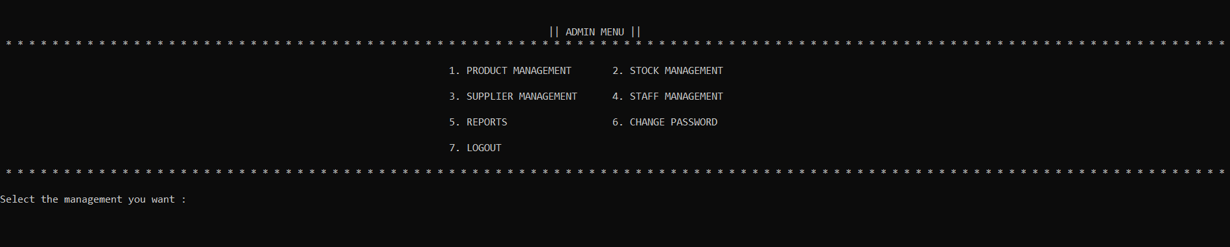
Figure 1.2 Admin Menu :

Slide 19
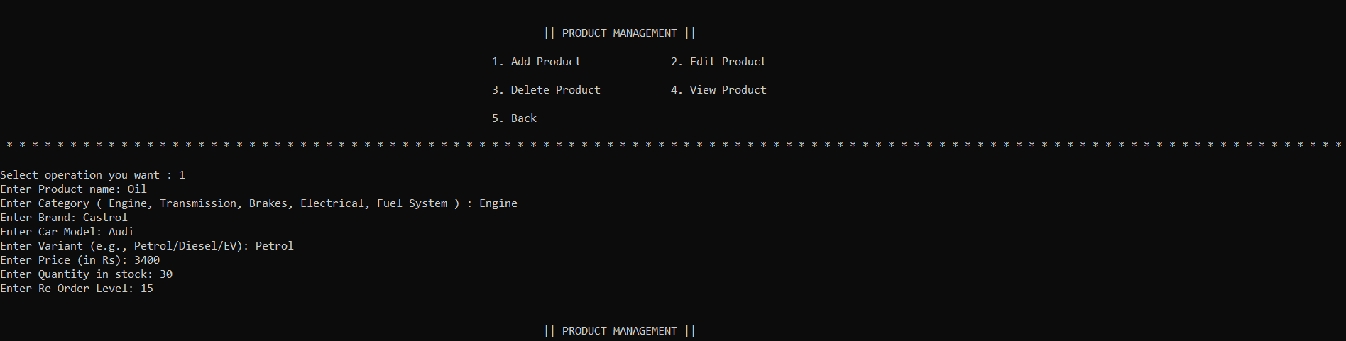
Figure 1.3 Product Management :
Figure 1.3.1 Add Product :

Slide 20
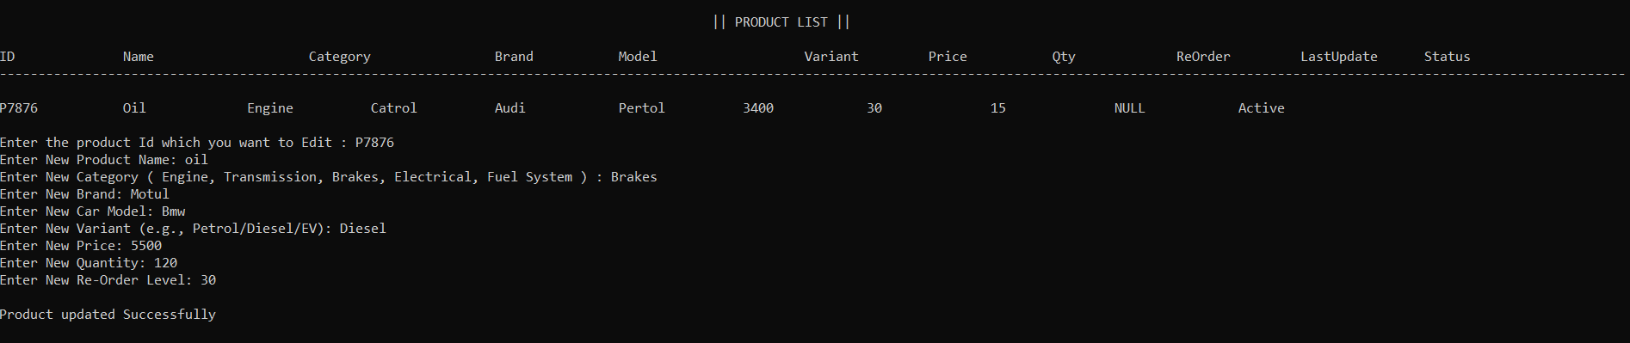
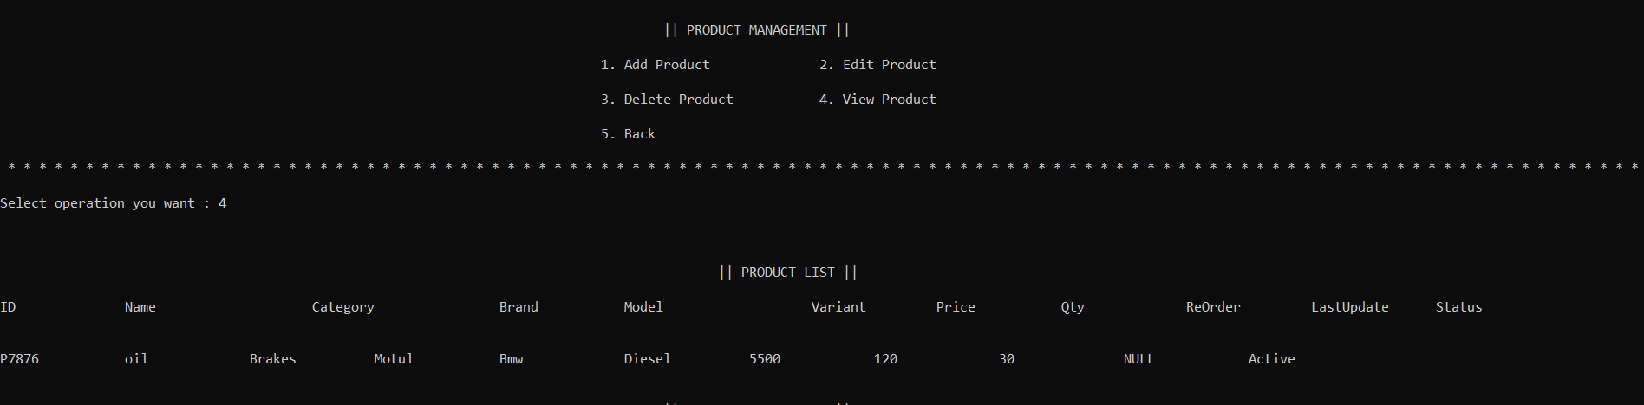
Figure 1.3.2 Edit Product :

Slide 21
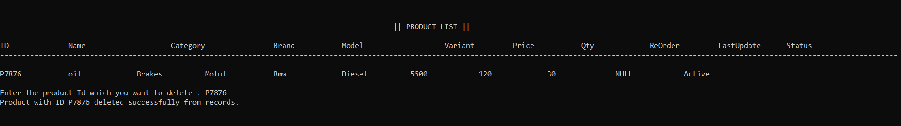
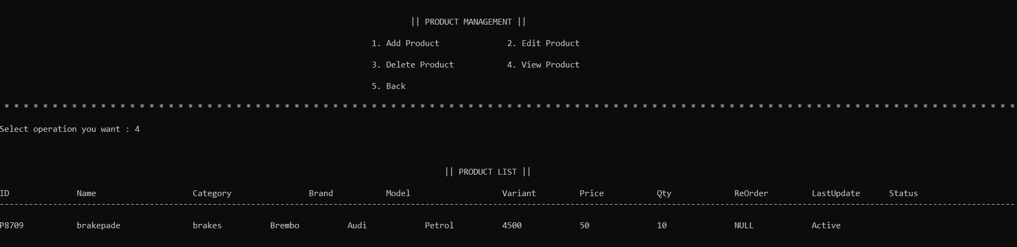
Figure 1.3.3 Delete Product :
Figure 1.3.4 View Product :

Slide 22
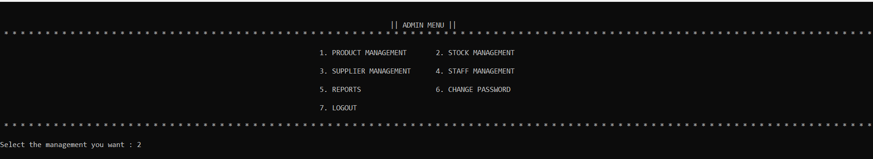
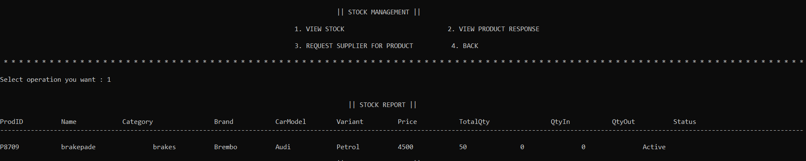
Figure 1.4 Stock Management :
Figure 1.4.1 view Stock :

Slide 23
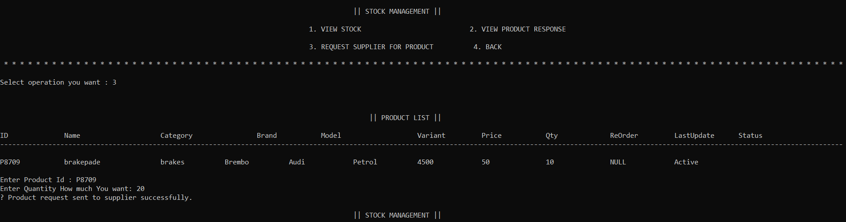
Figure 1.4.3 Request to supplier For product :

Slide 24
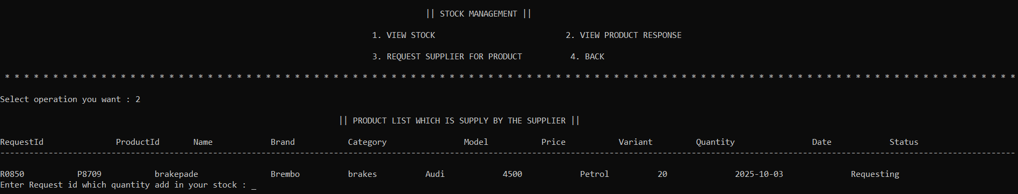
Figure 1.4.2 View Product Response :

Slide 25
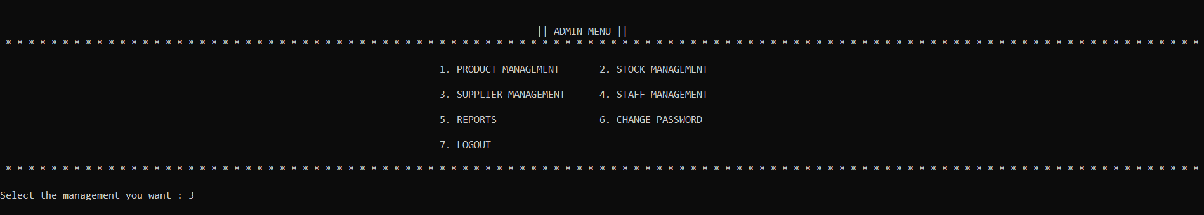
Figure 1.5 Supplier Management :

Slide 26
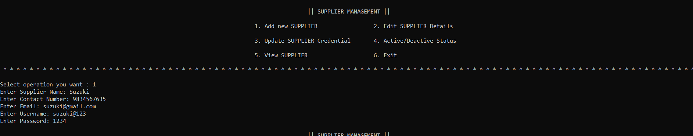
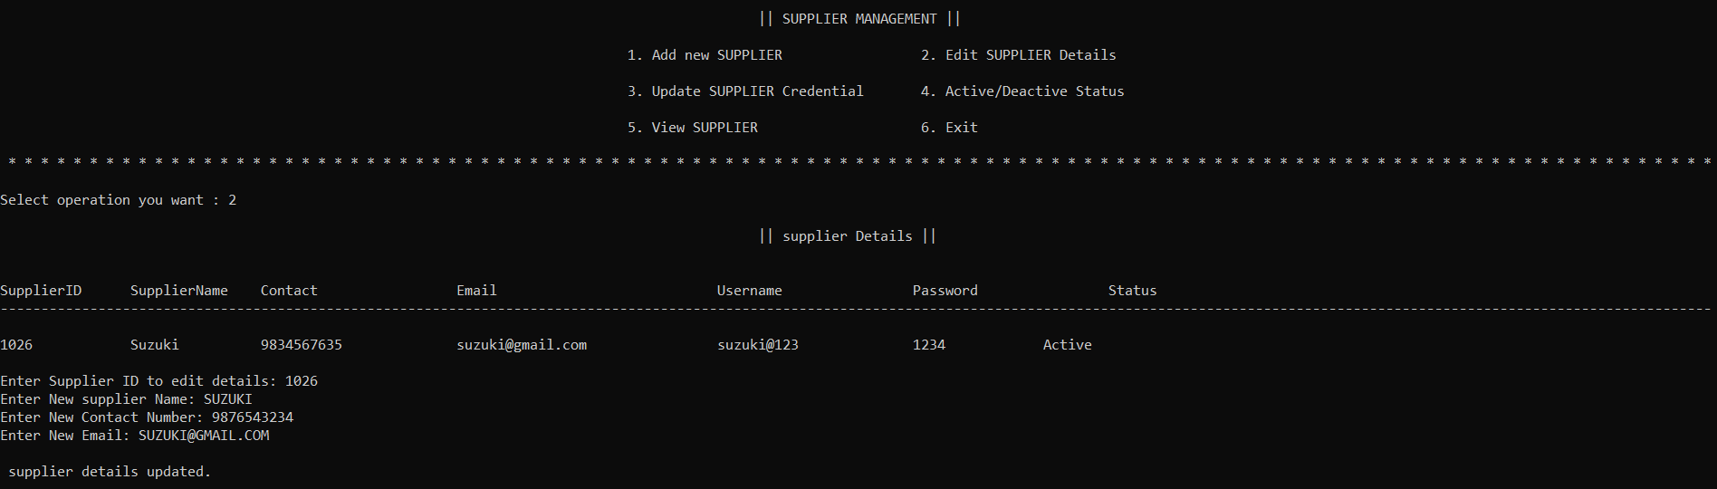
Figure 1.5.1 Add Supplier :
Figure 1.5.2 Edit Supplier :

Slide 27
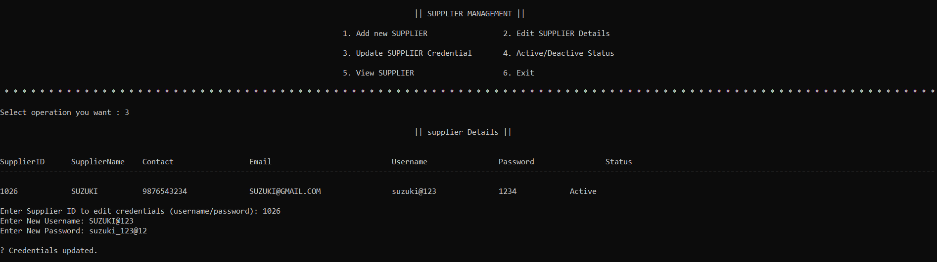
Figure 1.5.3 Edit Update Cridential :

Slide 28
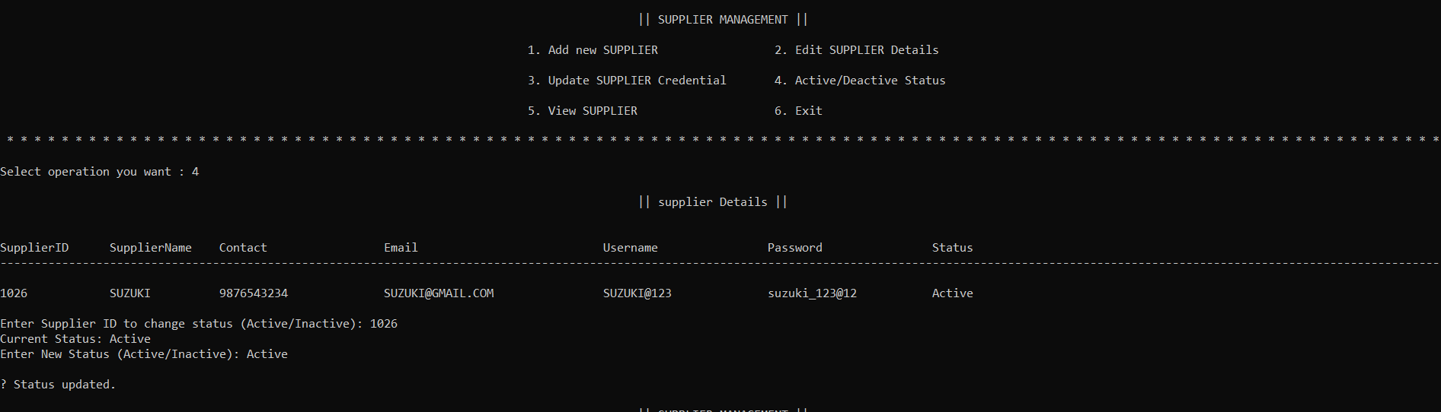
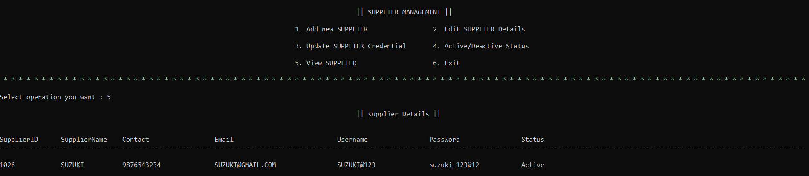
Figure 1.5.4 Edit Status :
Figure 1.5.5 View Supplier :

Slide 29
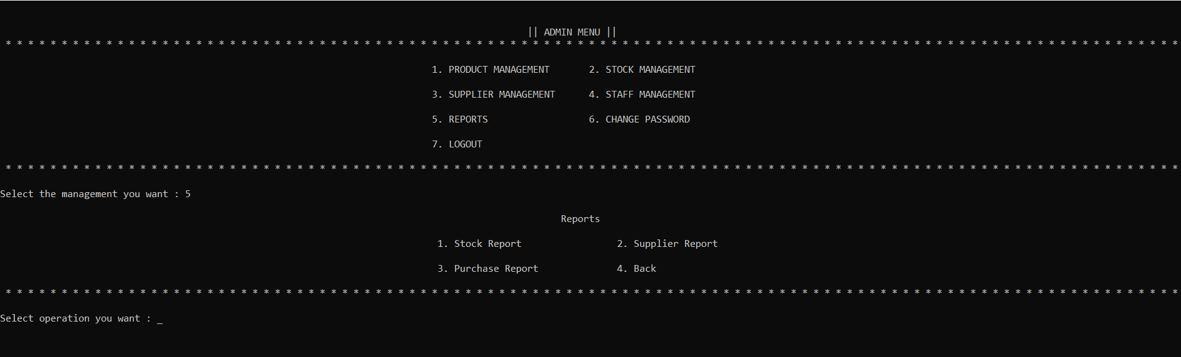
Figure 1.7 Reports :

Slide 30
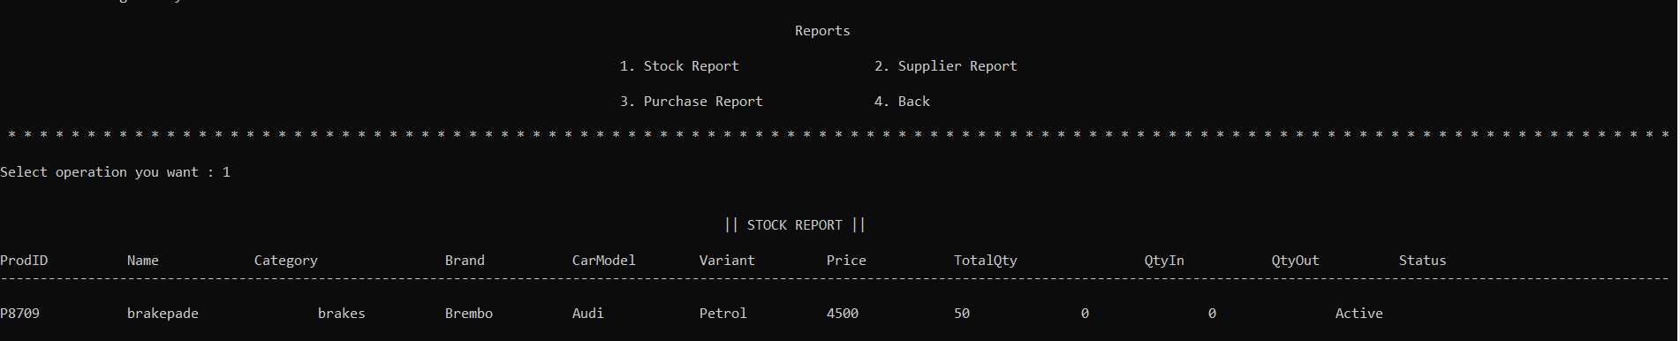
Figure 1.7.1 View Stock :

Slide 31
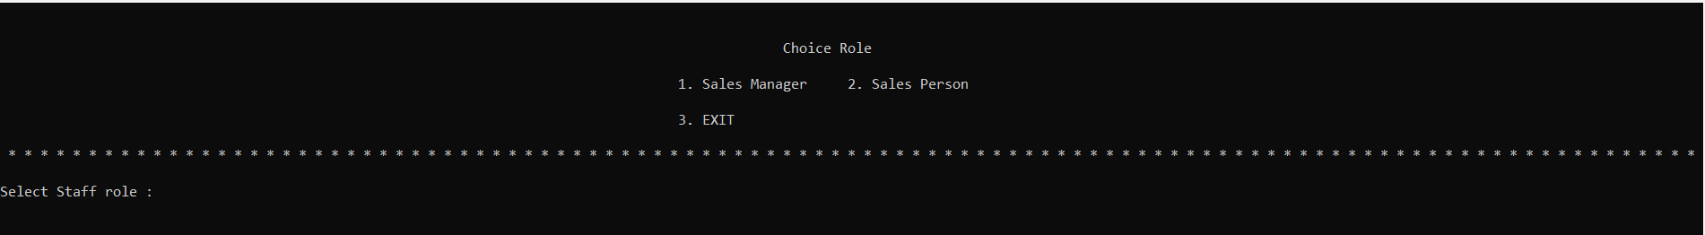
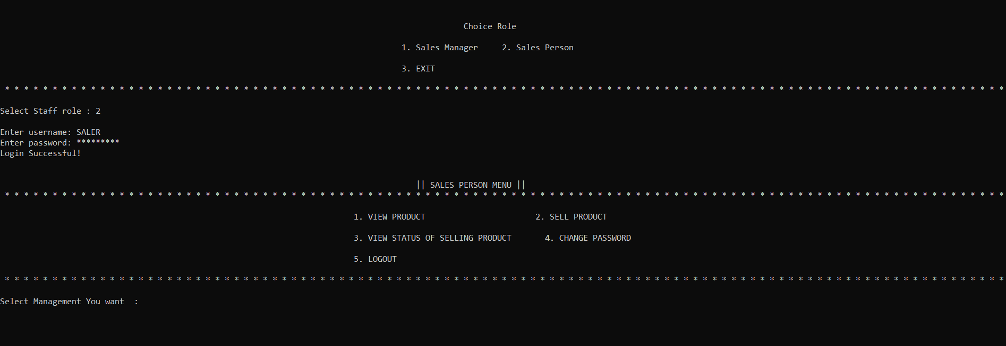
Figure 2.1 Staff Role :

Slide 32
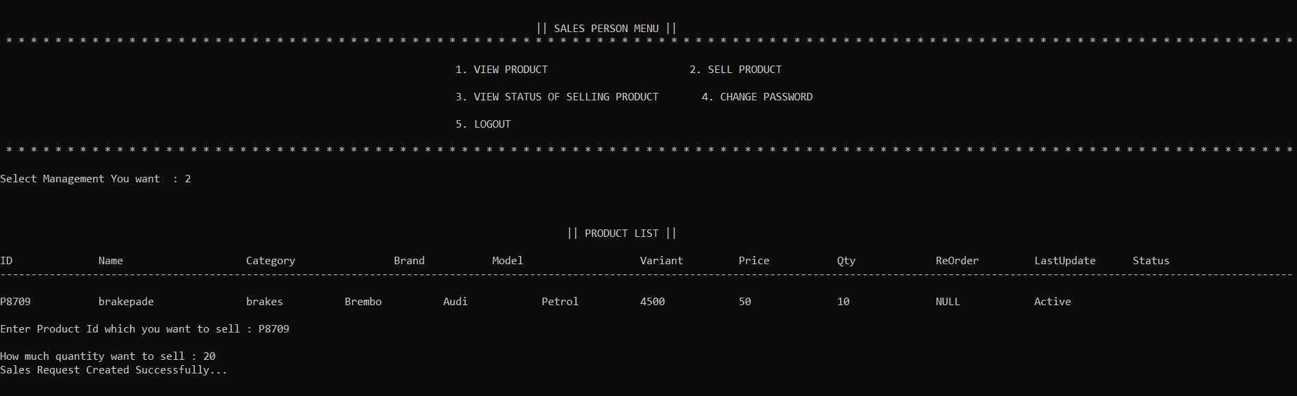
Figure 2.1.1 View Product :
Same as Figure 1.3.4
Figure 2.1.2 Sell Product :

Slide 33
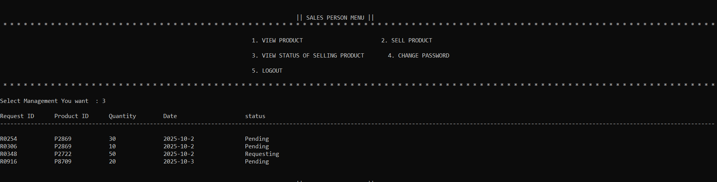
Figure 2.1.3 View Status Of selling Product :

Slide 34
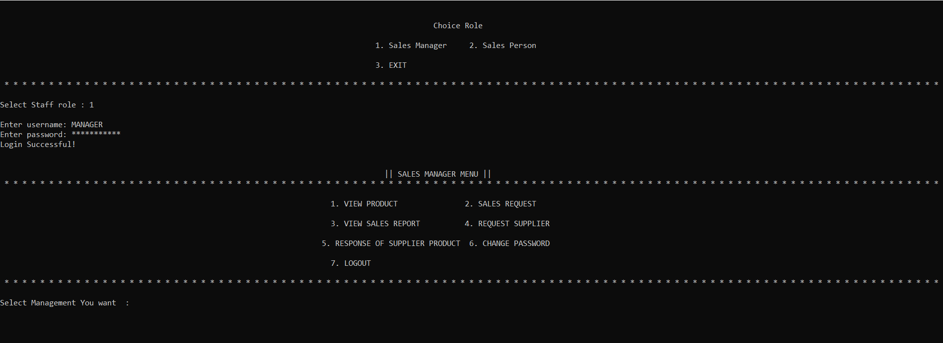
Figure 3.1 Manager Menu :

Slide 35
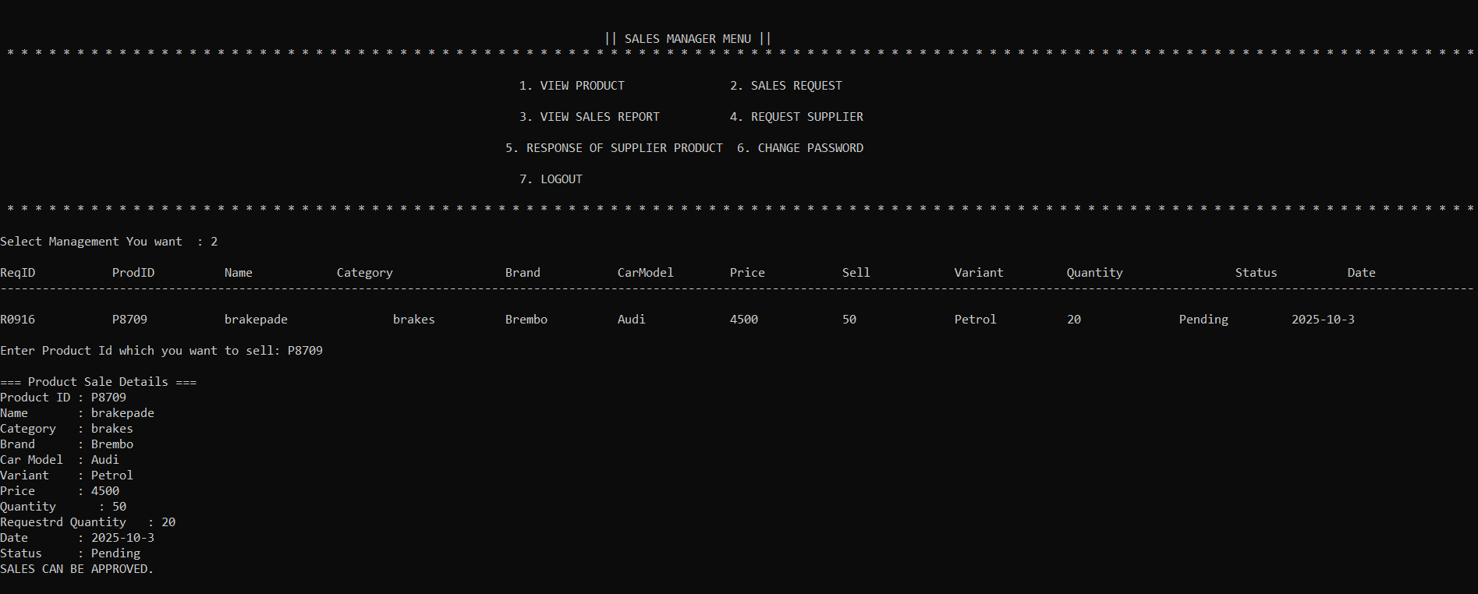
Figure 3.1.1 : View Product :
Same as Figuer 1.3.4
Figure 3.1.2 : Sales Request :

Slide 36
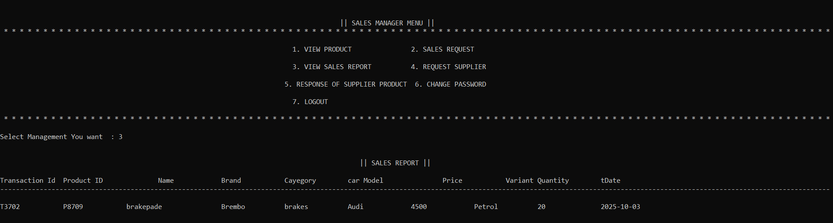
Figure 3.1.3 : View Sales Report :
Figure 3.1.3 : Request To Supplier :
Same as figure 1.4.3
Figure 3.1.4 : Response of Supplier Product :
Same as figure 1.4.2

Slide 37
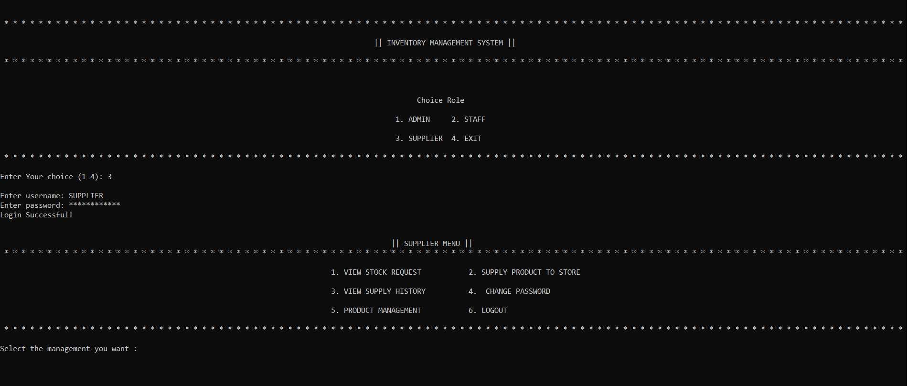
Figure 4.1 : Supplier Menu

Slide 38
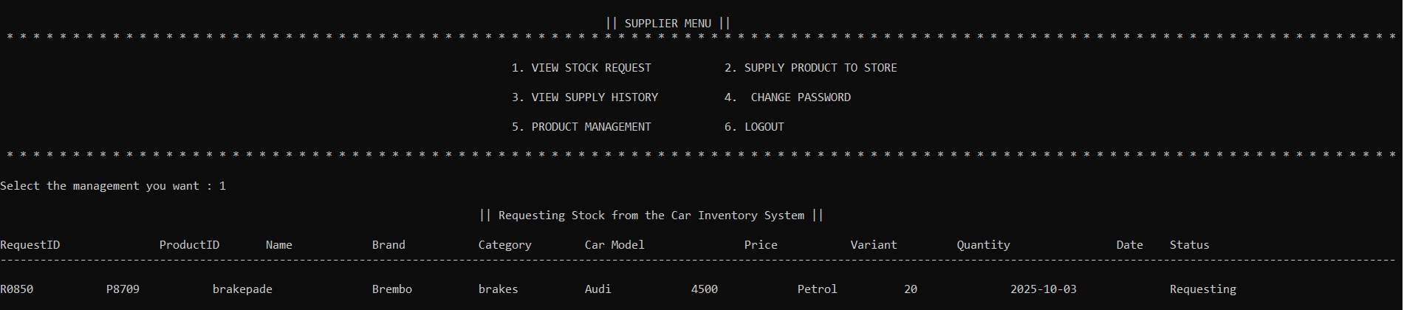
Figure 4.1.1 : View Request

Slide 39
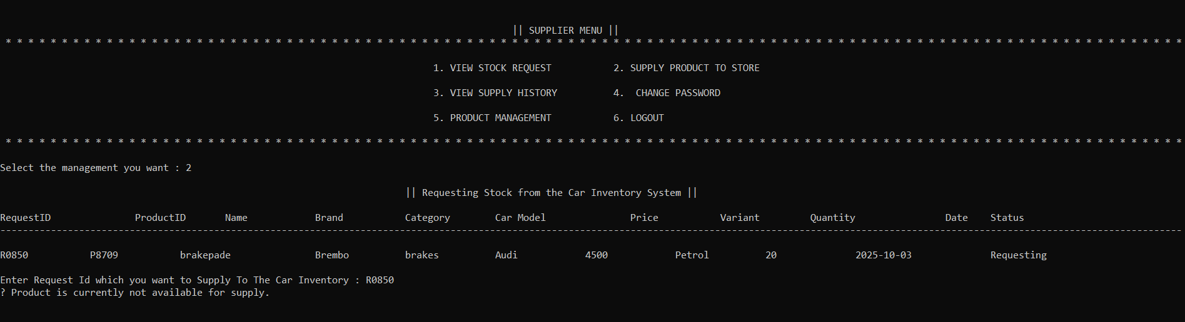
Figure 4.1.2 : Supply Product

Slide 40
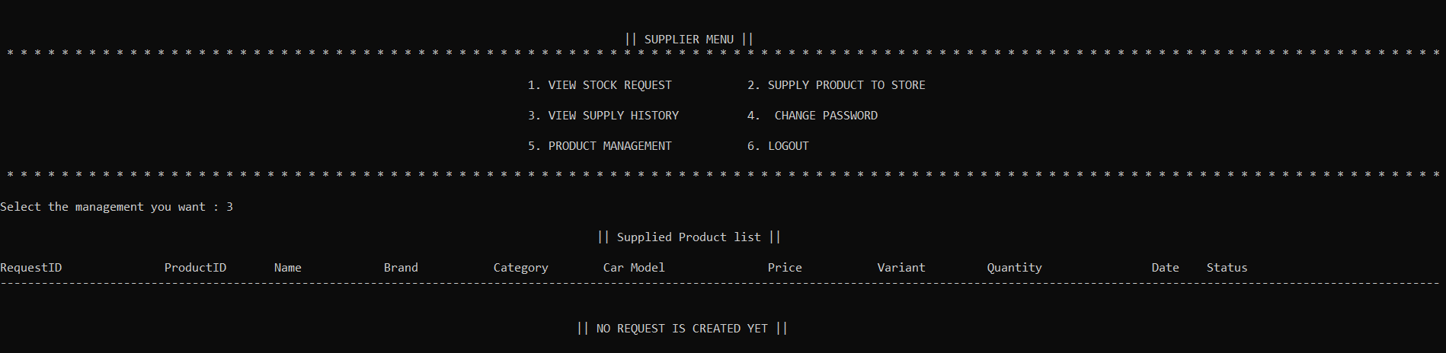
Figure 4.1.3 : View Supply History
Figure 4.1.4 : Product Management
Figure 4.1.4.1 : Add Product :
Same as figure 1.3.1 ( Supplier_Products.txt )
Figure 4.1.4.2 : Edit Product :
Same as figure 1.3.2 ( Supplier_Products.txt )

Slide 41
Figure 4.1.4.3 : Delete Product :
Same as figure 1.3.3 ( Supplier_Products.txt )
Figure 4.1.4.4 : View Product :
Same as figure 1.3.4 ( Supplier_Products.txt )

Slide 42
TEST CASES
Figure 5.1 Login
TC ID | Description | Steps | Input | Expected Result
TC_LOGIN_01 | Valid Admin Login | Enter correct username/password | ADMIN / admin@123 | Login Successful
TC_LOGIN_02 | Invalid Login | Enter wrong password | admin / wrong123 | Error message
TC_LOGIN_03 | Max Attempts | Enter wrong details 3 times | wrong creds | System locks for 30 sec

Slide 43
Figure 5.2 Admin
TC ID | Description | Steps | Input | Expected Result
TC_ADMIN_01 | Add Product | Go to Add → Save | Brake Pad | Product Added
TC_ADMIN_02 | Edit Product | Select product → Edit | P1001 | Updated
TC_ADMIN_03 | Delete Product | Select product → Delete | P1001 | Deleted
TC_ADMIN_04 | Add Supplier | Fill supplier form | Supplier Info | Added

Slide 44
Figure 5.3 Staff
TC ID | Description | Steps | Input | Expected Result
TC_STAFF_01 | Create Sales Request | Enter product & qty | P1001 / 5 | Request Created
TC_STAFF_02 | Approve Sale | Approve request | R1001 | Approved
TC_STAFF_03 | Reject Sale | Reject request | R1001 | Rejected

Slide 45
Figure 5.4 Supplier
TC ID | Description | Steps | Input | Expected Result
TC_SUPPLIER_01 | View Requests | Open stock requests | — | Requests displayed
TC_SUPPLIER_02 | Supply Product | Enter qty to supply | 10 | Supplied
TC_SUPPLIER_03 | Reject Supply | Insufficient stock | — | Rejected

Slide 46
CONCLUSION
The Car Inventory Management System ensures efficient handling of inventory, suppliers, and staff operations. By automating these processes, the system improves accuracy, reduces manual effort, and supports better decision-making through detailed reports.

Slide 47
REFERENCES
Inventory Management Fundamentals – Concepts related to stock control, supplier coordination, purchase management, and sales operations. https://www.tutorialspoint.com/inventory-management.
Inventory Control Techniques – Used to understand reorder levels, stock tracking, and supply-demand balancing. https://www.geeksforgeeks.org/inventory-control-techniques
File Handling in C++ – Referred for reading, writing, updating, and deleting product, staff, and supplier records. https://www.geeksforgeeks.org/file-handling-cpp

Slide 48
Thank You For Visiting Car Inventory Management System

