Slide 1
Tactile Robotics - Contact Level Sensor Trail
Xucheng Liu (Joe) · Sept 11th · Guidance

Slide 2
Trajectory
Intuition
simulation
bridge it

Slide 3
Today's walkthrough
01
What is a taxel?
From pixel to taxel — the smallest unit of touch.
02
What does a taxel sensor feel like?
Pacini DEXH13, the bottle demo, the app, teleoperation.
03
Taxel simulation
Why simulate touch, and how MuJoCo does it.
02

Slide 4
01
What is a Taxel?
From a pixel of light to a pixel of pressure.

Slide 5
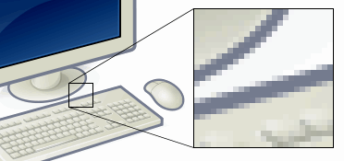
Pixel → Taxel
Pixel
Taxel
The smallest unit of a digital image. Millions of them form what you see on a screen.
The smallest unit of a tactile image. Hundreds of them form what a skin feels.
one taxel transduces pressure / normal force / shear into an electrical signal.
04

Slide 6
What is a taxel?
DEFINITION
RESOLUTION
A taxel (tactile pixel) is a single sensing element that measures contact pressure or force at one point on a tactile sensor. A grid of taxels produces a tactile image.
[ taxels / cm² ]
SENSING RANGE
[ force range ]
SAMPLING RATE
[ Hz ]
[ Add one line on why it matters for robots: grip stability, slip detection, force control. ]
05

Slide 7
02
What Does a Taxel Sensor Feel Like?
Pacini DEXH13, a live bottle demo, and the app that shows the heatmap.

Slide 8
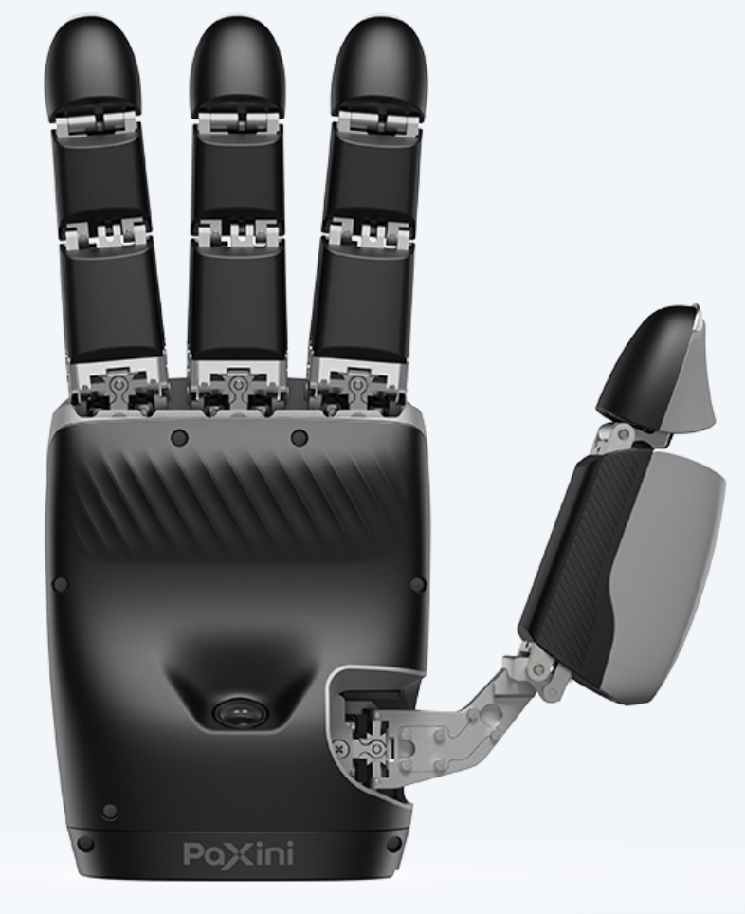
Contact-Level Sensor Example:
Pacini DEXH13
TAXELS
PATCH TYPES
1,140
5
07

Slide 9
Demo: Holding a Bottle
with or without tactile?
Seeing Touch: The Upper App
Close the Loop: Gesture Teleoperation
08

Slide 10
Seeing Touch: The Upper App
Open the upper application here — observe the pressure heatmap.
WHAT YOU SEE
Live pressure field across every patch
Intensity mapped to color (blue → red)
Spot where force concentrates, where it slips
[ heatmap UI screenshot ]
[ To fill: which metric / patch is highlighted during the demo. ]
09

Slide 11
Close the Loop: Gesture Teleoperation
Switch to the teleoperation demo here.
Hand gesture
operator input
Robot grip
follows the hand
Tactile feedback
taxels close the loop
[ To fill: the interaction shown — what gesture, what object, and what the operator feels from the heatmap. ]
[ Placeholder for demo sequence / screenshots. ]
10

Slide 12
03
Taxel Simulation
Why simulate touch before touching real hardware?

Slide 13
Why Robots Need Simulation
Real hardware is slow, fragile, and expensive. Touch is no exception.
Safety
[ To fill: test aggressive grasps and failure cases without damaging fingers or objects. ]
Cost & scale
[ To fill: thousands of trials in parallel, no wear on real sensors. ]
Repeatability
[ To fill: identical initial conditions every run; controlled contact geometry. ]
Data & learning
[ To fill: generate labeled tactile data for policies / models before transfer to real robots. ]
12

Slide 14
Tactile Simulation: MuJoCo & Beyond
How do you turn a physics engine into a skin?
MUJOCO
OTHER SIMULATORS / TOOLS
Collision geometry as a taxel grid
Contact force → per-taxel signal
Runs inside the physics step
[ to fill — e.g. Gazebo / Isaac / custom ]
[ to fill — strengths & gaps vs. MuJoCo ]
[ to fill — sim-to-real gap ]
TO FILL
[ Live demo: open MuJoCo / simulator here — show a taxel grid responding to contact. ]
13

Slide 15
Wrap-up
01 A taxel is the pixel of touch — one point of pressure.
02 DEXH-13 turns that touch into a live heatmap and a closed loop.
03 Simulation lets us design touch safely, at scale, before the real hand.
Questions?
[ Your contact / lab info ]

