Slide 1
01 / SYSTEM VIEW
A closed-loop VR teleoperation stack
One control loop connects tracked human motion, constrained planning, robot execution, and visual feedback.
INPUT LAYER
CONTROL LAYER
EXECUTION LAYER
Quest / WebXR
Control PC
Robot & hand
25-joint hand tracking
QuestBimanual + clutch mapping
Diana SDK servoJ_ex
Wrist pose + grip / buttons
Mink IK + safety constraints
DexH13 native bridge
HTTPS + WSS over LAN
200 ms watchdog + state machine
Position / Cartesian impedance
FEEDBACK LOOP
JPEG / WebRTC camera stream
Robot state + diagnostics
VR status + safety color
The same front end drives MuJoCo simulation or selected real hardware.
DEXMAN_LEROBOT / VR TELEOPERATION SYSTEM
01 / 10
Notes:
This first slide shows the closed loop at a glance. The Quest browser is the sensing and interaction surface: it provides WebXR hand tracking, wrist pose, grip state, and control buttons. Those packets travel over secure WebSockets to the relay and then to one control owner on the computer. The control owner performs relative clutch mapping, Mink planning, watchdog checks, and state transitions. From there, the same front end can drive MuJoCo for simulation or the real Diana arms and DexH13 hands. Camera and robot state return to the Quest as a separate feedback path. A key architectural boundary is that this runtime does not depend on ROS; it uses the Diana Python SDK, native hand bridges, and direct USB camera access.

Slide 2
02 / VR DATA PATH
WebXR turns the operator into a time-stamped control source
Tracking is validated, transformed into the robot frame, then consumed by one control owner.
CONTROL PACKET
VALIDATE
TRANSFORM
CONSUME
Pose
1
2
3
wrist xyz + quaternion
Freshness
25 named joints / hand
Coordinate frame
Relative clutch
Tracking flag
OpenXR wrist → DexH13 palm
Capture reference
Finite pose
Quest local floor → Robot base_link
Follow incrementally
Intent
Known buttons
left/right grip = clutch
Release → re-anchor
A / B / X / Y = state events
Latency > 200 ms
Shared calibration
No absolute pose
Latched stop
Transport
WSS /ws → relay → control loop
packet age measured on control PC
Video returns independently: JPEG fallback, WebRTC when explicitly enabled.
DEXMAN_LEROBOT / VR TELEOPERATION SYSTEM
02 / 10
Notes:
The VR packet has three kinds of information. First is pose: the wrist position and quaternion plus the 25 named WebXR hand joints. Second is operator intent: grip is a clutch for relative following, while A, B, X, and Y are state events. Third is freshness: the control computer measures the age of the newest packet on its own monotonic clock. Before a packet is consumed, the system checks tracking validity, finite values, and the known button set. The wrist is converted from the OpenXR convention into the DexH13 palm frame, and the Quest local-floor axes are mapped into the robot base frame using shared calibration. The arm command is relative, so releasing grip freezes the arm and discards the reference instead of leaving an old target active.

Slide 3

03 / CONSTRAINED PLANNING
Mink is the safety envelope around every commanded motion
The planner solves the task, then accepts only a legal, smooth, model-checked step.
RELATIVE FOLLOWING
EE SOLVE
NULL SPACE
VERIFY
SEND / HOLD
$$T_{cmd}^{ee}=T_{ref}^{ee}⋅{\left(T_{ref}^{vr}\right)}^{−1}⋅T_{now}^{vr}$$
1 Task + limits
2 Strict null-space
SMOOTHING
Mink FrameTask
Elbow ceiling 0.563 m
Lead-in
URDF joint ranges
Joint 1 / 3 / 4 → Home
full rate ≤ 2 cm / 5°
Main Task
dynamic dt: 5–50 ms
Escape only when stuck
Ramp
Palm / TCP tracking
soft slowdown zone
Null-space constrain
3 Collision envelope
4 Exact FK shaping
Stop
Elbow + home bias
Arm: 5 cm hard / 8 cm detect
0.50 m/s, 90°/s follow
zero at hard bound
Output
Hand collision avaoid: 0 cm
4 cm / 8° hard re-anchor
Home
Joint command or freeze
Hand decelerate: 3 cm
Freeze measured q on failure
direct joint interpolation
Release clutch → freeze + clear reference
DEXMAN_LEROBOT / VR TELEOPERATION SYSTEM
03 / 10
Notes:
Mink provides the constrained motion layer. The target is a relative end-effector transform, while joint limits, collision distances, and the current robot state remain constraints. The main task follows the palm or TCP. A strict null-space term can bias elbow height and joints one, three, and four toward the current Home pose, but it is only used when the arm is being followed and the configuration is sufficiently manipulable. If the solve fails or the arm becomes too close to a singularity, the safe result is the measured joint state. Motion is shaped using exact forward kinematics: normal following is capped at 0.50 meters per second and 90 degrees per second. The planner also uses a 4-centimeter and 8-degree command lead boundary for re-anchoring. Collision distances are asymmetric by design: arms keep a 5-centimeter hard minimum with an 8-centimeter detection zone, while the hand can touch the table but cannot penetrate it.

Slide 4
04 / DEXTEROUS HAND CONTROL
Retargeting preserves intent while respecting the DexH13 actuator model
The hand pipeline is separate from arm IK, but shares the same tracked wrist and safety state.
1
2
3
4
5
WebXR
Palm frame
DexPilot
DexH13
Bridge
25 joints + wrist pose
OpenXR → DexH13 axes
MediaPipe-21
16 logical
native owner
optimization
13 active
Move and hold
RETARGETING RULES
Wrist orientation is expressed in the palm-local frame before DexPilot.
Index / middle / ring joint4 are passive observations; the bridge fills them from the latest measured values.
Valid tracking is required before targets are sent; missing wrist orientation means no target.
Watchdog behavior: no fresh command → stop using old targets; fault recovery never auto-enables or auto-resumes.
DEXMAN_LEROBOT / VR TELEOPERATION SYSTEM
04 / 10
Notes:
The dexterous hand pipeline starts from the same WebXR skeleton, but it is a distinct retargeting path. The wrist orientation first defines the DexH13 palm-local frame. The 25 WebXR joints are arranged into the MediaPipe-style target ordering used by DexPilot, which solves for the 13 active actuator angles. The SDK still exposes 16 logical angles because index, middle, and ring joint four are passive observations. Those values are taken from the latest measurement when a command is built; they are never treated as independent targets. The native bridge owns the serial device, keeps a HOLD heartbeat, and refuses stale command reuse. Valid tracking and a valid wrist orientation are prerequisites for sending a new hand target.

Slide 5
05 / EXECUTION & SAFETY
Impedance control is a mode inside a fail-closed state machine
The operator can move the system only after explicit readiness, authorization, and fresh communication.
READY GATES
ARM EXECUTION
NON-NEGOTIABLES
POSITION
PREPARE
200 ms
packet age → latch violation
servoJ_ex • ah_t 0.05 • gain 150
fresh hand + arm state
AUTHORIZE
X
software soft stop
CARTESIAN IMPEDANCE
computer + VR ready
set once per mode switch
Y
full controller recovery unlocks
FOLLOW
Mode switch
grip held, target fresh
Grip / B
stop refresh; clear reference
stop servo → change mode → resume
LATCHED STOP
X / watchdog / SDK fault
Collision
controller + model checks stay on
Normal follow
servo horizon = max(40 ms, planning dt)
Safety is layered: model constraints, watchdogs, controller collision detection, explicit recovery, and a reachable physical emergency stop.
DEXMAN_LEROBOT / VR TELEOPERATION SYSTEM
05 / 10
Notes:
The final slide covers execution semantics. The arms can run in position mode or Cartesian impedance mode. A mode switch stops the current servo stream, changes mode once, and then resumes with the approved command timing. During normal following, servoJ_ex uses a horizon of at least 40 milliseconds and no more than the 50-millisecond planning window. Movement also requires explicit readiness: selected devices must be healthy, communication must be fresh, and the computer and VR operator must authorize the task. X latches a software stop. A communication violation, SDK failure, or controller collision keeps the system stopped. Y does not simply clear a software flag; it performs the complete hardware recovery chain before unlocking. Releasing grip or B stops refreshing commands and clears the old reference. These layers complement, but never replace, the physical emergency stop and Diana controller collision detection.

Slide 6
06 / WHY TACTILE ANALYSIS
Tactile sensing makes contact behavior measurable
Recorded tactile signals add evidence about the hand–object interaction during teleoperation.
UNDERSTAND INTERACTIONS
IMPROVE EXPERIMENTS
PREPARE LEARNING DATA
When and where does
the signal change?
Can we trust
the recording?
What can become
a useful training signal?
Inspect response intervals, peaks,
and the distribution across taxels.
Check masks, packet status, timing,
zero / repeated values, and temperature.
Use quality reports to review samples
and compare repeated trials.
After validation
Practical value
After calibration
Relate measured force and pressure
to contact phases in a task.
Find questionable intervals and
plan controlled follow-up measurements.
Build traceable force / area / pressure
targets for later learning experiments.
Current module: offline analysis. Using tactile feedback in control is a separate future integration.
DEXMAN_LEROBOT / VR TELEOPERATION SYSTEM
06 / 10

Slide 7
07 / DATA & VALIDITY
Check data validity before interpreting the signal
One hand provides 1,140 signed three-axis taxels per frame, plus 11 SDK summary vectors.
WHAT IS RECORDED
ACTUAL RECORDING / 2026-10-21
taxel_raw
[N, 1140, 3] int32
407 / 408
~8.75 Hz
Signed SDK x / y / z counts; no normalization.
frames, left / right
host sampling rate
sensor_summary_raw
[N, 11, 3] int32
Separate SDK summaries; not a verified taxel sum.
100%
0 / 1140
Validity fields
mask + packet + sample
packet_valid, both hands
verified taxels, both hands
Nonzero values alone do not establish valid contact.
Time + temperature
host ns + events.jsonl
Each hand keeps its own time; row numbers do not sync.
sample_valid = false for every frame
Raw diagnostics are possible; verified physical contact is not established.
Keep signed raw values and original timestamps. HDF5 conversion does not add calibration or synchronize streams.
DEXMAN_LEROBOT / VR TELEOPERATION SYSTEM
07 / 10

Slide 8
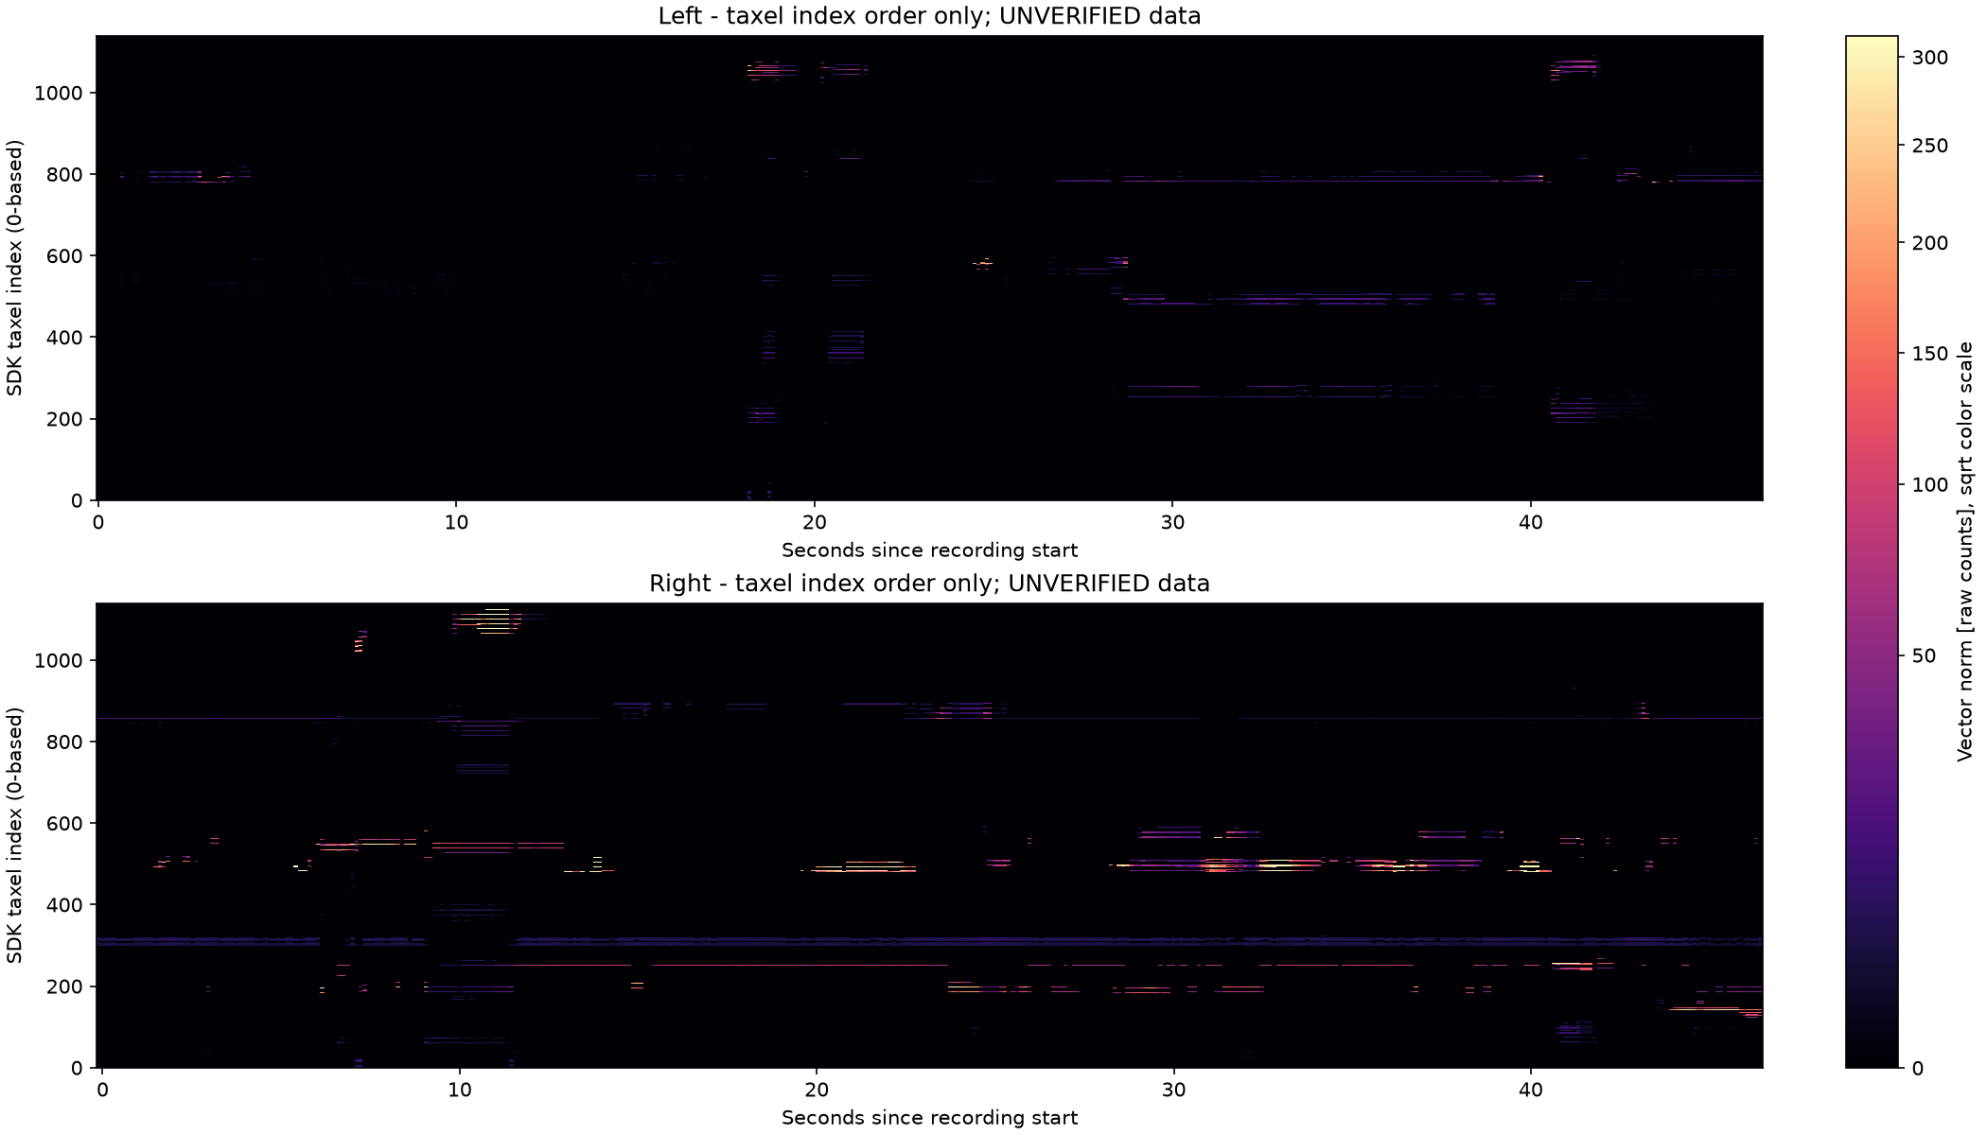
08 / ANALYSIS ATTRIBUTES
Analyze signal strength, distribution, and timing
Start with raw diagnostics; compare thresholds and inspect the plots before drawing task-level conclusions.
ACTUAL DATA / UNVERIFIED RAW SIGNAL
01 AMPLITUDE
Signed x/y/z; q = sqrt(x² + y² + z²).
Peaks, means, and thresholded magnitude sums.
02 RESPONSE OVER TIME
Above-threshold counts, approximate duration,
and raw·s integral; compare threshold 10 vs 20.
03 DISTRIBUTION
Time × SDK-index heatmap; per-taxel mean / max.
A spatial hand map needs a verified point layout.
04 CONTEXT & QUALITY
11 SDK summaries, sensor temperatures,
frame intervals, and host query latency.
Heatmap: host time on x; SDK taxel index on y; shared raw-magnitude color scale with square-root mapping.
Above-threshold count is not contact area. A raw magnitude sum is not a calibrated force or pressure.
DEXMAN_LEROBOT / VR TELEOPERATION SYSTEM
08 / 10

Slide 9
09 / AREA & PRESSURE
Contact area and pressure require measured calibration
Physical analysis is implemented, but the current all-false-mask recording cannot produce valid physical results.
1 / CALIBRATE FORCE
2 / ESTIMATE AREA
3 / COMPUTE PRESSURE
F_i = M_i (raw_i − bias_i)
Contact: valid i AND Fn_i ≥ τ
p_i = Fn_i / A_i × 10⁶
Fn_i = max(F_i · n_i, 0)
A = Σ A_i (i in contact)
Mean p = Σ Fn_i / A × 10⁶
Measured matrix + unloaded bias.
Unit surface normal in the force frame;
positive projection means compression.
Apply source + calibration masks, plus
packet_valid and sample_valid.
τ is a normal-force threshold in N;
each contact taxel adds its full area.
Sum over selected contact taxels only.
Areas are in mm²; pressures are in Pa.
Mean pressure is area weighted.
Divide Pa by 1,000 to report kPa.
Output: normal force in N
Output: discrete area in mm²
Output: mean / peak pressure
BEFORE REAL MEASUREMENTS
Verify taxels, unloaded bias, force calibration, compressive normals, and taxel areas separately for each hand.
Practice first with the README synthetic demo (§8). Its toy calibration must not be applied to the real recording.
DEXMAN_LEROBOT / VR TELEOPERATION SYSTEM
09 / 10

Slide 10
10 / REPOSITORY PRACTICE
Start with the ZIP, then follow the README exercises
Use the command-line workflow in lab3/tactile_analysis. A ZIP can be analyzed directly; HDF5 is optional.
RUN FROM THE REPOSITORY ROOT
YOUR TASKS
cd lab3/tactile_analysis
python examples/analyze_recording.py \
"teleop_20261021T090120_798e4203.zip" \
--trial all --allow-unverified \
--contact-threshold 10 \
--output-dir analysis_out/course_t10
1
Inspect validity and sampling quality
README §3: --list-trials
2
Read plots + JSON / CSV reports
README §§5–6: compare 10 vs 20
3
Run the synthetic area / pressure demo
README §§7–9: formulas + calibration
After installing dependencies and activating the environment (README §2).
Replace the ZIP path if needed; choose a new output directory for each run.
CONTINUE IN THE README
lab3/tactile_analysis/README.md (Chinese) | README.en.md (English)
DEXMAN_LEROBOT / VR TELEOPERATION SYSTEM
10 / 10

