Slide 1


A Simpler Approach to Obtaining O(1/t) Convergence Rate for the Projected Stochastic Subgradient Method
Presenters:
Ramanjaneyulu Lavanuru (拉曼杰)
National Yang Ming Chiao Tung University, Taiwan.
Ying-Tu Chen (陳盈圖) National Yang Ming Chiao Tung University, Taiwan.
Date: 12-28-2022
Optimization Algorithms

Slide 2
Outline of the Presentation
Introduction
Motivation
Convergence Analysis
Classical Analysis
New Analysis
Experiments
Discussion
Optimization Algorithms

Slide 3

Abstract
In this note, we present a new averaging technique for the projected stochastic subgradient method. By using a weighted average with a weight of $t+1$ for each iterate $w_{t}$ at iteration $t$, we obtain the convergence rate of $Ο(1/t)$with both an easy proof and an easy implementation. The new scheme is compared empirically to existing techniques, with similar performance behavior.
Optimization Algorithms

Slide 4
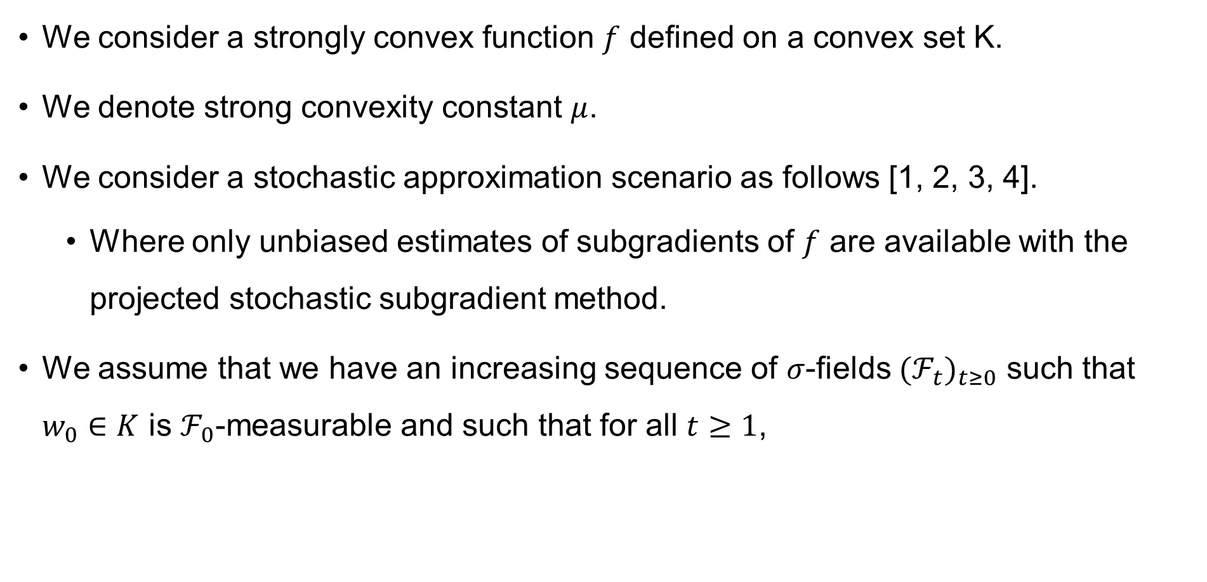
Introduction
We consider a strongly convex function $f$ defined on a convex set K.
We denote strong convexity constant $μ$.
We consider a stochastic approximation scenario as follows [1, 2, 3, 4].
Where only unbiased estimates of subgradients of $f$ are available with the projected stochastic subgradient method.
We assume that we have an increasing sequence of $σ$-fields ${(ℱ_{t})}_{t≥0}$ such that $w_{0}∈K$ is $ℱ_{0}$-measurable and such that for all $t≥1$,
Optimization Algorithms

Slide 5
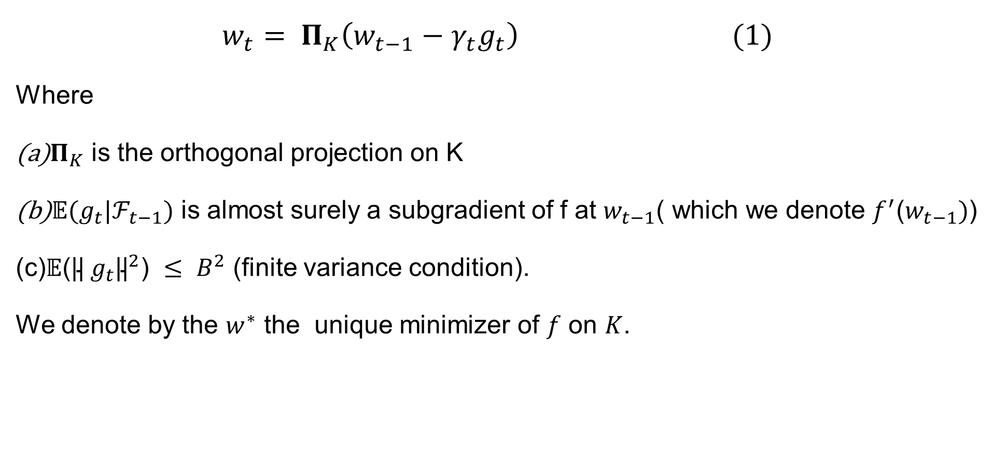
Introduction
$$w_{t}= Π_{K}\left(w_{t−1}−γ_{t}g_{t}\right) (1)$$
Where
$Π_{K}$ is the orthogonal projection on K
$𝔼(g_{t}|ℱ_{t−1})$ is almost surely a subgradient of f at $w_{t−1}$( which we denote $f^{′}$($w_{t−1})$)
𝔼(${\text{||} g_{t}\text{||}}^{2}$) $≤ B^{2}$ (finite variance condition).
We denote by the $w^{∗}$ the unique minimizer of $f$ on $K$.
Optimization Algorithms

Slide 6
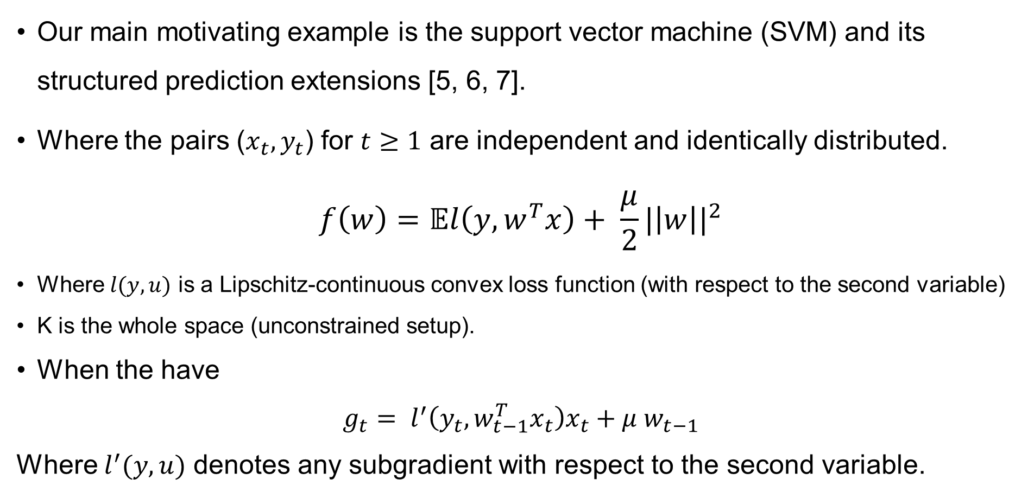
Motivation
Our main motivating example is the support vector machine (SVM) and its structured prediction extensions [5, 6, 7].
Where the pairs ($x_{t},y_{t}$) for $t≥1$ are independent and identically distributed.
$$f\left(w\right)=𝔼l\left(y,w^{T}x\right)+ \frac{μ}{2}{|\left|w\right||}^{2}$$
Where $l(y,u)$ is a Lipschitz-continuous convex loss function (with respect to the second variable)
K is the whole space (unconstrained setup).
When the have
$g_{t}= l^{′}\left(y_{t}, w_{t−1}^{T}x_{t}\right)x_{t}+μ$ $w_{t−1}$
Where $l^{′}(y,u)$ denotes any subgradient with respect to the second variable.
Optimization Algorithms

Slide 7
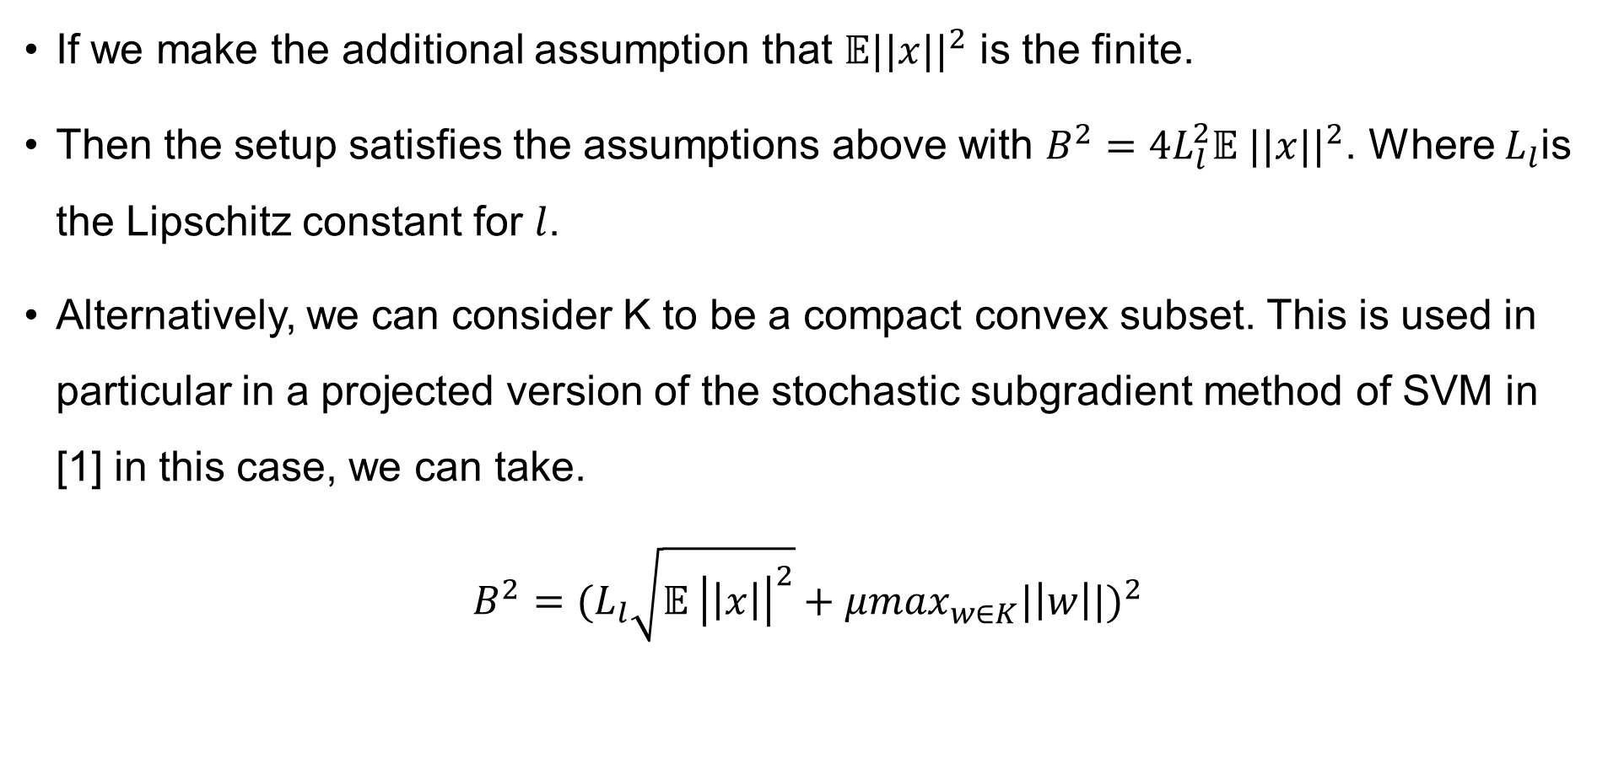
Motivation
If we make the additional assumption that 𝔼${||x||}^{2}$ is the finite.
Then the setup satisfies the assumptions above with $B^{2}=4L_{l}^{2}𝔼$ ${||x||}^{2}$. Where $L_{l}$is the Lipschitz constant for $l$.
Alternatively, we can consider K to be a compact convex subset. This is used in particular in a projected version of the stochastic subgradient method of SVM in [1] in this case, we can take.
$$B^{2}={(L_{l}\sqrt{𝔼 {\left|\left|x\right|\right|}^{2}}+μ\max_{w∈K}^{}|\left|w\right||)}^{2}$$
Optimization Algorithms

Slide 8
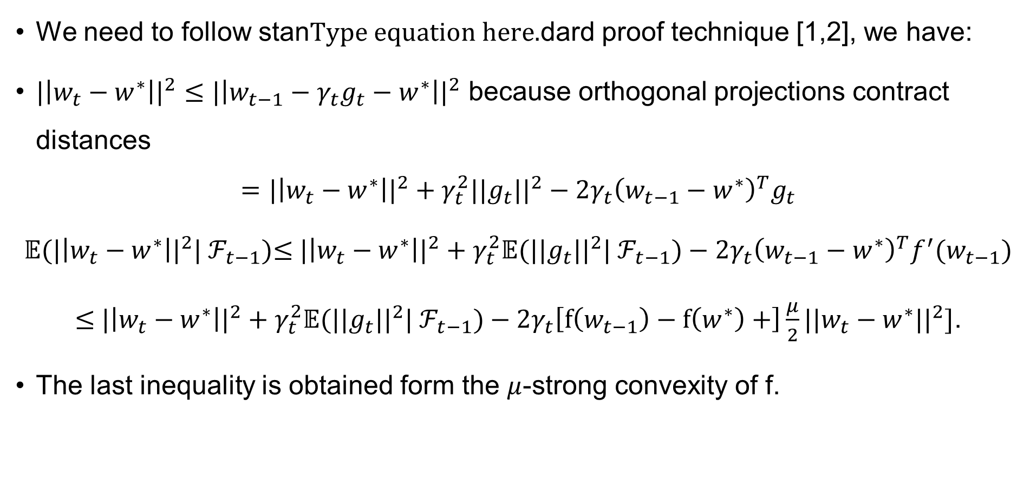
Convergence Analysis
We need to follow standard proof technique [1,2], we have:
${|\left|w_{t}−w^{∗}\right||}^{2}≤{|\left|w_{t−1}−{γ_{t}g_{t}−w}^{∗}\right||}^{2}$ because orthogonal projections contract distances
$$={|\left|w_{t}−w^{∗}\right||}^{2}+γ_{t}^{2}{{||g}_{t}||}^{2}−2γ_{t}{\left(w_{t−1}−w^{∗}\right)}^{T}g_{t}$$
𝔼(${|\left|w_{t}−w^{∗}\right||}^{2}$| $ℱ_{t−1}$)$≤$ ${|\left|w_{t}−w^{∗}\right||}^{2}+$ $γ_{t}^{2}$𝔼(${{||g}_{t}||}^{2}$| $ℱ_{t−1})−2γ_{t}{\left(w_{t−1}−w^{∗}\right)}^{T}f^{′}(w_{t−1})$
$≤$ ${|\left|w_{t}−w^{∗}\right||}^{2}+$ $γ_{t}^{2}$𝔼(${{||g}_{t}||}^{2}$| $ℱ_{t−1})−$ $2γ_{t}\left[f\left(w_{t−1}\right)−f\left(w^{∗}\right)+\right]\frac{μ}{2}{||w_{t}−w^{∗}||}^{2}]$.
The last inequality is obtained form the $μ$-strong convexity of f.
Optimization Algorithms

Slide 9
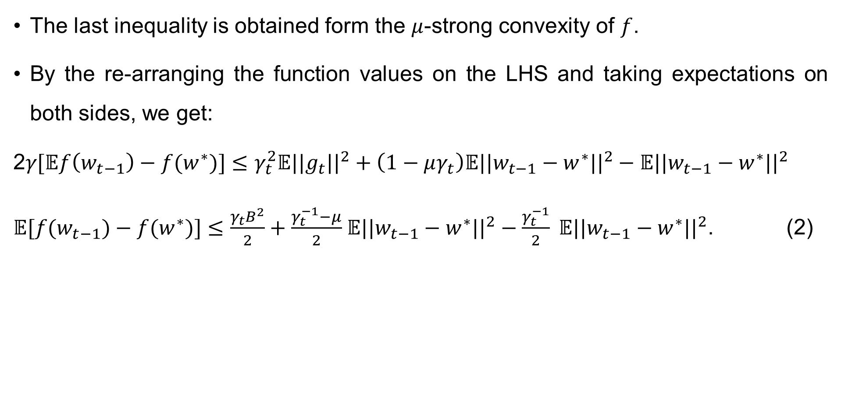
Convergence Analysis
The last inequality is obtained form the $μ$-strong convexity of $f$.
By the re-arranging the function values on the LHS and taking expectations on both sides, we get:
2𝛾[𝔼$f\left(w_{t−1}\right)−f(w^{∗})]≤γ_{t}^{2}$𝔼${||g_{t}||}^{2}+\left(1−μγ_{t}\right)\text{𝔼}{||w_{t−1}−w^{∗}||}^{2}−\text{𝔼}{||w_{t−1}−w^{∗}||}^{2}$
𝔼$[f(w_{t−1})−f(w^{∗})]≤\frac{γ_{t}B^{2}}{2}+\frac{γ_{t}^{−1}−μ}{2}$ $\text{𝔼}{||w_{t−1}−w^{∗}||}^{2}−\frac{γ_{t}^{−1}}{2} \text{𝔼}{||w_{t−1}−w^{∗}||}^{2}$. (2)
Optimization Algorithms

Slide 10
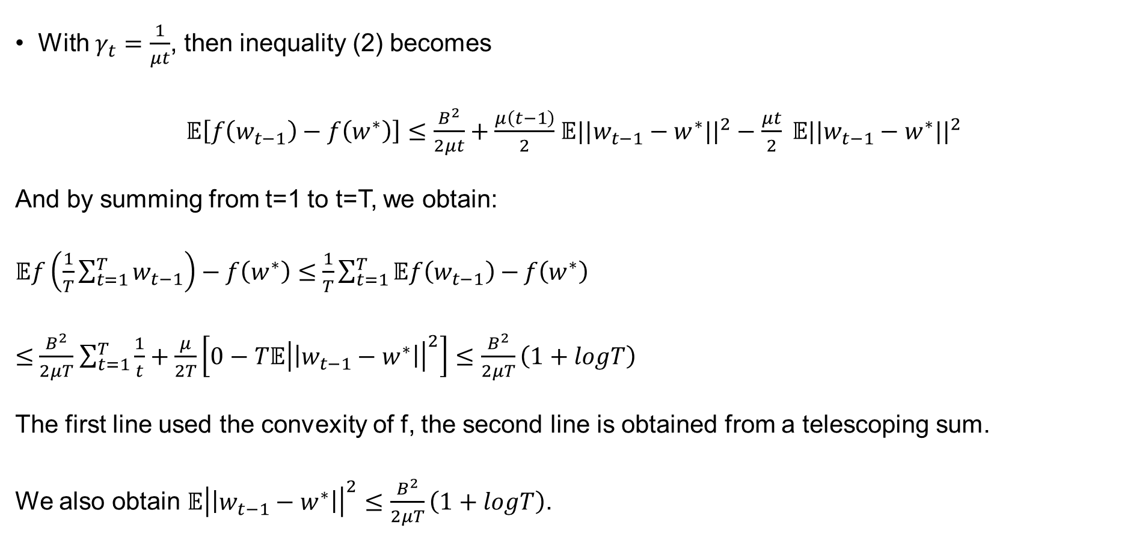
Classical Analysis
With $γ_{t}=\frac{1}{μt}$, then inequality (2) becomes
𝔼$\left[f\left(w_{t−1}\right)−f\left(w^{∗}\right)\right]≤\frac{B^{2}}{2μt}+\frac{μ\left(t−1\right)}{2}$ $\text{𝔼}{||w_{t−1}−w^{∗}||}^{2}−\frac{μt}{2} \text{𝔼}{||w_{t−1}−w^{∗}||}^{2}$
And by summing from t=1 to t=T, we obtain:
𝔼$f\left(\frac{1}{T}\sum_{t=1}^{T}{w_{t−1}}\right)−f\left(w^{∗}\right)≤$ $\frac{1}{T}\sum_{t=1}^{T}{𝔼f\left(w_{t−1}\right)−}f\left(w^{∗}\right)$
$≤$ $\frac{B^{2}}{2μT}$ $\sum_{t=1}^{T}{\frac{1}{t}}+\frac{μ}{2T}\left[0−T\text{𝔼}{\left|\left|w_{t−1}−w^{∗}\right|\right|}^{2}\right]≤\frac{B^{2}}{2μT}\left(1+logT\right)$
The first line used the convexity of f, the second line is obtained from a telescoping sum.
We also obtain $\text{𝔼}{\left|\left|w_{t−1}−w^{∗}\right|\right|}^{2}≤\frac{B^{2}}{2μT}\left(1+logT\right)$.
Optimization Algorithms

Slide 11
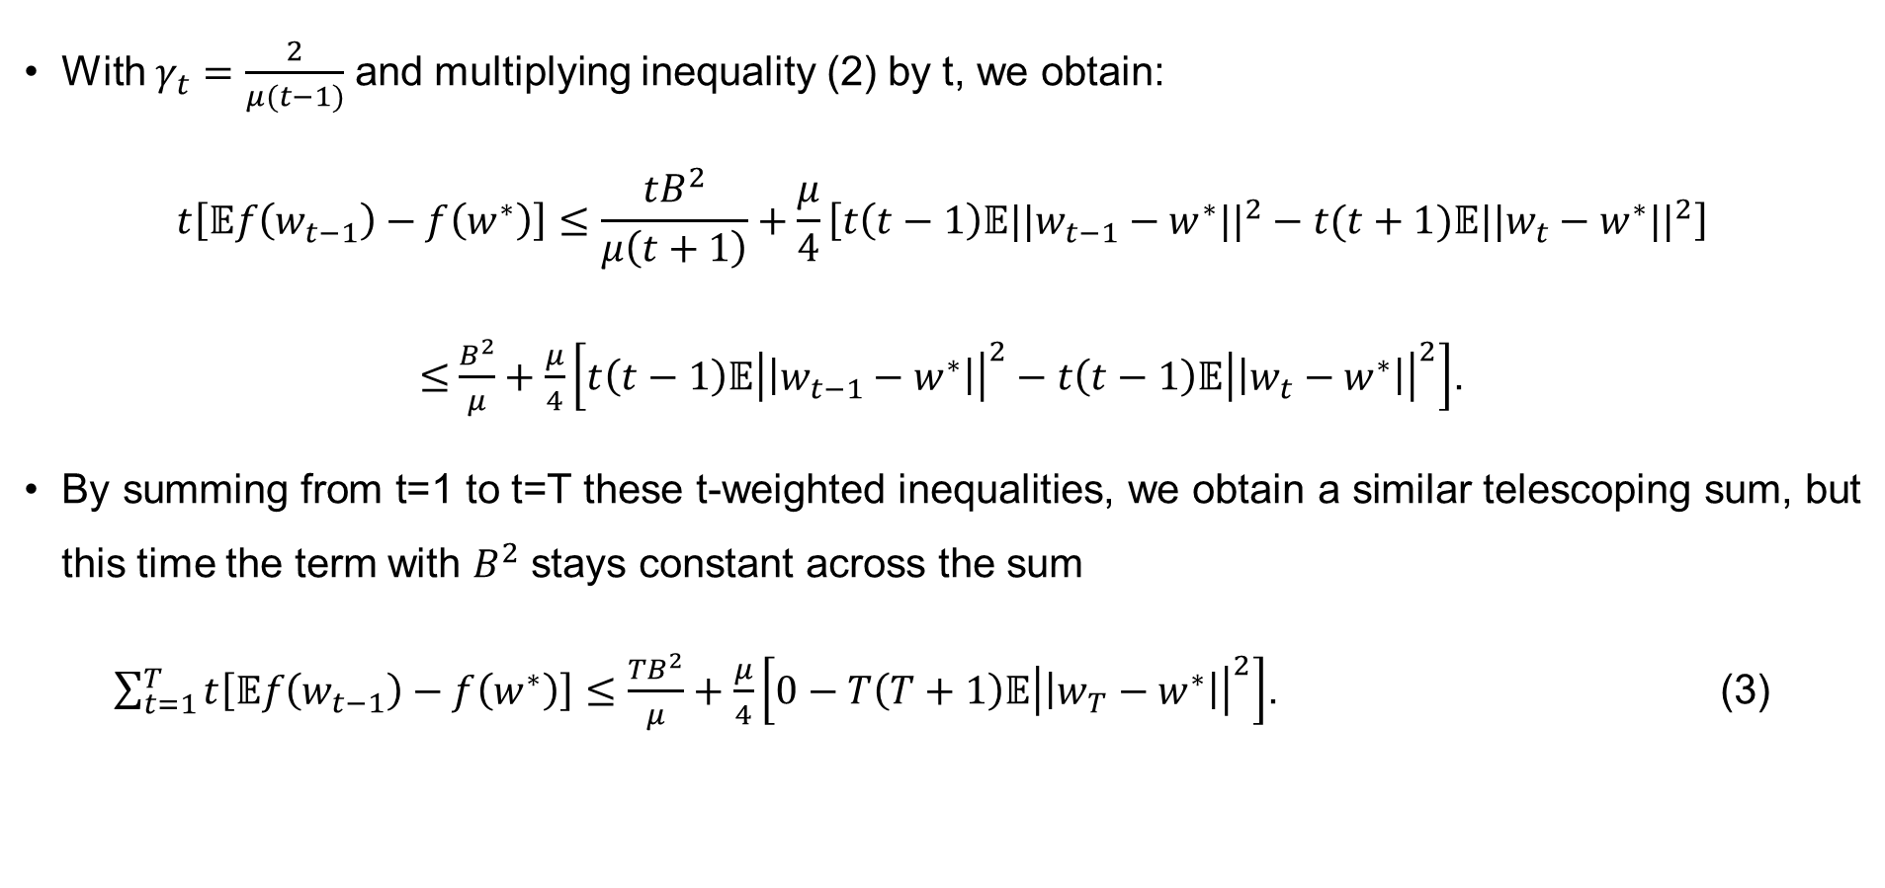
New Analysis
With $γ_{t}=\frac{2}{μ(t−1)}$ and multiplying inequality (2) by t, we obtain:
$$t\left[𝔼f\left(w_{t−1}\right)−f\left(w^{∗}\right)\right]≤\frac{tB^{2}}{μ\left(t+1\right)}+\frac{μ}{4}\left[t\left(t−1\right)\text{𝔼}{||w_{t−1}−w^{∗}||}^{2}−t(t+1)\text{𝔼}{||w_{t}−w^{∗}||}^{2}\right]$$
$≤$ $\frac{B^{2}}{μ}+\frac{μ}{4}\left[t\left(t−1\right)\text{𝔼}{\left|\left|w_{t−1}−w^{∗}\right|\right|}^{2}−t\left(t−1\right)\text{𝔼}{\left|\left|w_{t}−w^{∗}\right|\right|}^{2}\right]$.
By summing from t=1 to t=T these t-weighted inequalities, we obtain a similar telescoping sum, but this time the term with $B^{2}$ stays constant across the sum
$\sum_{t=1}^{T}{t\left[𝔼f\left(w_{t−1}\right)−f\left(w^{∗}\right)\right]}≤\frac{TB^{2}}{μ}+\frac{μ}{4}\left[0−T\left(T+1\right)\text{𝔼}{\left|\left|w_{T}−w^{∗}\right|\right|}^{2}\right]$. (3)
Optimization Algorithms

Slide 12

New Analysis
Thus
𝔼$f\left(\frac{2}{T\left(T+1\right)}\sum_{t=0}^{T−1}{\left(t+1\right)}w_{t}\right)−f\left(w^{∗}\right)+\frac{μ}{2}$ $\text{𝔼}{||w_{T}−w^{∗}||}^{2}≤\frac{2B^{2}}{μ(T+1)}$
Which implies
𝔼$f\left(\frac{2}{T\left(T+1\right)}\sum_{t=0}^{T−1}{\left(t+1\right)}w_{t}\right)−f\left(w^{∗}\right)$ $≤\frac{2B^{2}}{μ(T+1)}$
And
$\text{𝔼}{||w_{T}−w^{∗}||}^{2}≤\frac{4B^{2}}{μ^{2}(T+1)}$.
Optimization Algorithms

Slide 13
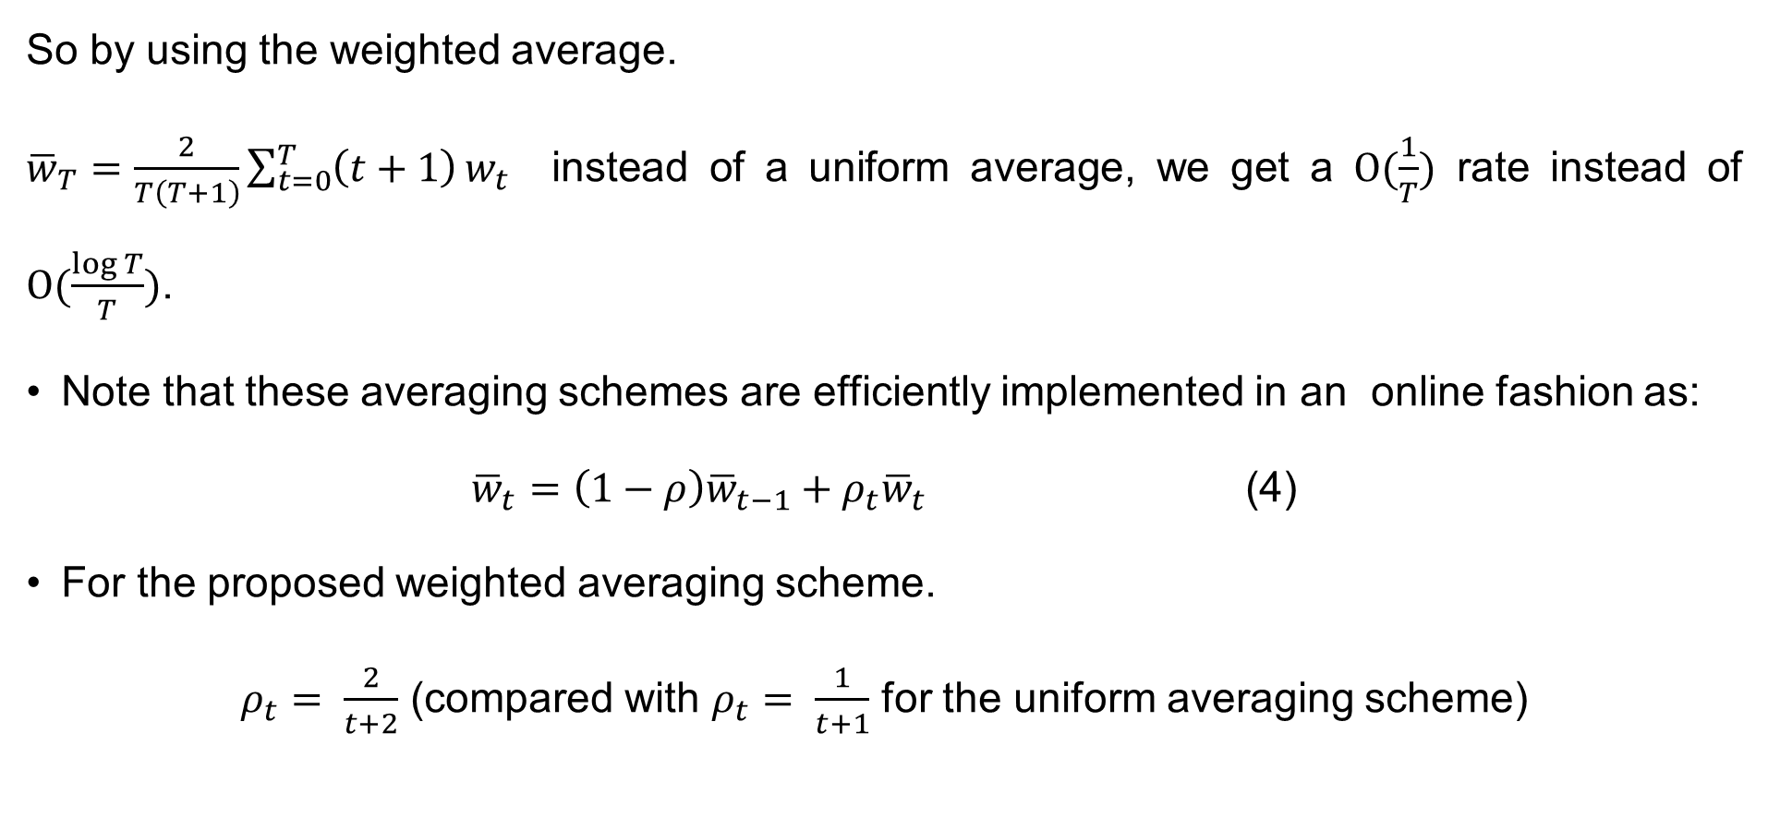
New Analysis
So by using the weighted average.
${\overline{w}}_{T}=\frac{2}{T\left(T+1\right)}\sum_{t=0}^{T}{\left(t+1\right)}w_{t}$ instead of a uniform average, we get a $Ο(\frac{1}{T})$ rate instead of $Ο(\frac{\log{T}}{T})$.
Note that these averaging schemes are efficiently implemented in an online fashion as:
${\overline{w}}_{t}=\left(1−ρ\right){\overline{w}}_{t−1}+$ $ρ_{t}{\overline{w}}_{t}$ (4)
For the proposed weighted averaging scheme.
$ρ_{t}= \frac{2}{t+2}$ (compared with $ρ_{t}= \frac{1}{t+1}$ for the uniform averaging scheme)
Optimization Algorithms

Slide 14
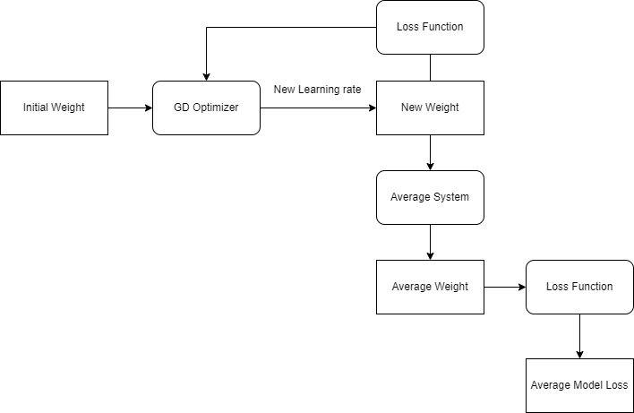
Experiment
The Architecture of the Model
Optimization Algorithms

Slide 15
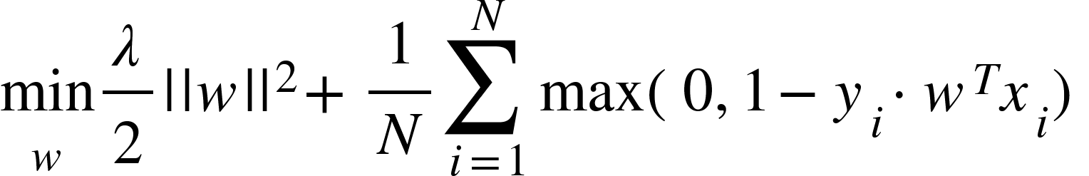
Experiment
Loss Function
Optimization Algorithms

Slide 16
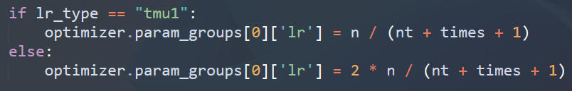

Experiment
Our Learning Rate type
$\frac{1}{μt}$
$\frac{2}{μ(t+1)}$
Optimization Algorithms

Slide 17
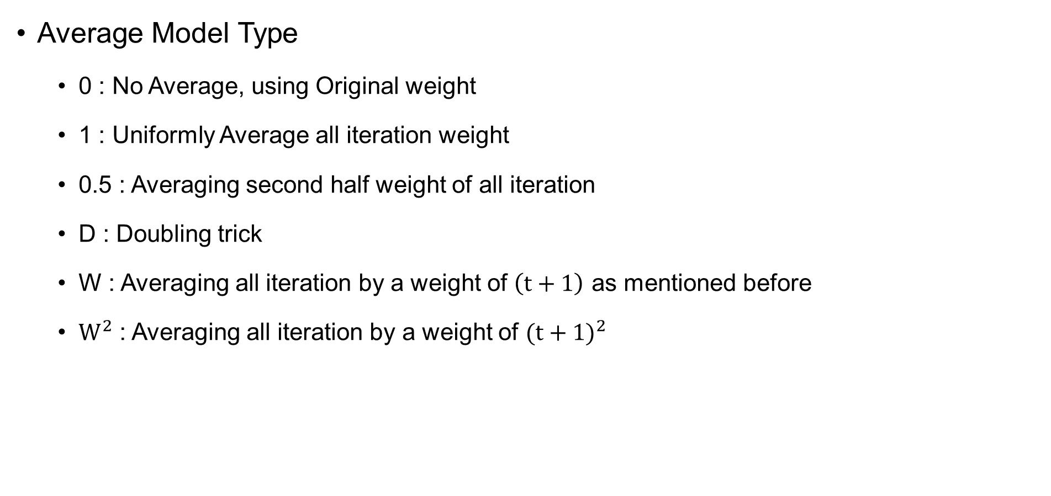
Experiment
Average Model Type
0 : No Average, using Original weight
1 : Uniformly Average all iteration weight
0.5 : Averaging second half weight of all iteration
D : Doubling trick
W : Averaging all iteration by a weight of $\left(t+1\right)$ as mentioned before
$W^{2}$ : Averaging all iteration by a weight of ${(t+1)}^{2}$
Optimization Algorithms

Slide 18
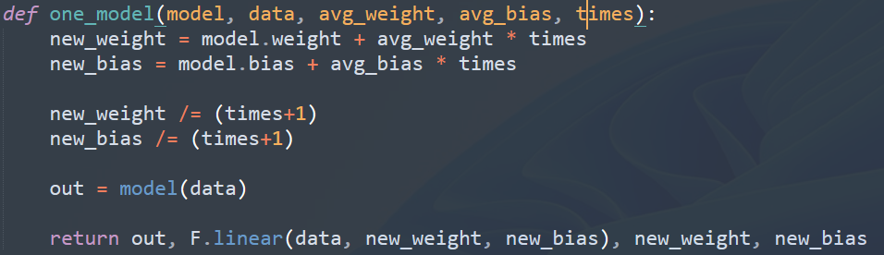
Experiment
The way to implement those Average in our model
1 :
Optimization Algorithms

Slide 19
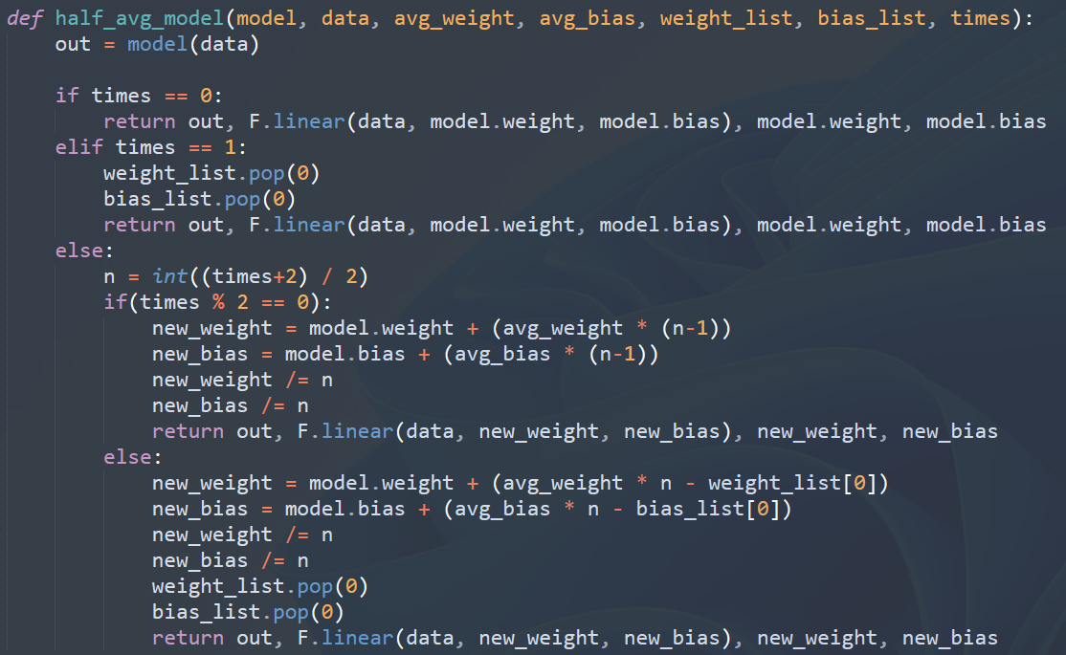
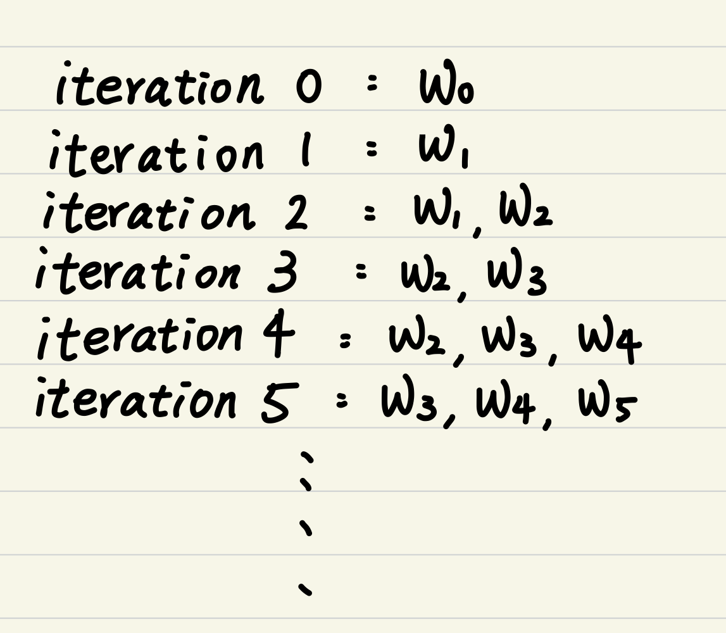
Experiment
The way to implement those Average in our model
0.5 :
Optimization Algorithms

Slide 20
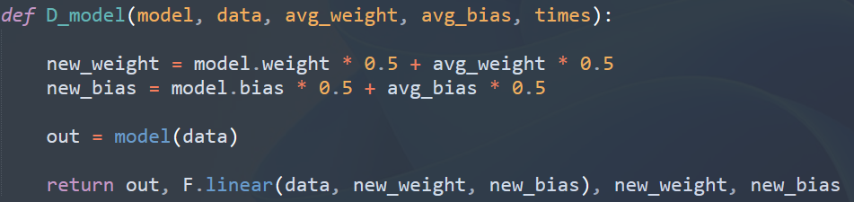
Experiment
The way to implement those Average in our model
D :
Optimization Algorithms

Slide 21
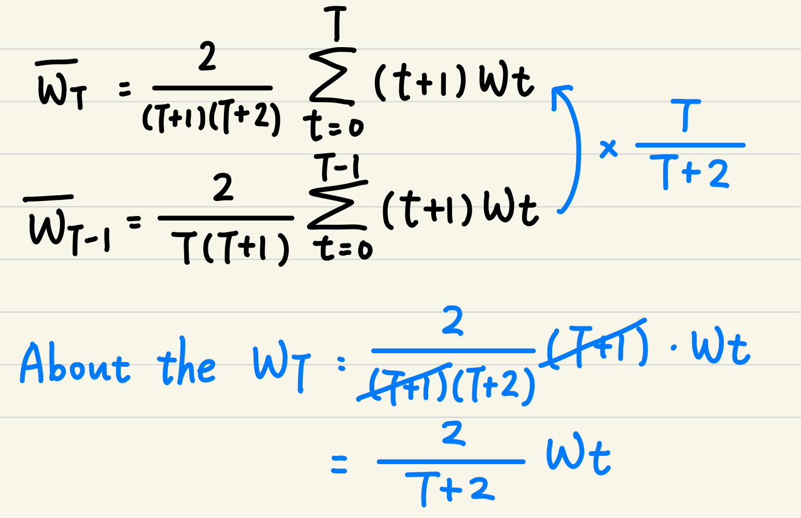

Experiment
The way to implement those Average in our model
W :
${\overline{w}}_{t}=\left(1−ρ\right){\overline{w}}_{t−1}+$ $ρ_{t}{\overline{w}}_{t}$ (4)
Optimization Algorithms

Slide 22
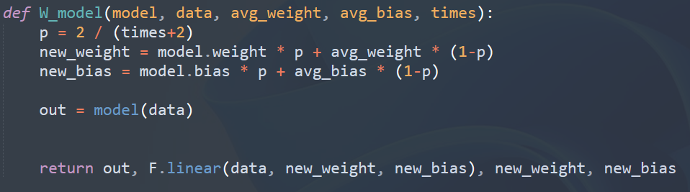
Experiment
The way to implement those Average in our model
W :
Optimization Algorithms

Slide 23
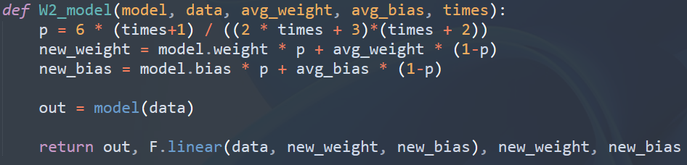

Experiment
The way to implement those Average in our model
$W^{2}$ :
Optimization Algorithms

Slide 24
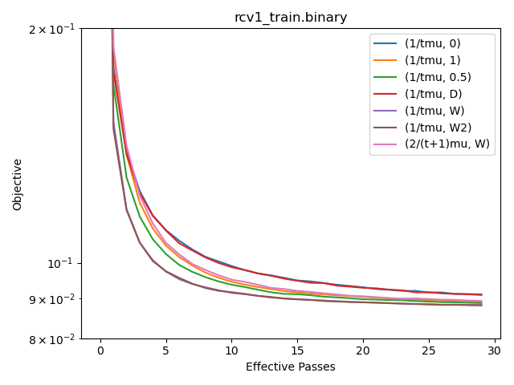
Experiment
Result
Optimization Algorithms

Slide 25
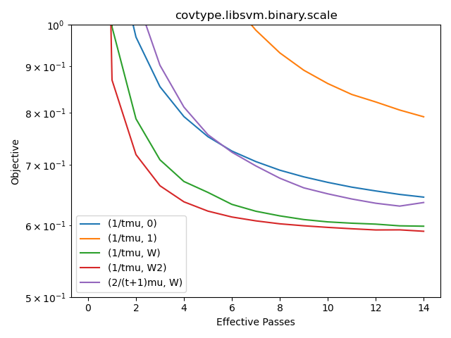
Experiment
Result
Optimization Algorithms

Slide 26

Discussion
The step size $\frac{1}{μt}$is better than $\frac{2}{μ(t+1)}$
It has proved that
0 and 1 have rate $O(\frac{logt}{t})$
0.5, D, W, $W^{2}$have rate $O(\frac{1}{t})$
On Strongly convex case, averaging with longer step sizes (i.e. $t^{−α} α∈(\frac{1}{2}, 1)$) leads to better rates
Optimization Algorithms

Slide 27
Thanks for Listening
Optimization Algorithms

