Slide 1

Google Summer of Code Rigorous support of Vertical Datums within OGRSpatialReference
Gottfried Mandlburger and Johannes Otepka
gm@ipf.tuwien.ac.at, jo@ipf.tuwien.ac.at
with contributions from:
Nicolas David: nicolas.david@ign.fr
IGN - Institut National de l'Information Géographique et Forestière

Slide 2
Spatial Referencing
OpenGIS® Implementation Specification: Coordinate Transformation Services
Available at: http://www.opengeospatial.org/standards/ct
Generic description of spatial reference systems
Known Text (WKT) representation
Horizontal systems (geographic and projected systems)
Reference spheroids (SPHERIOD)
Geodetic datum transformation (TOWGS84)
Map projections (PROJECTION)
Vertical systems
Vertical datum (VERT_DATUM)
Compound Systems (horizontal + vertical → 3D)
Implementations available:
GDAL/OGR library: Spatial reference classes (built upon PROJ4 library)
Existing problems
No standards for vertical transformations available
Different approaches for transition: national → global reference systems

Slide 3
Coordinate Transformation: Trans-national ←→ National via 7-P-Trafo
Trans-national sytem, ellipsoidal heights, (EU: ETRS89)
National sytem
Orthometric heights,
(AT: MGI)
UTM33
x, y, H
x‘, y‘, h
GK-M31
Geoid
GRS80
Φ, λ, H
Φ‘, λ‘, H‘
Bessel
ETRS89
X, Y, Z
7-Parameter-Trafo
X‘, Y‘, Z‘
MGI
Geodetic Datum Transition via Spatial Similarity Transformation
Homogeneous system
In-homogeneous historic system
x, y Map coordinates
h, H Orthometric/ellipsoidal height
Φ, λ geographic coordinates
X, Y, Z geocentric coordinates

Slide 4

Coordinate Transformation: Trans-national ←→ National via Grid Shifts
Trans-national sytem (EU: ETRS89)
National sytem (AT: MGI)
UTM33
x, y, H
x‘, y‘, h
GK-M31
Geoid
GRS80
Φ, λ, H
Φ‘, λ‘, H‘
Bessel
Grid shift Φ‘ = Φ + dΦ, λ‘ = λ + d λ
NTv2 (National Transformation v2) grid shifts
Developed in Canada
Adopted for USA, Australia, Germany (BeTA2007), Austria (GIS-Grid), ...
Became quasi-standard
Drawbacks
Not implemented as OGC Standard
Merges datum transition and inhomogeneities of national grids
Height information is lost
National height anomalies are not compensated (2D only)

Slide 5
OGC: Coordinate Transformation Services – Well Known Text Representation (example)
OpenGIS® Implementation Specification: Coordinate Transformation Services
http://www.opengeospatial.org/standards/ct
Well-Known Text Representation of Spatial Reference Systems
PROJCS["OSGB 1936 / British National Grid",
GEOGCS["OSGB 1936",
DATUM["OSGB_1936",
SPHEROID["Airy 1830",6377563.396,299.3249646, AUTHORITY["EPSG","7001"]],
TOWGS84[375,-111,431,0,0,0,0],
AUTHORITY[["EPSG","6277"]],
PRIMEM["Greenwich",0,AUTHORITY["EPSG","8901"]],
UNIT["DMSH",0.0174532925199433,AUTHORITY["EPSG","9108"]],
AXIS["Lat",NORTH],
AXIS["Long",EAST],
AUTHORITY[["EPSG","4277"]],
PROJECTION["Transverse_Mercator"],
PARAMETER["latitude_of_origin",49],
PARAMETER["central_meridian",-2],
PARAMETER["scale_factor",0.999601272],
PARAMETER["false_easting",400000],
PARAMETER["false_northing",-100000],
UNIT["metre",1,AUTHORITY["EPSG","9001"]],
AXIS["E",EAST],
AXIS["N",NORTH],
AUTHORITY[["EPSG","27700"]],
Quelle: http://www.opengeospatial.org/standards/ct

Slide 6
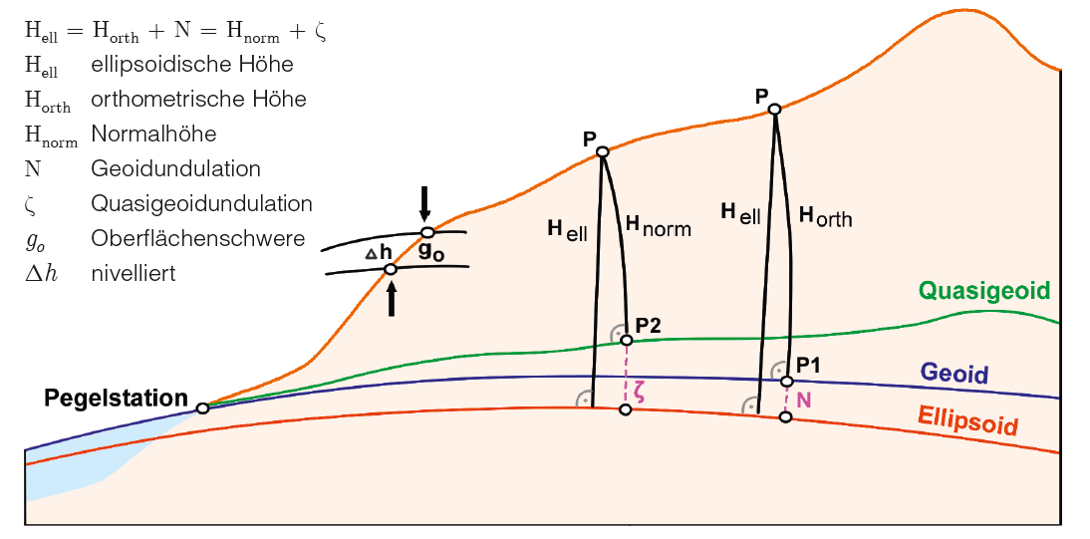
Height systems
Source: Briese et al., 2012: Transformation von GNSS-Höhen in österreichische
Gebrauchshöhen mittels einer Transformationsfläche (Höhen-Grid)

Slide 7
Height systems
Physical nature of heights (gravity field of the Earth)
geoid = aequi-potential surface in mean sea level
Height differences = potential difference
Geo-potential cote:

Slide 8
Height systems
Orthometric heights
Normal heights
Dynamic heights
Spherical heights
“Heights in use” (historically grown height systems, often in homogeneous)

Slide 9
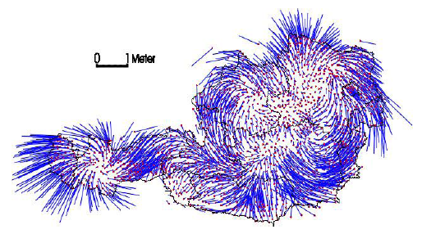
Inhomogenities of Austrian National Reference System (MGI)
0 1m 2m

Slide 10
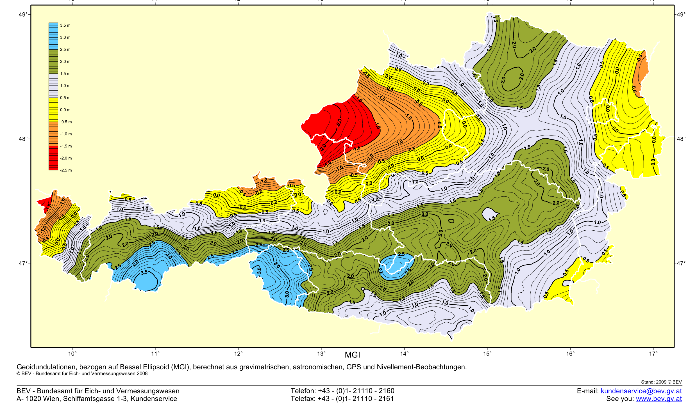
Austrian Federal Office of Metrology and Surveying (BEV) – Geoid model
Austrian Geoid 2008 – Reference Ellipsoid Bessel (MGI)
Accuracy: ± (2-3) cm
Undulations: -2,5 - 3,5 m
Quelle: http://www.bev.gv.at

Slide 11
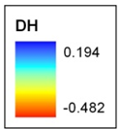
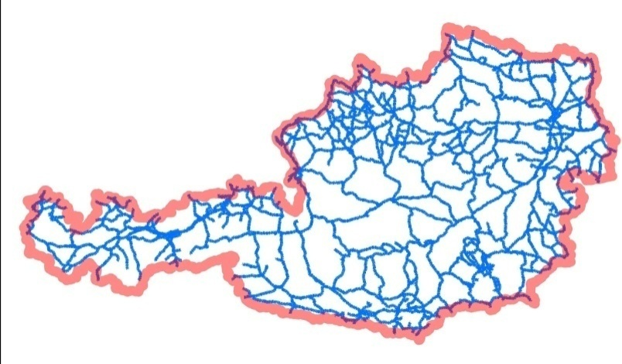
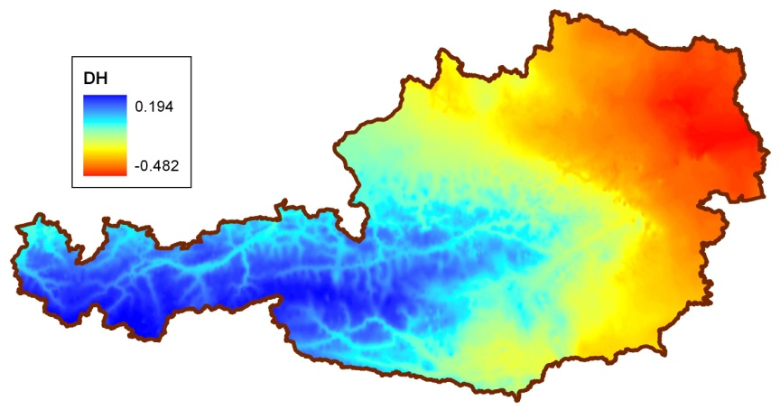
BEV - Height correction model
Vertical correction model compensating height anomalies in the Austrian national height system based on nivellement points
Transformation: „used heights (MGI) → orthometric heights (EVRS)
Modell NIV: aus Formel über Normalhöhe mit Verdichtung in die Fläche über Bougeranomalie
Source: http://www.bev.gv.at

Slide 12
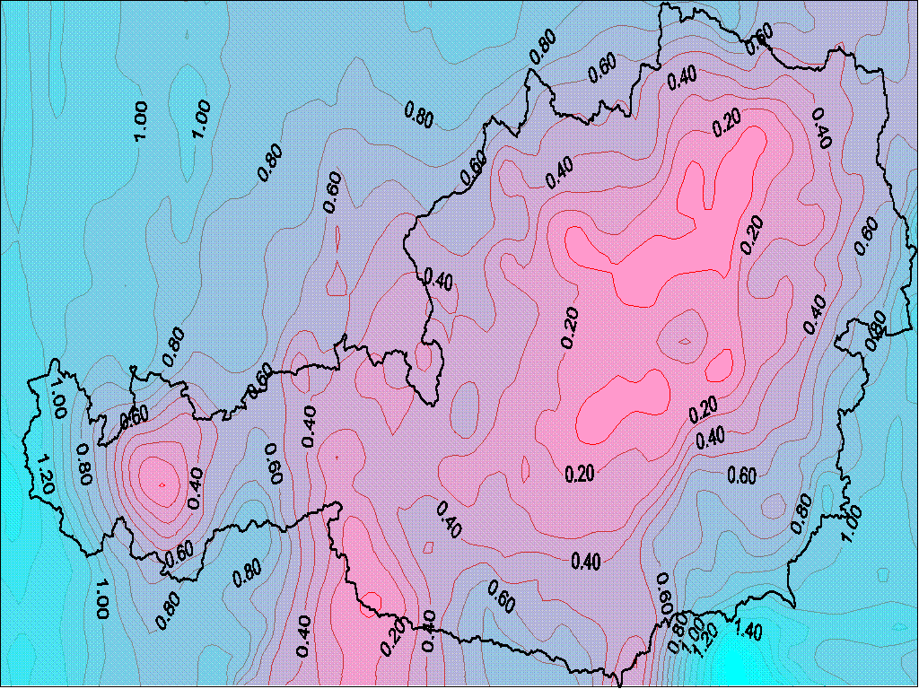
BEV GIS-GRID (=Ntv2 grid for Austria)
GRID (Raster) in geographic coordinate system ϕ, λ ; grid width z.B. 30“x45“ ( ≈ 1x1 km )
Each grid post contains correction values dϕ, dλ
49°03’00“ 9°30’00“
30 arcsec
46°21’00“ 17°09’45“
45 arcsec
Derived from 28.120 control points (coordinates available in both MGI und ETRS89 system); Transformation accuracy < 15 cm
GIS - GRID
Source: http://www.bev.gv.at

Slide 13
Issues
Transformation from ellipsoidal (geometric) to orthometric (physical) heights requires geoid model (quasi geoid for dynamic/normal heights)
In-homogeneity of historical height systems can be corrected with additional height correction models: h_{ell} → [geoid] → h_{ortho} →[vertic. corr. model] → h_{used}
Additional (optional) constant vertical offset (tidal diff., local heights, …)
Additional (optional) z-scaling
Geoid models are normally provided in geographic coordinates (GEOGCS; φ,λ). Thus, linkage between GEOGCS and VERT_CS would be necessary
Geoids are normally provided as rasters. Thus, (bi-linear) interpolation at arbitrary positions is required.
How to specify vertical CS (including geoids, height corr. models, height offsets) in OGC Coordinate Transformations (CT) Services spec.? This issue does not have to be tackled within the GSoC project
Height correction should be performed on the GEOGCS (φ,λ) level

Slide 14
Implementation issues
Available libraries
GDAL/OGR (Spatial Reference class)
Proj4 (currently doing most of the transformation job)
... ...
Class interface:
Based on OGR Spatial reference
Add members/functions for vertical component
SetGeoidModel( char* psz_geoidfile )
SetHeightCorrModel( char* psz_geoidfile )
SetHeightOffset( const double d_offset )
.... ...
Allow vertical transformations for all systems based on GEOGCS

Slide 15
Implementation issues
Support of different GEOID File Format
Using OGR different raster formats could easily be supported
Library dependency
PROJ.4 is an independent library
OGR depends on PROJ.4
Technical solution for vertical transformation
Inside PROJ.4 with GEOID interpolation calls to OGR
+ Current transformation workflow is preserved
- PROJ.4 loses independence
Full transformation workflow inside OGR (favored by IPF)
+ Transformation code at one place
- double transformation code in PROJ.4 and OGR (rewrite pj_transform)
Optional additional Libraries
The GeographicLib could be usefull (parts or full library). http://geographiclib.sourceforge.net/html/index.html

Slide 16
Implementation issues
Current Transformation class (OGR)
OGRProj4CT (derived from OGRCoordinateTransformation) wraps the transformation call to pj_transform
New Transformation Implemation
A new class e.g. OGRProj4CT3D (also derived from OGRCoordinateTransformation) should be written. Containing the changed/improved pj_transform code

Slide 17
Generic Transformation Path (status quo)
PROJ4 (pj_transform pseudo code):
projected coordinate (proj)
geographic coordinate
scale /meridian offset transformation
geoid transform
geographic to wgs84 :
-> grid shift
-> geographic to geocentric -> 3/7 parameter transform
wgs84 to geographic :
-> grid shift
-> geographic to geocentric -> three/seven parameter transform
geoid transform
scale /meridian offset transformation
geographic coordinate (inverse proj)
projected coordinate

Slide 18
Generic Transformation Path (3D add-ons)
PROJ4 (pj_transform pseudo code):
projected coordinate (proj)
geographic coordinate
scale /meridian offset transformation
generic height transformation (geoid + height.corr. + z offset/scale)
geographic to wgs84 :
-> grid shift
-> geographic to geocentric -> three/seven parameter transform
wgs84 to geographic :
-> grid shift
-> geographic to geocentric -> three/seven parameter transform
generic height transformation (geoid + height.corr. + z offset/scale)
scale /meridian offset transformation
geographic coordinate (inverse proj)
projected coordinate

Slide 19
Additional ideas
3D grid shift
Current status: Ntv2 only 2D
3D-extension desirable (not within GSoC project)
De-coupling in-homogeneities of national systems from datum transformation
Status quo:
geographic coo. (datum 1) →
grid shift →
geographic coo. (datum2)
Desired (optional)
geographic coo. (datum 1) →
grid shift (national in-homogeneities only) →
Homogenized geographic coo. (datum 1) →
to wgs84
Three/seven parameter transformation
… … (back again)

Slide 20
Proposed way of preceeding
Spatial Reference Systems:
Based on OGRSpatialReference class
Derived class OGRSpatialReference3D (working title)
Add members/functions for vertical transformation
Geoid model
Additional height correction model
z offset and scale
Transformations:
Based on OGRCreateCoordinateTransformation
Derived class OGRCreateCoordinateTransformation3D
Make OGRCreateCoordinateTransformation ::transform function virtual
Re-write OGRCreateCoordinateTransformation3D::transform (cf. Slide: Generic Transformation Path (3D add-ons))

