Slide 1
Time Series Analysis

Slide 2


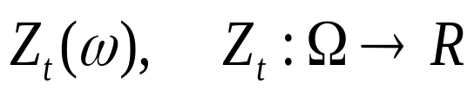

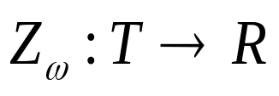
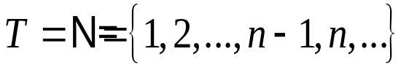
Stochastic Processes – Time Series
A stochastic process is a collection of time indexed random variables
defined on some space Ω, .
(1) For a fixed t
is a random variable.
(2) For fixed
is a realization or sample function
In the case when
or
this STOCHASTIC PROCESS is called a TIME SERIES
Notes:
Add graph to generate intuition

Slide 3
Time series in sciences
Examples:
In Economics, daily closing stock prices, weekly interest rates, monthly price indices and yearly earnings.
In Meteorology, hourly wind speed, daily temperature and annual rainfall
In Social Sciences annual birth rates, mortality rates, accident rates and various crime rates.
Ctd…

Slide 4
EXAMPLES
Data in business, economics, engineering, environment, medicine, earth sciences, and other areas of scientific investigations are often collected in the form of time series.
Hourly temperature readings
Daily stock prices
Weekly traffic volume
Annual growth rate
Seasonal ice cream consumption
Electrical signals

Slide 5
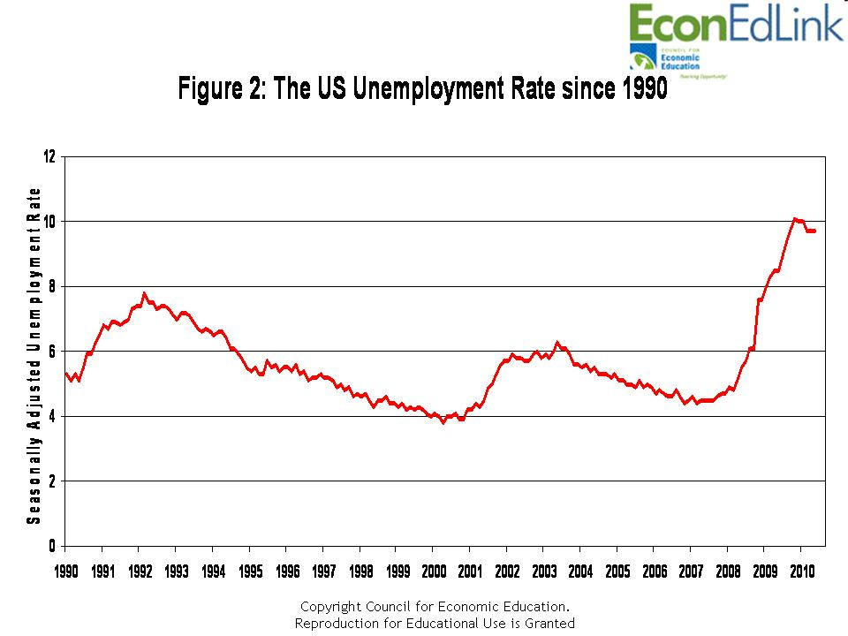

Slide 6
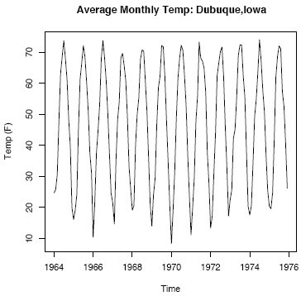

Slide 7
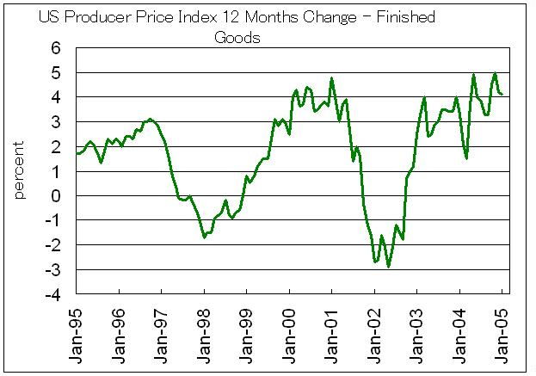

Slide 8
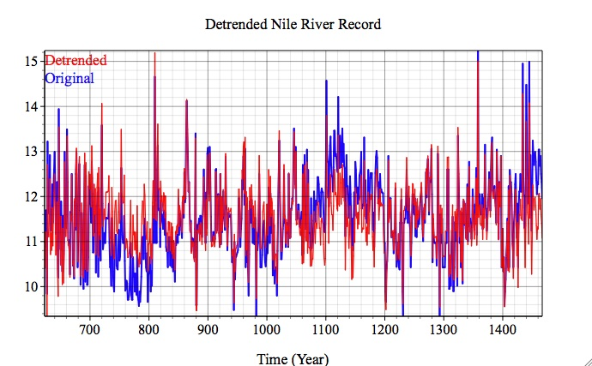

Slide 9
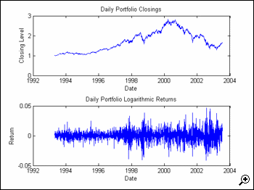
EXAMPLES

Slide 10
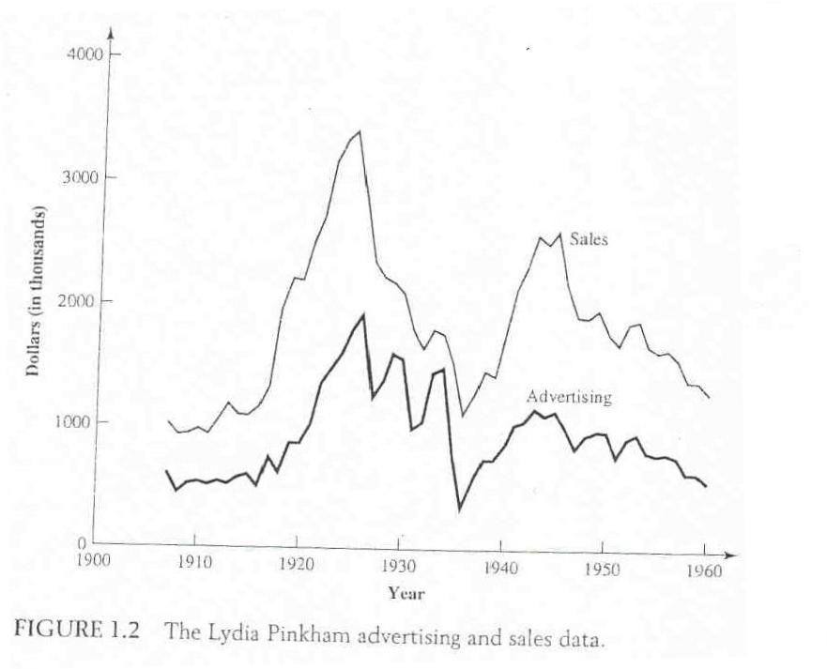

Slide 11
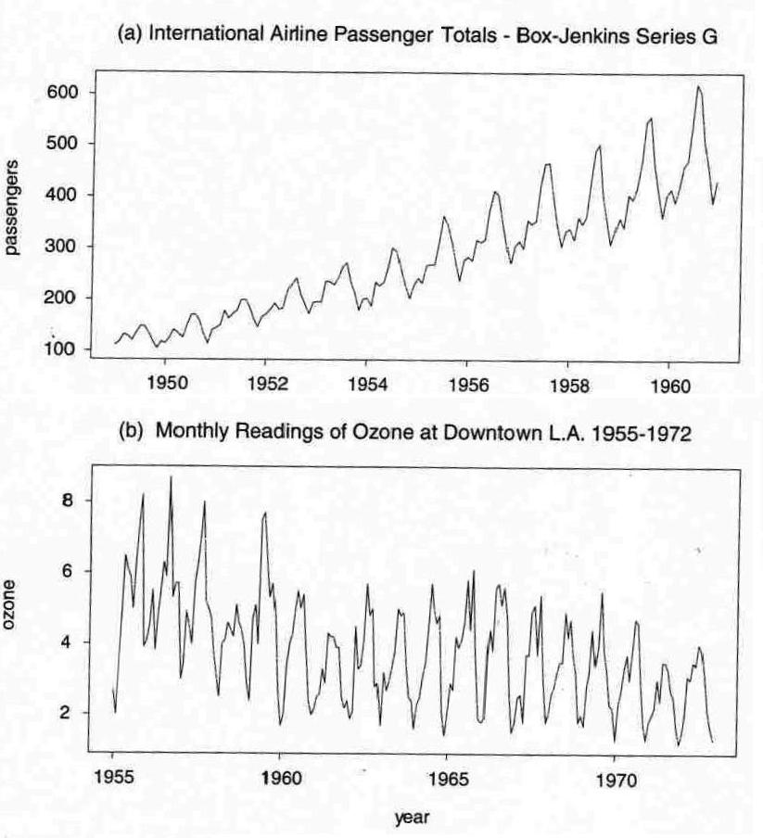

Slide 12
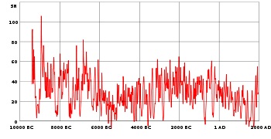
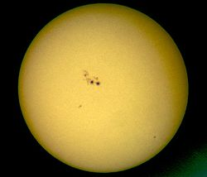
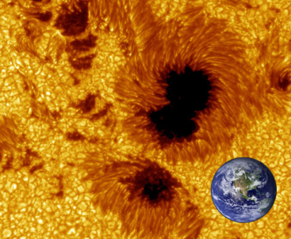
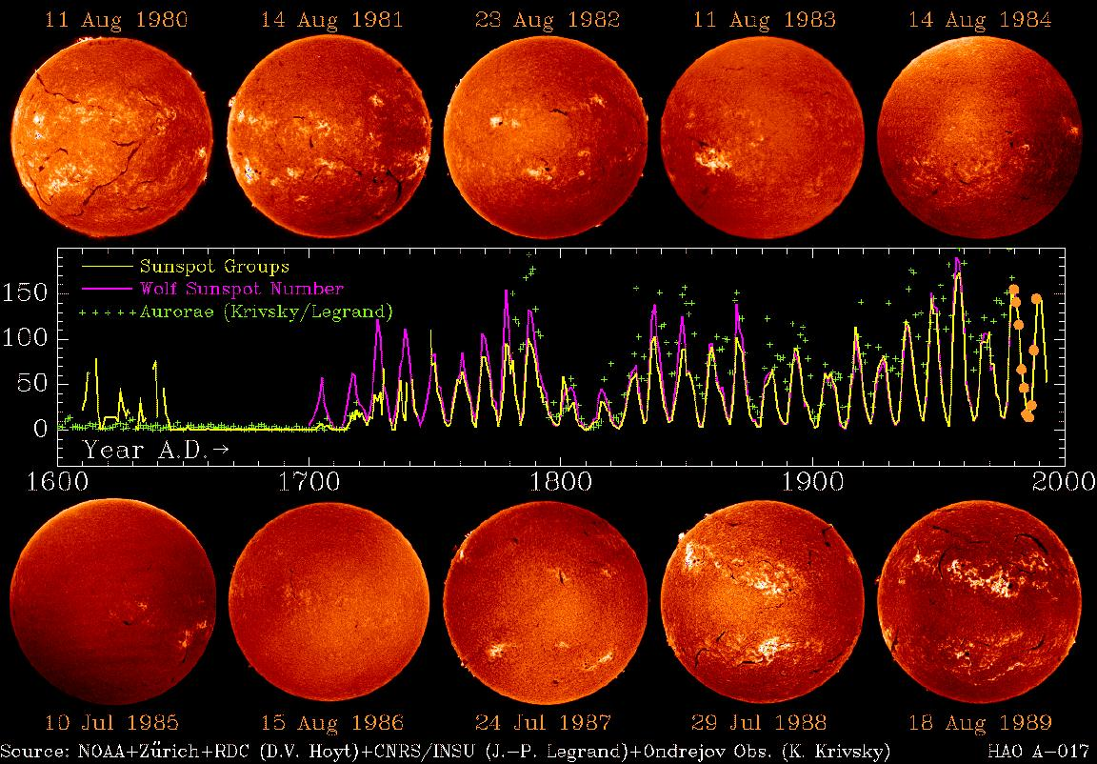
SUNSPOT NUMBERS
The Wolf number (also known as the International sunspot number, relative sunspot number, or Zürich number) is a quantity that measures the number of sunspots and groups of sunspots present on the surface of the sun. The Sunspot Number is a crucial tool used to study the solar dynamo, space weather and climate change.

Slide 13
  In Engineering electric signals, voltage and sound.
  In Geophysics ocean waves, earth noise in an area.
  EEG and EKG tracings in Medicine.
  In Agriculture annual crop production prices.

Slide 14
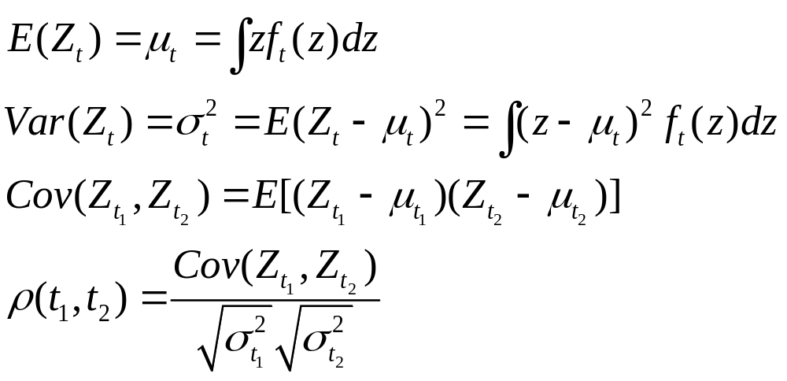
f_{t} = density function of Z_{t}
Expectation, Variance, Autocovariance, Autocorrelation Functions

Slide 15
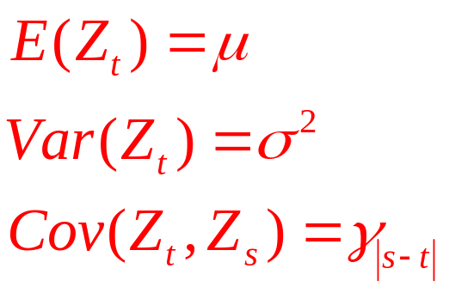
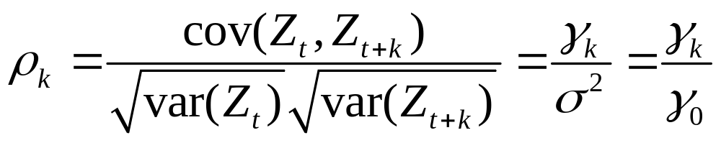
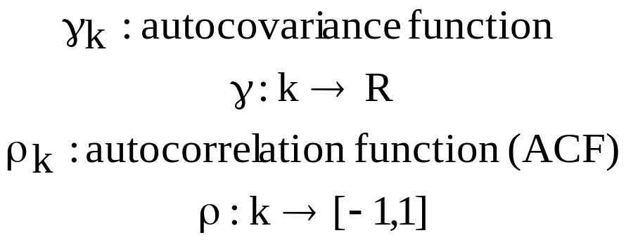
Autocovariance and Autocorrelation Functions of stationary process
Definition: (Weakly) stationary process:
Properties:
Notes:
Make a picture of the autocorrelogram

Slide 16
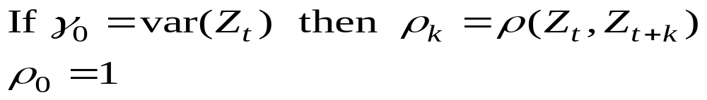
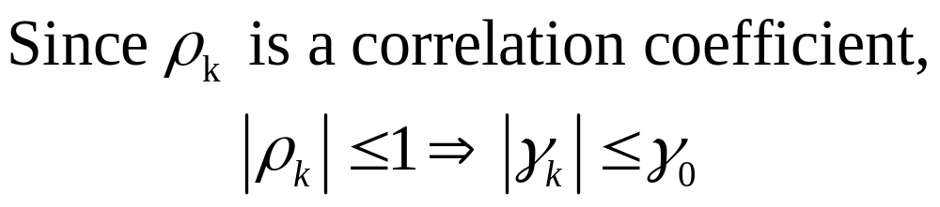
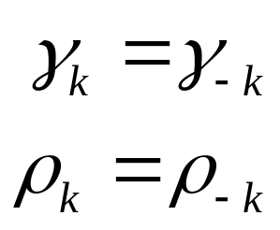
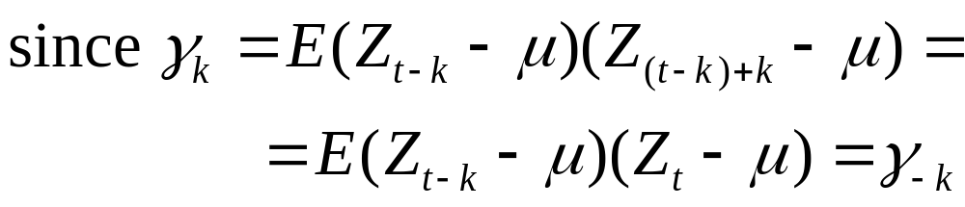
Properties of the autocorrelation function

Slide 17
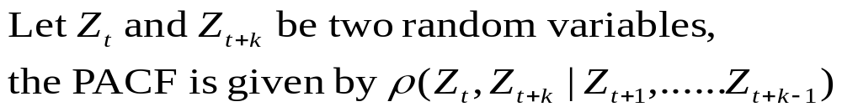
Partial Autocorrelation Function (conditional correlation)
Correlation between two random variables that are k periods apart
removed the in-between linear dependence (between t and t+k).

Slide 18
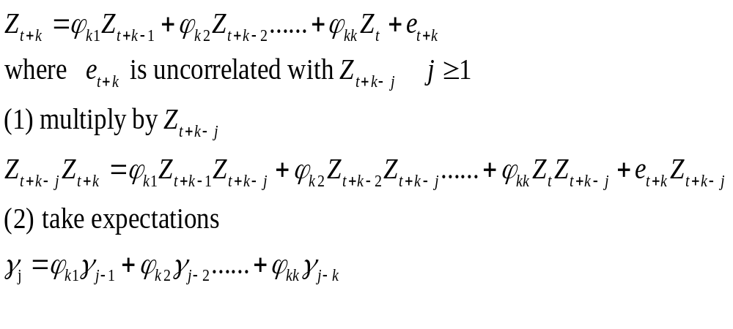
Partial Autocorrelation Function (conditional correlation)
Motivation
Think about a regression model
(without loss of generality, assume that E(Z)=0)

Slide 19

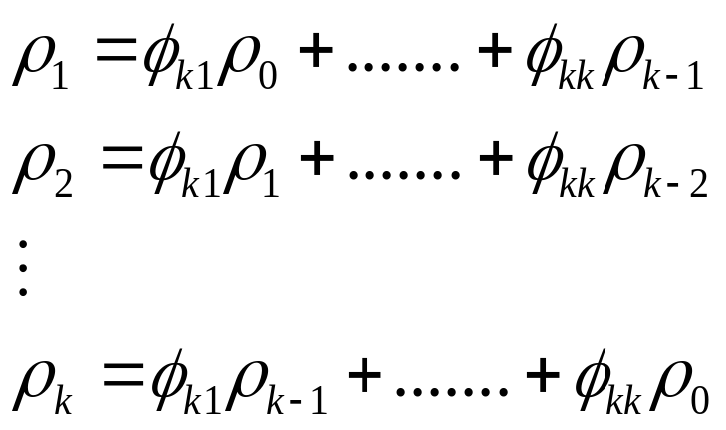
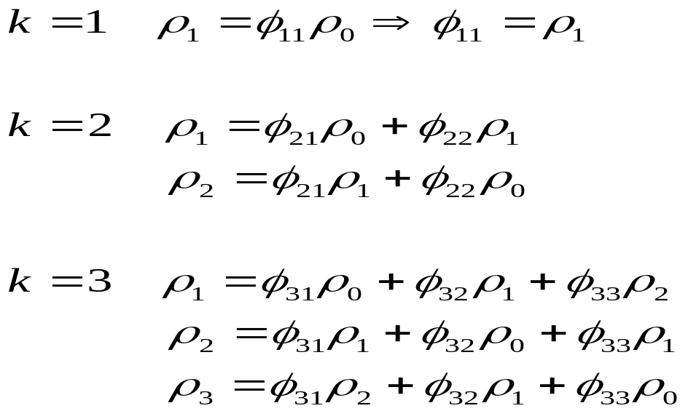
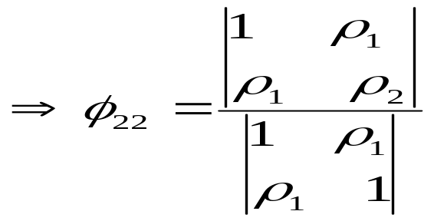
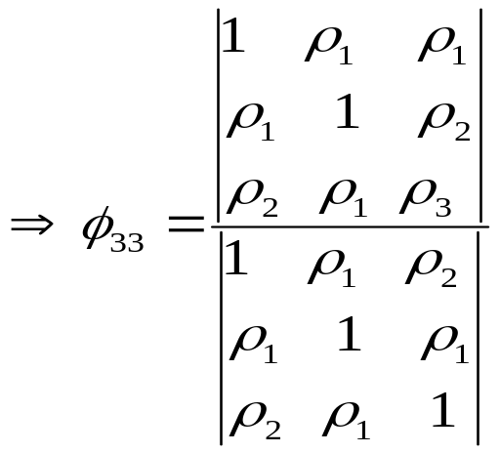
Dividing by the variance of the process:
Yule-Walker
equations

Slide 20
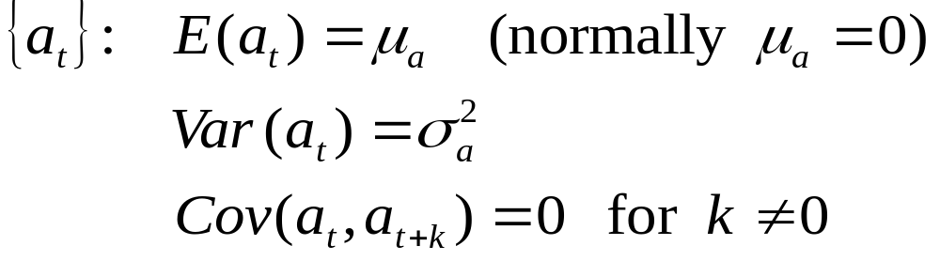
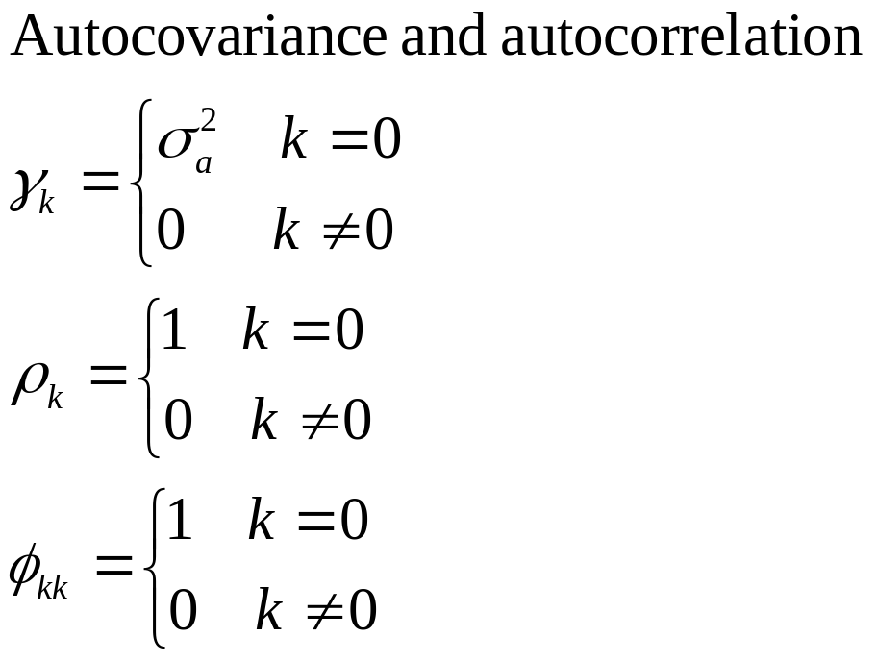

Examples of stochastic processes
E1: White Noise Process
A sequence of uncorrelated random variables is called a white noise
process.
. . . .
1 2 3 4 k

Slide 21
Objectives of Time series Analysis
    To understand the variability of the time series.
    To identify the regular and irregular oscillations of the time series.
    To describe the characteristics of the oscillations.
    To understand physical processes that give rise to each of these oscillations.
    Forecasting of future observations

Slide 22
STEPS IN TIME SERIES ANALYSIS
Model Identification
  Time Series plot of the series
  Check for the existence of a trend or seasonality
  Check for the sharp changes in behavior
  Check for possible outliers
Remove the trend and the seasonal component to get stationary residuals.
Estimation
  MME
  MLE
Diagnostic Checking
  Normality of error terms
  Independency of error terms
  Constant error variance (Homoscedasticity)
Forecasting
  Exponential smoothing methods
  Minimum MSE forecasting

Slide 23
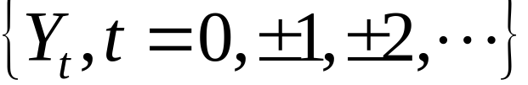
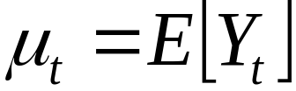
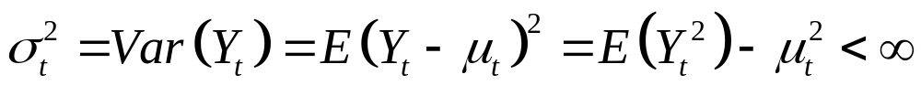
CHARACTERISTICS OF A SERIES
For a time series
THE MEAN FUNCTION:
THE VARIANCE FUNCTION:
The expected value of the process at time t.

Slide 24
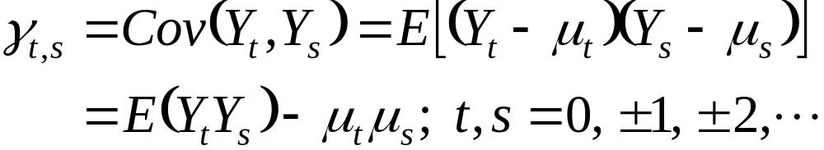
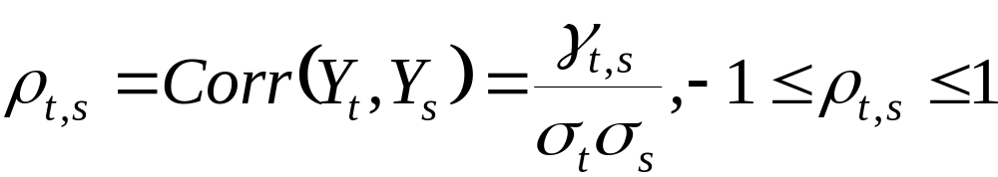
CHARACTERISTICS OF A SERIES
THE AUTOCOVARIANCE FUNCTION:
THE AUTOCORRELATION FUNCTION:
Covariance between the value at time t and the value at time s of a stochastic process Y_{t}.
The correlation of the series with itself

Slide 25
EXAMPLE
Moving average process: Let ε_{t}∼i.i.d.(0, 1), and
X_{t} = ε_{t} + 0.5 ε_{t−1}

Slide 26

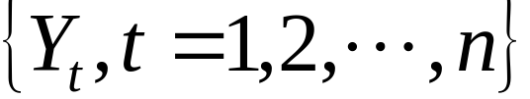
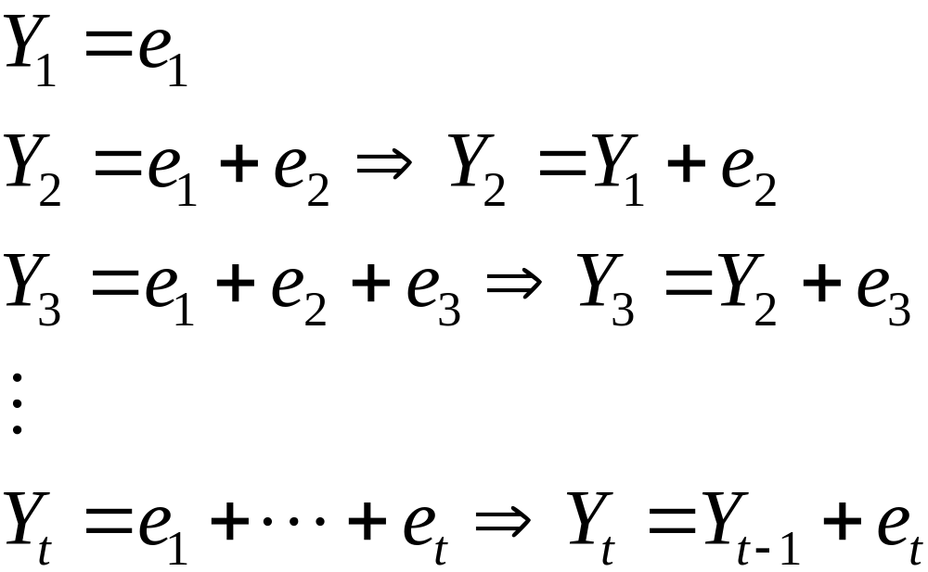
EXAMPLE
RANDOM WALK: Let e₁,e₂,… be a sequence of i.i.d. rvs with 0 mean and variance . The observed time series
is obtained as

Slide 27
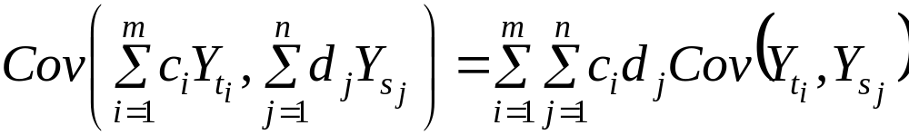
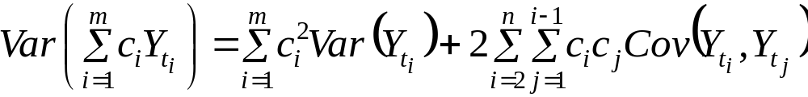
A RULE ON THE COVARIANCE
If c₁, c₂,…, c_{m} and d₁, d₂,…, d_{n} are constants and t₁, t₂,…, t_{m} and s₁, s₂,…, s_{n} are time points, then

Slide 28
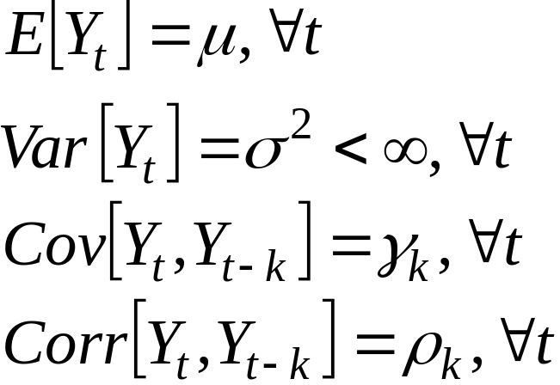
WEAK STATIONARITY
From, now on, when we say “stationary”, we imply weak stationarity.

Slide 29
EXAMPLE
Consider a time series {Y_{t}}, where
Y_{t}=e_{t}
and e_{t}∼i.i.d.(0,σ²). Is the process stationary?

Slide 30
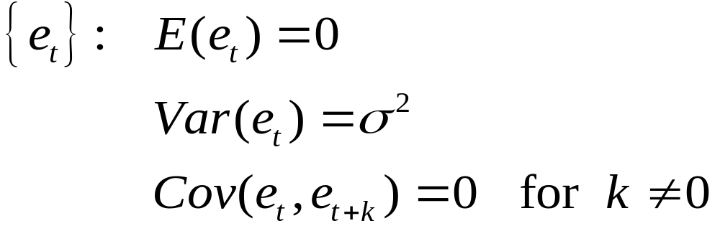

Answer

Slide 31
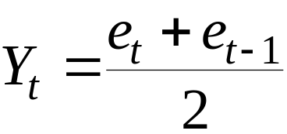
EXAMPLE
MOVING AVERAGE: Suppose that {Y_{t}} is constructed as
and e_{t}∼i.i.d.(0,σ²). Is the process {Y_{t}} stationary?

Slide 32
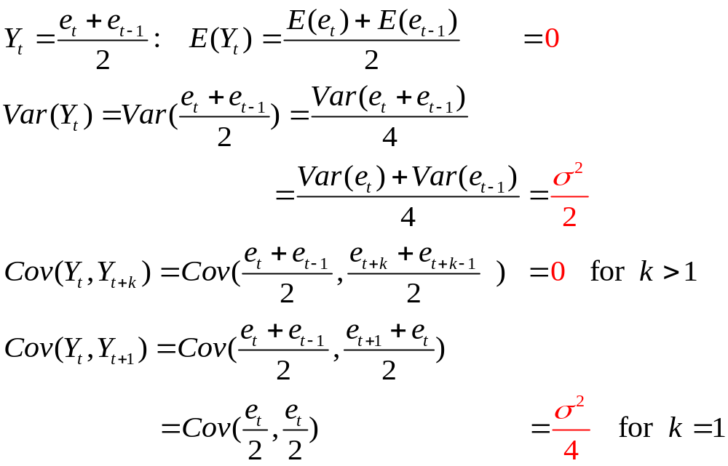
Answer

Slide 33

EXAMPLE
RANDOM WALK
where e_{t}∼i.i.d.(0,σ²). Is the process {Y_{t}} stationary?

Slide 34
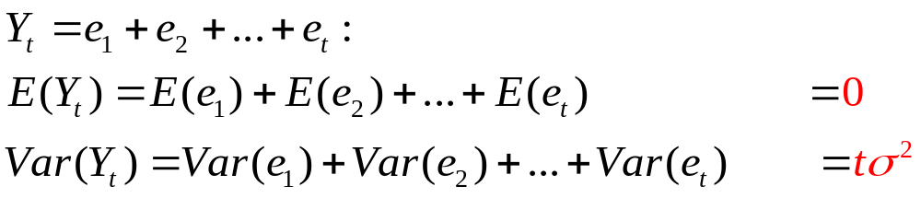

Answer

Slide 35

EXAMPLE
Suppose that time series has the form
where a and b are constants and {e_{t}} is a weakly stationary process with mean 0 and autocovariance function γ_{k}. Is {Y_{t}} stationary?

Slide 36
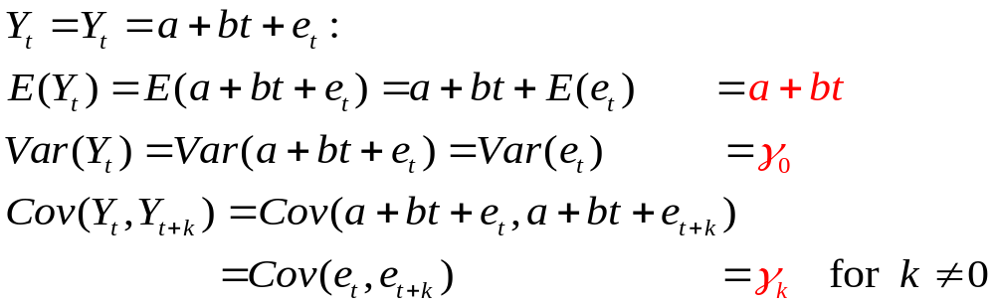
Answer

Slide 37
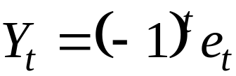
EXAMPLE
where e_{t}∼i.i.d.(0,σ²). Is the process {Y_{t}} stationary?

Slide 38
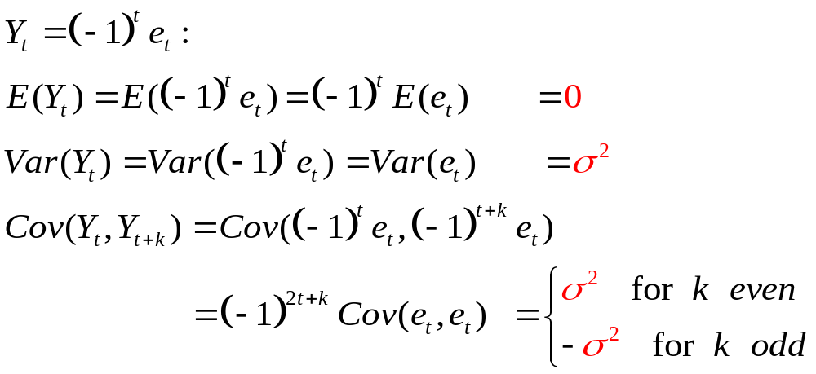
Answer

Slide 39
1.3 Components of a time series
A time series is a collection of data obtained by observing a response variable at periodic points in time. X_{t} is used to denote the value of the variable x at time t.
A time series is made up of one or more components of the following :
      1. Trend
      - Measures the average change in the
      variable per unit time. In other words
      it measures the change in the mean
      level of the time series.
      Ctd…

Slide 40
2. Seasonal variations
- Periodic variations that occur with some degree of regulations within a year or shorter.
3. Cyclical variations
- Recurring up and down movement which
are extended over a long period.( usually 2
years or more)
4. Irregular variations
- Random Fluctuations which happen due to errors.

Slide 41
Time-Series Components
Time Series
Trend Component
Seasonality Component
Cyclical Component
Irregular Component

Slide 42
These four components are combined in the additive time series model.
Time series models can be classified into two types:
Additive model & multiplicative model
The four components are combined in the additive time series model & multiplicative model as follows:
Y_{t} = T+S+C+R (additive)
Y_{t} = T*S*C*R (multiplicative)
Where Y_{t} – the actual value
T – trend or long-term movement
S – seasonal movement
C – cyclical movement
R - residual or random movement
(irregular variation)

Slide 43
The components of a time series are easily Identified and explained pictorially in a time series plot.
A time series plot is a sequence plot with the time series variable Y_{t} the vertical axis and time t on the horizontal axis.
The figure 1.1 shows a trend in the time series values. The trend component describes the tendency of the value of the variable to increase or decrease over a long period of time.

Slide 44
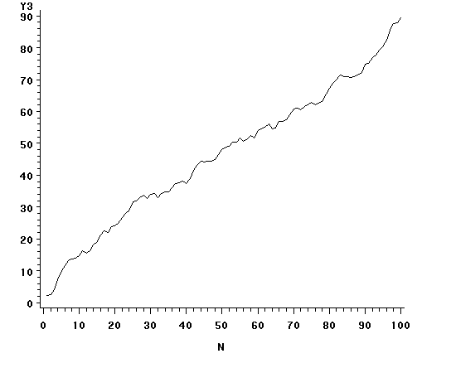
Figure 1.1 : Trend in a time series

Slide 45
Trend Component
Long-run increase or decrease over time (overall upward or downward movement)
Data taken over a long period of time
Sales
Upward trend
Time

Slide 46
Trend Component
(continued)
Trend can be upward or downward
Trend can be linear or non-linear
Sales
Sales
Time
Time
Downward linear trend
Upward nonlinear trend

Slide 47
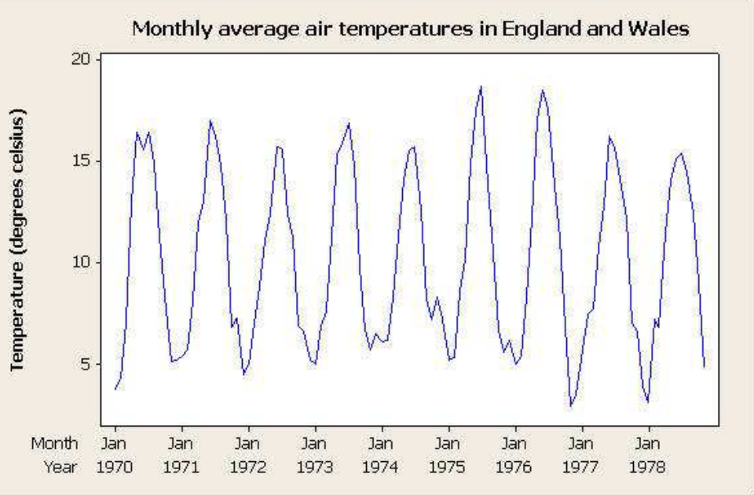
A seasonal variation in a series describes the fluctuations that recur during specific portions of each year ( monthly or seasonally), the pattern of change in the time series within a year tends to be repeated from year to year producing a wavelike or oscillating curve.
Figure 1.4 : seasonal variations in a time series

Slide 48
Seasonal Component
Short-term regular wave-like patterns
Observed within 1 year
Often monthly or quarterly
Year n+1
Year n
Sales
Summer
Winter
Summer
Winter
Spring
Fall
Spring
Fall
Time (Quarterly)
Ch. 16-<number>

Slide 49
Cyclical Component
Long-term wave-like patterns
Regularly occur but may vary in length
Often measured peak to peak or trough to trough
1 Cycle
Sales
Year

Slide 50
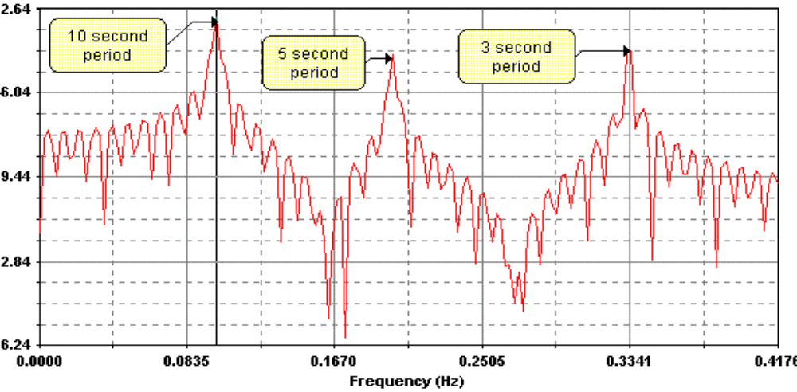
A cyclical effect in a time series as shown in the figure 1.2 describes the fluctuation about the trend line.
In business the fluctuations are called business cycles.
figure 1.2 : cyclic variations in a time series

Slide 51

Irregular Component
Unpredictable, random, “residual” fluctuations
Due to random variations of
  Nature
  Accidents or unusual events
“Noise” in the time series

Slide 52
  The final component, the residual effect is what remains after the trend, cyclical and seasonal components have been removed.
  This component is not systematic and may be attributed to unpredictable influences.
  Thus, the residual effect represents the random error component of a time series.

Slide 53
One of the objectives of time series is to forecast some future values of the series.
To obtain forecast some type of model that can be projected into the future must be used to describe the time series.
One of the most widely used models is the additive model.

Slide 54
Time-Series Components
Time Series
Trend Component
Seasonality Component
Cyclical Component
Irregular Component

Slide 55
Trend Projection
If a time series exhibits a linear trend, the method of least squares may be used to determine a trend line (projection) for future forecasts.
Least squares, also used in regression analysis, determines the unique trend line forecast which minimizes the mean square error between the trend line forecasts and the actual observed values for the time series.
The independent variable is the time period and the dependent variable is the actual observed value in the time series.

Slide 56
Linear Trend Regression
Using the method of least squares, the formula for the trend projection is:
T_{t} = b₀ + b₁t
where: T_{t} = linear trend forecast in period t
b₀ = intercept of the linear trend line
b₁ = slope of the linear trend line
t = time period

Slide 57



Linear Trend Regression
For the trend projection equation T_{t} = b₀ + b₁t
where: Y_{t} = value of the time series in period t
n = number of time periods (observations)

Slide 58
Linear Trend Regression
Example: Auger’s Plumbing Service
The number of plumbing repair jobs performed by Auger's Plumbing Service in the last nine months is listed on the right. Forecast the number of repair jobs Auger's will perform in December using the least squares method.
Month Jobs
Month Jobs
March 353
August 409
April 387
September 399
May 342
October 412
June 374
November 408
July 396

Slide 59




Linear Trend Regression
(month) t
Y_{t}
(Mar.) 1 -4 16 353 -33.67 134.68
(Apr.) 2 -3 9 387 0.33 -0.99
(May) 3 -2 4 342 -44.67 89.34
(June) 4 -1 1 374 -12.67 12.67
(July) 5 0 0 396 9.33 0
(Aug.) 6 1 1 409 22.33 22.33
(Sep.) 7 2 4 399 12.33 24.66
(Oct.) 8 3 9 412 25.33 75.99
(Nov.) 9 4 16 408 21.33 85.32
Sum 45 60 3480 444.00

Slide 60



Linear Trend Regression
T₁₀ = 351.07 + (7.12)(10) = 422.27

Slide 61











Trend Projection
Example: Auger’s Plumbing Service
Forecast for December (Month 10) using a three-period (k = 3) weighted moving average with weights of .6, .3, and .1 for the newest to oldest data, respectively. Then, compare this Month 10 weighted moving average forecast with the Month 10 trend projection forecast.
Month Jobs
Month Jobs
March 353
August 409
April 387
Septem. 399
May 342
October 412
June 374
Novem. 408
July 396

Slide 62
Trend Projection
Three-Month Weighted Moving Average
The forecast for December will be the weighted average of the preceding three months: September, October, and November.
F₁₀ = 0.1Y_{Sep.} + 0.3Y_{Oct.} + 0.6Y_{Nov.}
= 0.1(399) + 0.3(412) + 0.6(408)
= 408.3
Trend Projection
F₁₀ = 422.27 (from earlier slide)

Slide 63


Nonlinear Trend Regression
Sometimes time series have a curvilinear or nonlinear trend.
A variety of nonlinear functions can be used to develop an estimate of the trend in a time series.
One example is this quadratic trend equation:
T_{t} = b₀ + b₁t + b₂t ²
Another example is this exponential trend equation:
T_{t} = b₀(b₁)^{t}

Slide 64
Nonlinear Trend Regression
Example: Cholesterol Drug Revenue
The annual revenue in millions of dollars for a cholesterol drug for the first 10 years of sales is shown below. A curvilinear function appears to be needed to model the long-term trend.
Year Revenue
Year Revenue
1 23.1
6 43.2
2 21.3
7 59.5
3 27.4
8 64.4
4 34.6
9 74.2
5 33.8
10 99.3

Slide 65

Nonlinear Trend Regression
Example: Cholesterol Drug Revenue

Slide 66
Filtering( Smoothing techniques)

Slide 67

Number of Militarized Interstate Disputes (MIDs), 1816-2001

Slide 68
Filtering( Smoothing techniques)
A procedure to remove random variation revealing more clearly the underlying trend and cyclic components in a set of time series data, converting one time series to another by performing a linear operation for the use of forecasting.
Moving Average
    - Smooth out (reduce) fluctuations and gives
    trend values to a fair degree of accuracy.
    - The average value of a number of adjacent time
    series values is taken as the trend value for the
    middle point.

Slide 69
Moving Averages:
Smoothing the Time Series
Calculate moving averages to get an overall impression of the pattern of movement over time
This smooths out the irregular component
Moving Average: averages of a designated
number of consecutive
time series values

Slide 70

(2m+1)-Point Moving Average
A series of arithmetic means over time
Result depends upon choice of m (the number of data values in each average)
Examples:
  For a 5 year moving average, m = 2
  For a 7 year moving average, m = 3
  Etc.
Replace each x_{t} with

Slide 71


Moving Averages
Example: Five-year moving average
  First average:
  Second average:
  etc.

Slide 72

Example: Annual Data
Year | Sales
1 2 3 4 5 6 7 8 9 10 11 etc… | 23 40 25 27 32 48 33 37 37 50 40 etc…
…
…

Slide 73

Calculating Moving Averages
Let m = 2
Average Year | 5-Year Moving Average
3 | 29.4
4 | 34.4
5 | 33.0
6 | 35.4
7 | 37.4
8 | 41.0
9 | 39.4
… | …
Year | Sales
1 | 23
2 | 40
3 | 25
4 | 27
5 | 32
6 | 48
7 | 33
8 | 37
9 | 37
10 | 50
11 | 40
etc…
Each moving average is for a consecutive block of (2m+1) years

Slide 74

Annual vs. Moving Average
The 5-year moving average smoothes the data and shows the underlying trend

Slide 75


Centered Moving Averages
(continued)
Let the time series have period s, where s is even number
  i.e., s = 4 for quarterly data and s = 12 for monthly data
To obtain a centered s-point moving average series X_{t}*:
  Form the s-point moving averages
  Form the centered s-point moving averages

Slide 76
Centered Moving Averages
Used when an even number of values is used in the moving average
Average periods of 2.5 or 3.5 don’t match the original periods, so we average two consecutive moving averages to get centered moving averages
Average Period | 4-Quarter Moving Average
2.5 | 28.75
3.5 | 31.00
4.5 | 33.00
5.5 | 35.00
6.5 | 37.50
7.5 | 38.75
8.5 | 39.25
9.5 | 41.00
Centered Period | Centered Moving Average
3 | 29.88
4 | 32.00
5 | 34.00
6 | 36.25
7 | 38.13
8 | 39.00
9 | 40.13
etc…

Slide 77
Moving Averages and Exponential Smoothing
  Moving Averages
  Weighted Moving Averages
  Exponential Smoothing
They are called smoothing methods because their objective is to smooth out the random fluctuations in the time series.
They are most appropriate for short-range forecasts.

Slide 78
Moving Averages Forecasting
The moving averages method uses the average of the most recent k data values in the time series as the forecast for the next period.
where: F_{t+1}= forecast of the time series for period t + 1
Each observation in the moving average calculation receives the same weight.

Slide 79
Moving Averages
To use moving averages to forecast, we must first select the order k, or number of time series values, to be included in the moving average.
A smaller value of k will track shifts in a time series more quickly than a larger value of k.
If more past observations are considered relevant, then a larger value of k is better.

Slide 80
Moving Averages
Example: Rosco Drugs
If Rosco Drugs uses a 3-period moving average to forecast sales, what are the forecasts for weeks 4-11?
Week | Sales |  | Week | Sales
1 | 110 |  | 6 | 120
2 | 115 |  | 7 | 130
3 | 125 |  | 8 | 115
4 | 120 |  | 9 | 110
5 | 125 |  | 10 | 130

Slide 81




Moving Averages
Week
Sales
3MA Forecast
1
2
3
4
5
6
7
8
9
10
11
110
115
125
120
125
120
130
115
110
130
116.7
120.0
123.3
121.7
125.0
121.7
118.3
118.3

Slide 82

Moving Averages

Slide 83







Moving Averages
3MA
Forecast
Forecast
Error
Absolute
Error
Squared
Error
Abs.%
Error
Week
Sales
1
2
3
4
5
6
7
8
9
10
110
115
125
120
125
120
130
115
110
130
116.7
3.3
3.3
10.89
2.75
120.0
5.0
5.0
25.00
4.00
123.3
121.7
125.0
121.7
118.3
-3.3
8.3
-10.0
-11.7
11.7
6.6
3.3
8.3
10.0
11.7
11.7
53.3
10.89
68.89
100.00
136.89
136.89
489.45
2.75
6.38
8.70
10.64
9.00
44.22
Total

Slide 84



Moving Averages
3-MA Forecast Accuracy
The 3-week moving average approach provided
more accurate forecasts than the naïve approach.

Slide 85
Weighted Moving Averages
Weighted Moving Averages
  To use this method, we must first select the number of data values to be included in the average.
  Next, we must choose the weight for each of the data values.
    The more recent observations are typically given more weight than older observations.
    For convenience, the weights should sum to 1.

Slide 86
Weighted Moving Averages
Weighted Moving Averages
  An example of a 3-period weighted moving average (3WMA) is:
3WMA = 0.2(110) + 0.3(115) + 0.5(125) = 119
  In this example the weights are 0.2, 0.3, and 0.5 (which sum to 1).
  125 is the most recent of the three observations.

Slide 87
Exponential Smoothing
  This method is a special case of a weighted moving averages method; we select only the weight for the most recent observation.
  The weights for the other data values are computed automatically and become smaller as the observations grow older.
  The exponential smoothing forecast is a weighted average of all the observations in the time series.
  The term exponential smoothing comes from the exponential nature of the weighting scheme for the historical values.

Slide 88
Exponential Smoothing
Exponential Smoothing Forecast
F_{t+1} = αY_{t} + (1 – α)F_{t}
where:
F_{t+1} = forecast of the time series for period t + 1
Y_{t} = actual value of the time series in period t
F_{t} = forecast of the time series for period t
α = smoothing constant (0 < α < 1)
and let:
F₂ = Y₁ (to initiate the computations)

Slide 89
Exponential Smoothing
Exponential Smoothing Forecast
  With algebraic manipulation, we can rewrite
  F_{t+1} = αY_{t} + (1 – α)F_{t} as:
F_{t+1} = F_{t} + α (Y_{t} – F_{t})
  We see that the new forecast F_{t+1} is equal to the previous forecast F_{t} plus an adjustment, which is a times the most recent forecast error, Y_{t} – F_{t}.

Slide 90
Exponential Smoothing
Example: Rosco Drugs
If Rosco Drugs uses exponential smoothing to forecast sales, which value for the smoothing constant α, 0.1 or 0.8, gives better forecasts?
Week | Sales |  | Week | Sales
1 | 110 |  | 6 | 120
2 | 115 |  | 7 | 130
3 | 125 |  | 8 | 115
4 | 120 |  | 9 | 110
5 | 125 |  | 10 | 130

Slide 91
Exponential Smoothing
Using Smoothing Constant Value α = .1
F₂ = Y₁ = 110
F₃ = .1Y₂ + .9F₂ = .1(115) + .9(110) = 110.50
F₄ = .1Y₃ + .9F₃ = .1(125) + .9(110.5) = 111.95
F₅ = .1Y₄ + .9F₄ = .1(120) + .9(111.95) = 112.76
F₆ = .1Y₅ + .9F₅ = .1(125) + .9(112.76) = 113.98
F₇ = .1Y₆ + .9F₆ = .1(120) + .9(113.98) = 114.58
F₈ = .1Y₇ + .9F₇ = .1(130) + .9(114.58) = 116.12
F₉ = .1Y₈ + .9F₈ = .1(115) + .9(116.12) = 116.01
F₁₀= .1Y₉ + .9F₉ = .1(110) + .9(116.01) = 115.41

Slide 92
Exponential Smoothing
Using Smoothing Constant Value α = .8
F₂ = = 110
F₃ = .8(115) + .2(110) = 114.00
F₄ = .8(125) + .2(114) = 122.80
F₅ = .8(120) + .2(122.80) = 120.56
F₆ = .8(125) + .2(120.56) = 124.11
F₇ = .8(120) + .2(124.11) = 120.82
F₈ = .8(130) + .2(120.82) = 128.16
F₉ = .8(115) + .2(128.16) = 117.63
F₁₀= .8(110) + .2(117.63) = 111.53

Slide 93





Exponential Smoothing (α = .1)
α = .1
Forecast
Forecast
Error
Absolute
Error
Squared
Error
Abs.%
Error
Week
Sales
1
2
3
4
5
6
7
8
9
10
110
115
125
120
125
120
130
115
110
130
110.00
5.00
5.00
25.00
4.35
110.50
14.50
14.50
210.25
11.60
111.95
8.05
8.05
64.80
6.71
112.76
12.24
12.24
149.94
9.79
113.98
114.58
116.12
116.01
115.41
6.02
15.42
-1.12
-6.01
14.59
6.02
15.42
1.12
6.01
14.59
82.95
36.25
237.73
1.26
36.12
212.87
974.22
5.02
11.86
0.97
5.46
11.22
66.98
Total

Slide 94




Exponential Smoothing (α = .1)
Forecast Accuracy
Exponential smoothing (with α = .1) provided
less accurate forecasts than the 3-MA approach.

Slide 95








Exponential Smoothing (α = .8)
α = .8
Forecast
Forecast
Error
Absolute
Error
Squared
Error
Abs.%
Error
Week
Sales
1
2
3
4
5
6
7
8
9
10
110
115
125
120
125
120
130
115
110
130
110.00
5.00
5.00
25.00
4.35
114.00
11.00
11.00
121.00
8.80
122.80
-2.20
2.20
7.84
1.83
120.56
4.44
4.44
19.71
3.55
124.11
120.82
128.16
117.63
111.53
-4.11
9.18
-13.16
-7.63
18.47
4.11
9.18
13.16
7.63
18.47
75.19
16.91
84.23
173.30
58.26
341.27
847.52
3.43
7.06
11.44
6.94
14.21
61.61
Total

Slide 96




Exponential Smoothing (α = .8)
Forecast Accuracy
Exponential smoothing (with α = .8) provided
more accurate forecasts than ES with α = .1, but
less accurate than the moving average (with k = 3).

Slide 97
THANK YOU

