Slide 1
Deep learning for time-series

Slide 2
Deep learning for time-series
In forecasting, data is often highly erratic, violates the core assumptions of classical techniques, such as Gaussian errors, stationarity, or homoscedasticity.
Deep learning techniques applied to forecasting could overcome many of the challenges faced by classical approaches.
Most importantly, they could provide a way to model non-linear dynamics usually neglected by traditional methods.
Notes:
Add graph to generate intuition

Slide 3
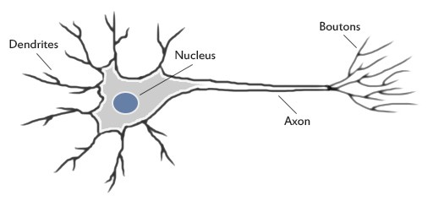
Deep learning - Artificial neural network method
Artificial neural networks are forecasting methods that are based on simple mathematical models of the brain. They allow complex nonlinear relationships between the response variable and its predictors.

Slide 4
Neural network architecture
A neural network can be thought of as a network of “neurons” which are organized in layers.
The predictors (or inputs) form the bottom layer, and the forecasts (or outputs) form the top layer.
There may also be intermediate layers containing “hidden neurons”.

Slide 5
Neural networks loosely mimic the way our brains solve the problem: by taking in inputs, processing them and generating an output.
They learn to recognize patterns, but they do this by training on labelled datasets.
Basic of artificial neurons: the perceptron, processes inputs and produces an output.

Slide 6
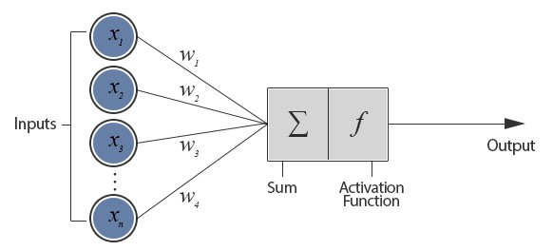
THE PERCEPTRON
Models of artificial neurons follow the general principles set by the perceptron.
The network of nodes sends signals in one direction. This is called a feed-forward network.
A neuron connected with n other neurons and thus receives n inputs (x₁, x₂, ….. x_{n}). This configuration is called a Perceptron.

Slide 7
TRAINING IN PERCEPTRONS
Input vectors from a training set are presented to the perceptron one after the other and weights are modified according to the following equation,
For all inputs i,
W(i) = W(i) + a*g’(sum of all inputs)*(T-A)*P(i),
where g’ is the derivative of the activation function,
and a is the learning rate.
Here, W is the weight vector, P is the input vector, T is the correct output that the perceptron should have known, and A is the output given by the perceptron.

Slide 8
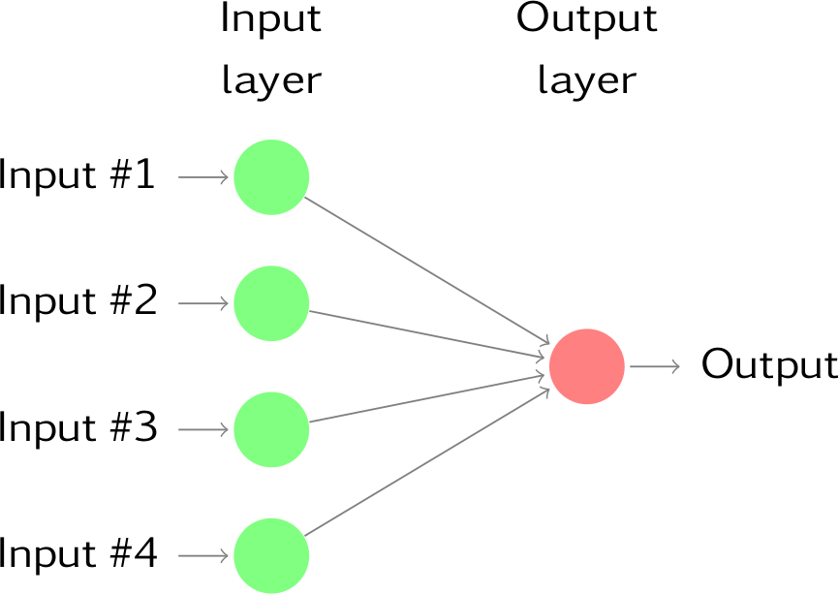
The simplest networks contain no hidden layers and are equivalent to linear regressions.
The coefficients attached to these predictors are called “weights”.
The forecasts are obtained by a linear combination of the inputs.
The weights are selected in the neural network framework using a “learning algorithm” that minimizes a “cost function” such as the MSE.

Slide 9
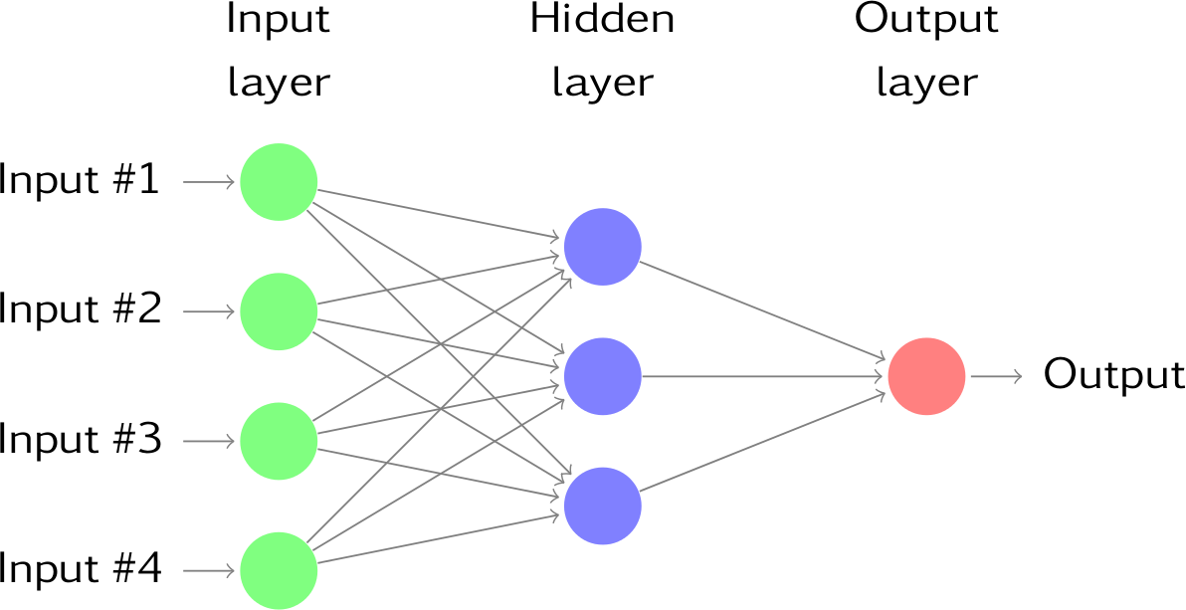
Once we add an intermediate layer with hidden neurons, the neural network becomes non-linear.
This is known as a multilayer feed-forward network, where each layer of nodes receives inputs from the previous layers.
The outputs of the nodes in one layer are inputs to the next layer. The inputs to each node are combined using a weighted linear combination.

Slide 10
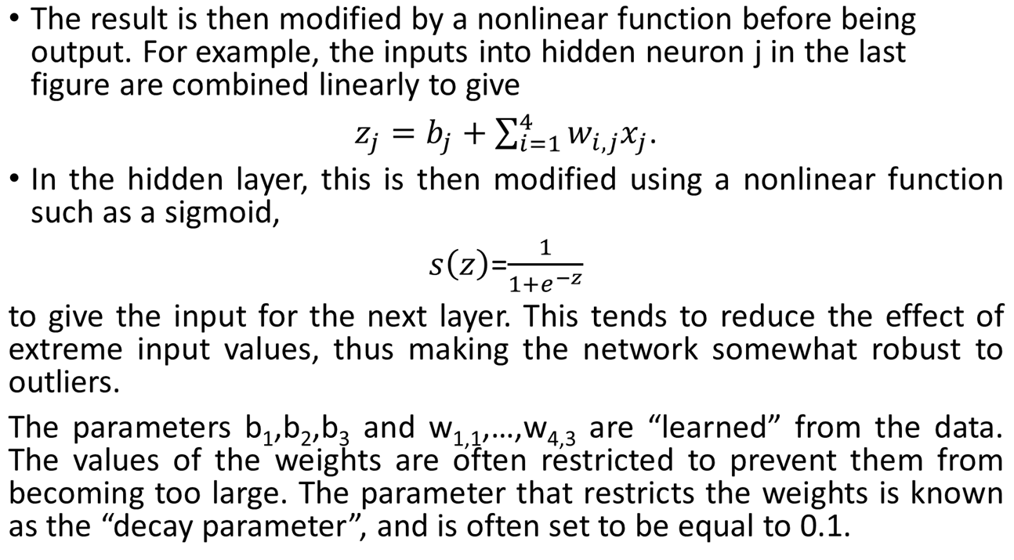

Slide 11
The weights take random values to begin with, and these are then updated using the observed data.
Consequently, there is an element of randomness in the predictions produced by a neural network.
Therefore, the network is usually trained several times using different random starting points, and the results are averaged.
The number of hidden layers, and the number of nodes in each hidden layer, must be specified in advance.

Slide 12
Neural network autoregression
With time series data, lagged values of the time series can be used as inputs to a neural network, in an autoregression model. This is called neural network autoregression or NNAR model.
With one hidden layer, the notation NNAR(p,k) indicates there are p lagged inputs and k nodes in the hidden layer.
For example, NNAR(9,5) model is a neural network with the last nine observations (y_{t−1},y_{t−2},…,y_{t−9}) used as inputs for forecasting the output y_{t}, and with five neurons in the hidden layer.
NNAR(p,0) model is equivalent to an ARIMA(p,0,0) model, but without the restrictions on the parameters to ensure stationarity.

Slide 13
Recurrent neural networks and time series
This is a type of network architecture that implements some kind of memory. This is achieved by implementing some neurons receiving as input the output of one of the hidden layers and injecting their output again in that layer.
In the Elman networks, the inputs of these neurons are taken from the outputs of the neurons in one of the hidden layers, and their outputs are connected back to the inputs of the same layer, providing a memory of the previous state of this layer.

Slide 14
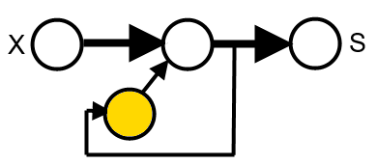
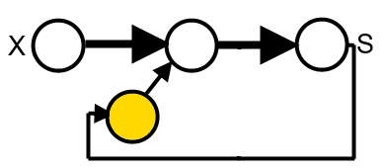
Recurrent neural networks
The scheme is as in the figure below, where X is the input, S the output and the yellow node is the neuron in the context layer:
In the Jordan networks, the difference is that the input of the neurons in the context layer is taken from the output of the network:

Slide 15
Time Series Prediction with Deep Learning in Keras
Multilayer Perceptron Regression
Step 1: Import all the functions and classes need to use (working SciPy environment with the Keras deep learning library installed).
import numpy as np
import matplotlib.pyplot as plt
import pandas as pd
from tensorflow.keras.models import Sequential
from tensorflow.keras.layers import Dense
Notes:
Add graph to generate intuition

Slide 16
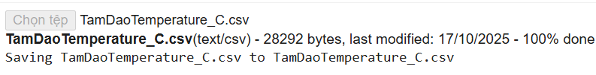
Step 2: Load data set
from google.colab import files
import pandas as pd
import io
import pandas as pd
import numpy as np
import matplotlib.pyplot as plt
uploaded = files. upload()
Notes:
Add graph to generate intuition

Slide 17
Step 2: Load data set
To load the dataset as a Pandas dataframe. Then extract from the dataframe the NumPy array in the column 2 (‘Ttb’ – Average temperature) and convert the integer values to floating point values, which are more suitable for modeling with a neural network.
# load the dataset
dataframe = pd.read_csv('TamDaoTemperature_C.csv', usecols=[2], engine='python')# index_col=0, usecols=[1], engine='python')
dataset = dataframe.values
dataset = dataset.astype('float32')
Notes:
Add graph to generate intuition

Slide 18
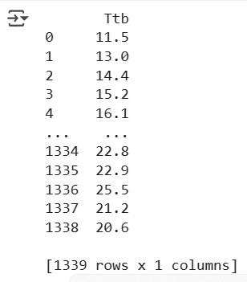
Step 2: Load data set
Checking the data set by printing
print(dataframe)
Notes:
Add graph to generate intuition

Slide 19

Step 3: Split data into the training and testing parts
With time series data, the sequence of values is important. The code below calculates the index of the split point and separates the data into the training datasets with 80% of the observations used to train your model, leaving the remaining 20% for testing the model.
# split into train and test sets
train_size = int(len(dataset) * 0.80)
test_size = len(dataset) - train_size
train, test = dataset[0:train_size,:], dataset[train_size:len(dataset),:]
print(len(train), len(test))
Notes:
Add graph to generate intuition

Slide 20
Step 4: Convert array of values into a dataset matrix
Convert the single column of data into a two-column dataset: the first column containing this day’s (t) temperature and the second column containing next day’s (t+1) temperature to be predicted.
Function to create the new dataset takes two arguments: the dataset, which is a NumPy array, and the look_back, which is the number of previous time steps to use as input variables to predict the next time period, in this case, defaulted to 1.This default will create a dataset where X is the temperature at a given time (t), and Y is the temperature at the next time (t + 1).
Notes:
Add graph to generate intuition

Slide 21
Step 4: Convert array of values into a dataset matrix
# convert an array of values into a dataset matrix
def create_dataset(dataset, look_back=1):
dataX, dataY = [], []
for i in range(len(dataset)-look_back-1):
a = dataset[i:(i+look_back), 0]
dataX.append(a)
dataY.append(dataset[i + look_back, 0])
return np.array(dataX), np.array(dataY)
Notes:
Add graph to generate intuition

Slide 22
Step 5: Prepare the train and test datasets for modeling
# reshape into X=t and Y=t+1
look_back = 1
trainX, trainY = create_dataset(train, look_back)
testX, testY = create_dataset(test, look_back)
Notes:
Add graph to generate intuition

Slide 23
Step 6: Create and fit Multilayer Perceptron model
Fit a Multilayer Perceptron model to the training data:
- Use a simple network with one input, one hidden layer with eight neurons, and an output layer.
- The model is fit using mean squared error.
# create and fit Multilayer Perceptron model
model = Sequential()
model.add(Dense(8, input_shape=(look_back,), activation='relu'))
model.add(Dense(1))
model.compile(loss='mean_squared_error', optimizer='adam')
model.fit(trainX, trainY, epochs=200, batch_size=2, verbose=2)
Notes:
Add graph to generate intuition

Slide 24
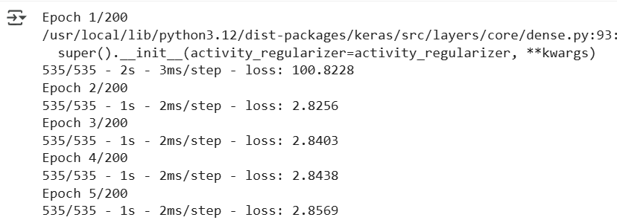
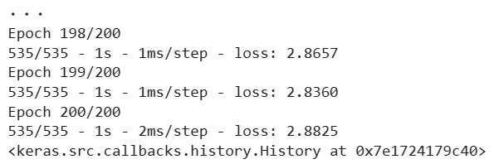
Step 6: Create and fit Multilayer Perceptron model
Notes:
Add graph to generate intuition

Slide 25

Step 7: Estimate model performance
We can estimate the performance of the model on the train and test datasets.
# Estimate model performance
trainScore = model.evaluate(trainX, trainY, verbose=0)
print('Train Score: %.2f MSE (%.2f RMSE)' % (trainScore, np.sqrt(trainScore)))
testScore = model.evaluate(testX, testY, verbose=0)
print('Test Score: %.2f MSE (%.2f RMSE)' % (testScore, np.sqrt(testScore)))
Notes:
Add graph to generate intuition

Slide 26
Step 8: Generate predictions for training
# generate predictions for training
trainPredict = model.predict(trainX)
testPredict = model.predict(testX)
# shift train predictions for plotting
trainPredictPlot = np.empty_like(dataset)
trainPredictPlot[:, :] = np.nan
trainPredictPlot[look_back:len(trainPredict)+look_back, :] = trainPredict
Notes:
Add graph to generate intuition

Slide 27
Step 9: Plot baseline and predictions
# shift test predictions for plotting
testPredictPlot = np.empty_like(dataset)
testPredictPlot[:, :] = np.nan
testPredictPlot[len(trainPredict)+(look_back*2)+1:len(dataset)-1, :] = testPredict
# plot baseline and predictions
plt.plot(dataset)
plt.plot(trainPredictPlot)
plt.plot(testPredictPlot)
plt.show()
the original dataset in blue, the predictions for the training dataset in red, and the predictions on the unseen test dataset in green.
Notes:
Add graph to generate intuition

Slide 28
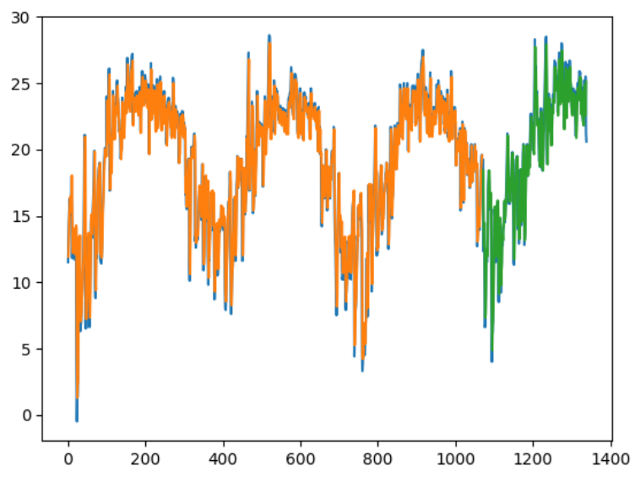
Step 8: Plot baseline and predictions
Notes:
Add graph to generate intuition

Slide 29
Time Series Prediction with Deep Learning in Keras
Multilayer Perceptron Using the Window Method
We can phrase the problem so that multiple recent time steps can be used to make the prediction for the next time step.
This is called the window method, and the size of the window is a parameter that can be tuned for each problem.
For example, given the current time (t) to predict the value at the next time in the sequence (t + 1), you can use the current time (t) as well as the two prior times (t-1 and t-2).
When phrased as a regression problem, the input variables are t-2, t-1, and t, and the output variable is t+1.
Notes:
Add graph to generate intuition

Slide 30
Step 1’: Import functions and classes need to use
# Multilayer Perceptron to Predict Average temperature (t+1, given t, t-1, t-2)
import numpy as np
import matplotlib.pyplot as plt
from pandas import read_csv
import math
from tensorflow.keras.models import Sequential
from tensorflow.keras.layers import Dense
Notes:
Add graph to generate intuition

Slide 31
Step 2’: Load data set
To load the dataset as a Pandas dataframe. Then extract from the dataframe the NumPy array in the column 2 (‘Ttb’ – Average temperature) and convert the integer values to floating point values, which are more suitable for modeling with a neural network.
# load the dataset
dataframe = pd.read_csv('TamDaoTemperature_C.csv', usecols=[2], engine='python
dataset = dataframe.values
dataset = dataset.astype('float32')
Notes:
Add graph to generate intuition

Slide 32

Step 3’: Split data into the training and testing parts
With time series data, the sequence of values is important. The code below calculates the index of the split point and separates the data into the training datasets with 67% of the observations used to train your model, leaving the remaining 33% for testing the model.
# split into train and test sets
train_size = int(len(dataset) * 0.67)
test_size = len(dataset) - train_size
train, test = dataset[0:train_size,:], dataset[train_size:len(dataset),:]
print(len(train), len(test))
Notes:
Add graph to generate intuition

Slide 33
Step 4’: Convert array of values into a dataset matrix
The create_dataset() function allows us to create this formulation of the time series problem by increasing the look_back argument from 1 to 3.
We can re-run the example in the previous section with the larger window size. We will increase the network capacity to handle the additional information. The first hidden layer is increased to 14 neurons, and a second hidden layer is added with eight neurons. The number of epochs is also increased to 400.
Notes:
Add graph to generate intuition

Slide 34
Step 4’: Convert array of values into a dataset matrix
# convert an array of values into a dataset matrix
def create_dataset(dataset, look_back=1):
dataX, dataY = [], []
for i in range(len(dataset)-look_back-1):
a = dataset[i:(i+look_back), 0]
dataX.append(a)
dataY.append(dataset[i + look_back, 0])
return np.array(dataX), np.array(dataY)
Notes:
Add graph to generate intuition

Slide 35
Step 5’: Prepare the train and test datasets for modeling
# reshape dataset
look_back = 3
trainX, trainY = create_dataset(train, look_back)
testX, testY = create_dataset(test, look_back)
Notes:
Add graph to generate intuition

Slide 36
Step 6’: Create and fit Multilayer Perceptron model
# create and fit Multilayer Perceptron model
model = Sequential()
model.add(Dense(14, input_dim=look_back, activation='relu'))
model.add(Dense(8, activation='relu'))
model.add(Dense(1))
model.compile(loss='mean_squared_error', optimizer='adam')
model.fit(trainX, trainY, epochs=400, batch_size=2, verbose=2)
Notes:
Add graph to generate intuition

Slide 37
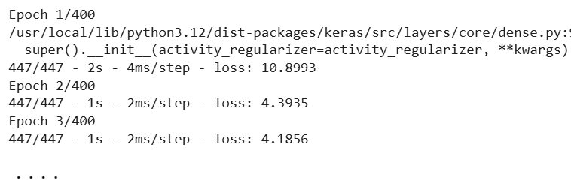
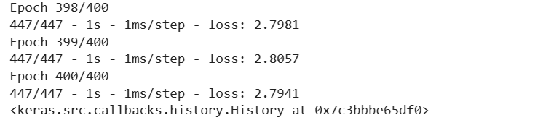
Step 6’: Create and fit Multilayer Perceptron model
Notes:
Add graph to generate intuition

Slide 38

Step 7’: Estimate model performance
We can estimate the performance of the model on the train and test datasets.
# Estimate model performance
trainScore = model.evaluate(trainX, trainY, verbose=0)
print('Train Score: %.2f MSE (%.2f RMSE)' % (trainScore, np.sqrt(trainScore)))
testScore = model.evaluate(testX, testY, verbose=0)
print('Test Score: %.2f MSE (%.2f RMSE)' % (testScore, np.sqrt(testScore)))
Notes:
Add graph to generate intuition

Slide 39
Step 8’: Generate predictions for training
# generate predictions for training
trainPredict = model.predict(trainX)
testPredict = model.predict(testX)
# shift train predictions for plotting
trainPredictPlot = np.empty_like(dataset)
trainPredictPlot[:, :] = np.nan
trainPredictPlot[look_back:len(trainPredict)+look_back, :] = trainPredict
Notes:
Add graph to generate intuition

Slide 40
Step 9’: Plot baseline and predictions
# shift test predictions for plotting
testPredictPlot = np.empty_like(dataset)
testPredictPlot[:, :] = np.nan
testPredictPlot[len(trainPredict)+(look_back*2)+1:len(dataset)-1, :] = testPredict
# plot baseline and predictions
plt.plot(dataset)
plt.plot(trainPredictPlot)
plt.plot(testPredictPlot)
plt.show()
the original dataset in blue, the predictions for the training dataset in red, and the predictions on the unseen test dataset in green.
Notes:
Add graph to generate intuition

Slide 41
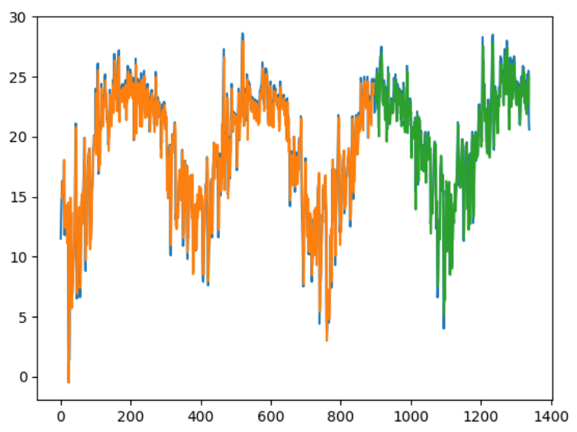
Step 9’: Plot baseline and predictions
Notes:
Add graph to generate intuition

Slide 42
THANK YOU

